Slide 1
BDM 3053 – INFONOMICS
HOW TO MONETIZE, MANAGE AND MEASURE INFORMATION AS AN ASSET FOR COMPETITIVE ADVANTAGE
CHAPTER 8: APPLIED ASSET MANAGEMENT FOR IMPROVED INFORMATION MATURITY
BY GROUP H
Nimmo Usman
Latharani Radhakrishnan
Onyinye Mbanefo

Slide 2
AGENDA This is the last chapter in the Part II – Managing Information as an Asset
We discuss how to tackle challenges and best practices for managing internal and external information as an asset and how to structure organizations and roles to build an info savvy organization.
We will address the barriers to managing information, provide new ways to approach information asset management and suggest a set of “Generally Accepted Information Principles” for doing so by taking an in-depth look into each of Gartner’s EIM dimensions or building blocks.

Slide 3
LEARNING OUTCOME
CONTENTS
Gartner’s EIM Maturity Model
Information Vision
Information Strategy
Metrics
Governance
People
Process
Infrastructure
Summary
References
COURSE OUTLINE
In this chapter we aim to understand each of Gartner’s EIM dimensions, along with the maturity levels, common challenges faced by organizations and the oft-cited remedies to improving maturity.
For each dimension, we will also see how to bring together observations and insights from supply chain, ecosystems and the other asset management disciplines into a supplemental set of ideas and practices to further elevate the concept of enterprise information management to one of information asset management.

Slide 4
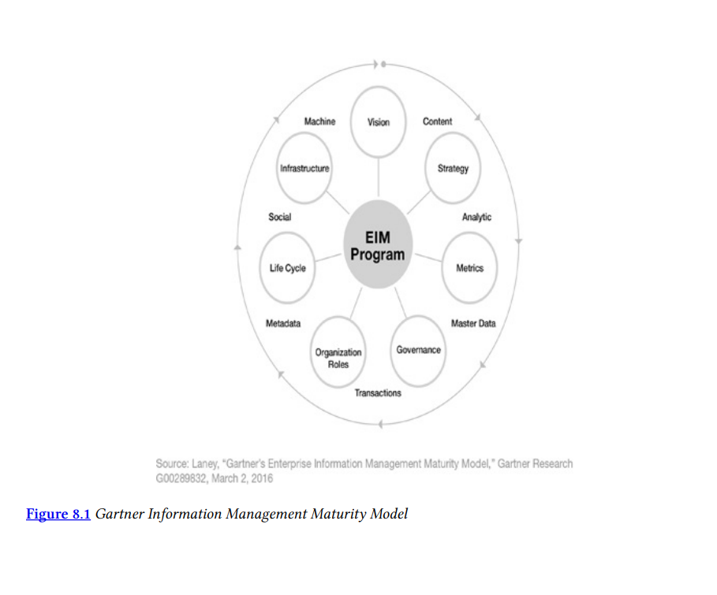
GARTNER’S ENTERPRISE INFORMATION MANAGEMENT MATURITY MODEL
Gartner’s EIM maturity model enables organizations identify what stage of maturity they have reached and what actions to take to get to the next level.
The EIM maturity model comprises of seven dimensions which have been identified as essential to enterprise information management.

Slide 5
INFORMATION VISION
A solid information management approach starts with a vision – a vision for the possibilities of how information can add economic value, or in other words: be monetized.
Vision corresponds to how well business goals that the EIM initiative must support are defined.
EIM should enable people from across the enterprise to share, manage and reuse information that was created in different applications and stored in different databases and repositories.
An enterprise goal might be to offer the best service in the market or to become more agile in adapting to changing business conditions.

Slide 6
VISION MATURITY, CHALLENGES AND TRADITIONAL REMEDIES
Establishing an information vision can be difficult for the following reasons
Lack of experienced resources
Competing priorities
Difficulty with untangling legacy systems
Lack of cultural acceptance for IM (Information Management)
Poor data governance
Organization leadership being on different pages
Organization lacking a well-articulated business vision and no specific funding for EIM.
Traditional remedies would include aspiring information leaders establishing a steering committee to hash out the objectives for deploying information and goals for information management.
The steering committee attempts to align these goals and objectives with the organizational priorities in order to help justify the benefits of EIM and secure executive buy-in.
Unfortunately, these committees too often lack in business unit representation and if sufficient leadership is lacking for EIM, often the CIO-but more often than lately, the CEO or board- institutes a CDO (or similar) position.

Slide 7
APPLIED ASSET MANAGEMENT FOR INFORMATION VISION
Information leaders should promote the principle that information capability is directly related to business process performance and a source of strategic advantage as their colleagues do in human capital management.
Information is no longer just a business by-product or resource.
The quality of information’s value should also be taken into consideration. For example, library science suggests that it’s important to note that the potential versus probable value of information must be discriminated and recognized.
An information asset management (IAM) vision should focus not only upon the organization’s own information assets, but also take into consideration how others within and even outside the industry are amassing and deploying them.
Just as with other forms of intellectual property, we must pursue a variety of ways to generate simultaneous value streams from any information asset, not be blinded and limited by a single monetization method.
An information asset vision should include the dominant principle of how to transform assets into business products and services. Moreover, it should include the ecosystem sustainability tenets of reusing, repurposing and recycling as approaches for conceiving how to generate more value from information while incurring nominal incremental expense.

Slide 8
INFORMATION STRATEGY
Strategy provides the long-term or ongoing plan for realizing information vision.
Information and business leaders cite one or more of three key strategy components their organization lacks:
Commitment from the enterprise
A roadmap of some sort
A plan for organizational structures to execute the strategy.
Information strategy covers a lot of territory and it can take a bit of time to cover all the bases.

Slide 9
STRATEGY MATURITY, CHALLENGES AND TRADITIONAL REMEDIES
Information and business leaders themselves suggest their top inhibitors to higher levels of information strategy are:
Siloed thinking about information across lines of business
The lack of a dedicated sponsor
An immutable corporate culture
Unfortunately, many organizations skip vision and jump right to strategy. Trying to determine the how before you’ve determined the why is never really a good approach. On the other hand, having no objectives ensures you’ll never fail to meet them!
As with vision, organizations seek to solicit executive sponsorship and make information strategy a C-Suite action item. Doing so can help consolidate various departmental “small s” strategies into an enterprise “big S” strategy, leading to improved prioritization and culture change. But if you’re not agile and pragmatic, this can lead to increased bureaucracy.

Slide 10
APPLIED ASSET MANAGEMENT FOR INFORMATION STRATEGY
From the world of knowledge management (KM) we learn how to important it is to have repeatable, experience-based methods.
KM processes also instruct on the importance of being able to adapt to new and exceptional situations.
An IAM strategy should ensure the most important information assets are tended to first.
Its too easy and seemingly lazy to treat all enterprise information assets equally. But this too is an inadequate strategy.
Ecosystems with higher degrees of biodiversity support the production of a greater quantity of goods and services. Similarly, a robust variety of information assets available to the organization breeds improved business production and performance.
Just as with ecosystem management, information ecosystem management is critical to maintaining an appropriate balance.
Three of the “Rs” of sustainability in the information ecosystem-Refuse, Reduce and Remove-suggest strategic approaches to ensure the information ecosystem does not become unnecessarily unruly.
A well-oiled supply chain process has the equal ability to handle make-to-stock and make-to-order requirements.
Even the best data lake or DAAS architecture isn’t going to be able to accommodate all information needs. Therefore, the IAM strategy must include approaches for creating common information layers and handling the intricacies of and collaboration needed for, bespoke information requirements.
Finally, organizations often have entirely separated, siloed, and disconnected strategies for managing different kinds of data, enterprise content, knowledge, records, and intellectual property-each of which could and should fall under an “information asset” strategy umbrella.

Slide 11
METRICS
As we saw with information strategy, many of the challenges lead back to justifying, funding, and prioritizing information management.
Rare is the organization which has expressed the benefits and value of information management using measurements and language in business terms rather than just IT terms.
Deriving metrics that link the information management goals in alignment with established enterprise goals and metrics is no easy task.
While data usage metrics may be a poor proxy for value, they’re certainly a useful indicator.

Slide 12
METRICS MATURITY, CHALLENGES AND TRADITIONAL REMEDIES
Most business and information leaders fairly consistently feel their organization’s information vision and strategy level of maturity is reactive. Whereas with information-related metrics, we see a fairly balanced split among organizations at the lowest level 1 of maturity (Aware), Level 2 (Reactive), and Level 3 (Proactive).
The top challenges recounted by information and business leaders all relate to or hint at a lack of metrics-related capabilities. They include challenges with: defining effective measurements, developing an understanding of metrics and lacking quantification know-how.
Defining effective information-related metrics is best achieved by tying actions to metrics.
Metrics for information-related programs and activities, and for information itself, require thresholds and triggers and must be actionable.
They should adequately reflect the achievement of a strategy milestones toward the vision, and the data used to generate them should be trusted, complete and accurate.
An excellent example of this is AIG’s analytics environment in which its CDO Leandro DelleMule spoke about how he is incorporating data quality metrics into its data lake so users can determine thier own comfort level with information.

Slide 13
APPLIED ASSET MANAGEMENT FOR METRICS
With EIM, most metrics are for justifying, funding and prioritizing and gauging the success of initiatives – both those involving the management of information and business initiatives utilizing information. In addition, metrics typically include those related to data quality.
Traditional supply chain doctrine advises on how to develop a complete financial picture of the information supply chain for any information asset.
These factors include: the cost to acquire, administer, and apply an information asset; the fulfillment cycle times; return on assets; and return on working capital.
Human capital management procedures remind us that the quality of any asset can be measured and improved at various levels of granularity.
Unfortunately, most data quality initiatives are undertaken without a financial or business performance analysis of upstream preventative data cleansing versus downstream remediation.
Furthermore, physical asset management discipline requires organizations to measure the risk profile of key assets. The security risks alone include hacking, damage, insider theft/disclosure and accidental disclosure. Assessing these may require manual audit by security professionals with sufficient expertise.
Just as with physical assets, information-borne risks include: the business impact from inaccurate, missing, incomplete and delayed information; integrity issues between multiple information assets; issues of precision; and information misunderstandings (typically due to lack of metadata).
It may seem cumbersome to assess risk at this level, but with data sampling techniques and data profiling technology, determing most of these metrics on a periodic basis can be straightforward and inexpensive.

Slide 14
The trick then is to link these metrics to their probable business impact. Once these probabilities are established they should be applied to the various remediation expenses involved, including:
Financial data breach penalties
Breach notification costs
Opportunity cost due to loss of customer revenue
Replacement cost of deleted data due to lost customers, malicious or accidental activity
Data security remediation tasks
Additional data security product purchases
Increased cyber insurance premiums
Legal expenses and potential litigation
And to information risk-related costs such as:
Dataset acquisition, storage and processing
Audit and compliance processes
Data security governance reviews and assessments
Data security product purchases
Cyber Insurance

Slide 15
GOVERNANCE
Information governance rarely aligns with established enterprise governance components. However, no matter how good an organization’s policies are, they tend to lack relevance when the business culture from the top down doesn’t value information as a business asset or when that value isn’t well articulated.
As James Price, managing director of the Australian information strategy firm Experience Matters, once said, "Data governance policies sit and gather dust; that is, until the next time some issue with information leads to something the investment community would consider ‘material.’”
Sometimes people have challenges with basic information governance concepts. For example, another analytics project for a U.S financial services company resulted in users complaining that the new reports didn’t match the old ones. The project manger then, and now Gartner analyst, Mark Beye, recounts how, “They insisted we re-introduce the errors from their old application that we’d fixed in the new one! So I had to give them a spontaneous tutorial on the difference between balancing and reconciling.”

Slide 16
GOVERNANCE MATURITY, CHALLENGES AND TRADITIONAL REMEDIES
Over one-third of organizations self-asses their information governance capabilities at Level 3(Proactive) or above, with nearly two-thirds still in a reactive or lesser level of maturity.
Leaders weighing in on the topic of governance relate their top three challenges as:
Moving accountabilities from IT to the business
Cultural/organizational buying
An understanding of the role of governance.
These enable the organization to focus better on the most important information assets rather than being overwhelmed by trying to govern them all equally (i.e., poorly).

Slide 17
APPLIED ASSET MANAGEMENT FOR IMPROVED GOVERNANCE
Information governance (or “data governance,” as it’s more commonly called) deals with establishing and enforcing the principles, guidelines, policies, procedures and standards for information within an organization.
No two organizations have a complimentary set of information governance precepts, let alone a consistent process.
Other than having a well-defined process, many of the lessons learnt form other asset management domains are reflected in common approaches to (or at least attempts at) information governance.
Physical asset management standards also impart the importance of, and steps for, documenting asset classifications, hierarchies and relationships and for tracking their utilization, failures and maintenance histories.
Finally, the world of financial management offers the concept of a true asset fiduciary – an individual with official, legal authority to manage and authorize the use of a particular asset or portfolio of assets.

Slide 18
PEOPLE
The ability to establish specific roles and organizational constructs is critical to getting anything done in an institutionalized, accountable way, as is needed for information management.
Otherwise, the IT organization is forced to tackle information management, often as an off-budget, project-by-project initiative lacking business backing or involvement.
A solid cross-section of dedicated skills and experience will keep the EIM initiative focused on attaining enterprise goals.

Slide 19
PEOPLE-RELATED MATURITY, CHALENGES AND TRADITIONAL REMEDIES
More information and business leaders believe their organization structure and personnel installment has achieved level 4 (Managed) maturity than any other of the seven dimensions. Yet over two-thirds still believe that they are reactive or less mature in this regard.
Most often they lament that the larger organization:
Lacks an understanding of the importance of information management
Does not see information related roles as a worthy investment
Is fearful that growing an information management organization will just lead to personnel layoffs.
Most organizations seek to boost their maturity in this area by attempting to educate the organization on the importance of information.
Other advances in organizational maturity involve creating and budgeting new roles for curating and harvesting information, information architecture, data science, content management, metadata management, master data management, full-time information governance and other newer roles.

Slide 20
APPLIED ASSET MANAGEMENT FOR PEOPLE-RELATED IMPROVEMENTS
The EIM dimension dealing with organization and roles is meant to ensure there are personnel resources and organizational structures for delivering the various capabilities of information enablement.
Looking to the personnel needs for IAM, the knowledge management discipline offers procedures and standards for aligning responsibilities with required capabilities, and for providing the training and certification for key roles.
It provides guidance on how to capture, codify and share experience including the creation of an “expert roster” to help identify and connect with designated resources and accomplished amateurs in various information competencies.
Supply chain management principles emphasizes the importance of identifying each of the individuals and organizations up and down the supply chain.
With the data and analytics discipline now spanning well over twenty-five years, the diversity among professionals who lead, architect, design and use information-related solutions has never been greater.
Diversity related to business-IT heritage, veterans-versus-rookies, data-versus-analytics backgrounds, along with industry vertical diversity, creates an environment of professionals who do not share a common language, thereby creating a deficiency in information literacy.
The “speaking data” as a language is rarely recognized, but it is starting to be embraced as the new language of digital business.
The rise of storytelling, customer journey maps, infographics and visualization techniques signals the demand for an enhanced communications medium to convey the business impact of applying information to the business moments that matter most.
The ability to speak this new language is a new organizational readiness factor: information literacy. Borrowing from language learning methods can help an organization on its “information as a second language” (ISL) journey.
Last but not least is the concept of leadership. The human capital management (HCM) discipline emphasizes the importance of, and defines the ten characteristics of strong leadership over key assets or resources.

Slide 21
PROCESS
This may be the most difficult to define – and therefore the most difficult to implement – of the seven EIM dimensions.
The lifestyle processes of a unit or set or group of information within a well-defined set of information architecture and flows (conceptual, logical and physical) supports information governance precepts, information value optimization and business objectives.
Lifecycle processes document and enable the proper flow of information from its creation or capture through to when it is ultimately archived or deleted.

Slide 22
PROCESS MATURITY, CHALLENGES AND TRADITIONAL REMEDIES
Likely due to varied conceptions about what information processes or lifecycles mean, enterprises’ maturity self-assessments for this dimension also vary.
Among the most often cited information process concerns are:
A “keep data forever because we might need it” mentality
A lack of understanding of the concept of an information lifecycle
Once information is out of sight, its out of mind.
Other challenges include complications from differing country regulations, information architects lack influence and that tending to lifecyle issues will impede time to market.

Slide 23
APPLIED ASSET MANAGEMENT FOR IMPROVED INFORMATION PROCESSES
These are the activities involved with defining an information architecture and the movement of information in support of the EIM strategy, within the constraints of information governance.
Additionally, a couple key concepts from library science provide further information lifecycle guidance: collect information from the most respected sources in the original format whenever possible, and organize information in ways that make it easy to locate and near other related information assets.

Slide 24
INFRASTRUCTURE
Information infrastructure refers to a range of information-related technologies used throughout the organization. Effective connection and coordination among disparate technologies, including the logical and physical integration of information, are paramount.
IT and information management are expected to coordinate on selecting, implementing and maintaining an integrated set of infrastructure components for enabling EIM. These components must support current and planned information architecture and application needs.

Slide 25
INFRASTRUCTURE MATURITY, CHALLENGES AND TRADITIONAL REMEDIES
Some of the major concerns from organizations about their information infrastructure are:
Business units demanding their own tools and engaging vendors on their own
IT’s poor response time
An undefined information architecture

Slide 26
APPLIED ASSET MANAGEMENT PRINCIPLES FOR IMPROVED INFRASTRUCTURE
The information infrastructure includes the technologies used throughout the organization to capture, collect or generate information; to integrate and transform information; and to move or enable the access to information.
Other asset management principles merely support and emphasize the objectives of information technology such as:
Library science and financial management tenets asserts the need for primary availability of high-demand assets
Library science includes copious procedures for ensuring the protection and preservation of artifacts
Enterprise content management standards require storing content in optimal structure, enabling its discoverability, and laying out work-flows to enable content creation and editing collaboration.

Slide 27
CONCLUSION
The Gartner’s seven EIM dimensions are guiding tools or blocks that should be taken into consideration and adapted by any organization that is serious about managing information as an actual asset.
The EIM dimensions are to be followed in order starting with Vision, followed by Strategy, next Metrics and Governance, then People and Process and lastly Infrastructure so as not to have a situation whereby the “cart is put before the horse”. As using them in the order provided will enable an organization realize their goals of identifying their maturity level and next steps to take.

Slide 28
SUMMARY
To become infosavvy means that organizations need to manage and deploy information with the same kind of discipline as with their traditional assets. This doesn’t happen without strong focused leadership or a variety of more tactical roles. Primary among these are the chief data officer (CDO).
The chief data officer role is foresight, not fad. From history, we see that advances in business and management science have always required new kinds of specialist leaders. Today, a new kind of leader is starting to arise, to take charge of the management and exploitation of the information assets of the firm and their existence is an important signal that should be heeded.
They are the pioneers of a key future discipline in infonomics. CDOs involved with progressive business strategy and adding business value tended to be reporting outside of IT and to a higher level. Their span of thinking about the kinds of information to be commanded tends to be wider and their notion of information as a valuable corporate asset tends to be more complete.
These are the kind of people needed to implement Gartner’s Enterprise Information Maturity Model.

Slide 29
REFERENCE
INFONOMICS: HOW TO MONETIZE, MANAGE AND MEASURE INFORMATION AS ASSET FOR COMPETITIVE ADVANTAGE.
by DOUGLAS B. LANEY
Gartner, Inc.

