Slide 1
Team Project – SS2020 Embedded Security Showcase on PSoC64
- Aadarsh Kumar Singh, 766499
- Hari Krishna Yelchuri, 766518
- Vaishnavi Sankaranarayanan, 766486

Slide 2
Objective
The aim of our project is to secure the communication between the remote control and the car .
Background
A remote-controlled student car with assisted driving was developed.
The remote control used PSoC5 MCU for reading the joystick data and this data was transmitted to the student car running a PSoC5MCU via ZigBee.
The communication between the remote control and the car was not secure because the received data is neither encrypted nor authenticated.

Slide 3
Development Cycle
Requirement Engineering
CIA analysis
Design Decisions
Hardware Selection
Software Architecture
Implementation
State machine of car and remote application
Activity diagram of security services
Verification and Testing
Showcase on PSoc64

Slide 4
Requirement Analysis
Threats based Analysis for Embedded Security Use Case – CIA Model
What is CIA?
The CIA Model stands for confidentiality, integrity and authenticity.
We identify the data assets of the product which we want to secure.
We identify all sources of threats to these data assets
Each threat is assigned a data security objective (confidentiality, integrity and authenticity).

Slide 5
Security Threats
Impersonation
Unauthorized actors can gain access to the data assets if confidentiality of security keys are compromised.
Man in the Middle
Unknown sources can eavesdrop if keys used for cryptographic services are exposed via unsecure channel.
Firmware Abuse
Firmware flashed into MCU of the car and remote control should be genuine.
Tamper
Unauthorized sources should not be able to modify the data assets like unique ID, cryptographic keys, firmware, feature data.

Slide 6
Security properties and threats related with assets
Data Asset | Security Properties | Threats
Identifier (ID) | Integrity | Tamper
Firmware | Con­fidentiality Integrity Authenticity | Firmware Abuse Tamper
Cryptographic Credentials | Con­fidentiality Integrity | Impersonation Man in the Middle Tamper
Feature data | Con­fidentiality Integrity | Man in the Middle Tamper

Slide 7
Security Objectives Table
Threats
 | Impersonation | Man in the middle | Firmware Abuse | Tamper
Access Control | X |  | X
Secure Storage |  |  |  | x
Firmware Authenticity |  |  | X
Communication |  | X
Secure State |  |  | X | X
Security Objectives

Slide 8
Security Objectives
Access Control
only authentic firmware should be allowed to be flashed into the device.
keys must be unique and must be confidentially inserted/generated in system.
before communication is established the authentication of the actor initiating communication should be checked.
Security Storage
keys must be stored in a secure area inside memory.
MCU must not allow overwriting the unique keys.
The secret keys must never be exposed to non-secure environment.

Slide 9
Security Objectives - Continued
Firmware Authenticity
Verifying the firmware authenticity before booting and before upgrading .
check if the authentic firmware is modified/tampered .
Communication
unauthorized sources should not able to read or modify the protocol that is being transmitted.
Secure State
secure state needs to be maintained , when firmware integrity and authenticity fails during boot up / upgrading.

Slide 10
Security Requirements
Security Objectives | Threats | Methods to avoid threats
Firmware authenticity | Firmware Abuse | Digital Signature (Flashing digitally signed firmware and verifying the authenticity of the signed firmware prior to boot or upgrade) using asymmetric cryptographic algorithm.
Access Control | Impersonation | Digital Signature (Signing the unique credentials exclusive to the car/remote control and verifying the signed credentials of the partner before starting communication with it) using asymmetric cryptographic algorithm.
Secure key Storage and key exchange | Tamper | Once the cryptographic keys are written in key storage area, the firmware must not allow it to be over-written. This can be implemented using e-fuses present in MCU. Cryptographic algorithms such as diffie-hellman Algorithm must be used for key exchange between car and remote control.
Communication | Man in middle | Encryption (Encoding the protocol before transmitting in such a way that only authorized person can decode it) using symmetric cryptographic algorithm.

Slide 11
Design Decisions for Hardware Selection
The MCU should contain all security capabilities for supporting the software to establish secure communication.
E Fuses:
The MCU should support e-fuses for secure storage of data assets like unique identi­fication numbers exclusive to the device and that never change throughout the lifetime of the product.
Hardware Accelerator for cryptographic algorithms.
The cryptographic algorithms are extensive and require complex mathematical computation. MCU must have hardware accelerator to run these algorithms for better performance.
Isolated execution environment for trusted applications.
MCU offers a strong hardware based isolation between unsecure and secure environment to protect the crucial data assets from being tampered.

Slide 12
Why PSoC64 MCU ?
Isolated execution environment.
PSoC64 is a dual core controller with a dedicated core (HSM) for performing all secure /cryptographic operations and cortex-M4 for performing unsecure/high performance operations.
Inter-Processor Communication (IPC) channels between the Arm Cortex-M4 and Cortex-M0+ cores are provided to support isolated API-based interaction.
Integrated secure element functionality.
It has MPU and PPU that allows cores to access only the permitted memory regions/peripherals.
PSoC64 provides a framework to add secure services such as key storage, cryptography, etc.
Hardware accelerator for cryptographic algorithms
The hardware accelerator are used for running cryptographic algorithms like AES, 3DES, RSA, ECC, SHA-256, SHA-512 and True Random Number Generator (TNRG) to improve the performance.
E-fuses
It has e-fuses support for secure storage of immutable data assets.

Slide 13
Design Decisions for Software
Mbed OS library :
Mbed-OS is an open-source embedded operating system, which supports PSoC64 MCU. It is modular, secure and connected.
Asymmetric cryptographic algorithm must be used for generating digital signatures (non–Repudiation)
Digital Signatures are used for validating the authenticity of firmware prior to boot/upgrade and checks if the device is communicating with authentic ally.
ECDSA algorithm was used.
Symmetric cryptographic algorithm for encryption/decryption(Credibility Check).
AES-128 algorithm is used.
Secure shared secret key exchange between car and the remote control
This application uses elliptic-curve Diffie–Hellman (ECDH) key exchange algorithm.

Slide 14
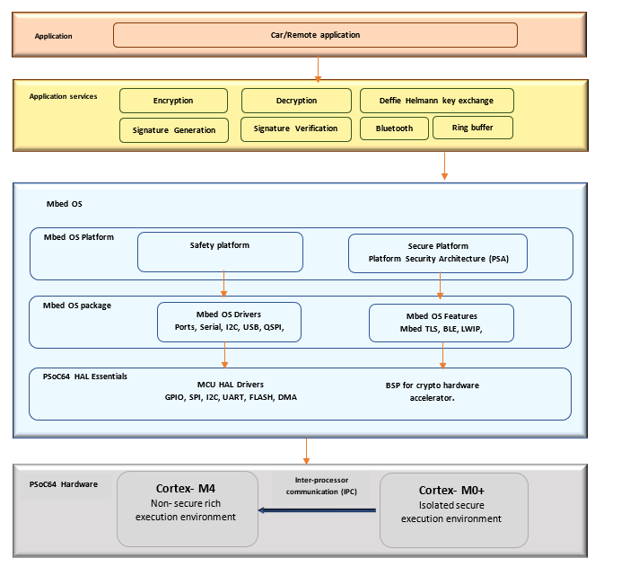
Software Architecture

Slide 15
Implementation
State machine of car and remote application
Activity diagram of security services
https://8edk7w.axshare.com

Slide 16

Verification and Testing
Embedded Security Showcase on Psoc64

Slide 17

Any Questions?

Slide 18

Thank You for your time !

