Slide 1
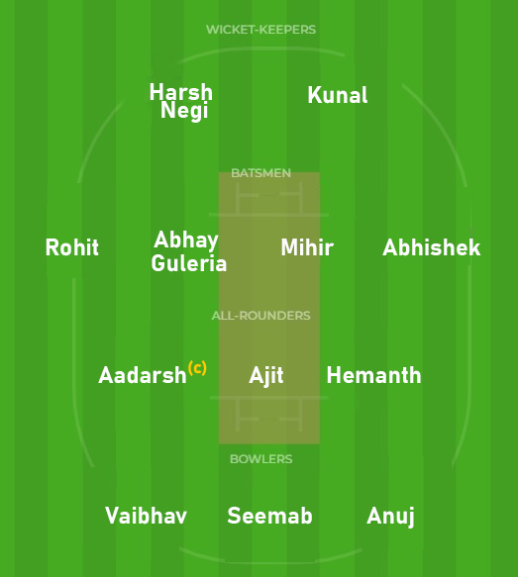
2nd Year Team A
12CONQUERORS
1st Year Team B
Kings
You all are heartily welcome for the match at the Ground. Please mark your presence with some cheering there. Stay there for at least one over who is in a real hurry to home. It will hardly take your 15 mins at max.
(vc)
Our Squad Today

