Slide 1

Nielsen – Store Transaction Imputation

Slide 2
Team Name: Random_State_42
No of team members: 1
Team Members: Aadarsh Singh

Slide 3
Problem Addressed:
To Build an imputation and/or extrapolation model to fill the missing data gaps for select stores by analyzing the data and determine which factors/variables/features can help best predict the store sales.

Slide 4
Approach adopted to solve the problem:
Assumptions:
If a store records a transaction for even one group on a particular DAY (as per the Working Data), it is assumed that all transaction for that day are recorded using the POS machine.
Sales of a particular store and a particular group on a particular day is SIMILAR for different months.

Slide 5
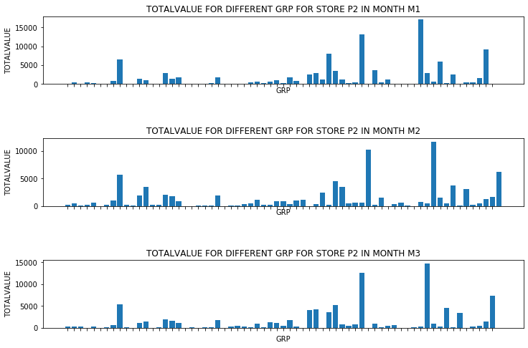

Approach adopted to solve the problem:
Basis of Assumption 2:
The figure alongside shows the plot of TOTALVALUE vs GRP for a store P2 in different months.
Observation: Similar patterns in both the graphs
Conclusion: Same store, same group, different month $⇒$ Similar value pattern.
NOTE: Although, only plot of store 2 is shown, similar patterns were observed in other stores as well !

Slide 6
Approach adopted to solve the problem:
The approach adopted is heavily based on Assumption 1 and Assumption 2.
Other than the above steps, it involves the KNN algorithm to fill missing values (if any remaining after the first two imputations).

Slide 7
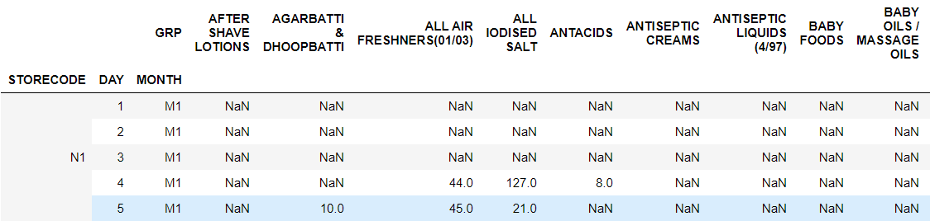
Explanation of the solution:
Form a table whole_partial_data_table with values as VALUE, columns as the GRP and the indices as STORECODE, DAY and MONTH.

Slide 8
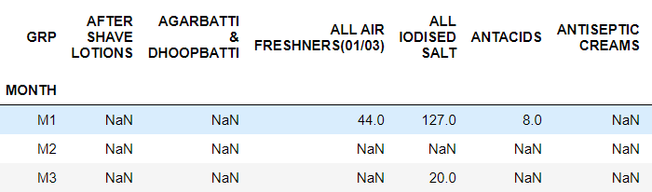
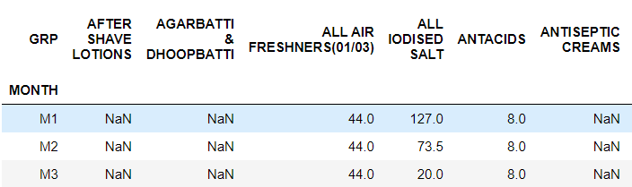
Explanation of the solution:
2. Impute the above table using Assumption 2. Eg. STORECODE – ‘N1’, DAY - 4
Imputation using Assumption 2

Slide 9
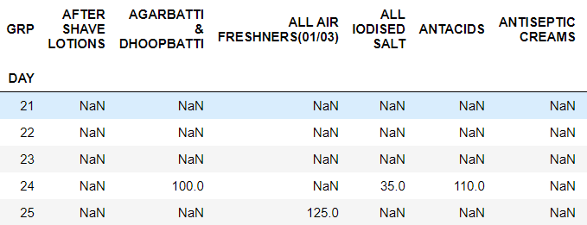
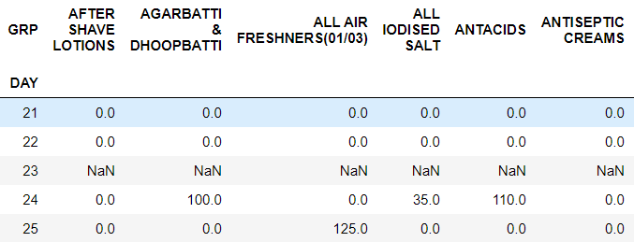
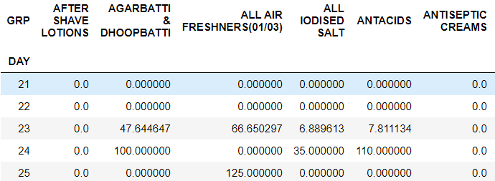
Explanation of the solution:
3. Impute the previously obtained table using Assumption 1 and KNN (if required).
Eg. STORECODE – ‘N2’, MONTH – ‘M1’
Imputation using Assumption 1
Imputation using KNN (K = 30)

Slide 10
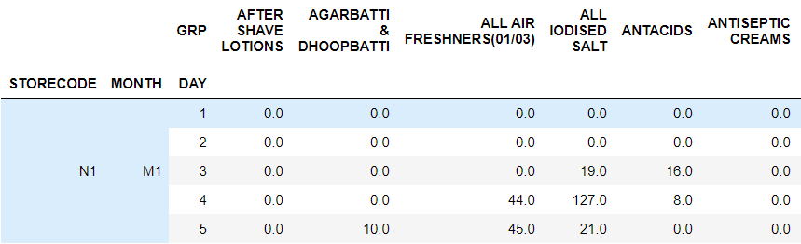
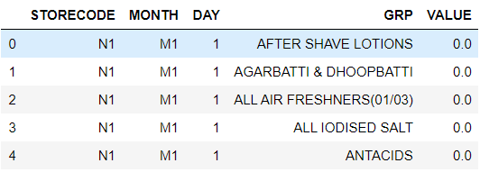
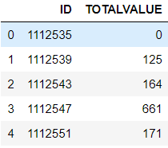
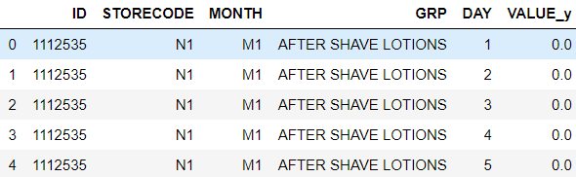
Explanation of the solution:
4. Stack the GRP from columns to indices, map with the IDs in Validation Data and SUM the VALUE to obtain the final solution.
STACK
SUM the VALUE_y
Map with IDs

Slide 11
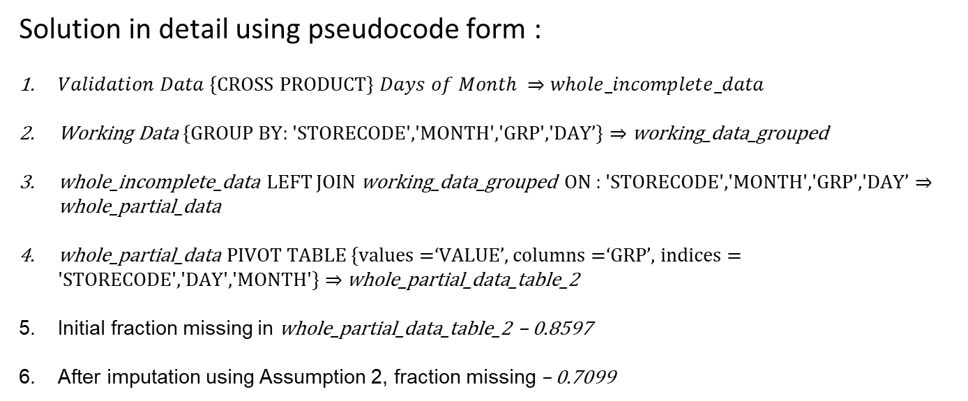
Explanation of the solution:
Solution in detail using pseudocode form :
$Validation Data${CROSS PRODUCT} $Days of Month ⇒$ $whole_incomplete_data$
Working Data {GROUP BY: 'STORECODE','MONTH','GRP','DAY’} $⇒$ working_data_grouped
whole_incomplete_data LEFT JOIN working_data_grouped ON : 'STORECODE','MONTH','GRP','DAY’ $⇒$ whole_partial_data
whole_partial_data PIVOT TABLE {values =‘VALUE’, columns =‘GRP’, indices = 'STORECODE','DAY','MONTH'} $⇒$ whole_partial_data_table_2
Initial fraction missing in whole_partial_data_table_2 – 0.8597
After imputation using Assumption 2, fraction missing – 0.7099

Slide 12
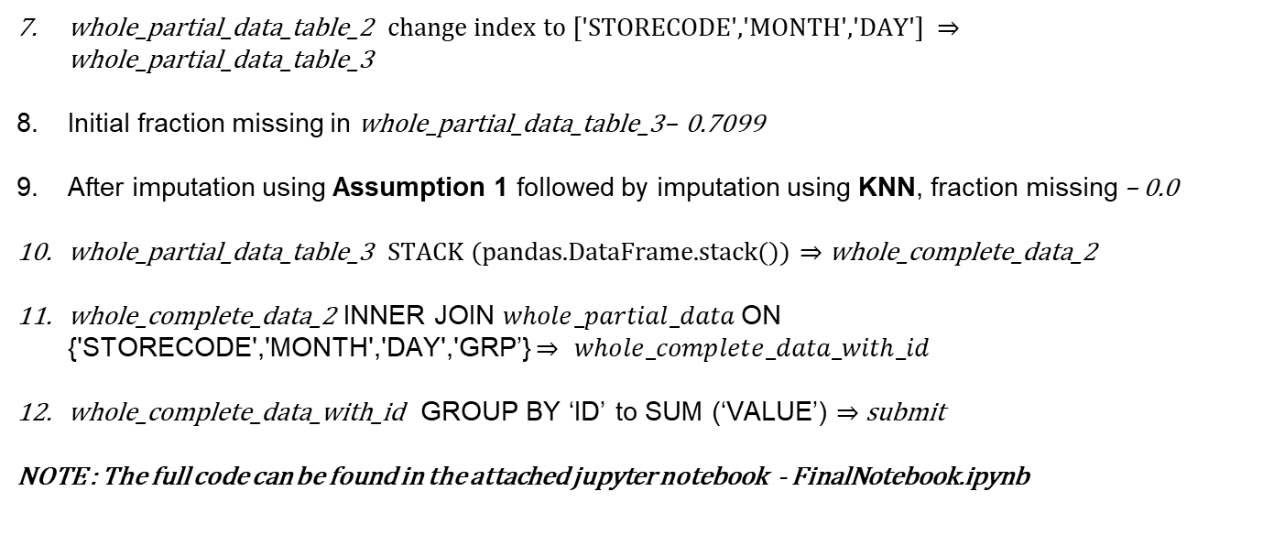
Explanation of the solution:
whole_partial_data_table_2 change index to ['STORECODE','MONTH','DAY'] $⇒$ whole_partial_data_table_3
Initial fraction missing in whole_partial_data_table_3– 0.7099
After imputation using Assumption 1 followed by imputation using KNN, fraction missing – 0.0
whole_partial_data_table_3 STACK (pandas.DataFrame.stack()) $⇒$ whole_complete_data_2
whole_complete_data_2 INNER JOIN $whole_partial_data$ON {'STORECODE','MONTH','DAY','GRP’} $⇒$ $whole_complete_data_with_id$
whole_complete_data_with_id GROUP BY ‘ID’ to SUM (‘VALUE’) $⇒$ submit
NOTE : The full code can be found in the attached jupyter notebook - FinalNotebook.ipynb

Slide 13
Workflow Diagram:
Imputation using Assumption 2
Intermediate Data
(79% missing values)
Imputation using Assumption 1
Intermediate Data
(3% missing values)
Imputation using KNN
(K = 30)
Working Data
(85% missing values)
Final Data
(No missing values)

Slide 14
Evaluation Metric and Final Leaderboard:
FINAL SCORE (RMSE) - 2359.0151807577
The solution managed to achieve the 3rd position on the leaderboard.

Slide 15
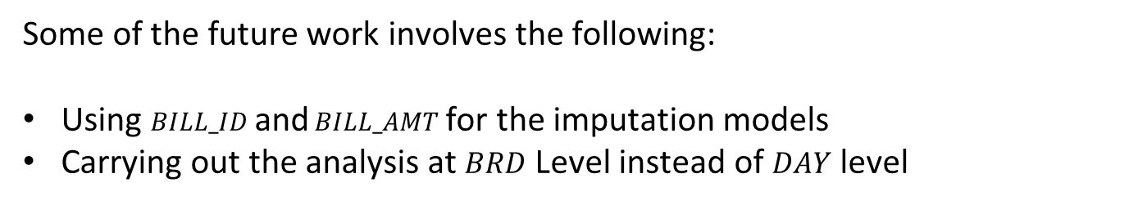
Future work:
Some of the future work involves the following:
Using $BILL_ID$ and $BILL_AMT$ for the imputation models
Carrying out the analysis at $BRD$ Level instead of $DAY$ level

Slide 16
Thank You

Slide 17
Appendix

Slide 18
Approaches and improvement:
Some of the major stages of the experiments are mentioned below:
Simple Grouped, Fill by 0 - 3389 [Baseline]
Assumption1, Fill by mean - 2816.227
Assumption1, Fill by mean without outliers - 2866
Assumption1, Fill by median – 3006
Assumption1, Fill by knn (30) - 2758
Automatic fill 0 - 2764
Assumption2- 2389
Assumption2_with_Assumption1 - 2359

Slide 19
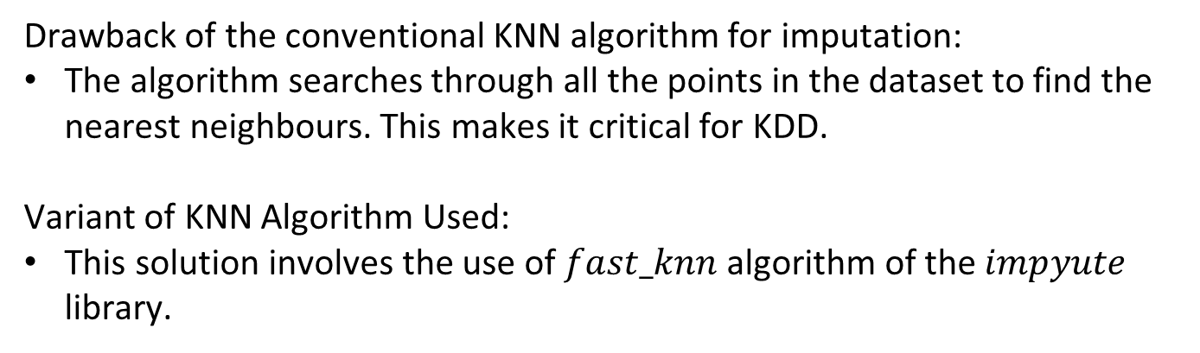
Details of the KNN algorithm used
Drawback of the conventional KNN algorithm for imputation:
The algorithm searches through all the points in the dataset to find the nearest neighbours. This makes it critical for KDD.
Variant of KNN Algorithm Used:
This solution involves the use of $fast_knn$algorithm of the $impyute$ library.

Slide 20

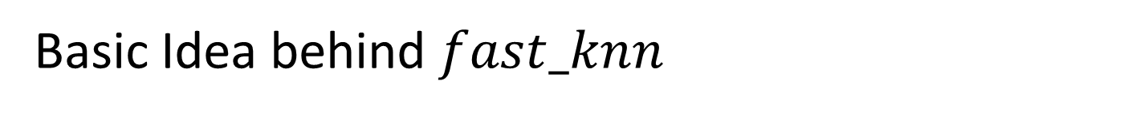
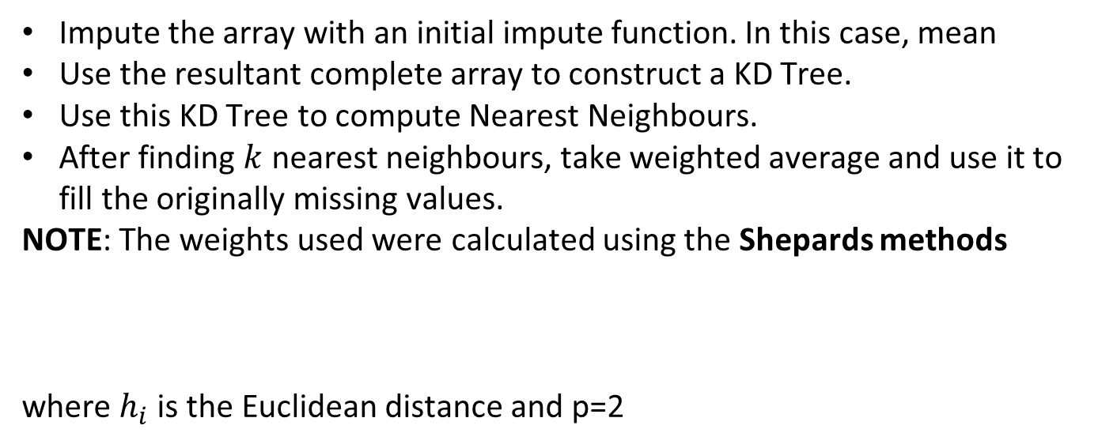
Basic Idea behind $fast_knn$
Impute the array with an initial impute function. In this case, mean
Use the resultant complete array to construct a KD Tree.
Use this KD Tree to compute Nearest Neighbours.
After finding $k$ nearest neighbours, take weighted average and use it to fill the originally missing values.
NOTE: The weights used were calculated using the Shepards methods
where $h_{i}$ is the Euclidean distance and p=2

Slide 21
Unique Points about the current Idea
Accurate – Leaderboard Position 3
Efficient – No complicated Method used. Simple approach that yields good results.
Explainability – Unlike feeding data to a machine learning model blindly, this idea explains each and every step/assumption.
Scope for Improvement – Since the idea is simple, it can be built upon easily.
Attempts used – 35; compared to 100+ attempts of the other contestants in the <2500 score range.

