Slide 1

Nielsen – Store Transaction Imputation

Slide 2
Team Name: Random_State_42
No of team members: 1
Team Members: Aadarsh Singh

Slide 3
Problem Addressed:
To Build an imputation and/or extrapolation model to fill the missing data gaps for select stores by analyzing the data and determine which factors/variables/features can help best predict the store sales.

Slide 4
Approach adopted to solve the problem:
Assumptions:
If a store records a transaction for even one group on a particular DAY (as per the Working Data), it is assumed that all transaction for that day are recorded using the POS machine.
Sales of a particular store and a particular group on a particular day is SIMILAR for different months.

Slide 5
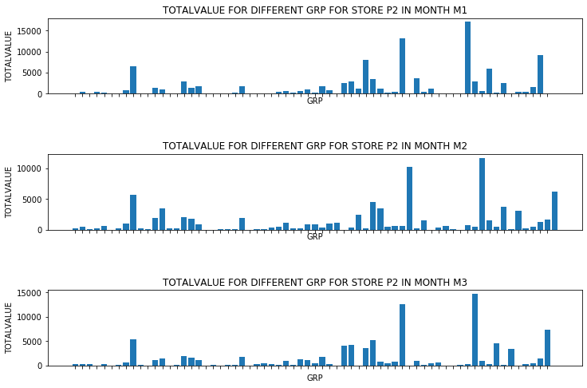

Approach adopted to solve the problem:
Basis of Assumption 2:
The figure alongside shows the plot of TOTALVALUE vs GRP for a store P2 in different months.
Observation: Similar patterns in both the graphs
Conclusion: Same store, same group, different month $⇒$ Similar value pattern.
NOTE: Although, only plot of store 2 is shown, similar patterns were observed in other stores as well !

Slide 6
Approach adopted to solve the problem:
The approach adopted is heavily based on Assumption 1 and Assumption 2.
Other than the above steps, it involves the KNN algorithm to fill missing values (if any remaining after the first two imputations).

Slide 7
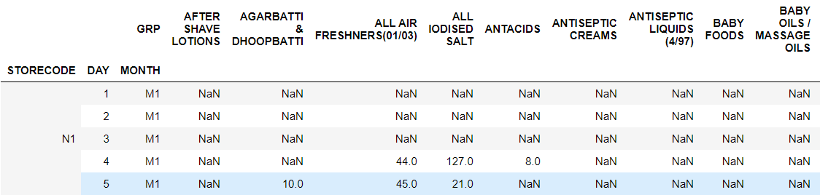
Explanation of the solution:
Form a table whole_partial_data_table with values as VALUE, columns as the GRP and the indices as STORECODE, DAY and MONTH.

Slide 8
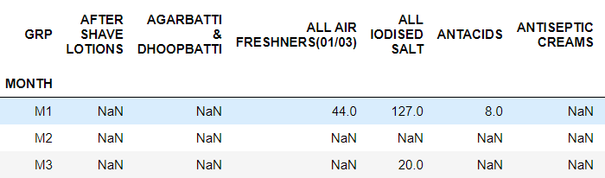
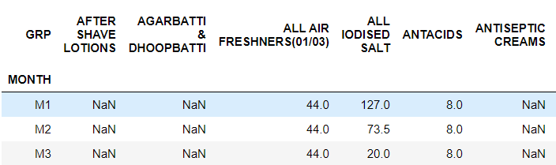
Explanation of the solution:
2. Impute the above table using Assumption 2. Eg. STORECODE – ‘N1’, DAY - 4
Imputation using Assumption 2

Slide 9
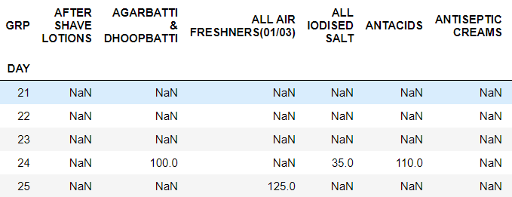
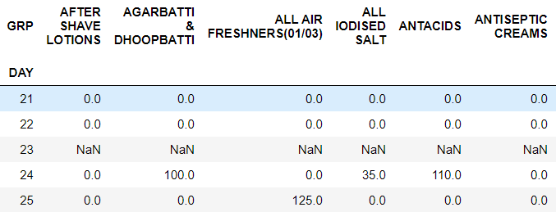
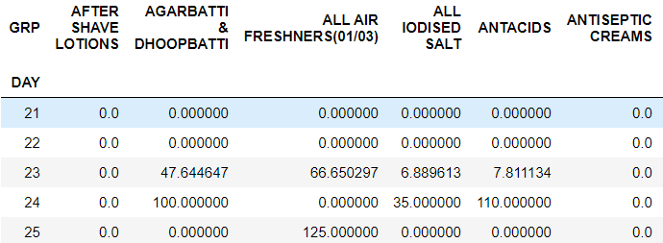
Explanation of the solution:
3. Impute the previously obtained table using Assumption 1 and KNN (if required).
Eg. STORECODE – ‘N2’, MONTH – ‘M1’
Imputation using Assumption 1
Imputation using KNN (K = 30)

Slide 10
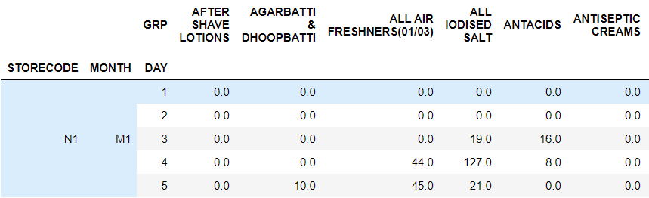
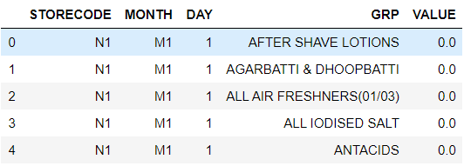
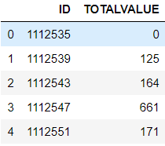
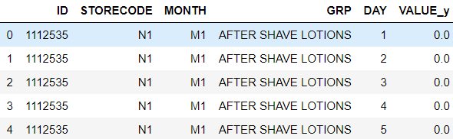
Explanation of the solution:
4. Stack the GRP from columns to indices, map with the IDs in Validation Data and SUM the VALUE to obtain the final solution.
STACK
SUM the VALUE_y
Map with IDs

Slide 11
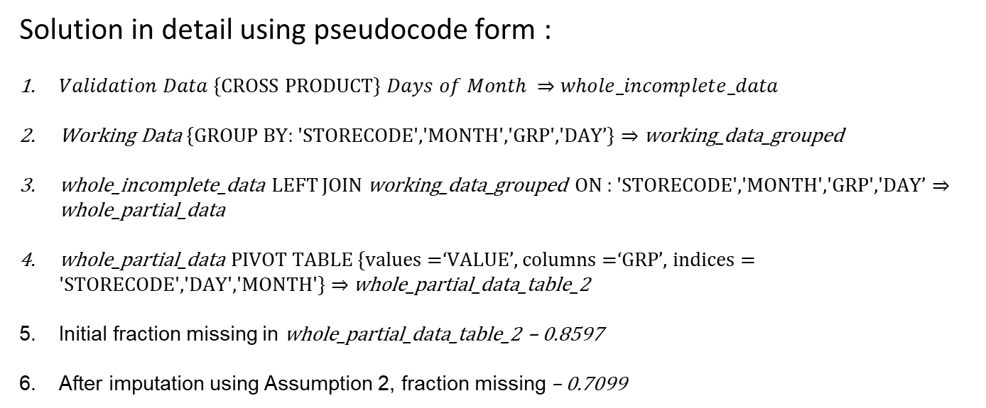
Explanation of the solution:
Solution in detail using pseudocode form :
$Validation Data${CROSS PRODUCT} $Days of Month ⇒$ $whole_incomplete_data$
Working Data {GROUP BY: 'STORECODE','MONTH','GRP','DAY’} $⇒$ working_data_grouped
whole_incomplete_data LEFT JOIN working_data_grouped ON : 'STORECODE','MONTH','GRP','DAY’ $⇒$ whole_partial_data
whole_partial_data PIVOT TABLE {values =‘VALUE’, columns =‘GRP’, indices = 'STORECODE','DAY','MONTH'} $⇒$ whole_partial_data_table_2
Initial fraction missing in whole_partial_data_table_2 – 0.8597
After imputation using Assumption 2, fraction missing – 0.7099

Slide 12
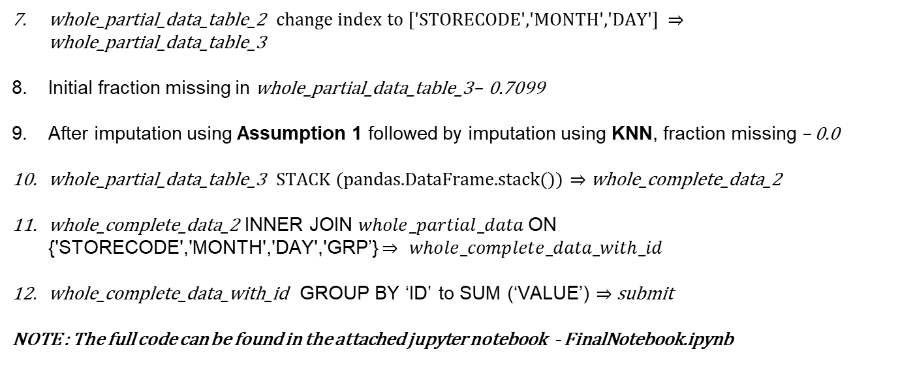
Explanation of the solution:
whole_partial_data_table_2 change index to ['STORECODE','MONTH','DAY'] $⇒$ whole_partial_data_table_3
Initial fraction missing in whole_partial_data_table_3– 0.7099
After imputation using Assumption 1 followed by imputation using KNN, fraction missing – 0.0
whole_partial_data_table_3 STACK (pandas.DataFrame.stack()) $⇒$ whole_complete_data_2
whole_complete_data_2 INNER JOIN $whole_partial_data$ON {'STORECODE','MONTH','DAY','GRP’} $⇒$ $whole_complete_data_with_id$
whole_complete_data_with_id GROUP BY ‘ID’ to SUM (‘VALUE’) $⇒$ submit
NOTE : The full code can be found in the attached jupyter notebook - FinalNotebook.ipynb

Slide 13
Workflow Diagram:
Imputation using Assumption 2
Intermediate Data
(79% missing values)
Imputation using Assumption 1
Intermediate Data
(3% missing values)
Imputation using KNN
(K = 30)
Working Data
(85% missing values)
Final Data
(No missing values)

Slide 14
Evaluation Metric and Final Leaderboard:
FINAL SCORE (RMSE) - 2359.0151807577
The solution managed to achieve the 3rd position on the leaderboard.

Slide 15
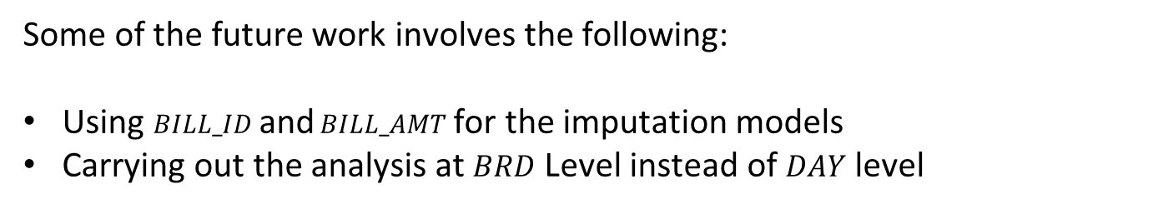
Future work:
Some of the future work involves the following:
Using $BILL_ID$ and $BILL_AMT$ for the imputation models
Carrying out the analysis at $BRD$ Level instead of $DAY$ level

Slide 16
Thank You

Slide 17
Appendix

Slide 18
Approaches and improvement:
Some of the major stages of the experiments are mentioned below:
Simple Grouped, Fill by 0 - 3389 [Baseline]
Assumption1, Fill by mean - 2816.227
Assumption1, Fill by mean without outliers - 2866
Assumption1, Fill by median – 3006
Assumption1, Fill by knn (30) - 2758
Automatic fill 0 - 2764
Assumption2- 2389
Assumption2_with_Assumption1 - 2359

Slide 19
Why KNN?
Can predict both discrete and continuous attributes
Lazy, so no necessity for creating predictive model for each attribute
Can be easily adapted to work with any attribute by just modifying which attributes will be considered in distance metrics.
Can easily treat examples with multiple missing values.
Reference - A Study of K-Nearest Neighbour as an Imputation Method

Slide 20
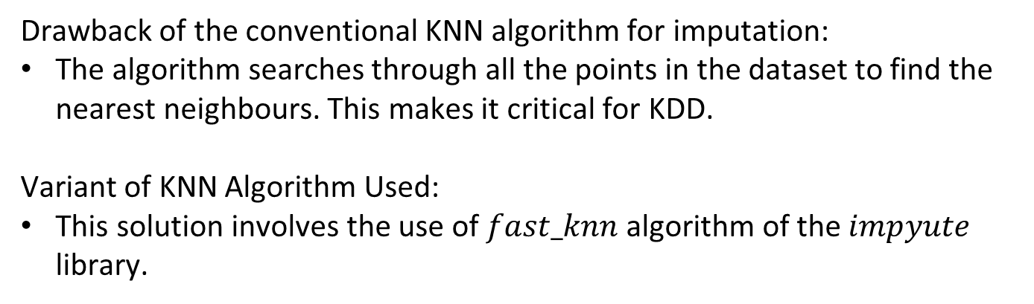
Details of the KNN algorithm used
Drawback of the conventional KNN algorithm for imputation:
The algorithm searches through all the points in the dataset to find the nearest neighbours. This makes it critical for KDD.
Variant of KNN Algorithm Used:
This solution involves the use of $fast_knn$algorithm of the $impyute$ library.

Slide 21

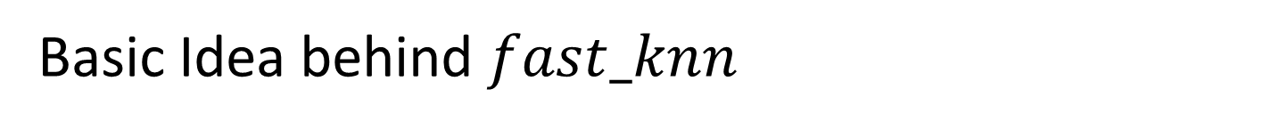
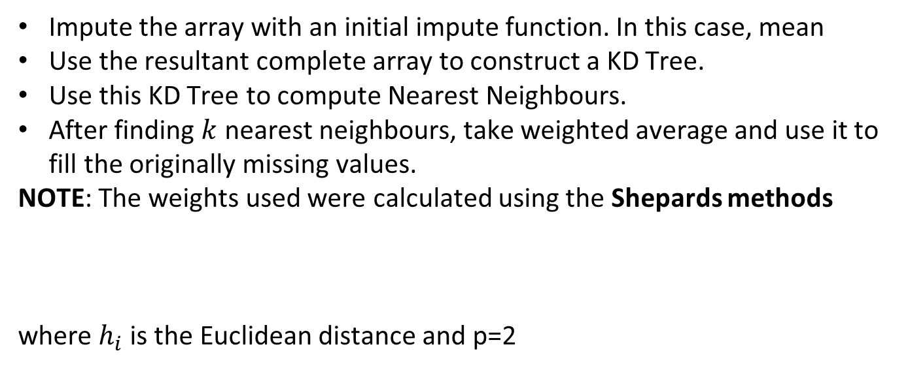
Basic Idea behind $fast_knn$
Impute the array with an initial impute function. In this case, mean
Use the resultant complete array to construct a KD Tree.
Use this KD Tree to compute Nearest Neighbours.
After finding $k$ nearest neighbours, take weighted average and use it to fill the originally missing values.
NOTE: The weights used were calculated using the Shepards methods
where $h_{i}$ is the Euclidean distance and p=2

Slide 22
Unique Points about the current Idea
Accurate – Leaderboard Position 3
Efficient – No complicated Method used. Simple approach that yields good results.
Explainability – Unlike feeding data to a machine learning model blindly, this idea explains each and every step/assumption.
Scope for Improvement – Since the idea is simple, it can be built upon easily.
Attempts used – 35; compared to 100+ attempts of the other contestants in the <2500 score range.

