Slide 1

Bill.com
NYSE: BILL
Gaurov Bansal, Tuhin Ghosh, Nitika Kurma, Lila Melkumova, Anqi Qu, Jackson Van Vooren, Kevin Yang
SL: Nik Tolpegin
Financials, Winter 2023

Slide 2
Company Overview
Gaurov Bansal and Anqi Qu

Slide 3
Executive Summary
Bill.com is a fundamentally strong business backed by a strong management team targeting a large market.
Products and Services
Strong Integration
Cloud-based financial management software company and payment processor
Provides value to SMBs through a suite of back-office financial operations and solutions
Four Products Offered
Accounts Payable Automation
Accounts Receivable Automation
Spend and Expense Management
Payment Services
Bill.com works with accounting systems and Enterprise Resource Planning (ERP) platforms
Automatic
Direct two-way sync with Oracle NetSuite, Intuit QuickBooks, Xero, Microsoft, and Sage
Data Integration
Easily import and export data with Thompson Reuters, SAP, and FreshBooks
Revenue Breakdown
Pricing Structure
 | Essentials | Team
Pay Bills | $45/user/month | $55/user/month
Get Paid | $45/user/month | $55/user/month
Custom pricing for ERP integration in combined plan
Transaction Services
Send/Receive: $0.49
Mail Your Checks: $1.69/check
Mail Your Invoices: $1.49/invoice

Slide 4
Deeper Dive into Products Offered
Accounts Payable Automation
Digitizes every invoice that comes in via any medium and leverages AI /ML to pull information into the system
Implements checks and balances by checking for potential errors and time-stamping every interaction
Keeps track of several different variable payment terms and ensures appropriate payment to vendors
Accounts Receivable Automation
Platform helps create, send, schedule sending one-time or invoices to the correct customers on appropriate dates
Empowers businesses to track the invoice, filter invoices by status, and send reminders for unpaid invoices to clients
Syncs invoices with a several different accounting software for accurate reconciliation and record-keeping purposes
Spend and Expense Management
Their spend and expense management platform is powered by their acquisition of Divvy in May, 2021
It powers collecting spending data and spend analytics that uses AI to identify opportunities to reduce costs
It identifies patterns between spending and Key Performance Indicators (KPIs) in order to indicate correlation
Payment Services
Bill.com helps businesses transition to paying vendors w. Automated Clearing House (ACH) instead of checks
Unlike other platforms that charge a percentage based-transaction fee, customers pay a flat fee for transactions
Bill.com automates ACH payments in payables and receivables processes to create a fully integrated platform

Slide 5

Quick Figures
Bill.com’s impressive numbers reflect their growing presence and strong vision.
Value add for SMBs
Target Segments
Payments are a manual and brain-dead task. Having it automated will free up time and energy
Current methods using paper/Excel are inaccurate and error-prone. Additionally, paper is not secure
There is a lack of visibility and data
Using Bill.com means SMBs have more time to focus on customers and mission
Market Segment
Current Tools
Enterprise
SMB
Microbusinesses
Mid-Market
Point solutions, ERP
Point solutions, Paper
Network Members
Number of Clients
4.7M
Excel, paper
400K+
Excel, paper
Gross Margin (Pro-Forma)
Net $ Retention Rate
87%
131%

Slide 6

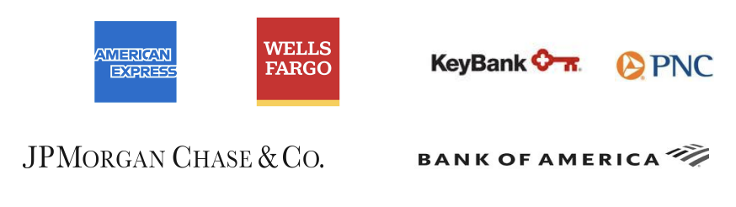
Company Past, Present, and Future
Bill.com has recently focused on expanding their platform offerings through strategic acquisitions and partnerships. They have a long runway for growth and are looking to continue on that trajectory.
Key Events
Forward-looking Growth Drivers
06/2021 – Acquires Divvy, a leading spend management company that combines expense management software and smart corporate cards into a single platform
09/2021 – Acquires Invoice2Go, an AR mobile-first company
11/2022 – Acquires Finmark, a leading financial planning software provider that simplifies financial planning and cash flow insights for SMBs
Acquiring new customers and focusing on SMBs
Increasing adoption by existing customers and having existing customers use more of their product offerings
Growing the number of network users including partner firms and institutions
Increasing platform capabilities through both acquisitions and in-house growth
Expanding internationally to capture growth potential
Partner Accounting Firms
Partner Financial Institutions
Bill.com is currently partnered with 6000+ accounting firms
Bill.com is also partnered with 6 of the top 10 financial institutions in the US

Slide 7
Industry Overview
Lila Melkumova

Slide 8
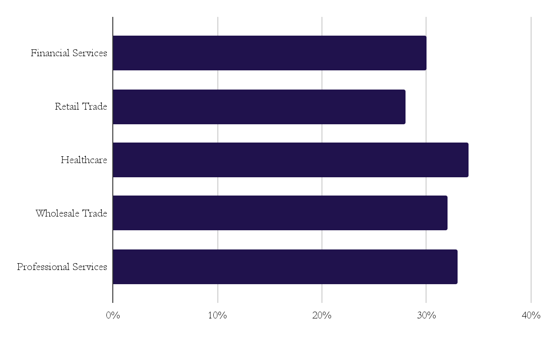
AP/AR Automation Industry Growth
General Environment
AP/AR Automation by Industry (End-User)
AP/AR automation market is currently valued at $2.7bb, growing at CAGR of 10.2%
Industry is broadly separated into cloud (provider servers) vs. on-premise (company servers) solutions
But generally, many SMBs use traditional, pen and paper methods, despite savings potential
Other big benefits reported are faster turnaround time on payment and better monitoring and transparency of invoice status
Yet, only 20% of small business (SMB) have adopted AP/AR automation compared to 30% of companies total
20% of SMBs have 3+ year plans to address automation compared to 35% of MMBs
23% of SMBs expect to increase their same-day ACH usage
72% of companies expect to automate and adopt real-time payments
High Savings Potential for SMBs & MMBs
On average, companies save more than 30% with AP/AR solutions, which has spurred recent industry growth
The median cost per invoice to process is $10. SMBs & MMBs might be processing 1000 or more invoices per month. At this level, a 29% saving at $10 per invoice is around $30,000 per year.
41% of AR system users report a payback time of 9 months or less. This rises to 82% in 18 months or less.

Slide 9
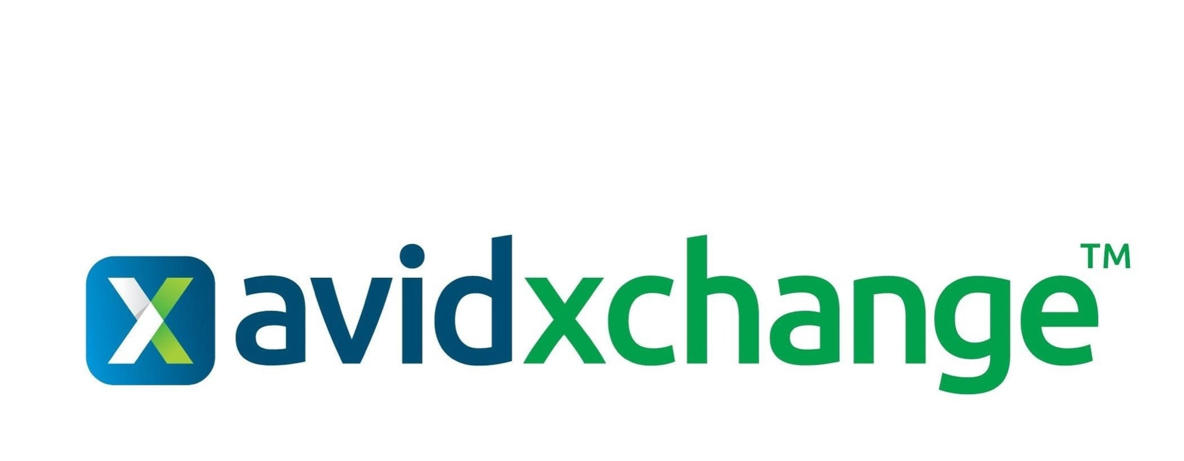
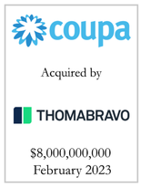
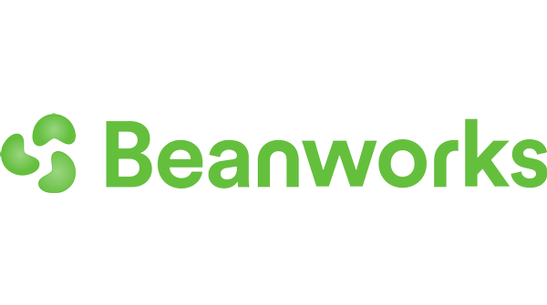




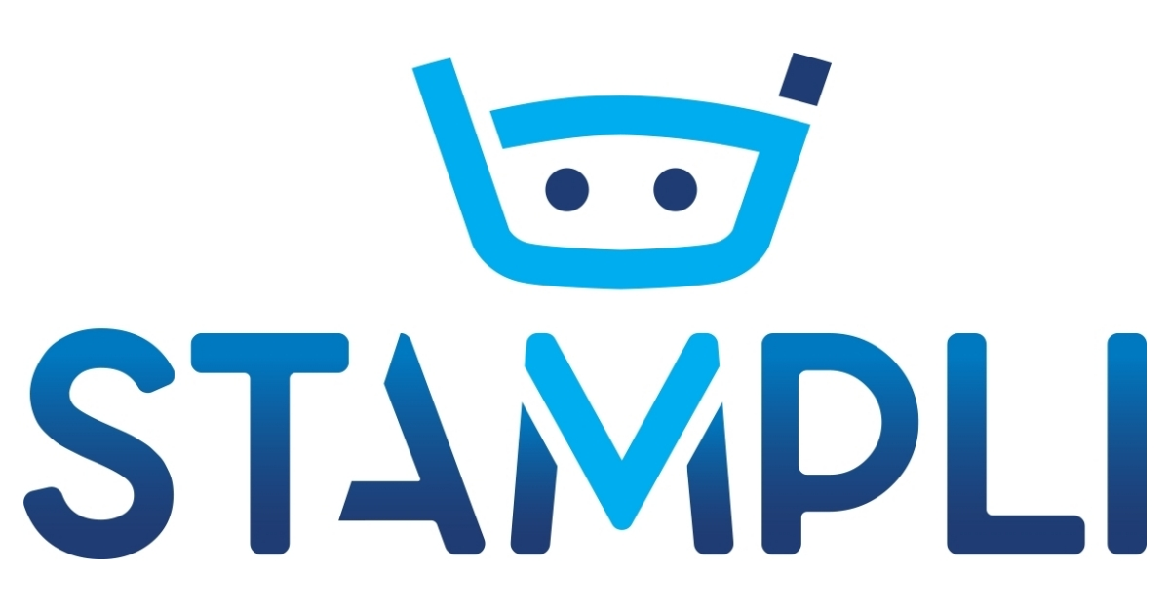

SMBs and MMBs Face Unique Problems
BILL is well-positioned to lead in a historically underserved, untapped market.
Key Factors of Client Needs
Players in SMB-MMB Space
COVID-19 pandemic highlighted the need for cloud-based solutions as compared to previously used on-premise ones, pushing demand for strictly digital ERP products.
Middle markets and small businesses feature hundreds of accounting systems and integrations across sub-industries, resulting in many complex sub-verticals and highly specific accounting and compliance requirements.
Costs related to AP/AR workflows can be a significant component of administrative expenses due to lower economies of scale, making them turn to payment solutions for cost savings.
MMBs are largely underserved by existing payment processing software solutions. A few key providers serve large enterprise buyers and SMBs, but MMBs are served by highly fragmented market of software solutions and ERPs, resulting in overwhelming diversity of accounting systems in today’s market.
MMBs
SMBs
As they [MMBs] grow, they need to design processes, build out functions, and create ever-more-sophisticated systems and infrastructure to support their growth. But at the same time, they tell us, they want to preserve their agility and they don’t want to get ahead of themselves. I call it just enough process – enough to support growth, not enough to encumber it. - Tom Stewart to VISA
Notes:
what each of the competitors does differently

Slide 10
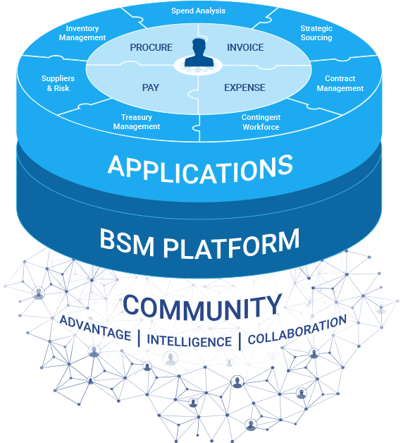
Competitor Differentiating Factors
The acquisition of Divvy is another step towards the full-suite ERP platform business model.
Divvy’s Competition in EM
Players Attack the AP/AR Automation Differently
The acquisition of Divvy positions BILL well in expense management space, which is adjacent to the invoice processing and automation
Still, BILL will not be the first business in the shared space, second to SAP Concur and Coupa
Divvy’s integration enables BILL to expand its platform towards expense management, taking advantage of the corporate trend to shift towards real-time, same-day payments with virtual and physical charge cards
Other Divvy’s competitors in expense management space include Ramp, Rydoo, Circula, and Payhawk
The industry in general is more mature than AP/AR automation; currently at $6BB and projected to grow at 9% CAGR
Space dynamics similar to AP/AR automation - 43% of business still use traditional pen and paper methods, which suggests a huge untapped market
In general, the industry is separated in two categories: strictly AP/AR automation with some horizontal integration and full-scale ERP platforms
Additional categories include microbusiness, SMBs, and MMBs and enterprises; little-to-no movement across the categories to other clientele groups
Coupa’s ERP platform & acquisition strategy emphasizes suite synergy across supply chain planning and general spend management. AvidXChange, on the other side, does not offer a full suite, but instead banks on network effects of AvidPay Network and the ease of use via their servers, as they operate on cloud-only mode.
Notes:
what is on premise solutions; most people do pen and paper;
nowadays, ppl get bills in the mail, physically. include labor costs
add citations
dont be afraid to put qualitative shit down
the industry is of who can get the open market

Slide 11
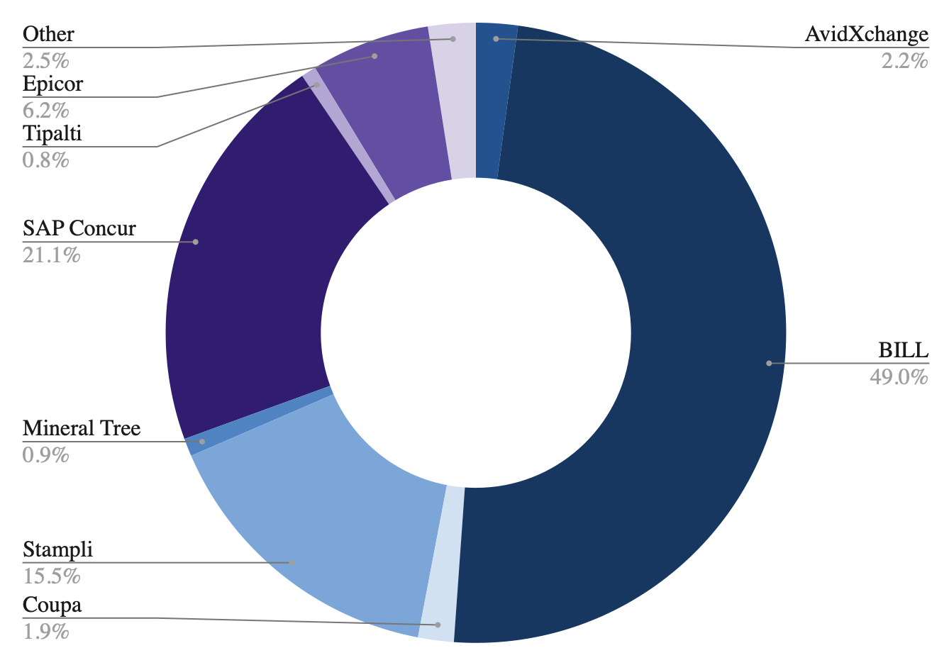
Industry Players & Market Share
Competitive Environment
AP/AR Automation Market Share
AP/AR software and payment solutions is highly fragmented, competitive market marked by rapid change and consolidation due to tech innovations.
Success relies on a platform’s ability to easily integrate accounting software.
Expanding into new verticals or attractive different-sized customer types is typically constrained by the need to tailor solutions to industry verticals or customer size
Calculated per total SMB-MMB customer number, excluding businesses that have not made the transition yet
Entry Barriers
Medium entry barriers such as capital expenses on R&D associated with developing a payment processing platform and need for strong partnerships with accounting software firms such as QuickBooks
At the same time, companies currently focused on providing solutions to different size businesses may seek to expand the offering of solutions to MMBs or SMBs through acquisitions
It is clear that BILL is the definite leader in shared SMB-MMB space.
Notes:
q: how to estimate NA & smb market
wtf to do w coupa if they dont report by segment

Slide 12
Investment Theses
Tuhin Ghosh, Jackson Van Vooren, and Nitika (Nik) Kurma

Slide 13
Overview
Synergies of Acquisitions
The synergies between BILL’s three acquisitions(Invoice2Go, Divvy, and Finmark) provide a differentiated product for growing SMBs.
These will attract more customers allowing BILL to penetrate the SMB market and increase the lifetime value of existing customers as they engage in more services.
The cash flow data that BILL has will allow the company to tailor its offering such as the corporate credit cards which bring BILL more fee revenue and optimize SMB spend operations.
Diverse Growth Opportunities Provide BILL With A High Potential For Expansion
Existing scale in the market has solidified partnerships and customer stickiness that is not easily replicable by competitors
Benefits from increasing adoption of products by existing customers and the large size of the market provides a wealth of opportunities to acquire new ones
International expansion plans add on to BILL’s already strong and various growth drivers, furthering their potential expansion in the future
Their network and data capabilities benefit customers and financial institutions who they partner with, which creates a strong business model
BILL Provides Services to All Parties in the Back Office Financial Value Chain Through Superior Product Integration
AP & AR software, the basis of BILL, creates customizable workflows and invited SMBs, vendors, and customers to a single platform.
BILL creates a combination of time, effort, customizing, and convenience related switching costs as it is difficult to recreate BILL’s APIs in a way such that all payment management services occur automatically with all parties, but also accounting software.
The increase in scale of time and money that is needed to facilitate a similar platform like BILL is not yet available as BILL’s acquisitions have proved essential for SMBs.

Slide 14
Thesis I: Synergies of BILL’s acquisitions catering to SMB growth and leveraging customer cash flow data
Tuhin Ghosh

Slide 15
Overview of Acquisitions
Creating synergies with existing businesses
DivvyPay Inc (Divvy)
Invoice2Go
Deal Structure
Provider of expense management products and smart charge cards for SMBs
Smart corporate credit card to provide instant visibility and control of company-wide spending
Provider of accounts receivable software to allow SMBs to manage invoicing and payments.
Automates SMBs’ back-office financial operations
Finmark
BILL’s Strategy
Budgeting and financial forecasting solution for SMBs.
Enables process automation for accounting firms with forecasting and cash flow management
Acquired for Undisclosed Amount (11/16/22)
BILL’s main priority is to build an integrated platform combining its products with these 3 in the near future.
This will provide a wide service platform for SMBs and other firms.
Acquires Divvy
Acquires Invoice2Go
Notes:
Just an overview of current acquisitions. Will quickly explain what each one does and talk about Bill’s current goal of building a unified platform to combine its offerings in one place.

Slide 16
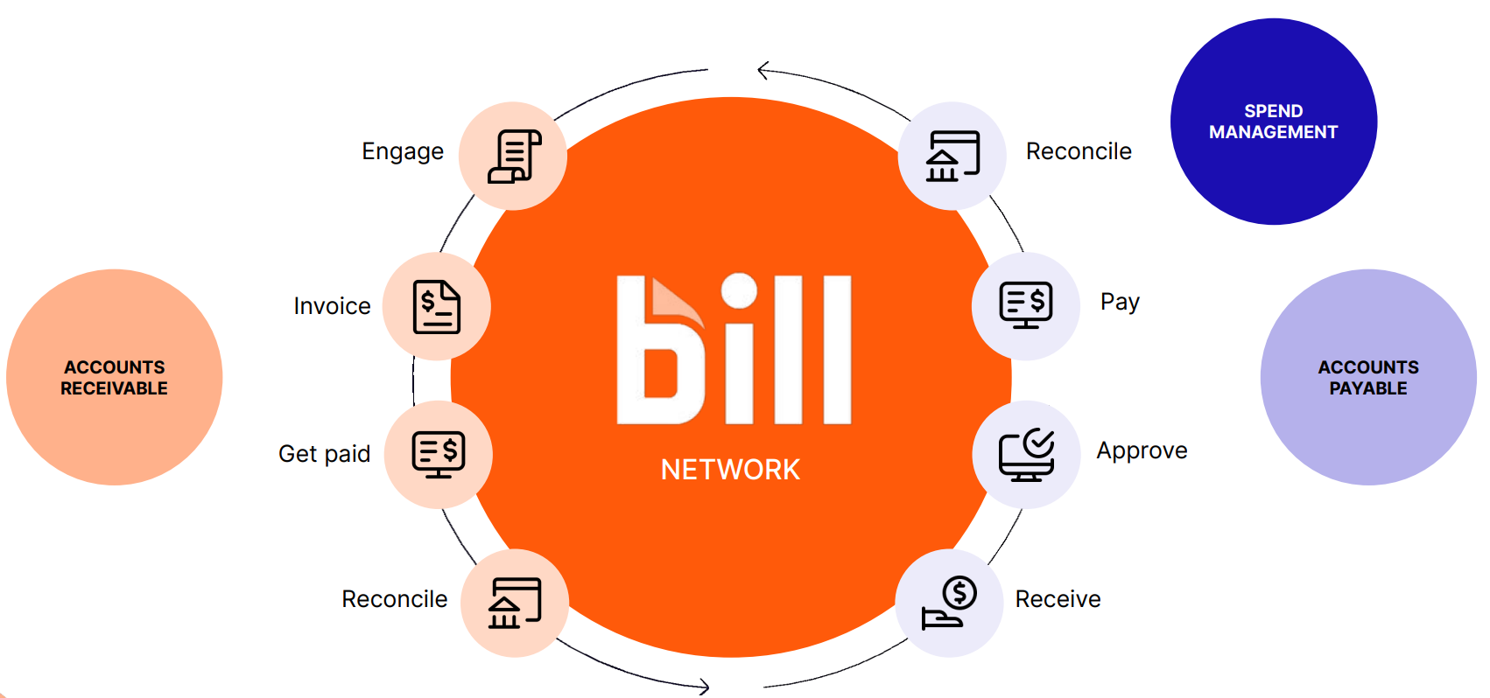
Invoice2Go
Offering full Accounts Payable + Accounts Receivable Automation
Invoice2Go’s position as being more than 50% of BILL’s business customers is indicative of its success and future potential
The acquisition completes the other half of back-office financial operations for SMB’s: Accounts Receivables, while BILL has established a platform for Accounts Payables.
Proven as a far better alternative than legacy, paper-processing solutions.
However, BILL still has a large amount of standalone customers, illustrating the large potential for Invoice2Go to penetrate.
Notes:
Will explain how Invoice2Go brings the other half to the AP automation that Bill has already built. As evidenced by there being so many Bill standalone customers, Invoice2Go has a lot of space to penetrate and expand its own customer base. This is the core of Bill’s offerings as it revolutionizes SMB’s back office and kills legacy, paper solutions.

Slide 17
Divvy
Credit Card Offerings which are easily advertised through the platform and cater to growing SMBs’ needs
Divvy’s credit card offerings are more cost-efficient and accessible for growing SMBs.
BILL has stated that customer payment modality is not changing even in the current dampened macroeconomic environment.
Net Dollar-Based Retention Rate(NDRR) movement and size indicates that BILL excels at increasing customer use of their products over time.
Increased Adoption
The Synergies
Firstly, Divvy can be easily advertised to Divvy customers as an easy and cost-efficient method of payment.
Apart from the advertising, BILL has an immense amount of data regarding the spending flows of their customers.
This will allow them to tailor the Divvy card to each customer’s needs and increase its adoption significantly.
With such a high NDRR and total payment volume rapidly increasing for Divvy, its place in BILL’s platform brings a differentiated product and the ability to use the unique insights which BILL has into its customer’s spending and income.
Notes:
Explain Divvy and how it offer corporate credit cards that allow for spend management for SMBs. Will address what NBRR is and how it’s size is indicative that Bill’s customers are willing to not only stick with it but also spend more with it. By offering corporate credit card, Bill now fulfills 2 of the 4 rails of B2B payments(along with its ACH offering), and there is a very easy way for Bill to advertise Divvy’s services to growing SMBs. Seeing that customer payment modality choice is not changing in dampened environments is very useful because it means that customers in the future who will get Divvy’s services won’t just drop them bc inflation pops up or something.

Slide 18
Finmark and Acquisitions Impact
Finmark: allowing clients to turn insights with automated data into decisions and impactful forecasting
Finmark
Since Finmark would automatically integrate with the companies’ cash flow software, the customers have easy access to otherwise laborious insights, and BILL could modify the software to better suit client needs
Finmark gives BILL the angle of being a financial insights service as well, so customers and accounting firms that already trust BILL for other services can easily turn to them for more sophisticated products.
BILL’s AP services
Finmark Automated Integration
Invoice2Go AR
Divvy Card Offerings
Customer Cash Flow Data
Future Services
Acquisition Combination
BILL’s acquisitions give it multiple growth levers to pull on by creating a unified platform to cater to many facets of SMB growth. The product simplifies SMB operations significantly and finds its niche in AP+AR automation
BILL ensures that it is not only catering to SMBs which are switching from legacy accounting solutions, but also supporting those that are looking to advance their operations significantly.
The benefits of Invoice2Go bring the necessary other half to BILL’s established Accounts Payable software and allow for BILL to take advantage of the valuable data regarding its customer’s cash flows.
BILL will unlock value within Divvy through synergies in integrated advertising and tailored credit card offerings which bring higher transaction and fee revenue to Divvy while offering SMB enhanced spend management.

Slide 19
The Differentiated Product
Catering to customer need by expanding from bill pay to card network and financial insights software
Future Value
BILL’s future unified platform and current synergies between recent acquisitions will ensure that it is able to capture customers and magnify tail-end growth.
BILL’s closest competitors lack the size and offerings which BILL has built to capture more of its niche market. With the help of partnerships with larger firms(i.e. Bank of America: 3 million SMBs, ~10K/q to BILL), BILL can access and easily advertise its products to SMBs.
BILL’s advertising capabilities will qualitatively and quantitatively produce rapid growth. With integrated advertising of Divvy in the AP+AR Automation Platform and increased reliance on attractive digital advertising, BILL will amplify its customer acquisitions which will establish strong recurring revenue and consistent growth prospects.
BILL is smaller in the financials space, allowing for it to take much better advantage of the economies of scale at play in this space. BILL’s acquisitions have given it both the product differentiation and scale to better take advantage of its niche.
As the platform expands both organically through aggressive advertising and inorganically through new products, BILL can drive up pricing, driving up revenue per customer without reducing the number of customers as found by the increasing NDRR.

Slide 20
Thesis II: Diverse growth opportunities provide BILL with a high potential for expansion
Jackson Van Vooren

Slide 21
Existing Scale Contributes to Market Position
As a first mover in the market, Bill.com has already created scale that solidifies their business model.
Customer Stickiness from Existing Scale
Bill.com Dominates Total Number of Customers
Approx 4.7 million network members have paid or received funds using the platform
Registered customers plus suppliers and clients
Partnerships with 70/100 top accounting firms
Since BILL’s founding in 2006, they have succeeded in creating scale through the integrations and partnerships mentioned
These efforts take time and are not quickly reproducible by competitors
Scale by targeting and dominating a niche market
“Non-consumer” focus, looking at enterprises
Large firms tend to target the consumer end (such as consumer payments)
Gives BILL the opportunity to take market share under the radar, gaining more and more traction
Being a first-mover in the market allows for loyalty
Over 86% of subscription revenue from customers came from those who were acquired in a prior year, which points to customer stickiness from their scale and integration capabilities
Captive Potential Customer Base
BILL is most effective when both parties (vendors and purchasers) are on the platform
157,000 registered customers and > 4M members who have received or sent payments on BILL
Large opportunity for customer acquisitions
Creates a captive customer base who could benefit from BILL’s product base and network effects
Despite being a leader in the market, there remains ample room for growth due to low penetration

Slide 22
Technological Adoption as a Growth Diver
Bill.com primed to capitalized off high adoption from new and existing customers alike.
Sheer Size of the Market
Benefits from Slow or Fast Adoption Rate
Approximately 25,920,000 small/medium businesses (SMBs) in the United States
Roughly 22,000,000 (85%) rely on paper checks
0.71% market penetration, offering BILL a large untapped opportunity to capitalize on
BILL has a long runway for growth because market is unpenetrated and SMBs are underserved by tech
Diverse drivers: Cloud, SMB, and fintech growth
If cloud adoption remains rapid over the next years
Will still not exhaust the market (~100% growth)
New competitors will struggle to keep up without already existing scale that Bill.com benefits from
If technological adoption and growth slows down
With a huge quantity of SMBs, BILL will consistently acquire market share
Slower growth discourages competitor entry
Increasing Adoption by Existing Customers
Payment Volume Growth and Internal Adoption
Strong ability to retain and grow engagement with existing customers
Expands within existing base by increasing transactions per customers, adding more users, and launching additional products to cross/up sell
Increased total payment volume from $140M to $220M, a 56% growth rate, despite total customers increasing by 30%
Demonstrates increasing existing adoption

Slide 23
International Expansion
Large untapped international opportunities supplement already strong domestic growth drivers for Bill.com.
In 2019, BILL expanded international payments footprint to 130 countries, with payments in 100 currencies¹
However, their payment products are not yet offered to customers outside of the United States
US customers can pay through BILL to vendors in other countries (cross-border payments/fund transfers)
Number of transactions increased dramatically after Bill.com began supporting international payments
Survey of SMBs revealed primary motives for the adoption of end-to-end solutions: to increase time savings using an online service, avoiding costly bank charges for wire payments, and fees for currency exchanges
Adds to Bill.com’s multiple growth drivers: acquiring new customers, increasing adoption by current users, and growing their network are all facilitated by international expansion because the market immediately expands
Growth in online services abroad (e-commerce trends and suppliers outside of the USA) further help BILL
International SMBs are traditionally underserved by technology services, but are increasingly adopting cloud and other services in the wake of COVID-19, offering BILL opportunities to penetrate new markets
International market opportunities provide Bill.com with 5x potential total payment volume
 | Number of Sole Proprietors | SMB Software Spend | B2B Payment Volume
Domestic Opportunity | 26M | $66B | $25T
International Opportunity | 50M | $239B | $125T
1. https://www.bill.com/about-us/press-release/billcom-expands-international-payments-footprint-more-130-countries

Slide 24
Unique, Difficult to Replicate Business Model
Bill.com has constructed a business model that fuels their network, which makes their products sticky for customers.
Network and Data
Extensive Partnerships with Financial Institutions
The more companies on the network, the easier it is for customers to use it
For payees in the network, the payor doesn’t need to verify bank info or worry about security
As a result, products become highly sticky
Customers benefit through interactions with others and from increased payment capabilities
Feeding data back to customers provides analytics and forecasting tools to easily manage payments
When businesses have problems with their cash, financial institutions add extra risk to their loans
Creates a natural incentive for banks to ensure customers manage cash and payments well
Recommending Bill.com to customers as a go-to, one-stop-shop solution sets the organic sales loop in motion
BILL has been the first to penetrate the market and has established these partnerships with BofA, JP Morgan, and AMEX due to their scale
The bank only benefits when their customers are on Bill.com as that’s how payments are managed
It’s not in the bank’s interest to get rid of these already established Bill.com partnerships
If a competitor comes along, not only does that bank switch, but every customer does, too
Such partnerships are unique in that they aren’t easy replicable by any competitor, especially a start-up
A new competitor is not likely to succeed in creating these relationships that BILL has done
Superior products
SMBs
Suppliers and Buyers
Data
Transaction

Slide 25
Thesis III: Bill.com Provides Services to All Parties in the Back Office Financial Value Chain Through Superior Product Integration
Nitika (Nik) Kurma

Slide 26
Accounts Payable and Accounts Receivable Software
Bill.com’s AP and AR software creates efficient workflows between customers and suppliers, making it difficult for various entities within the financial services value chain to use other accounts when BILL combines these services.
Boost Efficiency with AR & AP Services on One Platform
Complete Information
BILL users can understand the complete picture of cash inflows and cash outflows for their business to make faster and more informed decisions.
Companies rely on Bill.com to eliminate bottlenecks that prevent their business from scaling.
Simplified Tech Stack
Rather than needing multiple accounts and having information flow separated across different places, BILL’s system syncs both ways, between customers and suppliers, with various accounting software.
Compounded Benefits
SMBs can use BILL to both receive payments and supply payments to other entities, saving time and money.
Udi Oster, Co-Founder of Tapingo scaled his sharing economy business into 46 markets and 120 locations in a year using BILL.
SMBs
Without BILL
AP
AR
Audits
SMBs
With BILL
AP | AR| Audits | Invoicing
Notes:
Expensify is a software company that develops an expense management system for personal and business use. Expensify also offers a business credit card called the Expensify Card.

Slide 27

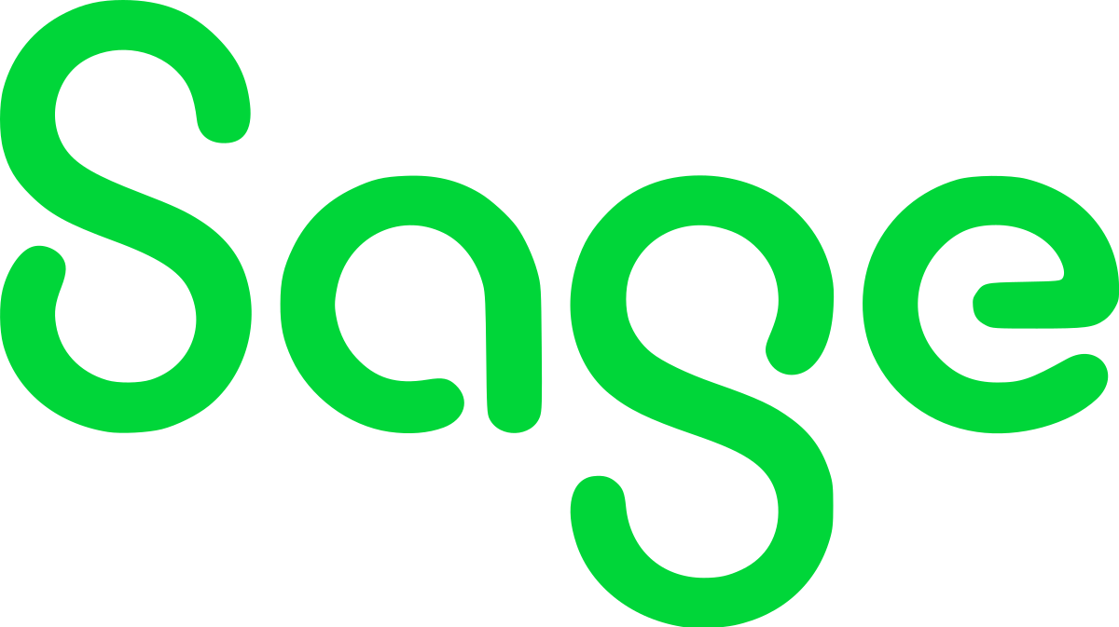

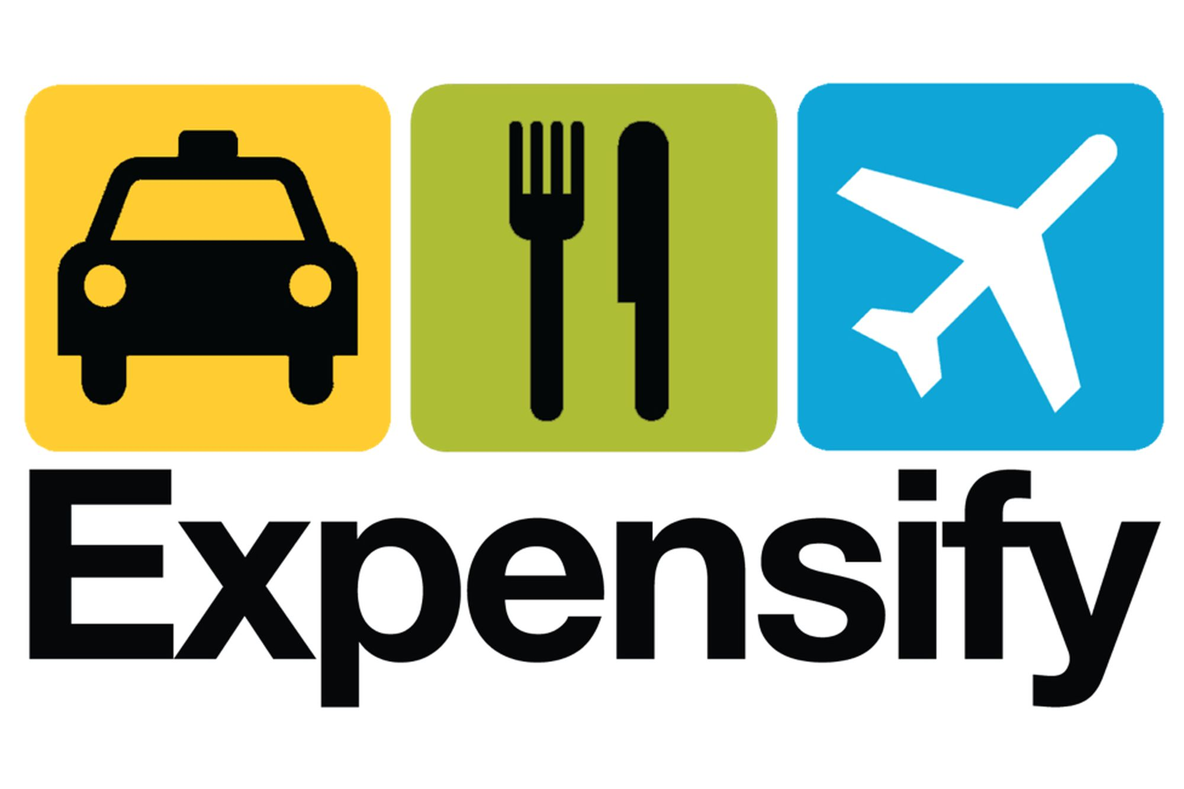
Time-Related Switching Costs and the Market
Bill.com’s AP and AR software, which integrated with accounting software, results in time related switching costs that cannot be replicated in other players or competitors in the payment processing market.
Time Related Switching Costs
How BILL’s Products Compares with Market
7 out of 10 vendors invited to Bill.com set up accounts with BILL to receive ePayments.
Allows SMBs to spend less time and money on organized accounting efforts.
Easier to manage AP & AR under one umbrella product, as switching to different software would mean training employees for different systems.
Using a new point of contact for different accounts (AP, AR, etc.) every step of the way when organizing expenses is cumbersome & results in a system predisposed to accounting and payment mistakes.
Business management services integrated with BILL.
Accounting software combined with BILL.
BILL offers same products, but with ability to invite vendors/customers.
AR
AP
Notes:
Expensify is a software company that develops an expense management system for personal and business use. Expensify also offers a business credit card called the Expensify Card.

Slide 28


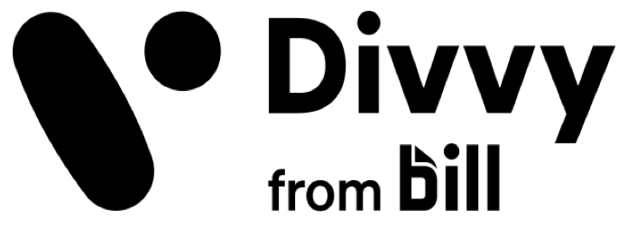
BILL Offers a Wide Variety of Switching Costs
Convenience Related Switching Costs
Customizing Related Switching Costs
The two-way sync (QuickBooks) and data integration features allow BILL to easily audit any expenses directly due to storage of prior transactions.
Attempting to use one platform for expenses and another for auditing makes it difficult for transactions to be kept organized and audits to conducted correctly if SMBs did not use BILL.
BILL offers customizable workflows, whether a user is a vendor, customer, etc.
Extremely convenient for businesses to easily set up operations and an easy payment service for all parties.
If users switched to another platform, customizable workflows would be almost impossible to recreate with seamless information flow, so SMBs would have information in numerous places at once.
Effort Based Switching Costs
Many companies turn to the Bill.com APIs to scale vendor payments with a minimal increase in accounting staff.
Switching would require new APIs to be constructed, resulting in a scale increase of effort and time for other payment based companies.
Divvy, Oracle, and Invoice2go integrations allow for unique, automatic syncing of invoices and payments.
Switching means an exponentially greater amount of effort must be placed into either manually syncing and filling out invoices or an increase of technicians to recreate those technologies.
“I think probably the biggest thing we would look for is to consolidate and save the subscription cost. So, you're paying a subscription cost for NetSuite, one for Bill.com, one for Expensify. We'd love to get rid of a subscription, if we could.”
- CFO at Data Management and Analytics Firm
Notes:
It’s not just fintech companies that use BILL. Other companies involved with other industries also use bill.
- Allows bill to scale up as SMBs also scale up due to an easier way to scale payments. Doing this manually would be virtually impossible.

Slide 29
Bill.com As A Whole
Through BILL’s strategic acquisitions and product/software integration with its platform, BILL accumulates switching costs exponentially to build a larger customer base and prevent users from switching platforms.
Time
Bill.com
Integrated AP & AR software.
Automatic two-way sync.
Convenience
Consists of all services essential to the back end financial value chain.
Data integration and conversion abilities.
Intelligent Virtual Assistant (IVA).
Customizing
Customizable workstreams.
Invoice2go.
15%
Effort
Divvy.
Oracle NetSuite, etc.

Slide 30
Valuation
Kevin Yang

Slide 31
Constant Assumptions
Revenue Build and Income Statement Assumptions
Income Statement Drivers
Breakdown of Customers in Base Case
Margins:
Service costs gradually decrease from 15% to 12%
R&D spending gradually decreases from 34% to 20%
G&A spending gradually decreases from 7% to 3%
Sales and marketing based on standard CAC
Revenue Build Drivers
BILL:
Customer retention rate gradually increases from 86% to 88%, Take rate: 0.13%
Divvy:
Customer retention rate gradually increased from 86% to 88%, Take rate: 3%
Interest Revenue from Funds:
3% of funds

Slide 32
DCF Valuation Summary
DCF Assumptions
11-year projection period
Terminal growth rate of 3% in all cases
Beta: 1.29
Risk Free Rate: 5.94%
WACC: 11.45%
Bear
-6.10%
Price target of $79.47
BILL customer growth rate steadily decreases from 35% to 20%, Divvy customer growth rate quickly decreases from 35% to 14%
BILL TPV steadily decreases from 8% to 2%, Divvy TPV steadily decreases from 10% to 3%
Base
+22.2%
Price target of $106.39
BILL customer growth rate quickly decreases from 35% to 25%, Divvy customer growth rate steadily decreases from 35% to 20%
BILL TPV steadily decreases from 8% to 4%, Divvy TPV quickly decreases from 10% to 5%
Bull
+58.5%
Price target of $133.81
BILL customer growth rate steadily decreases from 35% to 25%, Divvy customer growth rate steadily decreases from 45% to 20%
BILL TPV steadily decreases from 10% to 6%, Divvy TPV steadily decreases from 10% to 5%

Slide 33
Sensitivity Table
Return profiles for bear, base, and bull case

Slide 34
Income Statement

Slide 35
Balance Sheet

Slide 36
Cash Flow Statement

Slide 37
Questions?

