Slide 1

NexPoint
NYSE: NXRT
Katherine Chen, Tuhin Ghosh, Lila Melkumova, Hunter Peterson
SL: Gaurov Bansal
Financials, Fall 2023

Slide 2
Executive Summary
NexPoint Residential Trust, Inc. is a leading player in the multifamily Class B REIT space.
Company Focus
Value-Add Strategy
Real Estate Investment Trusts (REIT) focused on the acquisition, ownership, and operation of multifamily, value-add Class B properties in metropolitan cities throughout the Southeastern and Southwestern United States (Sunbelt region)
Targets properties with a value-add component for which life-style amenities can be added and improved, with a focus on workforce and middle-income housing
Potential to portfolio diversification for TBC
Seeks to identify properties where prior owners have failed to adequately invest, thereby providing the Company with the opportunity to increase rents substantially for minimal capital expenditure
Improvement types:
Exteriors and common areas (increases to useful life, landscape changes)
Interiors (appliances, kitchens, smart technology)
Costs (longer-lived materials, energy conservation)
Geographic Breakdown
Key Figures
40
$1,487
Properties
Average Monthly Rent / Unit
$83,175
$8,151
Average Household Income
Average Renovation Cost
All data as of May 2023
Subscription services is the fastest-growing segment (92% YOY), followed by fintech solutions (61%) and professional services (44%)

Slide 3
Deeper Dive into Strategy and Operations
Renovation and Improvement Capabilities
Includes improvements to exteriors, common areas, and interiors, as well as more effective cost management
Improves properties strategically, with a focus on areas where significant rent increases are feasible
Reserved ~$11.9M for value-add capex as of Dec. 2022, allowing 14,203 planned internal rehabs
Favorable Target Markets
Properties are concentrated within the Sunbelt region, which benefits from job growth and household formation
High costs of homeownership or Class A multifamily rental ($1,264 cheaper to rent on average in occupied markets)
Costs of building or replacing multifamily real property high and increasing
Value-Add Class B Focus
Targets units at a discount to replacement costs, where previous ownership has failed to make improvements
Value-add Class B present opportunities which can be achieved for relatively minimal investment, whereas Class A properties often lack improvement opportunities and Class C properties require significant expenditure
Effective Property Management and Advisors
The Company uses BH Management Services, LLC for property management and NexPoint Real Estate Advisors, L.P. for advisory services
The scale of BH enables competitive pricing to be achieved in relation to costs associated with value-add efforts, and NexPoint Real Estate Advisors is comprised of a highly experienced management team

Slide 4

Company Past, Present, and Future
NexPoint has a consistent record of acquisitions, renovations, and dispositions. The Company focuses on an attractive area of real estate in high-growth markets, providing significant runway to continue generating high returns.
Recent Events
Growth Drivers
Closed sales of Hollister Place in Houston and Silverbrook in Dallas in 2023, receiving equity multiples of 2.02x and 6.14x, respectively, with proceeds being used to pay down the Company's corporate credit facility
Completed 420 full and partial upgrades and leased 330 upgraded units during Q3 of 2023
Refinanced 19 properties in Q4 of 2022, increasing maturity date an average of over 7.5 years
Tailwinds to migration growth in Sunbelt markets such as cheaper housing and favorable job opportunities
Higher demand for rentals as consumers are increasingly precluded from homeownership and more consumers enter NexPoint’s target income market
Lack of Class B housing supply and fewer housing starts in target markets
Current Markets of Operation
Top 6 States by Units
State | Units | State | Units
Florida | 3707 | Texas | 3511
Arizona | 2009 | North Carolina | 1706
Georgia | 1692 | Tennessee | 1338

Slide 5




Management Quality
NexPoint has a capable and qualified management team with proven capital-allocation pedigree leadings its operations
The NexPoint management team fosters strong connections within the industry, maintaining a robust network of vendors, professional service providers, property managers, and strategic partners
President and Founder, James Dondero, has 27 years of prior experience working in the Sunbelt in the leveraged loan market at an Asset Management firm based in Dallas. His 12 years at NexPoint have augmented his platform further
NexPoint’s general counsel, Dennis Sauter, was previously a partner at a Dallas-based law firm and has experience working within the sunbelt and real estate specifically
Chief Investment Officer and MD of Real Estate at NexPoint has been in his position for over a decade, and in his tenure has led more than $2.5B of real estate investments
Strong track-record of capital allocation and ability to find the correct markets and has an empirical track record of strong value-add returns
Management Team
James Dondero
President
Brian Mitts
Chief Financial Officer
Matt McGraner
Chief Investment Officer
Matthew Goetz
Senior Vice President
Notes:
- Emphasize why cap allocation being good is important
Founder has lots of experience working in leveraged loan market in real estate vertical
- General counsel has worked in Texas all his life
- CIO has led more than 2.5B in RE investments

Slide 6
Industry Overview
Katherine Chen, Tuhin Ghosh, Hunter Peterson

Slide 7


Real Estate Investment Trusts
Owning, operating, or financing income-producing real estate properties
Own variety of assets such as residential apartments, commercial buildings, cell towers, hospitals, and more
Drive revenue from rental income, gains from sales of developed/refurbished properties, or interest income
REITs are split by industry(residential, industrial, etc.), asset class(equity, mortgage, etc.), and often region.
Within the commercial/residential vertical, REITs can be further distinguished by the quality of property it chooses to invest in: Trophy, Class A, Class B, Class C and so on.
Investment Qualities
Class A
<10 yrs, Premium
Professional Class, new or like new
Class B
<20 yrs, Average
Class C
Low/Moderate, limited/no amenities
Median Earners, dated, good condition
< 30 yrs, Dated
Trophy
<10 yrs, Luxury
Top income, best amenities
REITs distribute > 90% of taxable income as dividends, providing steady and attractive income stream
Distribution requirement reduces the tax burden on the REIT.
Provides investor with diversification potential coupled with 3.49% dividend yields on average for REITs
Must invest 75% of assets in real estate, cash, or treasuries
Industry Metrics
Current real estate market size estimated at $114T
CAGR of 4-5% until 2030
~35% of real estate is rent-based
Notes:
- Split by industry, asset class, and region. Type of residences as well
- Dividend yield is beneficial with NXRT’s at 6%
- RE isn’t going anywhere and will see growth in general

Slide 8
Class B Multifamily Real Estate Industry
Class B Properties Overview
Real-estate investment properties including apartment complexes and condos
Multifamily properties are evaluated on a Class A, B or C scale in terms of luxury, location and newness
Class B real estate is desirable because of stable demand and lighter capital needs
Stable demand: Located in areas with higher demand, Class A residents move to Class B in recessions
Low capital requirement: Class B real estate properties are in good condition, only light renovations needed
Trends in Class B Real Estate
Select Class B Verticals
The Class B Multifamily Real Estate industry has been on the rise.
Higher demand for Class B properties in times of economic recessions, provides downside protection
Class B rent growth outpaced Class A in 8 out of 11 recessionary quarters since 1999
In recessions, Class A residents “trade down” to Class B properties
Class B segment has shown consistently stronger performance compared to Class A
Maintained higher occupancies than Class A
Undersupply: new supply has been largely concentrated in Class A
Value Add: offer opportunities for improvement or enhancement to increase their value
NexPoint is one of the only REITs of its size specialized in Class B Value-Add. Offers greater returns and smaller quantity of properties
More considerable capital needs and higher risk than normal real estate income generation strategies
Opportunistic: high-risk, high-reward ventures that involve capitalizing on unique, time-sensitive situations or undervalued properties
Turnkey: fully renovated, ready-to-rent, or ready-to-sell real estate assets. They require minimal or no additional work or improvement
Notes:
- Say if recession happens, we’re good
- Renovations can be capital light while providing large future benefit in increased rent
- Trading down of class A to class B
- Ability to maintain high occupancy rates, with undersupply and movement of demand
https://www.globest.com/2022/09/06/are-households-trading-down-to-class-b-and-c-properties/?slreturn=20230928140612

Slide 9

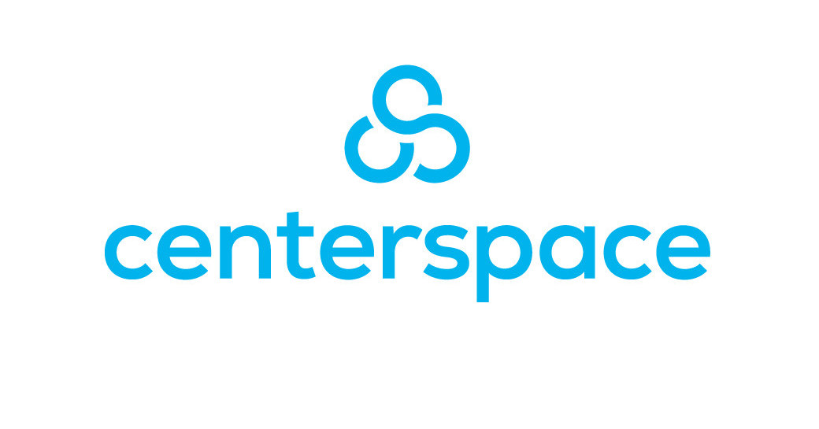


Key Players and NXRT’s Position
Many players in the REIT space diversified in both product and region, but NXRT is a primary player in its niche
Key Industries
Value-Add Real Estate
Largest REIT players are in
Industrials sector: due to pure valuation size of average industrial real estate and recent growth
Communications: including wireless infrastructure such as cell towers
Self-Storage: Public Storage is largest REIT, storage facilities near urban areas
Data Centers: growth driven by increasing data storage and processing needs from cloud
One of the fastest growing segment as data needs continue to grow
Residential: “classic” real estate investing, names like NexPoint and Avalon Bay. Split in further verticals as well
NexPoint does not compete directly with many REITs in both the residential industry and beyond since its focus is on the potential for value-add
Even within the residential space, players within the space are often not targeting the same properties on a constant basis
Value-Add vertical is separate from other sectors and does not often compete with other residential players
The Value-Add real estate relies on higher leverage for higher returns. Forecasting higher, yet more unpredictable cash flows following remodel
NXRT achieves 22% Value-Add ROI
Notes:
- By not focusing on turnkey, NXRT doesn’t face competition from big players.
- Higher than competitors

Slide 10
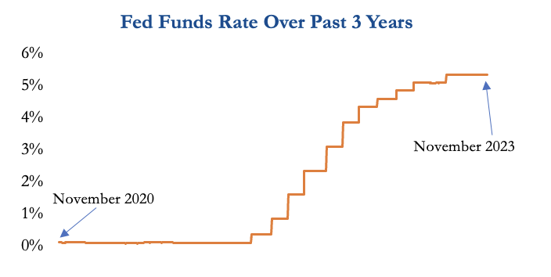
Capital Barriers to Entry
High entry costs due to rising interest rates and land prices shield NexPoint from competition.
Entry Costs
Significantly Larger Land Costs
Borrowing has been made more expensive given the current interest rate environment, which forces real estate acquirers and developers to fund acquisitions and development with debt that requires a higher interest burden
Further, the price of raw land in Sunbelt has increased significantly over the past decade due to heightened residential and commercial demand in the region, further depressing the profitability of new development in the region
There are a limited number of companies that can achieve acceptable ROI figures given these higher upfront capital costs, which serves to shield NexPoint, which already has a significant presence in the Sunbelt, from new entrants
NexPoint does not require additional acquisitions to generate additional income but can instead focus on performing value-add on additional properties and rental income from existing tenants
Fewer competitors over the investment horizon insulates NexPoint’s income generation capacity and tenant base from erosion by other firms
Heightened Interest Rates

Slide 11
Inaccessibility of Home Ownership and Class A Rentals
Value-Add Class B assets appeal to consumers who are increasingly unable to afford more expensive options.
Prohibitively High Costs
Increasing Costs of Home Financing
Homeownership and rental of higher-end Class A property has become increasing unaffordable for the average American consumer in recent years
Individuals who are precluded from buying homes are referred to as renters-by-necessity, with many renters of Class B properties fitting this description
Renters of Class A properties are typically considered renters by choice, meaning that they have the option to purchase a home but opt not to do so. This implies that many of the same individuals who are unable to afford to own a home are also priced out of Class A properties
Renters by necessity do not possess the flexibility to easily shift housing arrangements, thus making these consumers stickier as renters
While Class A rentals are more susceptible to economic fluctuations given the luxury nature of the rental offering, Class B rentals do not experience the same level of disruption given that consumers are not purchasing housing as a luxury
Tighter lending standards serve as another barrier preventing would-be buyers from obtaining mortgages
The majority of Americans (67.5%, or 96 million households) can afford to live in a NexPoint community, with the household income of the Company’s target renter spanning between $45k to $135k. With many of these Americans being priced out of the home-buying market, NexPoint ensures steady demand for its offering
2008
2013
2023
Income Compared to Home Prices and Mortgage Payment

Slide 12
Favorable Positioning and Supply / Demand Dynamics
NexPoint capitalizes on favorable supply / demand dynamics and positioning of value-add Class B assets.
In the Sunbelt, housing demand from working-class consumers has lagged higher-income workers but is growing as more companies relocate to the region. Supply constraints limit the amount of new housing that can be created to meet this demand, placing NexPoint in a strong position to capitalize on these favorable dynamics
This positioning also means that the Company is relatively insulated from both economic booms and recessionary environments: in a recession, the loss of current tenants to Class C housing would be offset by an influx of Class A renters into Class B, while any loss of tenants to increased income in growth periods would be accompanied by an increase in demand for Class B housing by formerly Class C renters
Sunbelt Class B Supply Dynamics
Insulated in Both Recessions and Periods of Growth
Higher-income individuals (Class A renters) comprised the initial migration into the Sunbelt region. Combined with the more lucrative nature of Class A development, the development of Class A properties has largely outpaced the development of Class B properties in the Sunbelt
Middle and working-class individuals continue to migrate to the Sunbelt to take advantage of increasing job opportunities in the region, most of whom are or will be seeking Class B offerings
Given the current interest rate environment, it will be difficult to finance projects for the development of new Class B properties, thereby constraining supply and allowing NexPoint to benefit from the combination of a high demand for its properties and limited competition as an incumbent in these markets
Recession
Class A
Growth
Class B
Class C

Slide 13
REITs in a Rising Interest Rate Environment
REITs’ underperformance in a high-rate environment is a misconception.
Traditional View
Empirical Data
The traditional view is that rising interest rate correlates to poor REIT returns.
High interest rate poses challenges to REITs:
Decreasing value of properties
Increasing REIT borrowing costs
Riskier asset class compared to fixed-income low-risk financial instruments
Overall uncertainties in the economy
REITs can benefit from rising rate environment
These environments create opportunities for significantly higher rent
Dividend growth exceeds rate of inflation
Strong empirical data supporting this view
In past high-rate environments, US REITs have earned positive returns and outperformed stocks
REIT income consistently outpaced CPI
As shown by empirical data, rising rates and REITs are not oppositely correlated. In general, the market is overtly-pessimistic about US REITs in a rising rate environment.
Notes:
https://www.spglobal.com/spdji/en/documents/research/the-impact-of-rising-interest-rates-on-reits.pdf
We also want to briefly touch upon US REIT performance in a rising interest rate environment. In a rising rate environment, the market typically expects REITs to underperform. This is true to a certain extent, and increasing interest rate does pose challenges to REIT businesses, such as decreasing property valuation, increasing borrowing costs and lowering investor confidence.
However, empirical evidence has suggested that it is possible for REITs to benefit from rising interest rates. According to a study published by S&P Global, rising interest rate is typically correlated with stronger economic growth and heightened demand for real estate, creating opportunities for REITs to grow their rental income and NOI. There is strong empirical data supporting this view too. Since 1970s, the US has experienced 6 periods where high interest rate sustained. In 4 out of 6 of these periods, US REITs on aggregate made positive returns, and in 3 of these periods, US REITs have outperformed the US stock market.
Therefore, we don’t necessarily see the high interest rate in the current market as an indicator of REIT underperformance, since we don’t see them as negatively correlated. If anything, we expect the probability of REITs moving higher to be more likely than what the market thinks, which presents an attractive investment opportunity.

Slide 14
Thesis Overview
Thesis I: Sunbelt’s High Potential Market
NexPoint’s focus on operating and renovating properties in the Sunbelt region has allowed for optimal positioning to take advantage of current hot housing markets
Migration of people, especially those in NexPoint’s target segment being young and more likely to move, from larger cities and to Sunbelt cities/states has increased rapidly in the last few years and will continue to flourish.
Movement to the Sunbelt also extends to companies including financial firms moving capital and employees to Southern states with better growth prospects & tax benefits
Thesis II: Value-Add Program
NexPoint’s value-add program increases property valuation and has empirically had a greater increase on property value compared to its competitors
The firm’s partnership with BH Management Services empowers its exterior and interior value-add strategies by seeking industry expertise on investment decisions
NexPoint’s ability to perform value-add renovations so successfully allows it to focus on stabilizing properties and lays the foundation for the market mispricing
Market Mispricing
NexPoint has traded down along with other REITs as rates have risen over the past several years on the premise that higher rates entail more expensive debt burdens
This fails to consider the substantial number of non-stabilized assets that NexPoint currently has, which has and will continue to allow NexPoint to focus on performing value-add as opposed to acquiring new properties, which is more expensive
Higher capital costs also benefit NexPoint by imposing entry barriers into NexPoint's markets, which allows NexPoint to leverage economies of scale to capture market share

Slide 15
Thesis 1: Sunbelt’s High Potential Market
Tuhin Ghosh

Slide 16
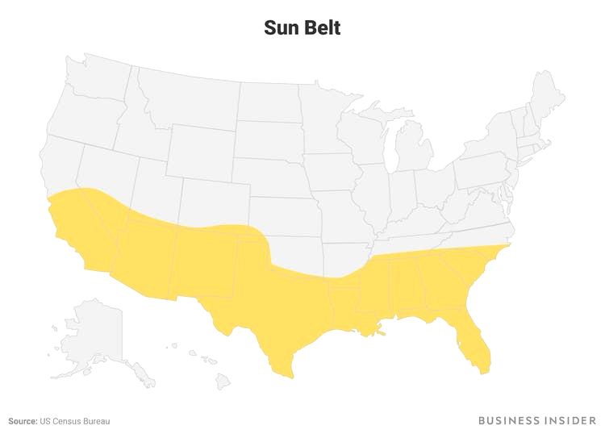
Sun Belt and High-Growth Markets
Attracting Residents Seeking Rentals Post-Pandemic
Population Moves
Worker migration from large cities to the South/Sun Belt after the pandemic brings business opportunities and expands the target customer population in this area.
Domestic migration brought over 1.3 million residents to the South in 2022, according to agency data.
9 out of top 10 hottest housing markets in 2023 are in the Southern US
Increasing portion of younger population moving to the South for cheaper housing & low/no state income tax
The Sun Belt (10y Pop. Growth)
Moving Patterns of people aged 25-39
1
9
2
8
2
8
7
5
9
6
1
3
5
3
6
7
4
1
29%
2
24%
3
21%
5
20%
1
11,284
2
6,241
3
5,561
4
4,186
6
20%
7
20%
8
17%
9
17%
17%
5
3,808
6
3,235
7
2,997
8
2,873
9
2,802
Notes:
- Worker migration due to pandemic has moved the labor to the south, and provided further business opportunities in the sunbelt
- 1st image is top 10 highest population growth over the last 10 years of which the sunbelt has 9 of the fastest growing
- 2nd is moving patterns of NXRT’s target age group which are also largely concentrated in the sunbelt

Slide 17
Growth in Major Sun Belt Markets
Exploring Potential in Key Cities located primarily in Texas and Florida
Example 1: South Florida
Example 2: Dallas
Top 10 most populous metropolitan areas
Adding ~17,500 residents per year, seeing 2% growth between 2020-2023
Includes cities such as Miami, Fort Lauderdale, and West Palm Beach
Highest net migration of any US state in 2021-2022
Grew 2.2% in 2022 while NY, LA, and Chicago experienced population loss
5th fastest-growing economies out of top 50 US metropolitan areas
Local rate of job gain: 3.8% for August 2023 compared to National rate of 2%
Added 26,000 jobs in Business Services in Aug’ 23
South Florida Growth
Overall Population Growth
NexPoint owns a significant # of properties in 4 out of the 5 counties
Notes:
- Just a more specific look at two markets where NXRT has heavy presence
- South Flor has highest net migration. No state income tax
- Dallas has one of the fastest growing econs and business migration
https://www.bls.gov/regions/southwest/news-release/areaemployment_dallasfortworth.html

Slide 18
Attracting Large Firms from HCOL Areas
Tech and Finance companies are moving to the Sun Belt
Notable Moves within Finance Industry from NY and West Coast
From 2019 to August 2023, 158 investment firms have relocated headquarters out of New York
104 of these firms moved to Florida motivated by desires for LCOL and lower taxes
Range of incentives offered, including tax refunds, tax credits, tax exemptions, and grants, designed to encourage job creation, capital investment, and economic growth.
Economic development process involves partnerships between DEO, EFI, and other agencies, emphasizing transparency, accountability, and due diligence to protect taxpayers' investments while attracting and retaining businesses in the state.
Texas received the most firms from the West Coast, most notably Charles Schwab moving HQ from SF to Dallas. While NY is still the frontrunner for HQ locations, the Sun Belt is attracting businesses and their workers
NXRT Holdings in the Sunbelt
Focused on properties in Southeastern and Southwestern US
High cost of homeownership and class A multifamily rentals
Driving people(especially younger population) to Class B, value add where NXRT specializes
Own 40 multifamily properties: 15,127 units
11 markets in 7 Southern States
Average effective rent: $1,497
Diversification of regions allows for geographic insulation and greater protection from location-specific catastrophes
Notes:
- Looking more at the businesses side of things
- Financials services have been moving with billions of dollars moving out of NY and SF to Sunbelt
- LCOL and lower taxes. Charles Shwab is notable big name. Still potential as vast majority are still HQed in NY
- NXRT low rents not only attracts those moving away from Class A but also potential for margin expansion down the line
https://www.fastcasual.com/companies/showcases/toast/products/reporting-analytics/

Slide 19
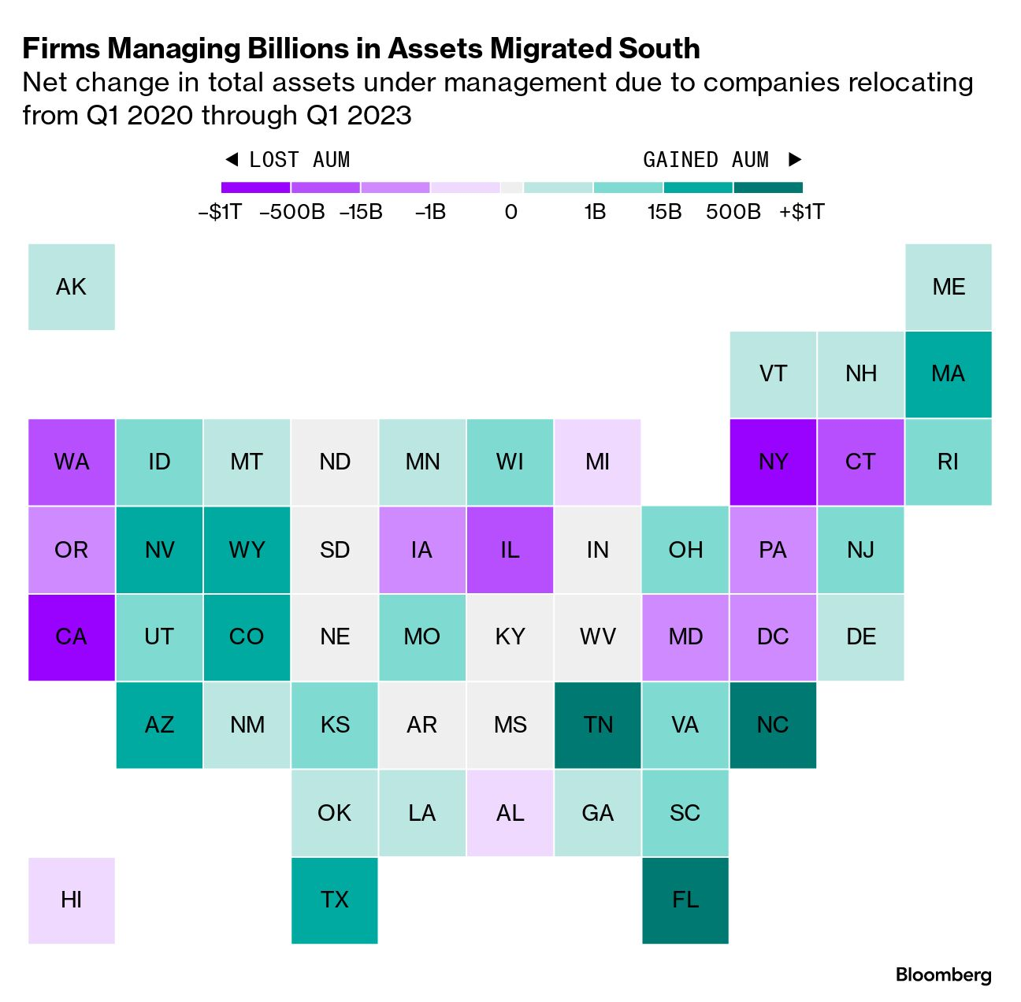
Potential for Future Growth
Large number of firms still in NY and SF provide potential for future movement as well as future commercialization
Commercialization of up-and-coming cities
Future migration of companies
Full commercialization of growing cities like Tampa, Nashville, and Raleigh has yet to come to fruition
Austin, for example, is very promising for job growth and firm presence; Silicon Hills
Educational opportunities at top tier institutions attracts top talent pool
Companies respond by following talent which is cheaper than NY or similar hubs
Positive feedback loop encouraging modernization which feeds into labor expansion
New York: more than 250,000 have headquarters in NY and 43 of the companies in the S&P 500
Over 35% of employment income comes from financial services and ~350,000 individuals
25% of the working population is <29 yrs old
San Francisco: close to 35,000 employers in SF with close to 650,000 employed
Large portion of firms in tech industry which is tending to migrate south (Texas).
Strong Education Opportunities
Post-Secondary Education: strong universities such as the University of Texas system, Rice, Texas A&M, Duke, Vanderbilt, UNC, Emory,
Around 20% of the top universities are in the sunbelt and make up the biggest in the US
Secondary and Primary:
States like Texas and Florida have large number of students passing through successful schools
Notes:
- Future potential in Texas, Tennessee and NC. Educational and professional opps
- Income is focused in fin services sector, so further predicted migration of them will move the money to the Sunbelt
- 25% of working pop is <29. NXRT targets >29 too, but majority is <29
- From pic, FL, NC, TN, and TC are some highest gainers

Slide 20
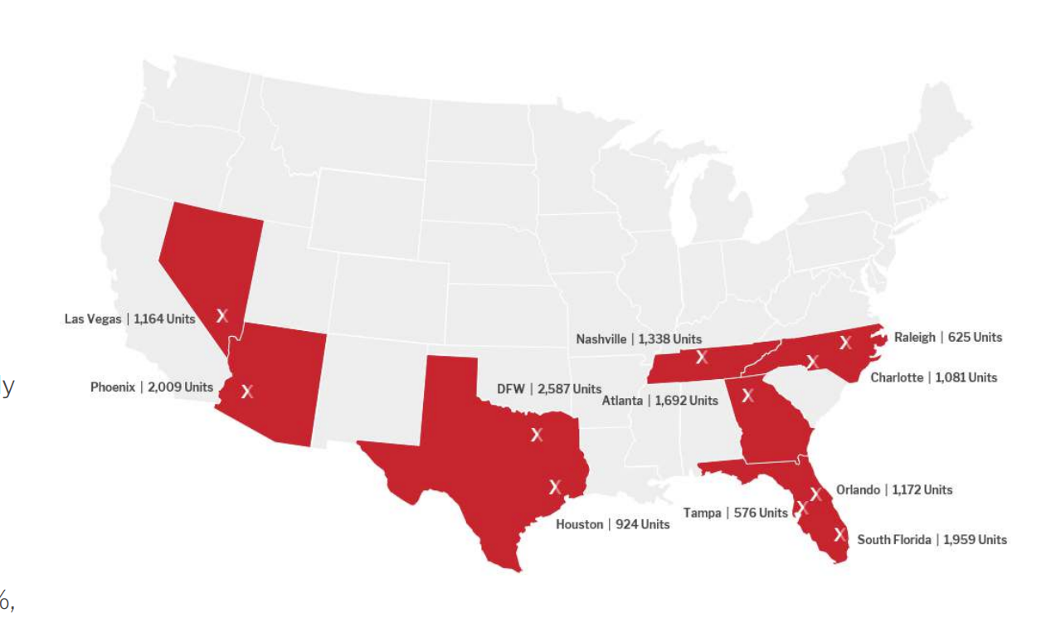
NXRT Sunbelt Holdings
NXRT’s holdings are concentrated in areas of high growth with great potential for increase in population and renters in young target segment
Notes:
- Greatest Holdings by state are in Texas and Florida, with Dallas having the most of any city followed by Phoenix then South Florida

Slide 21
Thesis 2: Value-Add Program
Katherine Chen

Slide 22
Value-Add Program At A Glance
Nexpoint employs a value-add program in most of their acquisitions
Value-Add Program Overview
Three-tiered Value Add Program
Goal: purchase under-managed assets in high demand neighborhoods, invest capital into value-add renovations, increase rent/NOI
As of December 31, 2022, Nexpoint completed renovations in 7,633 units out of 15,127 units owned
Since inception, the Company has completed 8,127 full & partial, 4,914 kitchen and laundry appliances, and 10,423 technology packages
Value-add renovations typically take place within three years after property acquisitions
Interior Value-Add
Primary driver of rent and NOI growth
Invested in better interior amenities and aesthetics
i.e. aesthetic design improvements, replacement of outdated appliances, smart technology
Exterior Value-Add
Secondary driver of rent and NOI growth
Extend building lifetime and improve aesthetics
i.e. exterior design improvements, redecoration
Management and Cost Improvements
Investments in strategic initiatives such as energy conservation projects and longer-lived materials
Partnership with BH
Partnership with BH Management Services, an external property manager located in Iowa
BH is a non-controlling limited partner
Outsourced leasing and operation to BH; used BH’s market insights to inform investment decisions and value-add strategies
Notes:
Onto our second thesis point about value add. NexPoint has a unique value-add program where it aims to improve and increase value of acquisitions. They do so by acquiring solid but under-managed assets and investing in value-add renovations, which would then increase rent and NOI. As of the end of 2022, Nexpoint has completed renovations in over half of their properties, and most of the value-add takes place within three years after property acquisitions.
They primarily engage in three types of renovations: interior, exterior and cost management, with interior renovations being the primary driver of rent and NOI growth. Some examples of these renovations include investments in better, more modern amenities and overall aesthetic improvements. For instance, NexPoint would invest in building fiber internet infrastructure for older apartments, building more renovated and functional common areas in buildings, and investing in energy conservation projects.
The specifics of the value-add program is managed by Nexpoint’s external contracted partner, BH Management, which is a property manager and a non-controlling limited partner in NexPoint, owning around 0.3% of NexPoint. BH Management would help NexPoint with operating the properties and would also advise NexPoint on certain investment decisions. Currently, NexPoint pays a management fee to BH Management equal to around 3% of monthly gross income, in addition to other one-off management fees.
Sources: Company Website, 10-K

Slide 23
NexPoint Value-Add Program
NexPoint’s value-add Class B focus and extensive renovation capabilities provide a competitive advantage.
Given the luxury nature of and additional amenities associated with multifamily Class A assets, a higher price is demanded for these assets relative to value-add, multifamily Class B assets.
Further, value-add Class B allows for differentiation to be achieved through renovation and improvement processes on the part of the acquirer, whereas fewer opportunities for value-add exist in Class A
Relative to Class C assets, which require significant capital expenditures to complete value-add opportunities, value-add Class B properties require relatively less upfront investment to achieve returns
The expertise and processes employed by NexPoint’s property manager, which relies on making improvements to several aspects of a property, presents a barrier to entry, as a specialized skillset is required to successfully renovate and generate returns from value-add Class B assets in this way. NexPoint’s operations across many cities within the Sunbelt also allow it to spread the costs of an improvement team over more renovated units, thereby allowing it to achieve more favorable cost dynamics than potential new entrants
NexPoint’s expertise is evidenced by its track record of consistently generating higher ROIs than competitors
NexPoint’s Capabilities
Exteriors
Interiors
Costs
Useful Life Extension
Kitchen and Bath
Washer and Dryer
Longer-Lived Materials
Landscape and Signage
Appliances and Fixture
Smart Tech
Energy Conservation
Common Areas
Private Yards
Fiber Internet
Management Style
Notes:
We think the value-add program works well for NexPoint given its focus on Class B properties and its partnership with BH Management.
First, Nexpoint’s focus on Class B can achieve higher ROI compared to Class A and Class C. Class B properties sit between Class A and Class C in terms of renovations and qualities. Compared to Class A properties that are fully renovated, Class B properties have significantly higher upside because their valuation can benefit from value-add, but they also don’t require as much upfront investment in renovation as Class C would need, since Class C properties are typically older and less furnished. The relatively low upfront capital investment and the potential upside combined make Class B properties attractive in terms of ROI for a value-add REIT like NexPoint.
In addition, Nexpoint can also leverage its scale and partnership with its external property manager. BH Management is the largest property manager in Sunbelt and can provide valuable industry insights. Given their scale and presence in the Sunbelt market, BH Management can also negotiate better deals with suppliers and spread costs over more renovated units. The cost advantage effectively protects NexPoint from new market entrants. This is a strong moat because both parties are leading players in their fields and benefit from this partnership. Not only does Nexpoint benefit from BH Management’s industry insights, Nexpoint is also BH Management’s largest client and consistently brings in opportunities and revenue for BH. We expect to see this partnership continue and more economies of scale to be achieved.

Slide 24
Financials of Value-Add Program
Value-Add Program Results
Financial Results
Nexpoint’s value-add strategies have been proven effective through its growing NOI, net retention rate and rental price.
Total rental income for FY2022 was $257.9 million, an increase from $213.5 million rental income from FY2021
Growth is mostly driven by value-add campaign and a 17.4% increase in the weighted average monthly effective rent per occupied unit
Empirically, renovation investments have consistently achieved strong ROIs
Partnership with BH Management allows for:
Industry expertise (106,000 multifamily properties, 30+ years in the industry)
Scale allowing for highly competitive pricing for value-add, increasing ROI
As of December 31, 2022, NXRT reserves $11.9m for financing value-add renovations
Value-add renovations do not need significant debt financing
Notes:
From a financial perspective, NexPoint has generated high ROI on renovated units through increasing rental income. In the last fiscal year, total rental income on properties increased by $44 million dollars, which is mostly driven by a 17.4% increase in the weighted average monthly effective rent per occupied unit. On average, Nexpoint and BH reserve anywhere between $3,000 to $7,000 per unit for renovation. After renovation is performed on a NexPoint property, the average monthly rental price increases by $149 in the past year. On the right, you can also see a graph on ROIs achieved through different types of value-add renovations. Anecdotally, property owners have also reported positive experience collaborating with both NexPoint and BH Management,

Slide 25
Market Mispricing
Hunter Peterson

Slide 26
NexPoint Grouped With Non-Value-Add REITS
NexPoint’s substantial capacity to perform value-add on its existing base of properties is underappreciated by the market.
NXRT vs. S&P SmallCap 600 Real Estate Index
NexPoint’s Extensive Value-Added Capabilities Enable Avoidance of High-Rate Debt
REITs require an extensive amount of capital to make acquisitions and develop property, which implies that REITs are especially susceptible to the interest burden seen during high interest rate environments
However, the extent to which a REIT must borrow additional funds to conduct its operations depends largely on the strategy of the REIT in question, as REITs which focus on developing new property or acquiring property without a value-add component are heavily reliant on continuously deploying capital to invest in new assets
In contrast, value-add REITs such as NexPoint have an additional level to pull to ensure consistent income generation in that they can perform value-add on existing properties without being forced to acquire new properties. Higher financing costs also allow disincentivize new entrants, thereby allowing incumbents in high-growth markets such as NexPoint to capture market share.
This significantly reduces the future interest rate burden on NexPoint relative to REITs which lack value-added capabilities, thus making a direct comparison inaccurate.

Slide 27
Long Runway for Value-Add At Low Leverage
NexPoint’s extensive portfolio of non-stabilized properties provides a means of managing an elevated rate environment.
Non-value-add REITs generate returns through acquiring or developing properties. In an environment with higher interest rates, such firms are forced to finance operations with more expensive debt or scale back operations
While NexPoint is also negatively impacted by higher rates, it also has an extensive portfolio of non-stabilized assets for which value-add has yet to be performed, with only 9,914 of its 15,127 units receiving value-add treatment thus far
The extensive value-add opportunity for NexPoint means that the firm has been and will continue to focus its capital on improving its existing properties as opposed to being forced to acquire new properties
Given the nature of the firm’s value-added initiatives, which involve changes to property features such as home interiors and appliances, they will require significantly less capital to successfully perform value-add than other REITs will require to acquire or develop new properties. Further, according to an expert interview with a real estate professional, the stabilization of units tends to reduce leverage over time
We expect that this will be reflected in the share price over the hold period as NexPoint reports better results than other REITs due to the existing value-add runway
Significant Value-Add Opportunity
State | Total Units | Rehabbed Units | Total Minus Rehabbed
AZ | 2009 | 971 | 1038
FL | 3707 | 2430 | 1277
GA | 1692 | 1417 | 275
NC | 1706 | 1004 | 702
NV | 1164 | 138 | 1026
TN | 1338 | 712 | 626
TX | 3511 | 3242 | 269
Cost Advantages of Value-Add
$4,759
$101,894
Average Rehabilitation Expenditure per Unit
Average Purchase Price per Unit

Slide 28
Higher Capital Costs Create Entry Barriers for Competitors
NexPoint can take advantage of Sunbelt incumbency and value-add program to maintain and grow market share.
To acquire or develop properties, real estate firms must rely on more expensive debt due to the higher interest rate environment, which increases interest expense and reduces ROI and thus imposes entry barriers on new entrants
This dynamic has and will preclude new firms without a Sunbelt presence from meeting the growing demand for class B housing in the Sunbelt as middle- and working-class Americans enter the region
As one of the larger existing multifamily Class B providers in Arizona and Nevada, NexPoint is particularly well-positioned to continue capturing share in these markets due to the combination of new entrants being excluded, its differentiated value-add program and consistent generation of higher ROI on value-add, and ability to leverage its existing presence and infrastructure within these states to achieve economies of scale, all of which allow the Company to fare the best after a period of sustained rate hikes relative to other real estate firms in these markets
These dynamics will be reflected in the stock price during the investment horizon through a greater number of NexPoint units coming online relative to competitors and new entrants
Sunbelt REITs in AZ and NV Multifamily Class B
REIT | AZ Units | NV Units
MAA | 2,968 | 721
CRT | 4,029 | 0
IRT | 0 | 0
NXRT | 2,009 | 1,164
BRT | 0 | 0
Comparison on ROI for 2023 Value-Added Properties
NXRT
IRT
21.2%
Q1
17.8%
20.9%
Q2
16.2%
23.6%
Q3
14.2%
Note: ROI is defined as the sum of the actual rent premium divided by the sum of the total cost.

