Slide 1
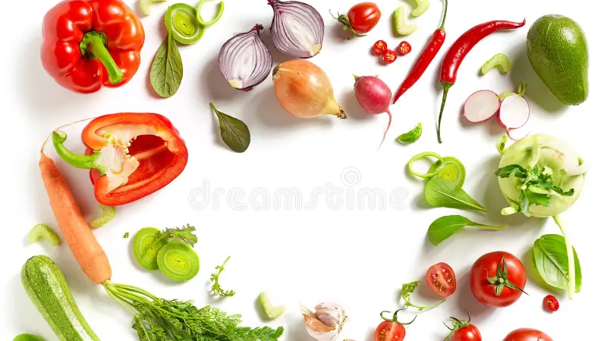


Slide 2
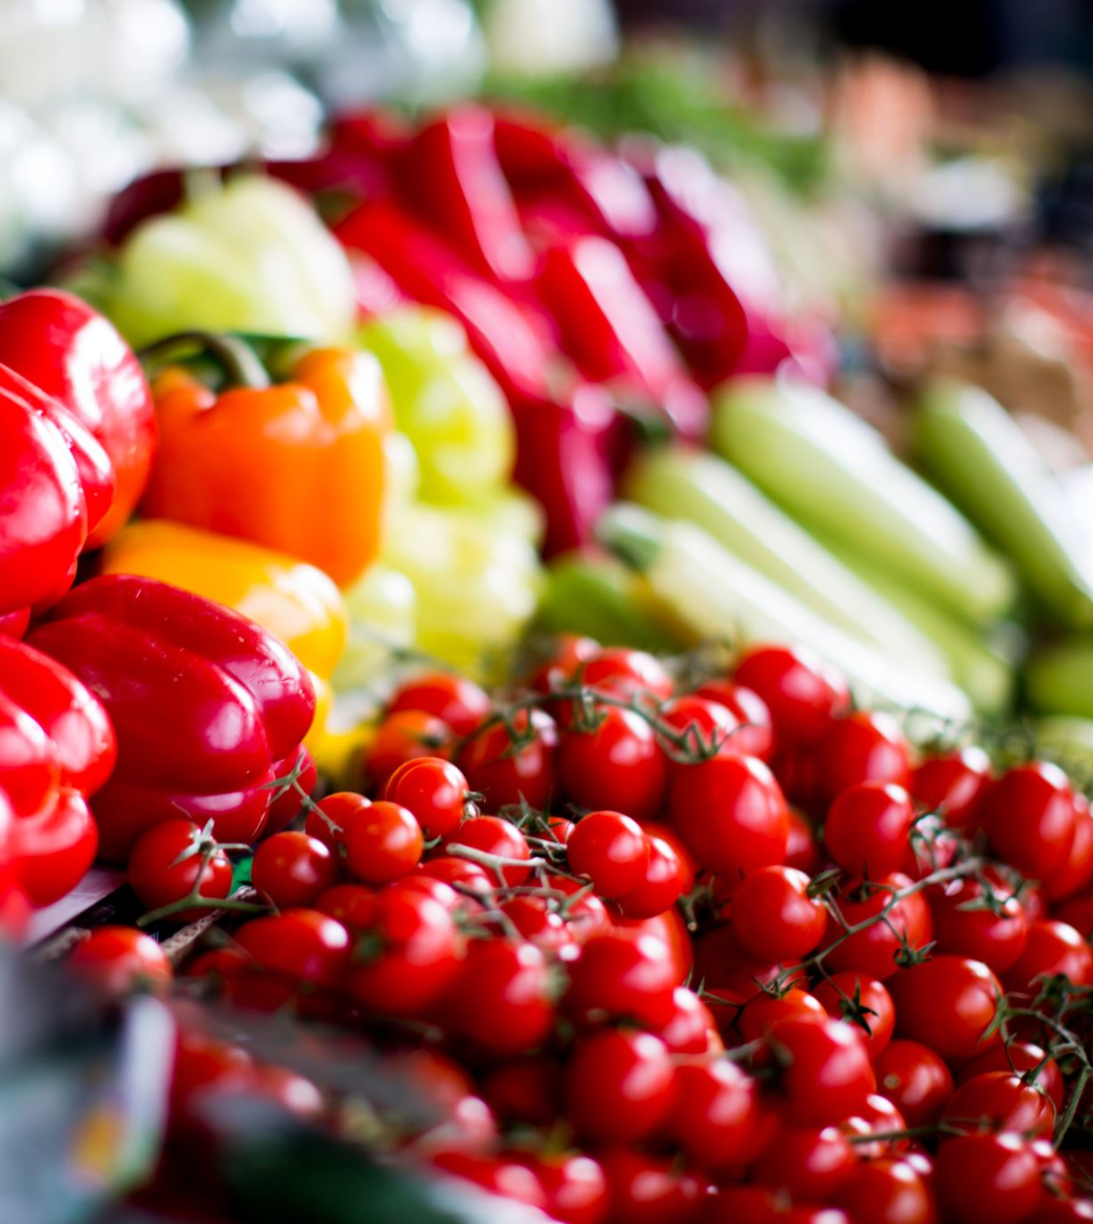
PROJECT INTRODUCTION
The vegetable market in Noida plays a crucial role in meeting the nutritional needs of its residents. This project aims to conduct a comprehensive analysis of the vegetable market in Noida, shedding light on various aspects that contribute to its functionality and impact on the local community.

Slide 3





TEAM INTRODUCTION
ASHA
HARSHIT
LAKSHYA
ADITYA
NAMAN

Slide 4
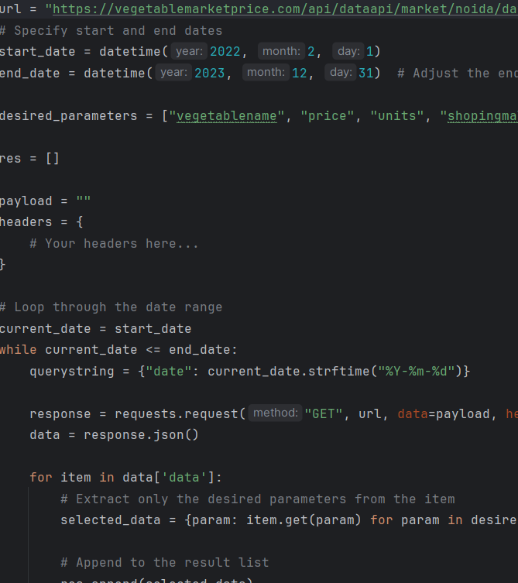
EXTRACTION
Data extraction serves a pivotal role, particularly when faced with the intricate task of obtaining data datewise. To overcome this challenge, we strategically leveraged APIs for a seamless and efficient extraction process.

Slide 5
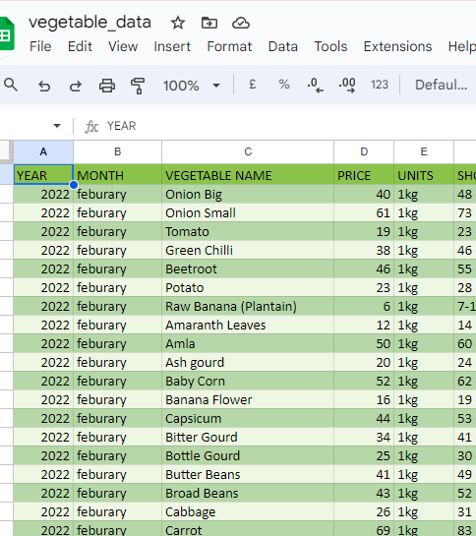
CLEANING
Post-extraction, the pivotal phase of data cleaning becomes imperative, given the raw nature of the data. In navigating this process, we employed the versatile functionalities of Excel, leveraging its robust tools to enhance data quality and refine its integrity. This meticulous cleaning procedure not only streamlines the data for analysis but also ensures its accuracy, paving the way for more informed and reliable insights.

Slide 6
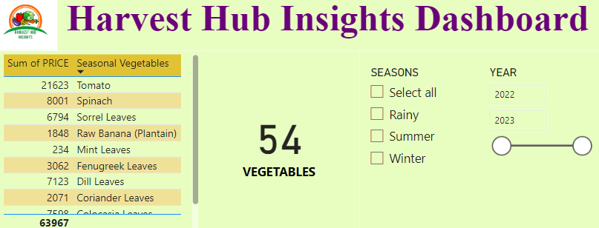
VISUALIZATION
Transitioning to the visualization phase, we harnessed the refined data to create compelling and insightful visual representations. Through the integration of advanced visualization tools, such as [mention specific tools if applicable], we transformed the cleaned data into visually appealing charts, graphs, and dashboards. This approach not only facilitated a comprehensive understanding of trends and patterns but also enabled stakeholders to grasp complex information briefly. The visualization component served as a powerful medium for effective communication, aiding decision-making processes and fostering a deeper understanding of the underlying data dynamics.

Slide 7
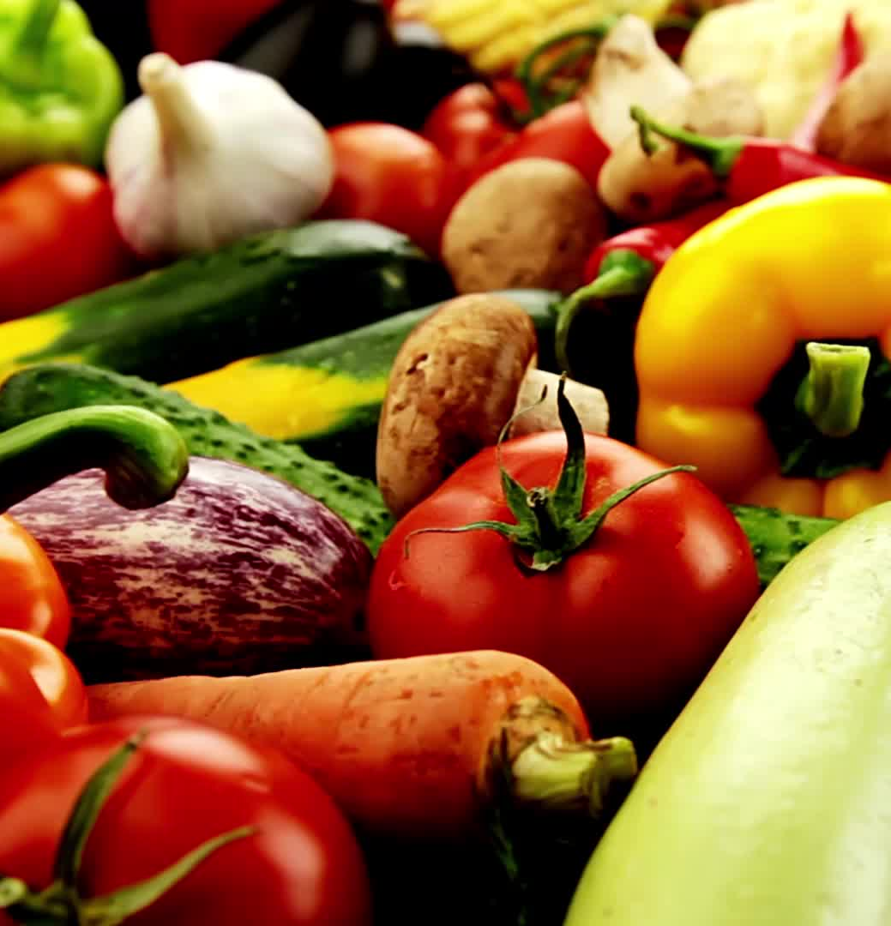
INSIGHTS
What was the average monthly price of each vegetable in the Noida Vegetable Market between 15th March 2022 and 31 December 2023?
Using the data available on the above website, can we identify any differences or similarities in the prices of vegetables in Noida Vegetable Market and nearby located vegetable markets, and what could be the possible reasons for such variations in prices?
What are the seasonal vegetables in Noida Vegetable Market and nearby markets based on their prices?
For a family with a low-income group, middle-income group, and high-income group what would be the total cost of a vegetable basket containing at least 2 seasonal vegetables, 1 non-seasonal vegetable, some potato, some onion, and others?
How do the prices of the vegetable basket change over time for each income group?

Slide 8
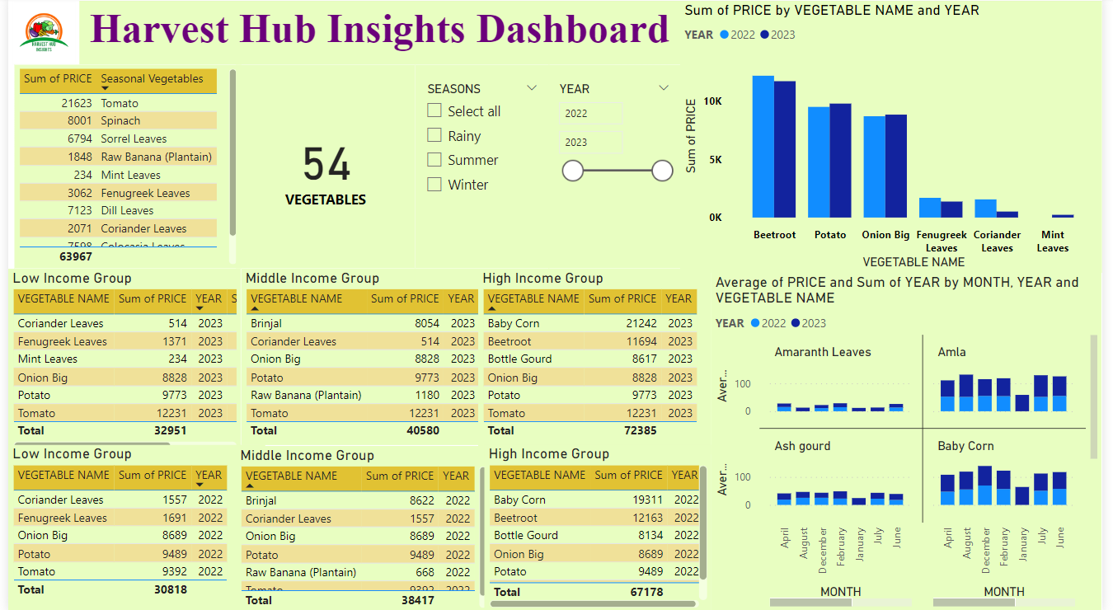

Slide 9
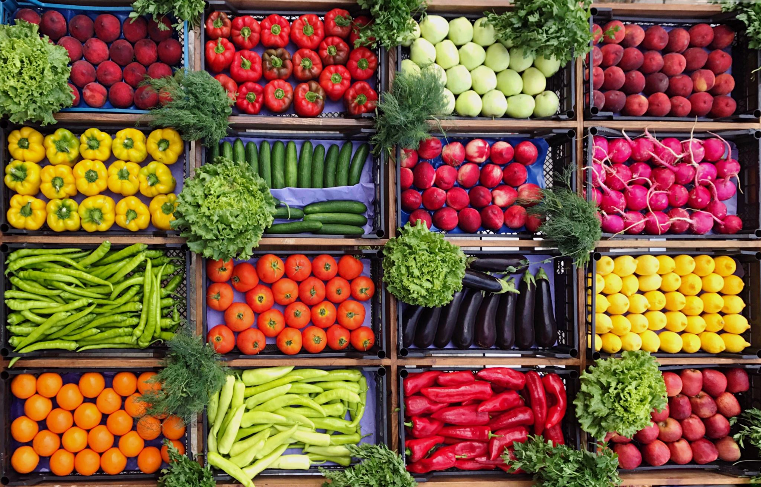
Case Study on Quick Commerce Vegetable Business in Delhi
Insights for Quick Commerce Vegetable Business in Delhi:
Market:
Substantial market size driven by population and demand for convenient fresh produce.
High growth potential due to increasing online shopping trends.
Competition:
Dynamic landscape with e-commerce giants and specialized startups focusing on fresh produce.
Challenges:
Time management for timely delivery without compromising quality.
Quality control to maintain freshness.
Building and maintaining customer trust and regulatory compliance.
Success Factors:
Efficient logistics for quick and reliable delivery.
Quality assurance for fresh, high-quality vegetables.
Customer engagement through excellent service.
Partnerships with local farmers for a diverse supply.
Technology:
User-friendly platforms for ordering and tracking.
Data analytics to understand customer preferences.
IoT devices for real-time monitoring.
Digital payments for a seamless transaction experience.
Conclusion:
Significant potential with a focus on efficient operations, quality, customer engagement, innovation, and technology.
Addressing challenges related to logistics, quality control, and customer trust is crucial for sustained success.

Slide 10

CONCLUSION
Examination of vegetable price data in Noida and neighboring markets revealed substantial price fluctuations for both seasonal and non-seasonal vegetables.
These price fluctuations can be linked to factors including transportation expenses, supply and demand fluctuations, and government regulations.
Notably, low-income households experienced a more pronounced impact, with an average inflation rate of 5% recorded during the study duration.
Overall, this analysis highlights the complexity of vegetable pricing dynamics and underscores the need for targeted policies to mitigate the financial burden on vulnerable households.

