Slide 1

A mini project on
Vidya: Multilingual Financial News Sentiment Analysis System using FinBERT
Project Guide: Prof. Naresh Shende
SR.NO | Name | Roll No
1 | AADESH MAHESH ANGRE | 702
The start page: choose a language
Notes:
Introduce the project: Vidya reads financial news in the reader's own language, labels it with a language model and explains why.

Slide 2
ABSTRACT
Most tools that read the mood of financial news work only in English and give just a score.
Vidya reads news about 100 listed Indian companies and labels each headline positive, neutral or negative, with a confidence score and a plain-language reason.
English headlines use FinBERT. Other languages use a multilingual XLM-RoBERTa model.
The website also shows the company's story, financial ratios, world peers, price-versus-mood graphs and a date timeline.
Vidya (विद्या) means knowledge and study: it helps users learn before they decide.
100
listed companies
12
Indian languages
3
labels with reasons
Notes:
Keep this short: the three numbers summarise what the system covers.

Slide 3


INTRODUCTION
The problem today
What NLP can do
Hundreds of headlines every day, in many languages
Tools give a score but no reason
News, company facts and history sit on different websites
FinBERT understands finance words in context
XLM-RoBERTa reads many languages
Every label can be explained in simple words
Goal: one website where a reader studies how the news treats a company, in their own language.
Notes:
Explain why language and explanations matter for Indian readers.

Slide 4
LITERATURE SURVEY
TITLE | STUDY | LIMITATION | CONCLUSION | YEAR
Giving Content to Investor Sentiment (Tetlock) | Measured media pessimism in a newspaper column using word counts | Ignores context; one newspaper; English only | Media mood is related to stock price movements | 2007
When Is a Liability Not a Liability? (Loughran and McDonald) | Built finance-specific positive and negative word lists | Cannot understand full sentences; English only | General word lists misclassify financial words | 2011
FinBERT (Araci) | Trained BERT on financial text and tested on Financial PhraseBank | English only; gives a label and score without a reason | A finance-tuned transformer improves on general models | 2019
XLM-T (Barbieri et al.) | Fine-tuned multilingual XLM-RoBERTa for sentiment on tweets | Social-media text, not financial news; few Indian languages | One model can be reused across languages | 2022
Notes:
Move from word counting to transformers to multilingual models; the gap is explanations, Indian languages and company context together.

Slide 5



EXISTING SYSTEM
Common features
Strengths
Limitations
News portals list headlines by company
Sentiment tools return a score
Finance sites show price and ratios
Mostly English
Fast access to headlines
Free price and ratio data
FinBERT is accurate on English finance text
English-only tools
Score without a reason
News, company facts and history are in different places
Old news is hard to find by date
Notes:
Existing systems are useful but split across tools and mostly English.

Slide 6
PROBLEM STATEMENT
Objectives
Problem
Collect news for 100 companies in the chosen language and dates
Classify headlines with FinBERT or a multilingual model
Explain each label with signal words
Show company story, finance details and world peers
Give interactive graphs, a date timeline and easy help
Indian readers must read many newspapers in different languages to understand how the news treats a listed company. They cannot easily see the trend over time and get no reason behind a positive or negative judgement. Existing tools are mostly English and keep company background, numbers and news in separate places.
Notes:
State the problem first, then the objectives that answer it.

Slide 7





PROPOSED SYSTEM
Vidya is a web application that studies the mood of financial news in the reader's own language.
Language first
Two models
Reasons
12 languages; font and news edition follow the choice
FinBERT for English, XLM-RoBERTa for other languages
Plain-language reason and signal words for every label
Company story
Timeline
Easy help
History, finance details and world peers
Yesterday, today, month, year or any dates
? buttons and a guided tour with a blurred background
Notes:
Six features: language first, two models, reasons, company story, timeline, help.

Slide 8
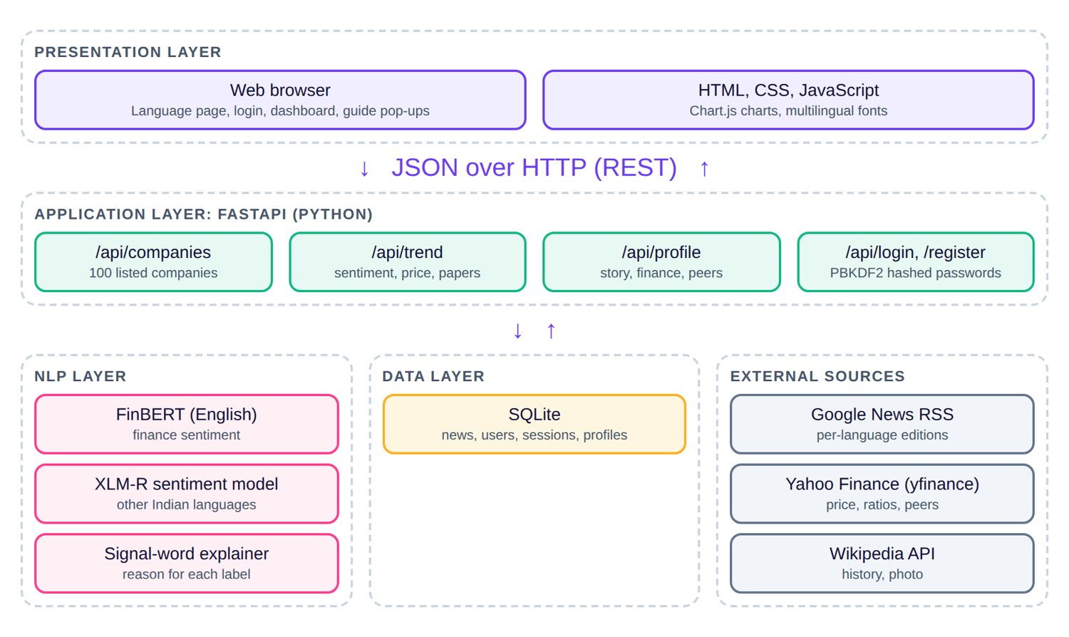
SYSTEM ARCHITECTURE
Presentation
Browser, HTML, CSS, JavaScript, Chart.js
Application
FastAPI routes for companies, trend, profile and login
NLP
FinBERT, XLM-R and the signal-word explainer
Data
SQLite and the external sources: Google News, Yahoo Finance, Wikipedia
Notes:
Walk through the four layers from top to bottom.

Slide 9
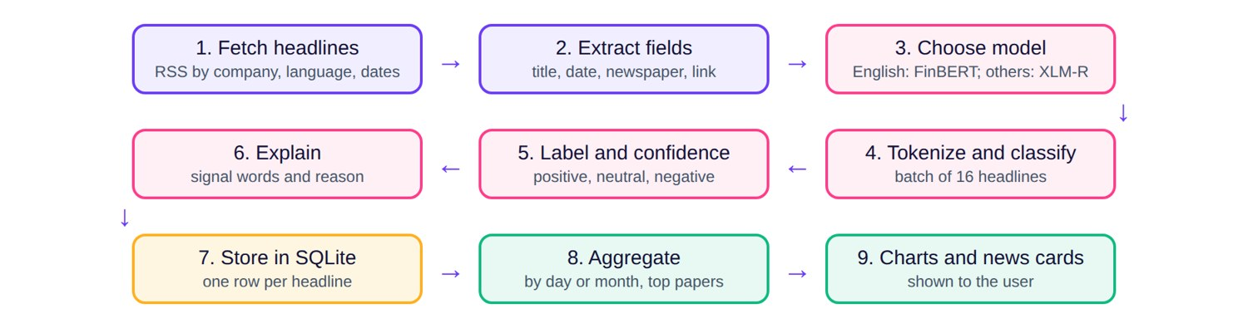
WORKING OF THE NLP PIPELINE
Model by language
Batch scoring
Explain
FinBERT for English, XLM-R for others
16 headlines at a time, saved once
Signal words and a reason for each label
Notes:
Nine steps from RSS feed to the news card.

Slide 10




IMPLEMENTATION DETAILS
Python and FastAPI
SQLite
Transformers
REST API: companies, trend, profile, predict, register, login
Headlines, users, sessions and cached company profiles
FinBERT and XLM-R sentiment models, batches of 16
Data sources
Chart.js
Security
Google News RSS, Yahoo Finance (yfinance), Wikipedia API
Price and mood combo, stacked bars, doughnut, peer bars
PBKDF2-SHA256 salted passwords; guest mode available
Notes:
Python back end, HTML, CSS and JavaScript front end, tested in Chrome on Windows.

Slide 11
CODE 1: SCORING HEADLINES
def model(lang):
k = "en" if lang == "en" else "xx"
if k not in _m:
_m[k] = pipeline("text-classification",
model="ProsusAI/finbert" if k == "en"
else "cardiffnlp/twitter-xlm-roberta-base-sentiment")
return _m[k]
def score_many(texts, lang="en"):
m = model(lang)
if m: # FinBERT or the multilingual model
return [(r["label"].lower(), round(r["score"], 2))
for r in m([t[:512] for t in texts], batch_size=16)]
# fallback: count positive and negative keywords
...
How it works
English uses FinBERT; other languages use XLM-R
Models load once and are reused
Headlines are scored in batches of 16
A keyword fallback keeps the site working if models are missing
Notes:
Code shown is a shortened excerpt from main.py; the full source is in the report.

Slide 12
CODE 2: FETCHING NEWS
def fetch(c, lang, a, b):
key = (c[1], lang, a, b)
if time.time() - last.get(key, 0) < 1800: return # 30 min cache
last[key] = time.time()
hl, ceid = LANG.get(lang, LANG["en"])
q = quote(f"{c[0]} after:{a} before:{b + 1 day}")
url = ("https://news.google.com/rss/search?q=" + q
+ f"&hl={hl}&gl=IN&ceid={ceid}")
es = feedparser.parse(url).entries[:100]
for e, (label, s) in zip(es, score_many([e.title for e in es], lang)):
db.execute("insert or ignore into news values(?,...)",
(c[1], lang, e.title, day, label, s,
e.source.title, e.source.href, e.link))
How it works
The query holds the company name and the chosen dates
The language picks the Google News edition
Up to 100 headlines per search, cached for 30 minutes
Newspaper name, site and link are saved for every card
Notes:
Code shown is a shortened excerpt from main.py; the full source is in the report.

Slide 13
CODE 3: TREND AND MOOD
rows = db.execute("select title,day,label,score,paper,site,link "
"from news where ticker=? and lang=? and day between ? and ?",
(ticker, lang, a, b)).fetchall()
n = 7 if (b - a).days > 90 else 10 # month or day buckets
for r in rows:
bk.setdefault(r[1][:n], {"positive": 0, "negative": 0,
"neutral": 0})[r[2]] += 1
mood = ("Bullish" if pos > neg * 1.3 else
"Bearish" if neg > pos * 1.3 else "Mixed")
return {"labels": labels, "price": prices(...), "mood": mood,
"papers": top_8_newspapers, "headlines": rows[:25]}
How it works
Long ranges are grouped by month, short ones by day
Net mood is positive minus negative
Mood is Bullish, Bearish or Mixed by a 1.3 ratio rule
Price and top newspapers come with the same response
Notes:
Code shown is a shortened excerpt from main.py; the full source is in the report.

Slide 14
CODE 4: SECURE LOGIN
hp = lambda pw, salt: hashlib.pbkdf2_hmac(
"sha256", pw.encode(), salt, 120000).hex()
@app.post("/api/register")
def register(b: Cred):
...
salt = secrets.token_bytes(16)
db.execute("insert into users values(?,?,?,?)",
(e, name, salt.hex(), hp(b.password, salt)))
return session(e, name) # random 48-character token
@app.post("/api/login")
def login(b: Cred):
u = db.execute("select name,salt,hash from users where email=?",
(e,)).fetchone()
if not u or hp(b.password, bytes.fromhex(u[1])) != u[2]:
return {"error": "Email or password is wrong."}
How it works
Passwords are never stored as plain text
Each user has a random salt; 120,000 PBKDF2 rounds
Login recomputes the hash and compares
A session token is returned; guests need no account
Notes:
Code shown is a shortened excerpt from main.py; the full source is in the report.

Slide 15
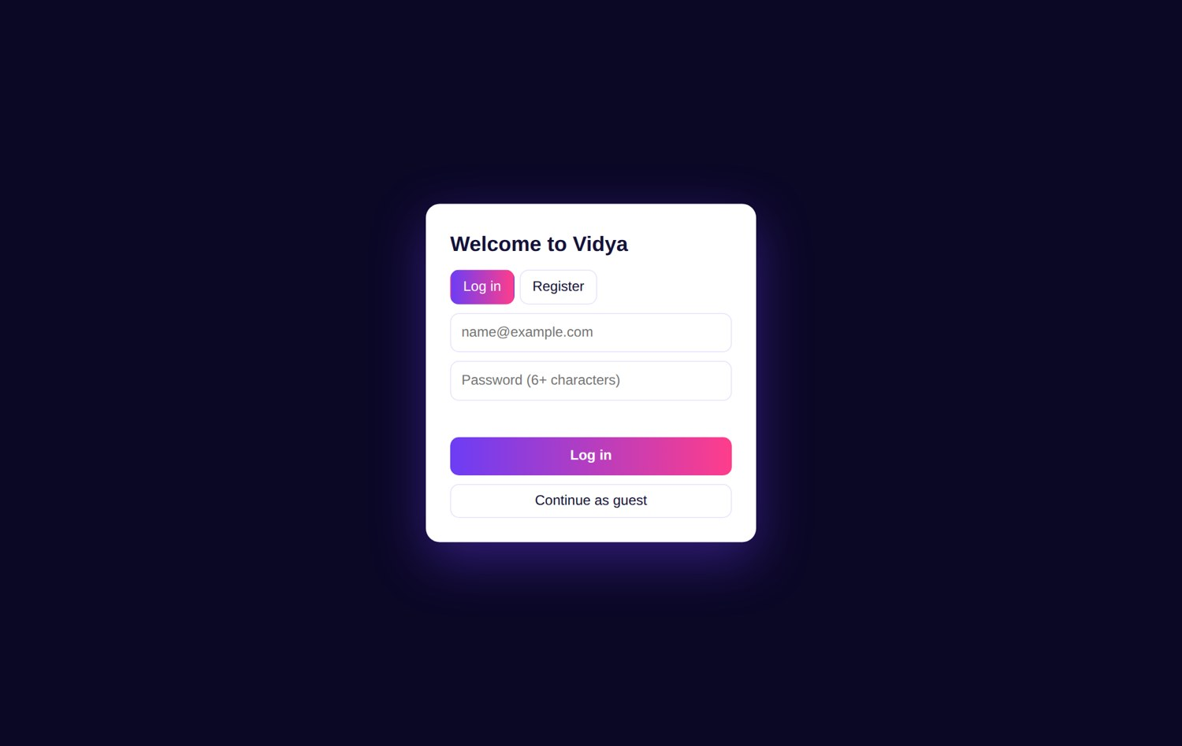
RESULTS: LANGUAGE AND LOGIN
Figure 1: Language selection page
Figure 2: Login, register or guest
Notes:
The first screen asks for a language; the login page follows.

Slide 16
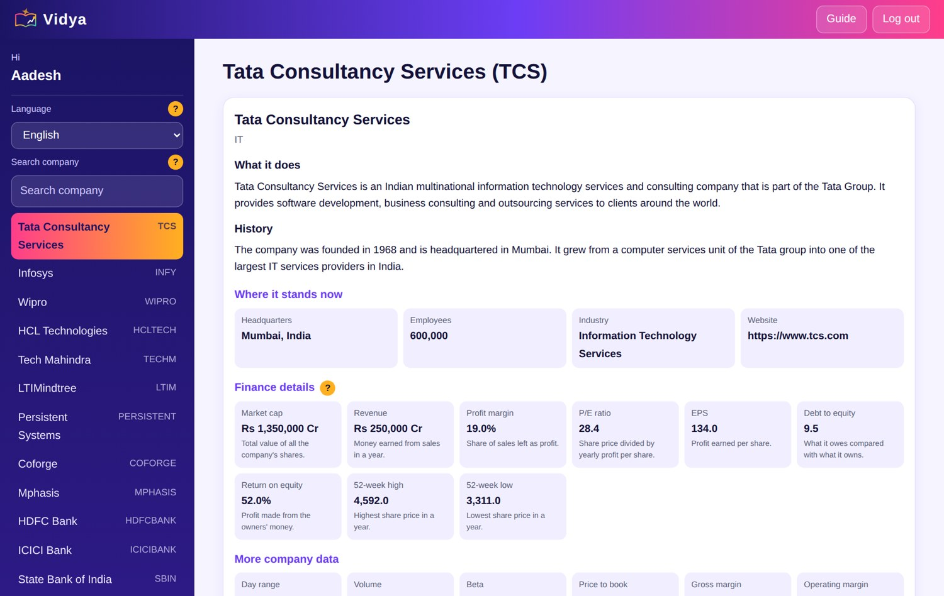
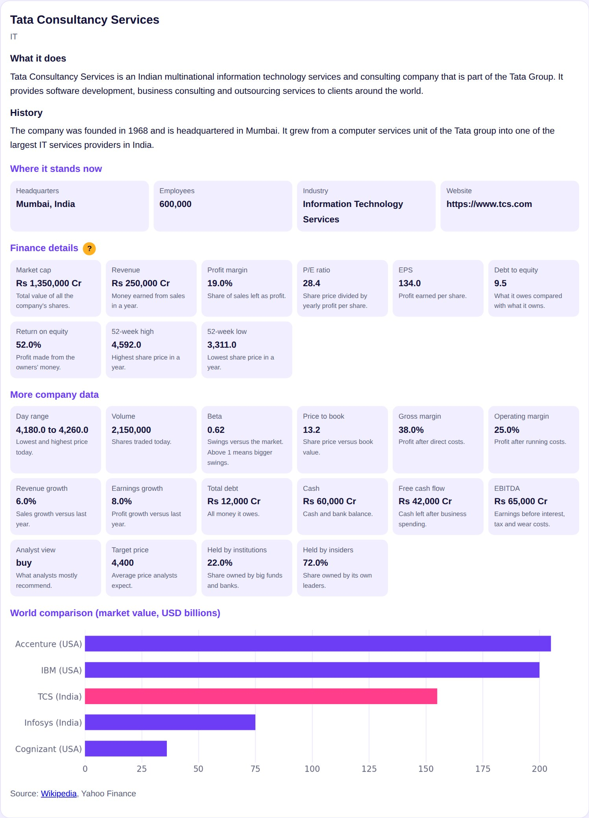
RESULTS: HOME AND COMPANY PROFILE
Figure 3: Sidebar with user name, language and companies
Figure 4: Company story and finance
Notes:
Sidebar on the left, company story first, then finance details and world peers.

Slide 17
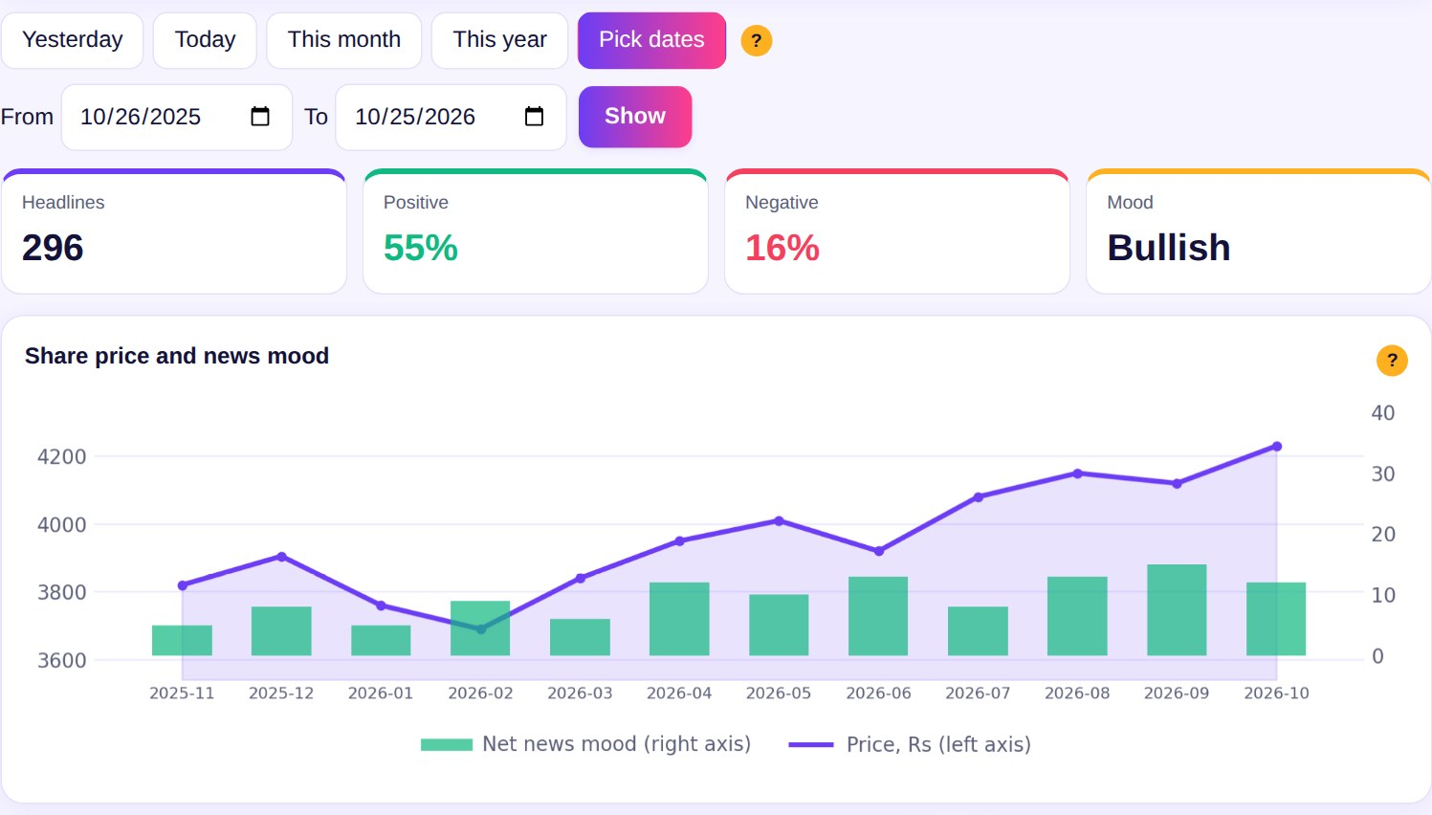
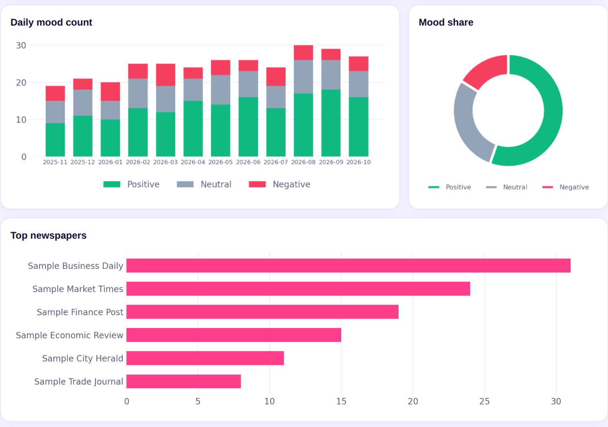
RESULTS: TIMELINE AND GRAPHS
Figure 5: Date timeline and price vs mood
Figure 6: Mood charts and top newspapers
Notes:
Any start and end date can be chosen; graphs update with the range.

Slide 18
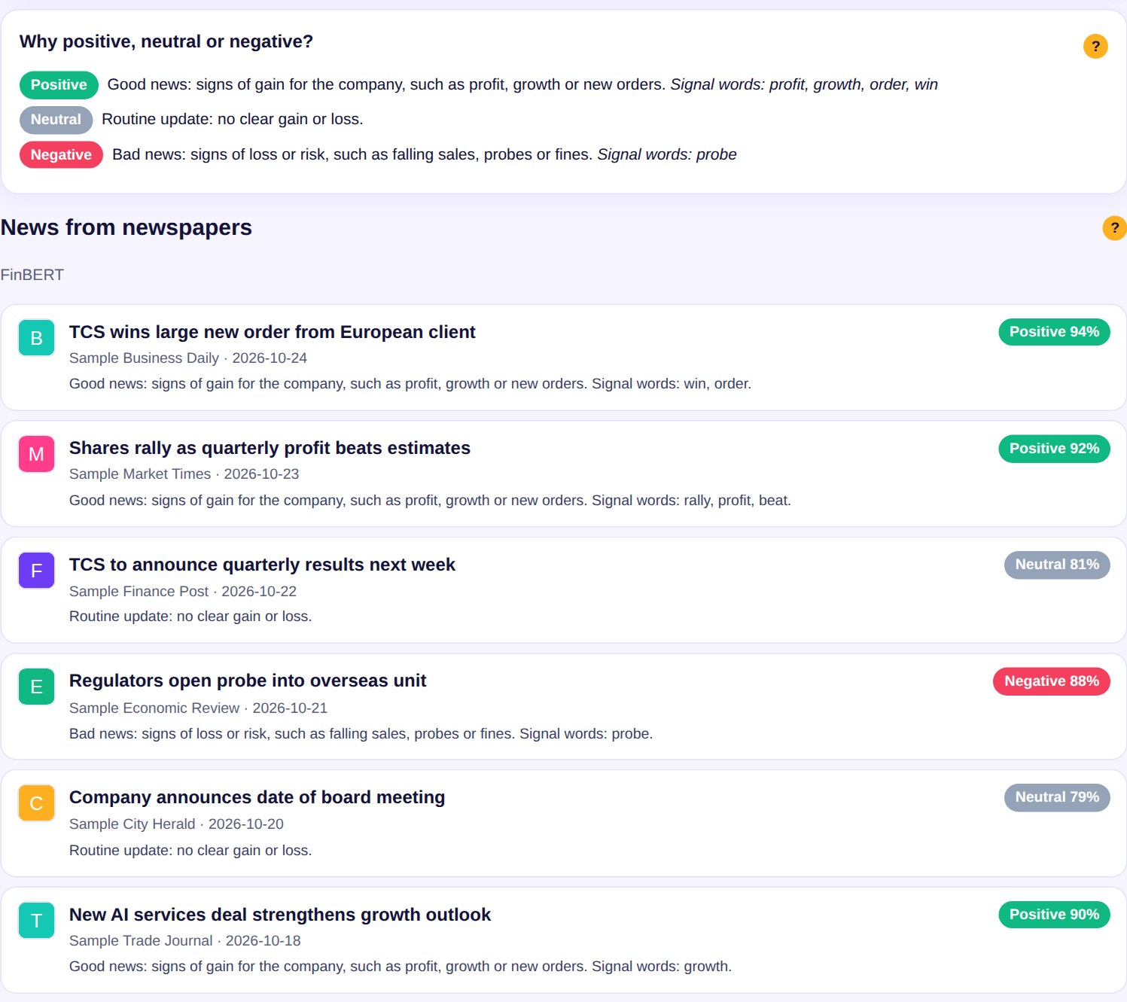
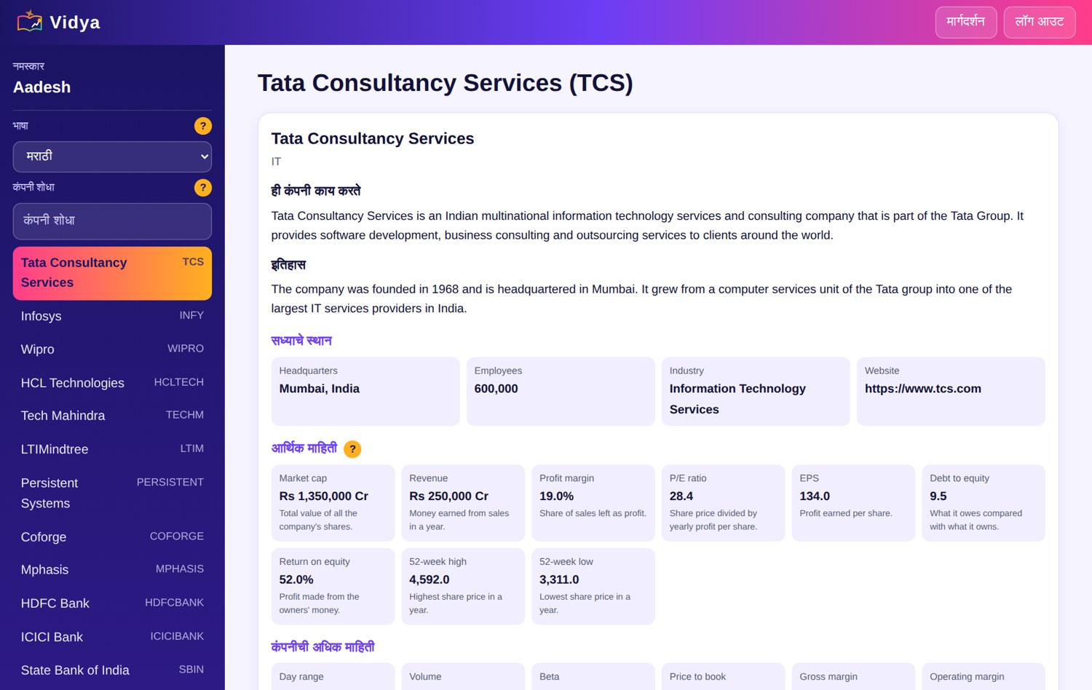
RESULTS: NEWS CARDS AND MARATHI
Figure 8: Marathi interface
Figure 7: News cards with reasons
Notes:
Every card shows the newspaper, link, label and reason. Marathi changes font, labels and news edition.

Slide 19
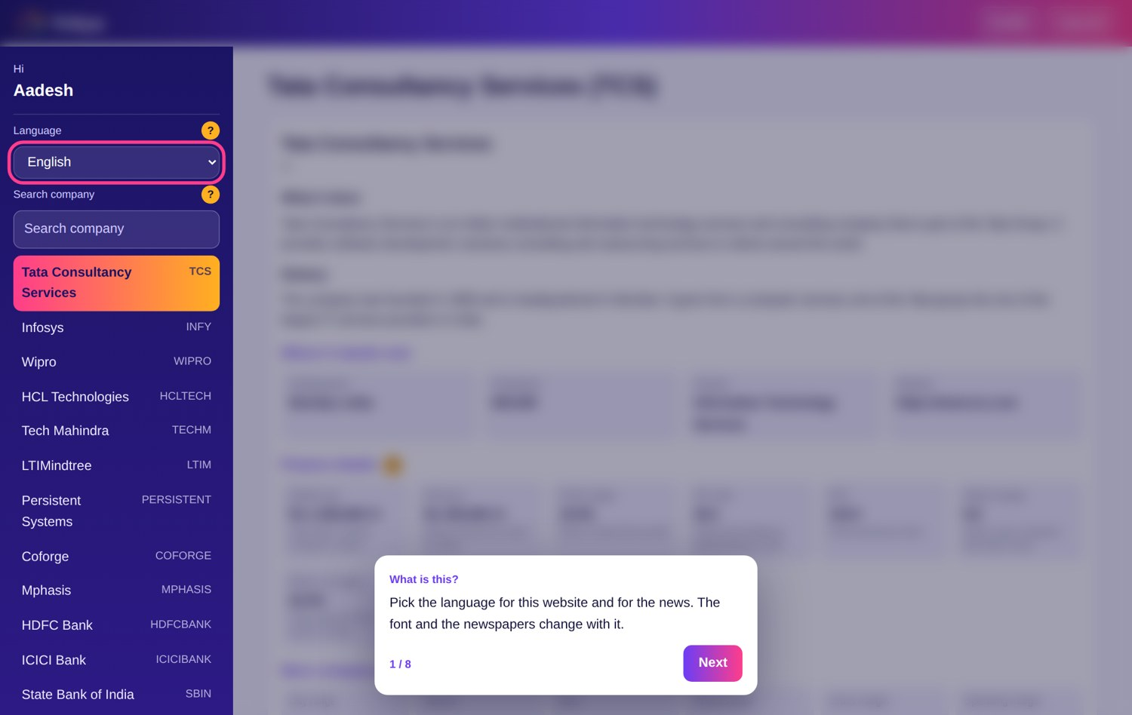
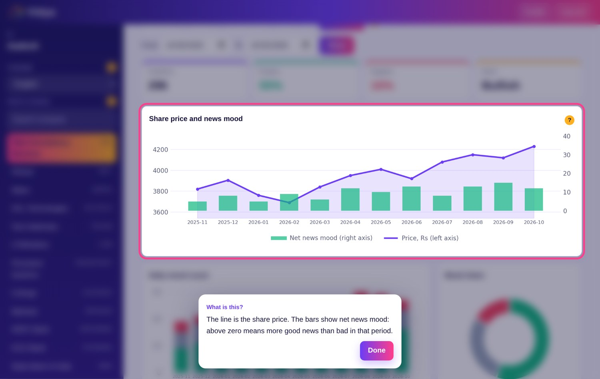
RESULTS: GUIDE AND HELP POP-UPS
Figure 9: Guided tour with blurred background
Figure 10: Help pop-up for one chart
Notes:
Pop-ups blur the background and highlight the section being explained.

Slide 20
COMPARATIVE ANALYSIS
Feature | Manual reading | English-only tool | Vidya
News language | Reader's own | English | Twelve Indian languages
Reason for label | Reader's judgement | Score only | Plain reason and signal words
Company background | Separate search | Not provided | Story, finance and peers on one page
Older news | Archive search | Limited | Any date range
Newspaper source | By paper | Often missing | Name, logo and link
Limits: non-English labels come from a general model, Google News returns up to 100 headlines per search, and the site is for learning, not investment advice.
Notes:
Be honest about limitations: general multilingual model and a 100-headline cap per search.

Slide 21

CONCLUSION AND FUTURE SCOPE
Conclusion
Future scope
Vidya reads financial news in the reader's language and labels it with FinBERT or XLM-R
Every label comes with a reason
Company story, finance and world peers sit beside the news
A language-first start page, login and pop-up help make it easy for beginners
Fine-tune a multilingual model on Indian financial news
Translate the full interface into all 12 languages
Article images and summaries on news cards
Personal watchlists and mood alerts
Tamper-proof multi-node ledger for stored results
Notes:
Close with what was achieved and what comes next.

Slide 22
REFERENCES
P. C. Tetlock, "Giving Content to Investor Sentiment: The Role of Media in the Stock Market," The Journal of Finance, vol. 62, no. 3, 2007.
T. Loughran and B. McDonald, "When Is a Liability Not a Liability?" The Journal of Finance, vol. 66, no. 1, 2011.
P. Malo et al., "Good Debt or Bad Debt: Detecting Semantic Orientations in Economic Texts," JASIST, vol. 65, no. 4, 2014.
J. Devlin et al., "BERT: Pre-training of Deep Bidirectional Transformers for Language Understanding," NAACL-HLT, 2019.
D. Araci, "FinBERT: Financial Sentiment Analysis with Pre-trained Language Models," arXiv:1908.10063, 2019.
A. Conneau et al., "Unsupervised Cross-lingual Representation Learning at Scale," ACL, 2020.
F. Barbieri et al., "XLM-T: Multilingual Language Models in Twitter for Sentiment Analysis and Beyond," LREC, 2022.
FastAPI Documentation, https://fastapi.tiangolo.com | Chart.js Documentation, https://www.chartjs.org

Slide 23
THANK YOU
Aadesh Mahesh Angre | Roll No. 702
Project Guide: Prof. Naresh Shende

