Slide 1
Customer Churn Analysis
Business Analyst Presentation
Customer Segmentation · Predictive Modelling · Retention Strategy
Final project summary | October 2026

Slide 2
REPORT SECTIONS 1–3
Executive Summary, Business Problem and Objectives
Why churn prediction matters to the telecommunications business
KEY FINDINGS
• The dataset covers 6,741 customer records.
• Overall observed churn is 26.57%.
• Customer attrition reduces recurring revenue.
• The analysis identifies four customer segments.
• The goal is targeted, early retention contact.
• Prediction supports decisions rather than replacing them.
6,741
26.57%
Customer records
Observed churn rate
4
91.90%
Published clusters
ANN test recall
Business aim
Prioritise high-risk customers and test cost-effective retention offers.
CUSTOMER CHURN | BUSINESS ANALYST SUMMARY
02

Slide 3
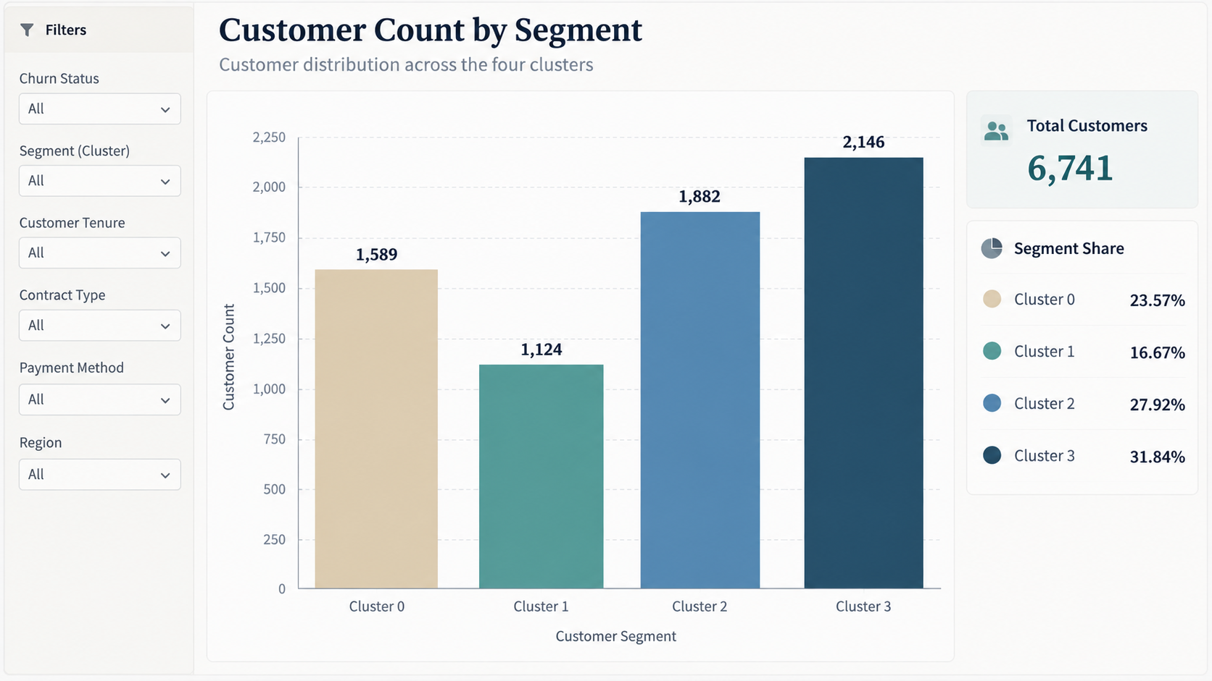
REPORT SECTIONS 4–6
Analyst Role, Data Preparation and Methodology
Clear separation of exploratory clusters and model testing
KEY FINDINGS
• Twelve encoded predictors describe customer profiles.
• The analyst translates results into business action.
• Training data contains 4,313 customer records.
• Validation data contains 1,079 customer records.
• The held-out test set contains 1,349 records.
• New K-Means clustering is fitted to training data only.
Source: supplied Tableau-style visual
STRATIFIED TRAIN / VALIDATION / TEST SPLIT
64% TRAIN
16% VAL
20% TEST
CUSTOMER CHURN | BUSINESS ANALYST SUMMARY
03

Slide 4
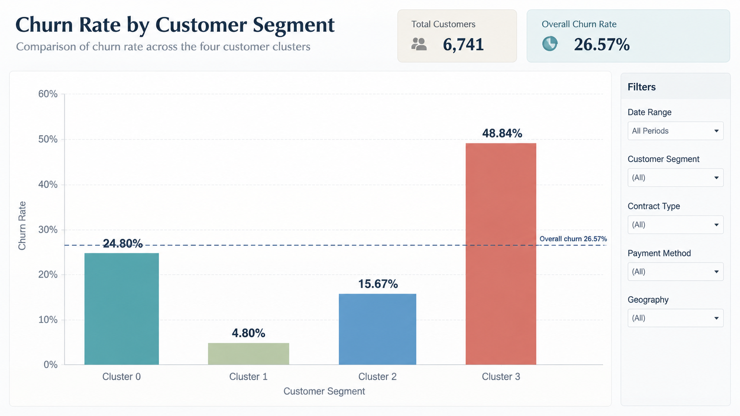
REPORT SECTIONS 7 AND 9
Clustering Findings and Factors Linked to Churn
The key segment differences are visible in the supplied Tableau dashboard
KEY FINDINGS
• Cluster 0 has 1,589 customers and 24.80% churn.
• Cluster 1 has 1,124 customers and 4.80% churn.
• Cluster 2 has 1,882 customers and 15.67% churn.
• Cluster 3 has 2,146 customers and 48.84% churn.
• Tenure, charges and contracts mark risk patterns.
• These associations do not establish direct causes.
Source: supplied Tableau-style visual
HIGHEST RISK SEGMENT
Cluster 3 · 48.84% churn
CUSTOMER CHURN | BUSINESS ANALYST SUMMARY
04

Slide 5
REPORT SECTION 8
ANN Predictive Modelling and Performance Scores
All scores are from the held-out test set at validation-selected thresholds
KEY FINDINGS
MODEL SCORECARD · INDEPENDENT TEST
• The ANN was selected using validation PR-AUC.
• ANN recall reached 91.90% on test customers.
• ANN ROC-AUC was 0.810 and PR-AUC was 0.587.
• ANN F1 reached 0.557 at the chosen threshold.
• Logistic regression slightly led on test scores.
• High recall came with many false positive alerts.
Model
ROC
PR
F1
Recall
Prec.
Acc.
ANN
0.810
0.587
0.557
91.9%
40.0%
61.2%
Logistic
0.817
0.596
0.561
92.7%
40.2%
61.5%
Forest
0.789
0.542
0.530
90.2%
37.5%
57.5%
329 / 358 actual churners detected by ANN
Trade-off: 494 non-churners were also flagged
CUSTOMER CHURN | BUSINESS ANALYST SUMMARY
05

Slide 6
REPORT SECTIONS 10–11
Retention Strategy, Implementation Roadmap and KPIs
Link the predicted risk to targeted, measurable retention programmes
KEY FINDINGS
SEGMENT-FOCUSED INTERVENTION
• Prioritise Cluster 3 for proactive outreach.
• Test affordable options for price-sensitive groups.
• Protect the stable Cluster 1 customer base.
• Rank contact lists using model risk estimates.
• Run a controlled pilot before wider rollout.
• Track churn uplift, campaign costs and recall.
Cluster 3
Proactive retention
Cluster 0
Affordable plans
Cluster 2
Value and service
Cluster 1
Loyalty maintenance
PILOT TIMELINE
0–30 Design
31–60 Pilot
61–90 Review
CUSTOMER CHURN | BUSINESS ANALYST SUMMARY
06

Slide 7
REPORT SECTIONS 12–14
Limitations, Future Improvements and Conclusion
Practical interpretation and next steps for the business
KEY FINDINGS
DECISION FRAMEWORK
• Historical data does not capture live behaviour.
• Available variables omit complaints and outages.
• High ANN recall creates substantial false alarms.
• Cluster profiles need business validation.
• Future work should test costs and thresholds.
• A/B pilots must verify actual retention impact.
WHO?
Prediction probability
WHY?
Segment and customer context
WHAT?
Targeted retention offer
PROVE IT
Controlled campaign results
Conclusion: combine prediction with business judgement.
CUSTOMER CHURN | BUSINESS ANALYST SUMMARY
07

Slide 8
EVIDENCE AND METHODS
References
References supporting the dataset, neural network and evaluation approach
Goreja, A. (n.d.) Stage_2_Deliverables.
Open source
Keras Team (n.d.) Model training APIs.
Open source
Kingma, D.P. and Ba, J. (2015) Adam: A method for stochastic optimization.
Open source
Fawcett, T. (2006) An introduction to ROC analysis.
Open source
Pedregosa, F. et al. (2011) Scikit-learn: Machine learning in Python.
Open source
Saito, T. and Rehmsmeier, M. (2015) Precision–recall plots.
Open source
Scikit-learn developers (n.d.) Model evaluation.
Open source
Dashboard images: user-supplied static Tableau-style screenshots; values checked against clustered customer dataset.
CUSTOMER CHURN | BUSINESS ANALYST SUMMARY
08

