Slide 1
CLUSTERING ANALYSIS
Customer Churn Segmentation
for a Telecommunications Company
K-Means clustering — 6,741 customers — 4 behavioural segments
Adesh Kumar | Data Analyst — Clustering Analysis
13 September 2026

Slide 2



Objective & Approach
What this analysis set out to do
Select & apply K-Means clustering
6,741
Group customers by behaviour and demographics, not by whether they already churned.
customers analysed
Determine optimal clusters via the Elbow Method
Cross-checked with Silhouette Score for a statistically defensible choice of k.
4
Visualise and label clusters
customer segments identified
Turn raw cluster numbers into interpretable, business-ready customer segments.
12
features used in clustering
Customer Churn Clustering Analysis
2

Slide 3



Methodology: Features & Algorithm
K-Means clustering was applied to 12 standardised customer features, grouped into four categories. The Churn label was deliberately excluded from clustering — kept aside only to interpret the resulting segments.
Demographics
Tenure
Services
Billing & Contract
gender
tenure (standardised)
PhoneService
MonthlyCharges
SeniorCitizen
MultipleLines
Contract (Month-to-month / One year / Two year)
Dependents
InternetService (DSL / Fiber)
Customer Churn Clustering Analysis
3

Slide 4
Determining the Optimal Number of Clusters
Elbow Method (WCSS) & Silhouette Score across k = 1–10
k = 4 selected. Inertia flattens sharply after k=4 (elbow bend). Silhouette peaks at k=2 (a trivial split) then stabilises ≈ 0.17 from k=4 onward — confirming 4 as the best balance of statistical separation and interpretability.
Customer Churn Clustering Analysis
4

Slide 5
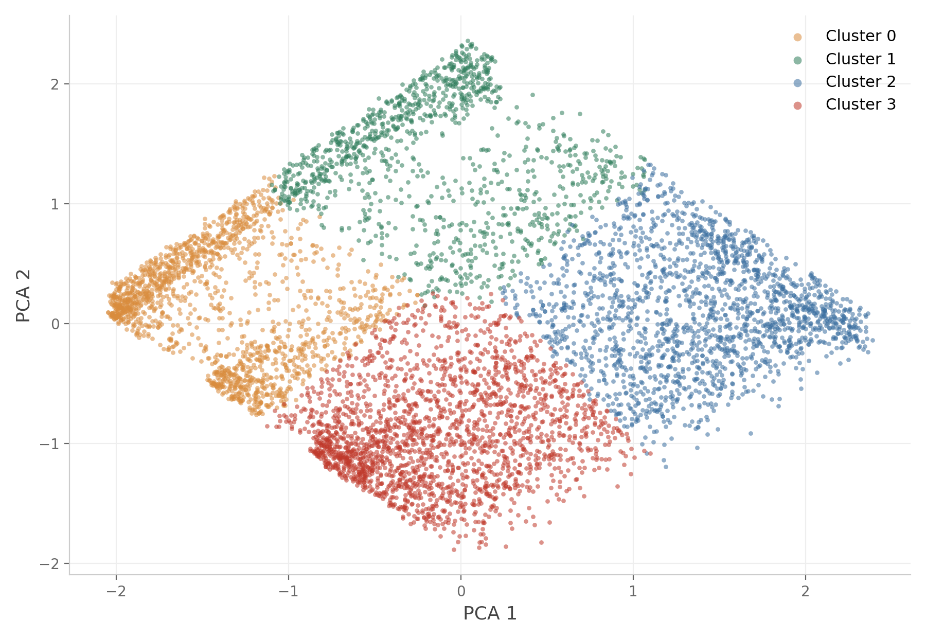
Customer Segments — PCA Projection
All 6,741 customers, reduced to 2 dimensions via PCA (49.8% of variance explained)
Customer Churn Clustering Analysis
5

Slide 6
Segment Overview
Four behaviourally distinct customer segments emerged
Cluster 3
Cluster 0
Cluster 2
Cluster 1
At-Risk New High-Spend Customers
New, Budget-Conscious Customers
High-Value Established Customers
Loyal Long-Tenure Customers
48.8%
24.8%
15.7%
4.8%
churn rate
churn rate
churn rate
churn rate
2,146
1,589
1,882
1,124
customers (31.8%)
customers (23.6%)
customers (27.9%)
customers (16.7%)
URGENT
MEDIUM
LOW–MEDIUM
LOW
Customer Churn Clustering Analysis
6

Slide 7

Cluster 3 — “At-Risk New High-Spend Customers”
URGENT
The most critical cluster and the largest segment in the customer base. Short-tenure customers who already pay above-average charges — and carry the highest churn risk by far.
48.8%
Key Characteristics
Short tenure — well below the customer-base average
Above-average monthly charges despite the short relationship
Highest Senior Citizen share of any cluster — 24.3%
Lowest share with dependents — 18.1% (mostly individual customers)
2,146 customers — 31.8% of total base (largest segment)
churn rate
2,146
customers (31.8% of base)
PRIORITY
Business Insight
URGENT
Combines the highest churn rate with the largest customer count — driving the majority of lost revenue. Urgent priority for retention.
Customer Churn Clustering Analysis
7

Slide 8

Cluster 0 — “New, Budget-Conscious Customers”
Newer customers paying the lowest monthly charges of any group, with short tenure and a fairly even mix of contract types.
24.8%
Key Characteristics
Short tenure — below the customer-base average
Lowest monthly charges of all clusters
Low Senior Citizen share — 7.2%
Mixed contracts — about half (50.8%) month-to-month
1,589 customers — 23.6% of total base
churn rate
1,589
customers (23.6% of base)
PRIORITY
Business Insight
MEDIUM
Price-sensitive and still forming loyalty. Focus on onboarding and incentives to move them onto longer contracts.
Customer Churn Clustering Analysis
8

Slide 9
Cluster 2 — “High-Value Established Customers”
A stable, established base with the longest average tenure and the highest monthly charges of any cluster.
15.7%
Key Characteristics
Longest average tenure of all clusters
Highest monthly charges of all clusters
Highest Senior Citizen share — 21.7%
Nearly universal phone service — 99.7%
1,882 customers — 27.9% of total base
churn rate
1,882
customers (27.9% of base)
PRIORITY
Business Insight
LOW–MEDIUM
A valuable, long-standing segment. Maintain service quality and offer senior-specific perks to protect this revenue base.
Customer Churn Clustering Analysis
9

Slide 10
Cluster 1 — “Loyal Long-Tenure Customers”
The most loyal segment by far — long tenure, below-average charges, and the highest share of customers with dependents.
4.8%
Key Characteristics
Most loyal group — lowest churn rate of all clusters
Long average tenure — well above the customer-base average
Below-average monthly charges
Highest share with dependents — 44.8%
1,124 customers — 16.7% of total base
churn rate
1,124
customers (16.7% of base)
PRIORITY
Business Insight
LOW
The most stable, reliable source of long-term revenue. Reward with loyalty programmes and family bundles — requires the least intervention.
Customer Churn Clustering Analysis
10

Slide 11
Churn Rate by Cluster
The clearest actionable signal in this analysis
Overall average churn: 26.6%
Cluster 3 churns at 10× the rate of Cluster 1 (48.8% vs 4.8%) — and is also the largest single segment.
That single cluster represents the greatest revenue risk in the portfolio.
Customer Churn Clustering Analysis
11

Slide 12
Recommendations
Priority actions, ranked by segment urgency
1
Retain Cluster 3 first
Launch proactive retention campaigns for at-risk, new high-spend customers — the top priority.
2
Senior-specific plans
Introduce senior-tailored pricing & support, given the high senior share in Clusters 2 and 3.
3
Strengthen onboarding
Improve early-tenure engagement for Clusters 0 and 3 to build loyalty sooner.
4
Incentivise longer contracts
Offer long-term contract discounts to shift customers off month-to-month plans.
5
Protect loyal segments
Maintain service quality for Clusters 1 and 2; reinforce with family bundle offers for Cluster 1.
Customer Churn Clustering Analysis
12

Slide 13
Thank You
Questions & discussion welcome
Adesh Kumar | Data Analyst — Clustering Analysis

