Slide 1

Grocery Store Management
Name : Yogi Aadeshkumar
Batch No. : 450

Slide 2
About me
My name is Yogi Aadeshkumar. I have completed my B.Tech in Information Technology from Silver Oak University, Ahmedabad (2021-2025).
I want to learn Data Science because I enjoy finding useful insights from data to help make better decisions. I also like working with numbers and tools to uncover patterns that solve real-world problems.
LinkedIn profile : LinkedIn
GitHub Profile : GitHub

Slide 3
Agenda
Business Problem & Problem Statement
Objective
ER Diagram
Table Relationships
Key analysis questions
SQL query results with screenshots
Insights and Recommendations
Conclusion
Q&A

Slide 4
Business Problem
Grocery stores generate large volumes of sales and customer data daily, but without a structured database system, it becomes difficult to track revenue, performance, and operations efficiently.
The store lacks clear insights into top customers, product performance, supplier contribution, and employee efficiency, leading to poor data-driven decision-making.
Problem Statement
Develop a structured SQL-based relational database to efficiently store and manage customers, products, suppliers, employees, and order data.
Perform SQL-based data analysis to generate insights on revenue trends, customer behavior, product performance, and supplier contribution for better decision-making and improved operational efficiency.

Slide 5
Objective
Design and develop a structured relational database system for efficient grocery store operations management.
Retrieve, manage, and manipulate stored data effectively using SQL queries.
Generate meaningful business insights such as identifying top customers, high-selling products, and revenue patterns.
Apply advanced SQL concepts including joins, aggregations, subqueries, and filtering for analytical problem-solving.

Slide 6

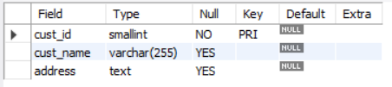
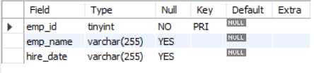
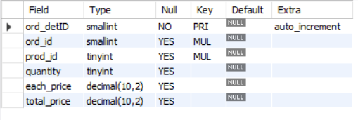
Tables
Categories Table
Customers Table
Employees Table
Order Details Table
Employees Table

Slide 7
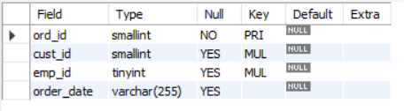
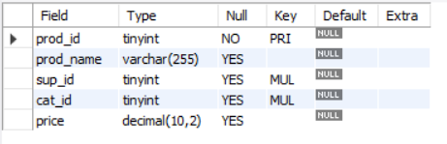
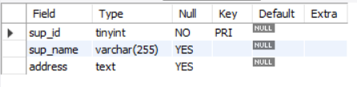
Orders Table
Products Table
Supplier Table

Slide 8
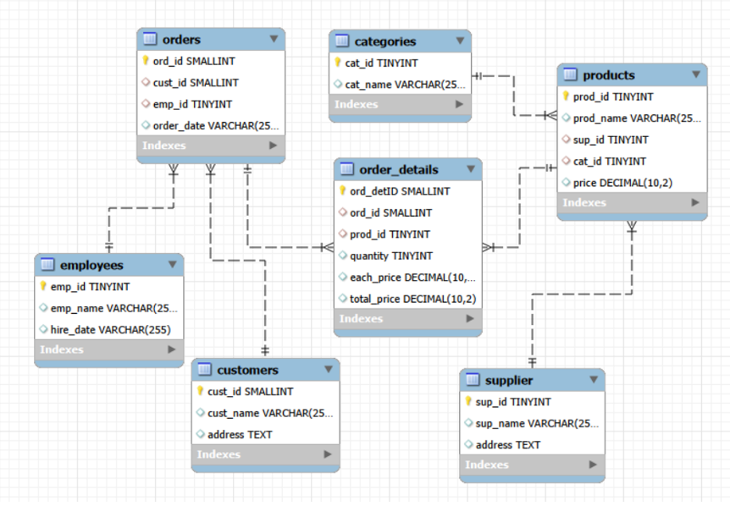
ER Diagram

Slide 9
Table Relationships
One-to-Many from supplier to products
One-to-Many from categories to products
One-to-Many from products to order_details
One-to-Many from orders to order_details
One-to-Many from customers to orders
One-to-Many from employees to orders

Slide 10
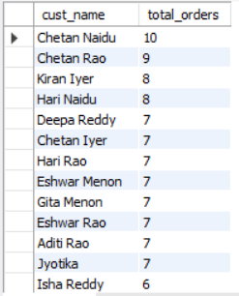
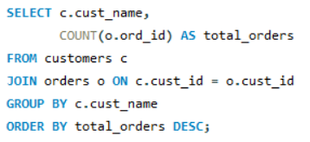
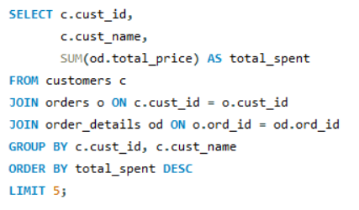
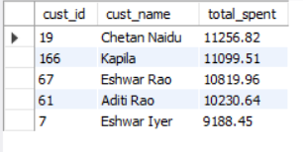
Customer Insights
Which customers have placed the highest number of orders?
Who are the top 5 customers by total purchase amount?

Slide 11
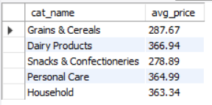
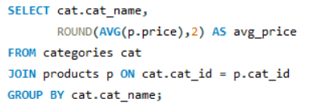
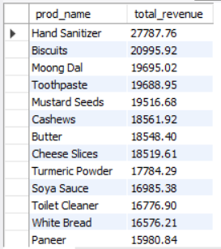
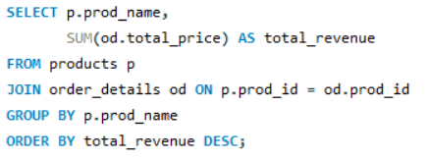
Product Performance
What is the average price of products by category?
What is the total revenue generated by each product?

Slide 12

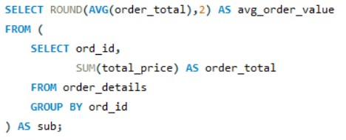
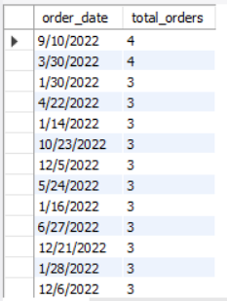
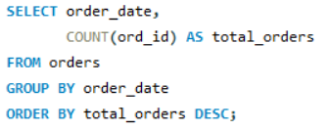
Sales and Order Trends
What is the average value per order?
On which dates were the most orders placed?

Slide 13
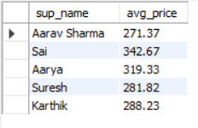
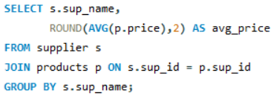
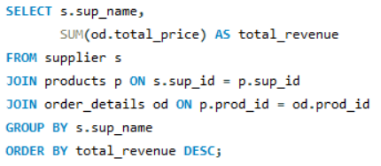
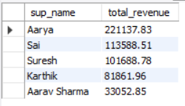
Supplier Contribution
What is the average price of products from each supplier?
Which suppliers contribute the most to total product sales (by revenue)?

Slide 14
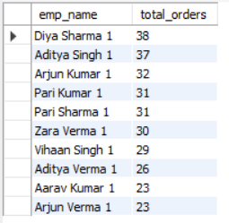
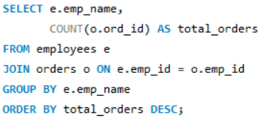
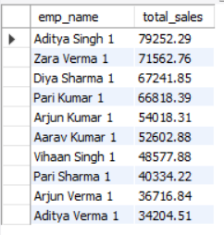
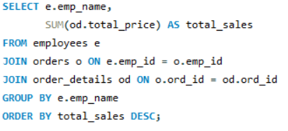
Employee Performance
Which employees have handled the most orders?
What is the total sales value processed by each employee?

Slide 15
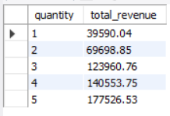
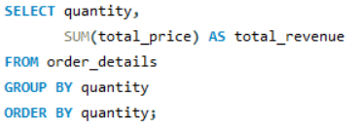
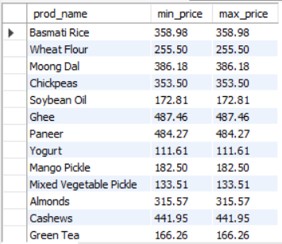
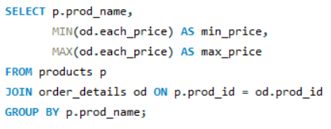
Order Details Deep Dive
What is the relationship between quantity ordered and total price?
How does the unit price vary across products and orders?

Slide 16
Insights
High-priced categories such as Dairy Products, Personal Care, and Household items indicate strong revenue contribution and potential for higher profit margins.
Certain essential items show significantly higher sales volume, highlighting their importance as fast-moving products that consistently drive overall store performance.
Focusing on premium categories for profitability and maintaining strong availability of high-demand essentials can help balance revenue growth and sales stability.

Slide 17
Recommendations
Offer personalized rewards, special discounts, or loyalty benefits to high-value customers to encourage long-term engagement.
Implement a structured loyalty program that tracks purchase behavior and provides incentives based on customer activity.
Ensure efficient inventory management for fast-moving products to prevent stockouts and maintain consistent daily sales performance.

Slide 18
Conclusion
Revenue distribution is uneven, with a limited segment of customers generating a substantial portion of total sales, indicating the importance of focusing on high-value customer retention.
Supplier performance analysis reveals that a few suppliers contribute significantly across multiple product categories, helping identify strong partnership opportunities.
Strengthening relationships with top-performing suppliers while monitoring diversification can improve supply stability and overall profitability.

Slide 19


Slide 20


