Slide 1
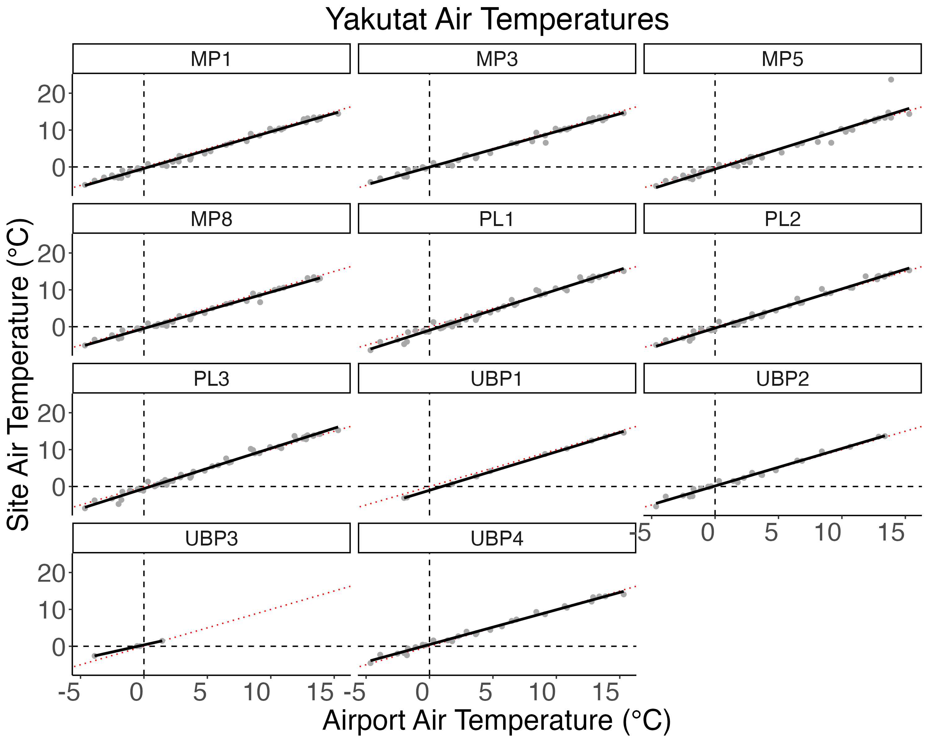
R² = 0.881
R² = 0.827
R² = 0.874
R² = 0.890
R² = 0.886
R² = 0.931
R² = 0.918
R² = 0.922
R² = 0.854
R² = 0.904
R² = 0.824

Slide 2
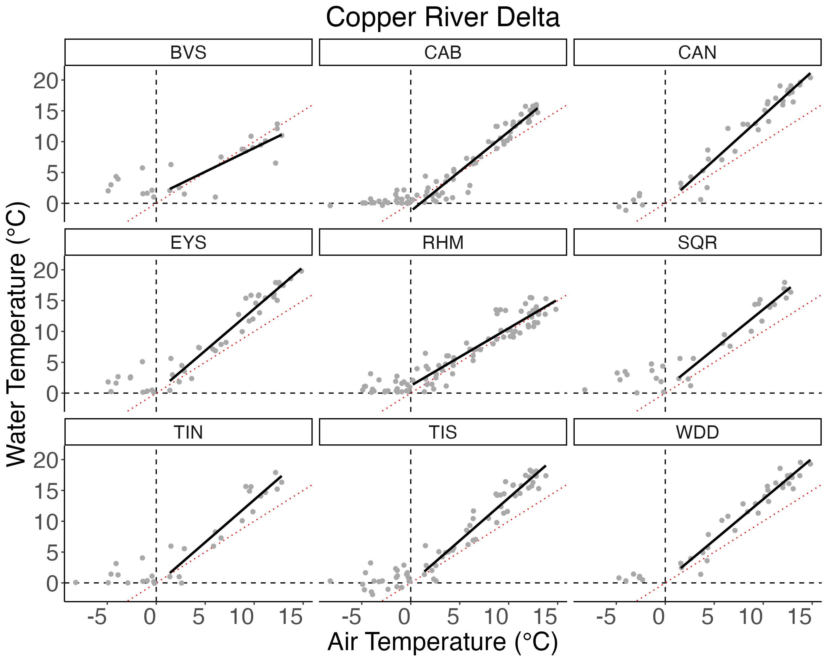
R² = 0.638
R² = 0.869
R² = 0.926
R² = 0.884
R² = 0.872
R² = 0.848
R² = 0.821
R² = 0.872
R² = 0.926

Slide 3
R² = 0.957
R² = 0.953
R² = 0.899
R² = 0.937
R² = 0.943
R² = 0.943
R² = 0.945
R² = 0.955
R² = 0.929
R² = 0.685
R² = 0.950

