Slide 1
FERO
Onboarding & Invite User Journeys
Real preview-app captures for team review. Backend data is fixture-driven only for repeatable screenshots.
Generated 13 Aug 2026

Slide 2
FERO USER JOURNEY
Cold User: Create a Bloc
First install -> onboarding -> create Bloc -> auth -> display name/photo -> lands inside Bloc
1 / 5

Slide 3
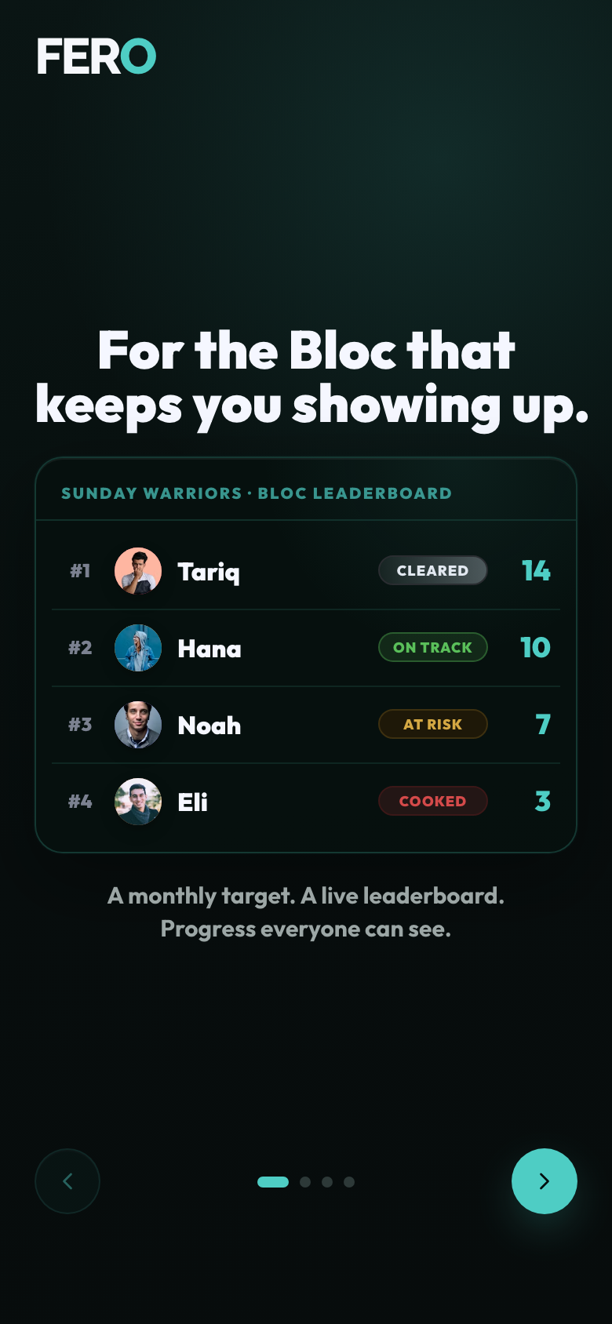
FERO
COLD USER: CREATE A BLOC
01 Onboarding Leaderboard
Captured from the real preview app UI
1 of 12

Slide 4
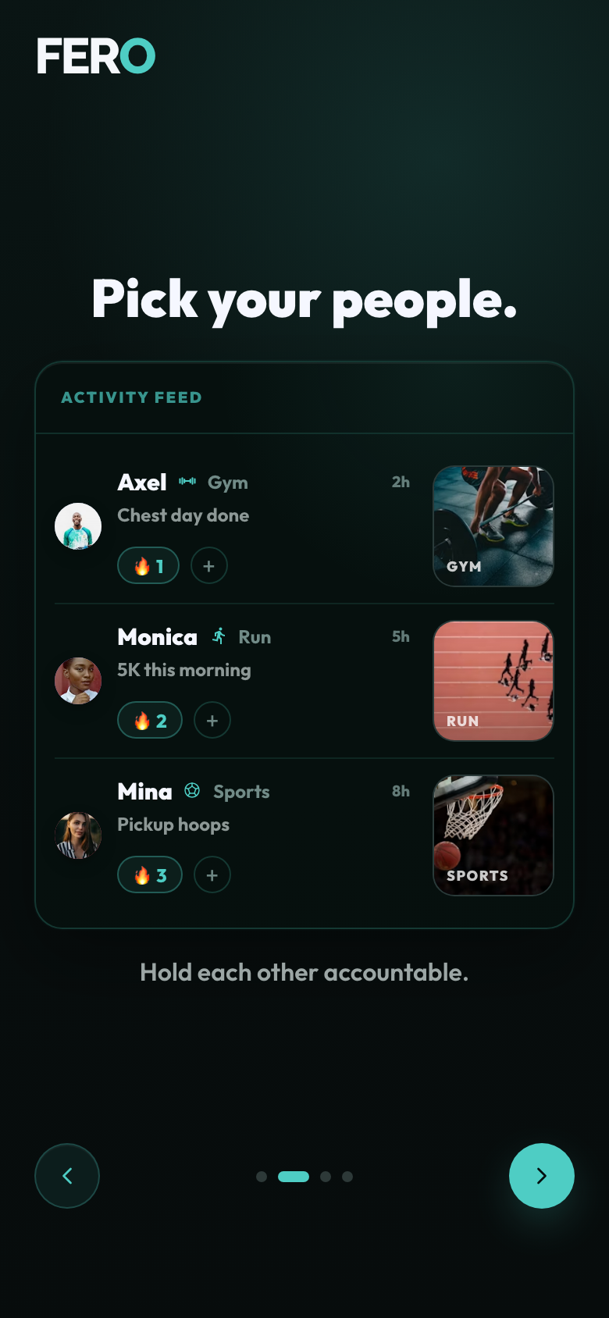
FERO
COLD USER: CREATE A BLOC
02 Onboarding Activity
Captured from the real preview app UI
2 of 12

Slide 5
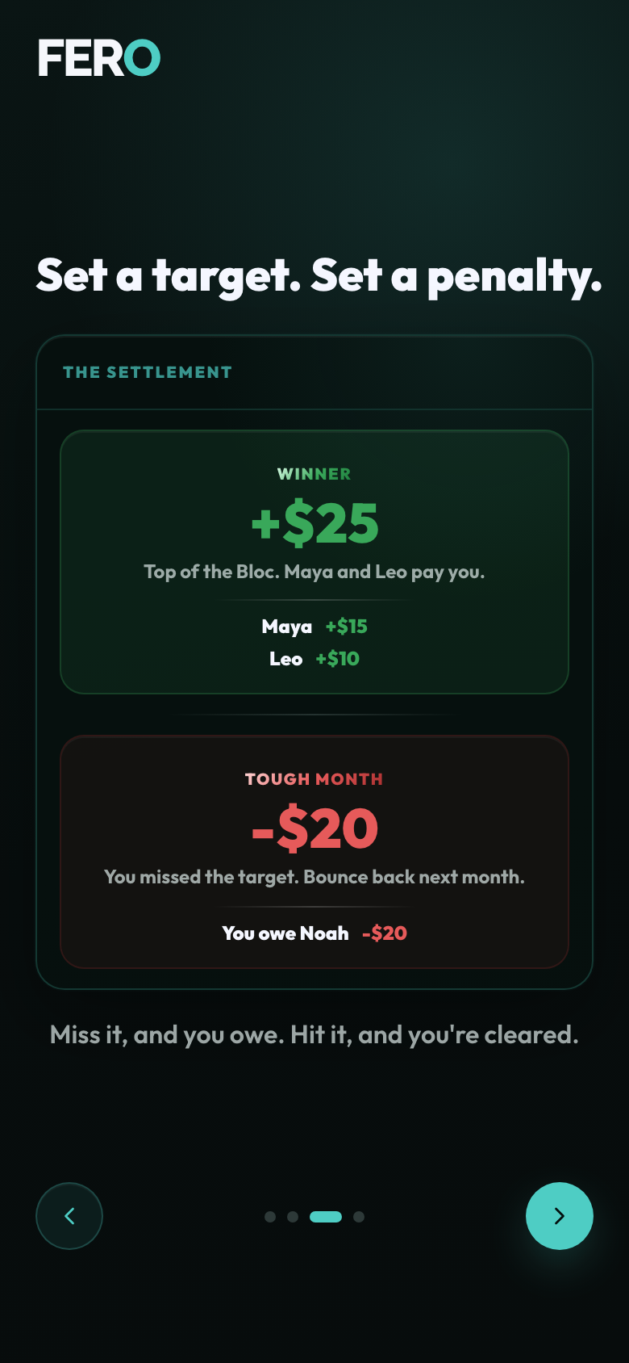
FERO
COLD USER: CREATE A BLOC
03 Onboarding Settlement
Captured from the real preview app UI
3 of 12

Slide 6
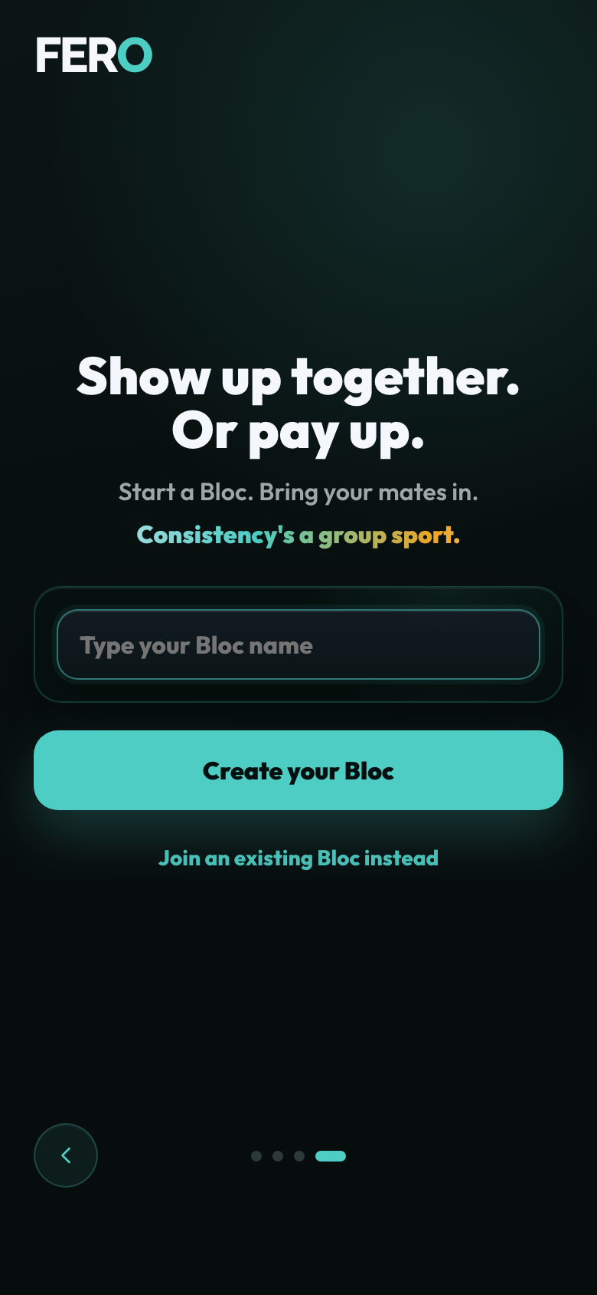
FERO
COLD USER: CREATE A BLOC
04 Onboarding Create Entry
Captured from the real preview app UI
4 of 12

Slide 7
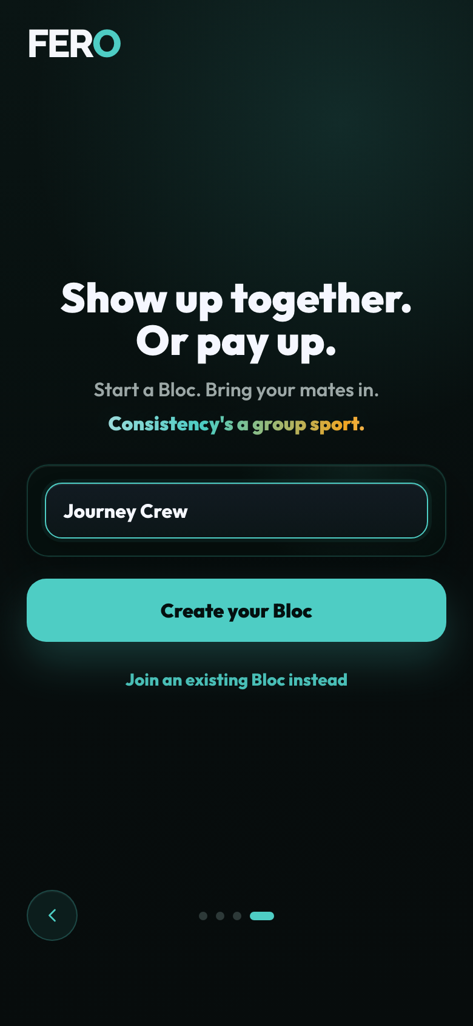
FERO
COLD USER: CREATE A BLOC
05 Onboarding Create Entry Filled
Captured from the real preview app UI
5 of 12

Slide 8
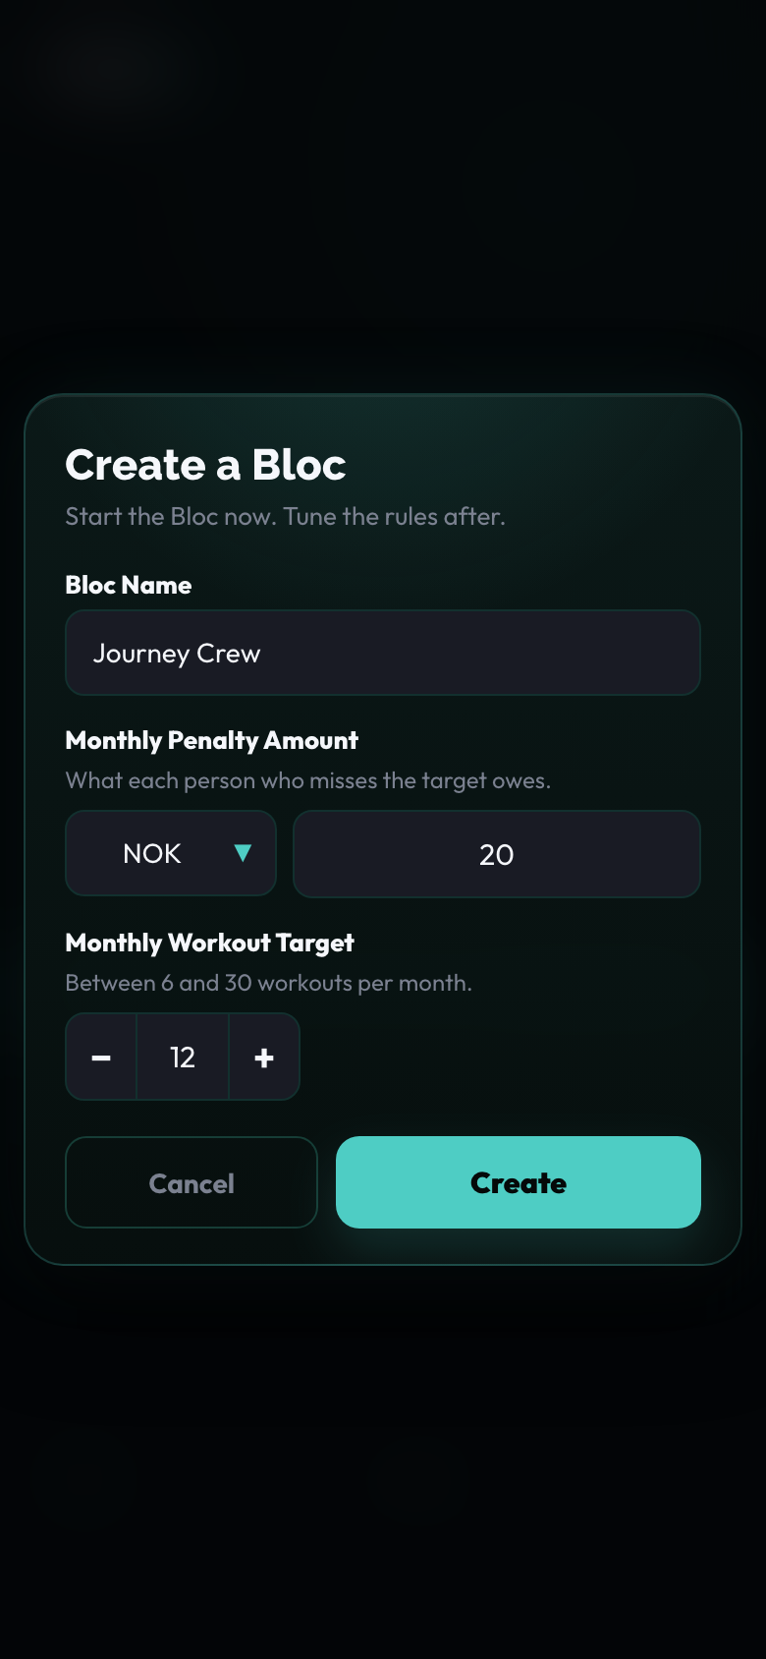
FERO
COLD USER: CREATE A BLOC
06 Create Bloc Modal
Captured from the real preview app UI
6 of 12

Slide 9
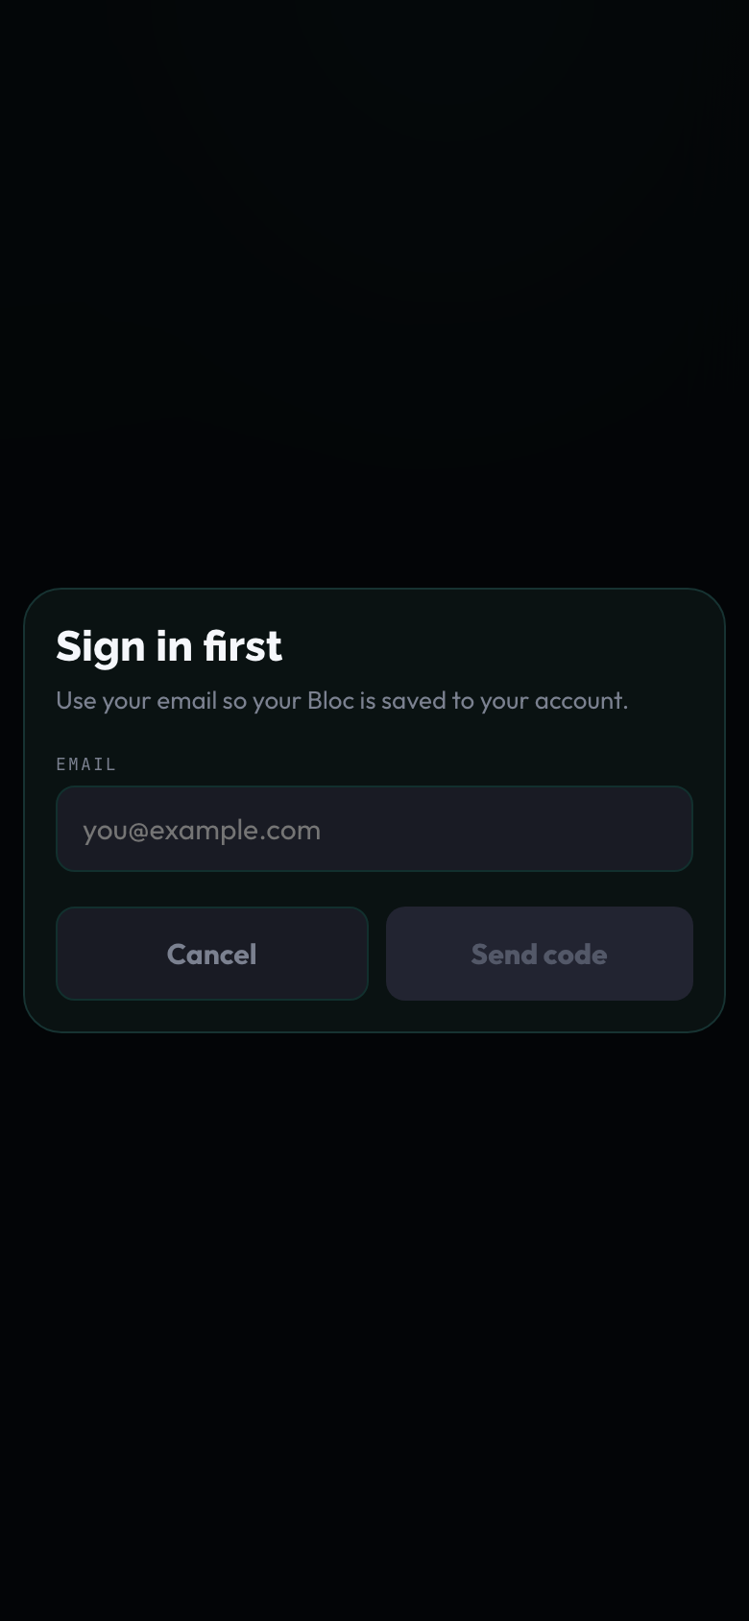
FERO
COLD USER: CREATE A BLOC
07 Sign In First Email
Captured from the real preview app UI
7 of 12

Slide 10
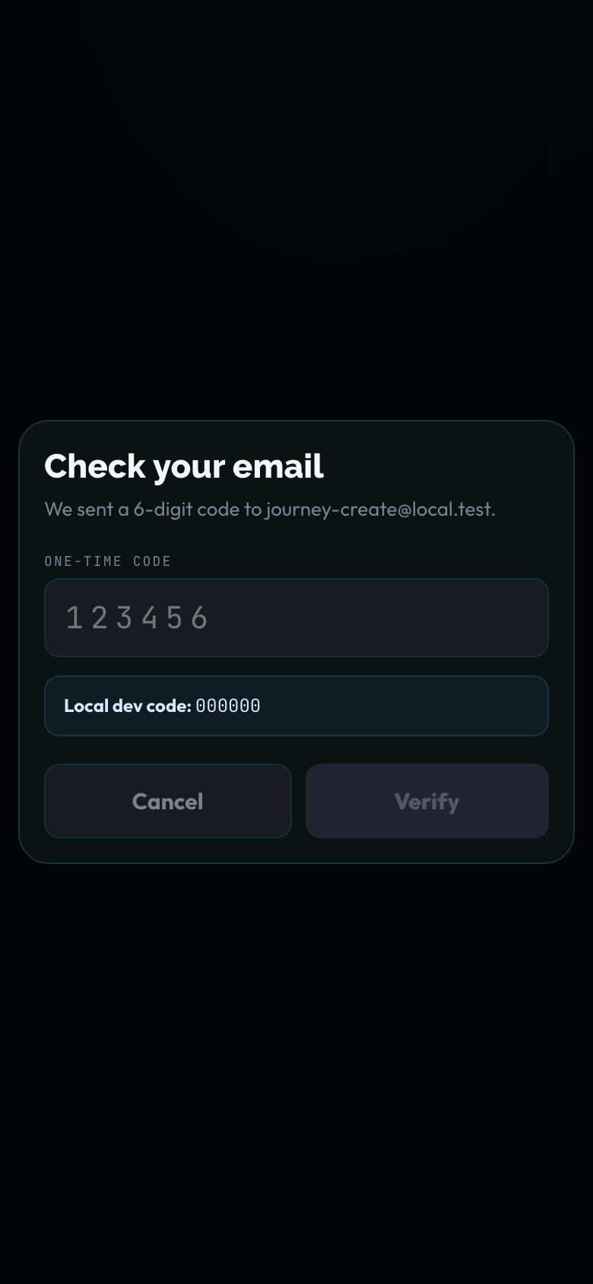
FERO
COLD USER: CREATE A BLOC
08 Otp Code
Captured from the real preview app UI
8 of 12

Slide 11
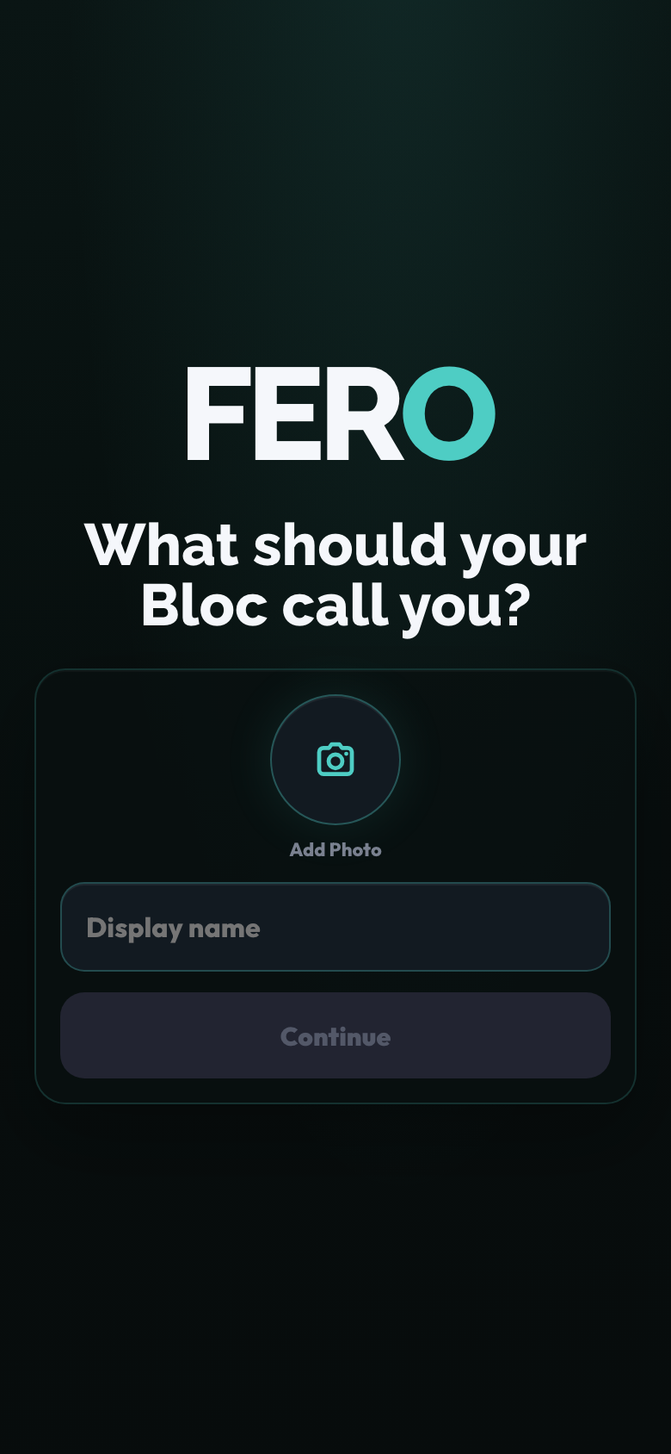
FERO
COLD USER: CREATE A BLOC
09 Display Name Photo Empty
Captured from the real preview app UI
9 of 12

Slide 12
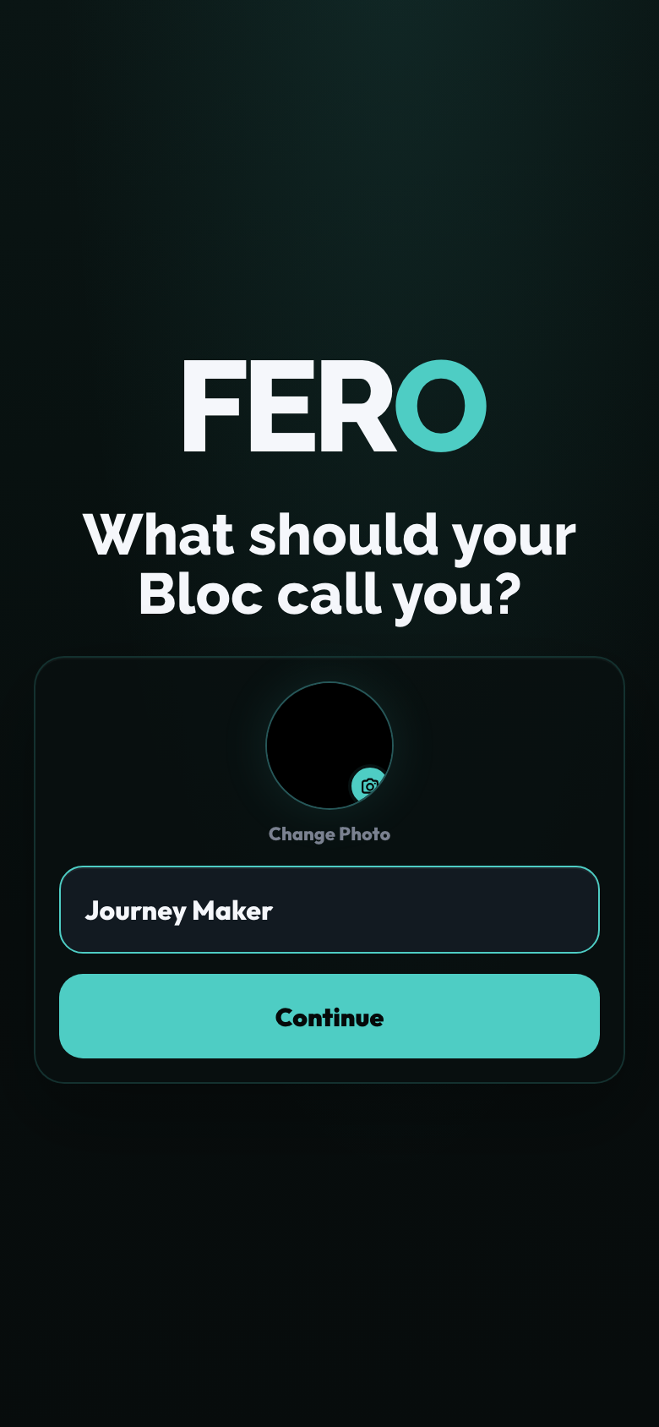
FERO
COLD USER: CREATE A BLOC
10 Display Name Photo Filled
Captured from the real preview app UI
10 of 12

Slide 13
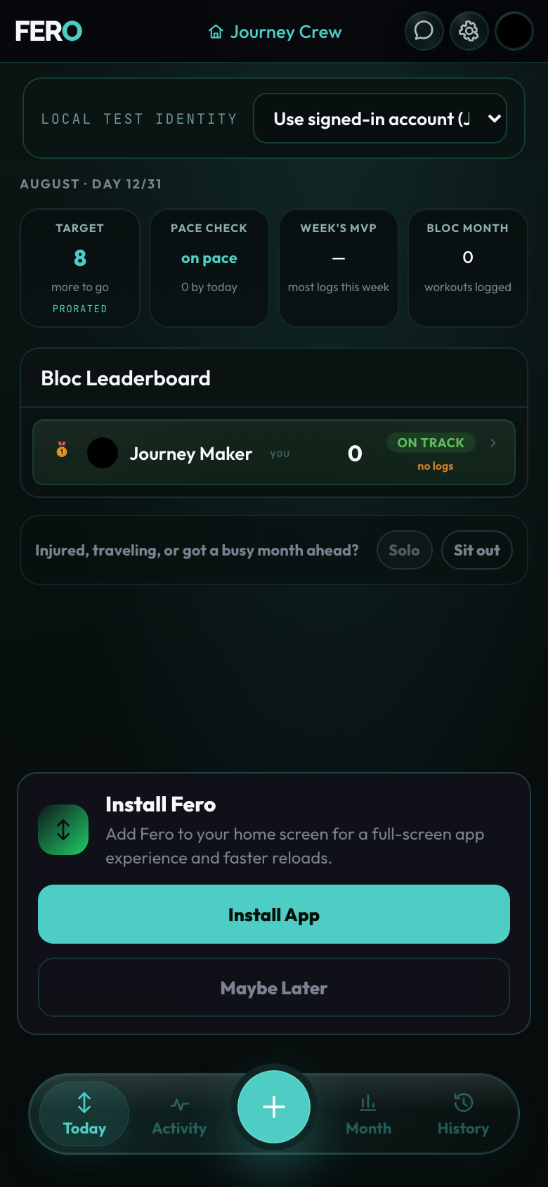
FERO
COLD USER: CREATE A BLOC
11 Progress Creating
Captured from the real preview app UI
11 of 12

Slide 14
FERO
COLD USER: CREATE A BLOC
12 Landed In New Bloc
Captured from the real preview app UI
12 of 12

Slide 15
FERO USER JOURNEY
Cold User: Join by Code
First install -> onboarding -> invite code -> auth -> display name/photo -> lands inside Bloc
2 / 5

Slide 16
FERO
COLD USER: JOIN BY CODE
01 Onboarding Join Entry
Captured from the real preview app UI
1 of 8

Slide 17
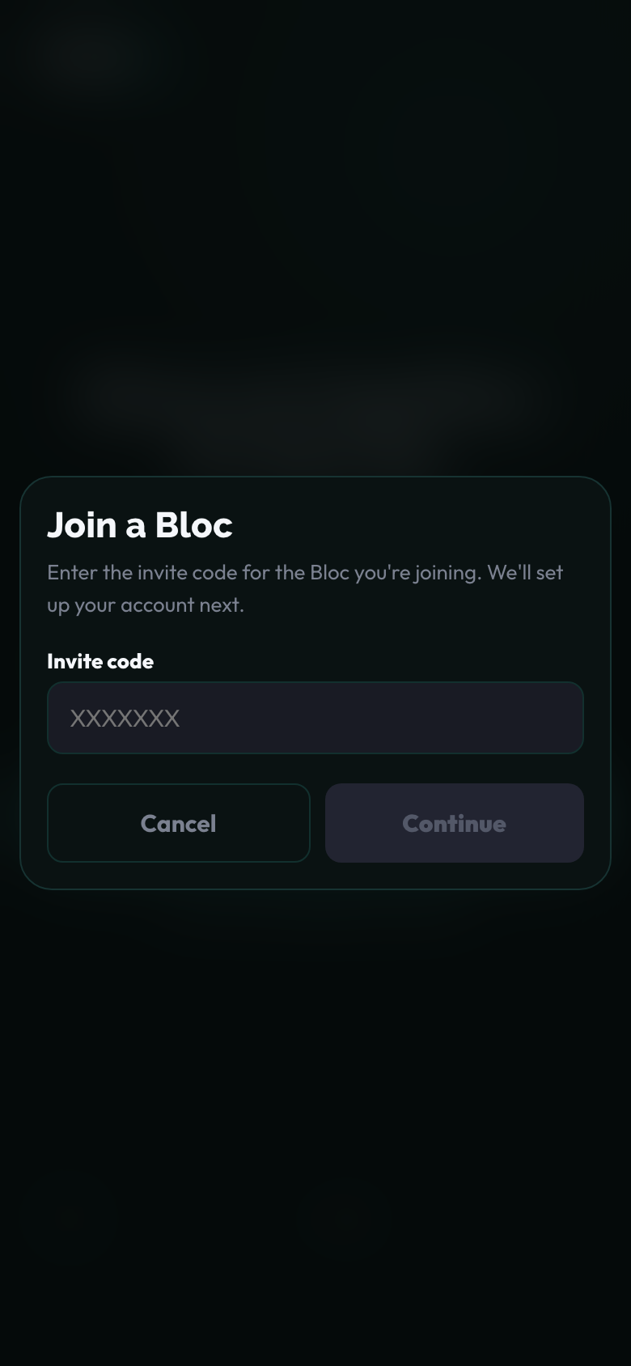
FERO
COLD USER: JOIN BY CODE
02 Invite Code
Captured from the real preview app UI
2 of 8

Slide 18
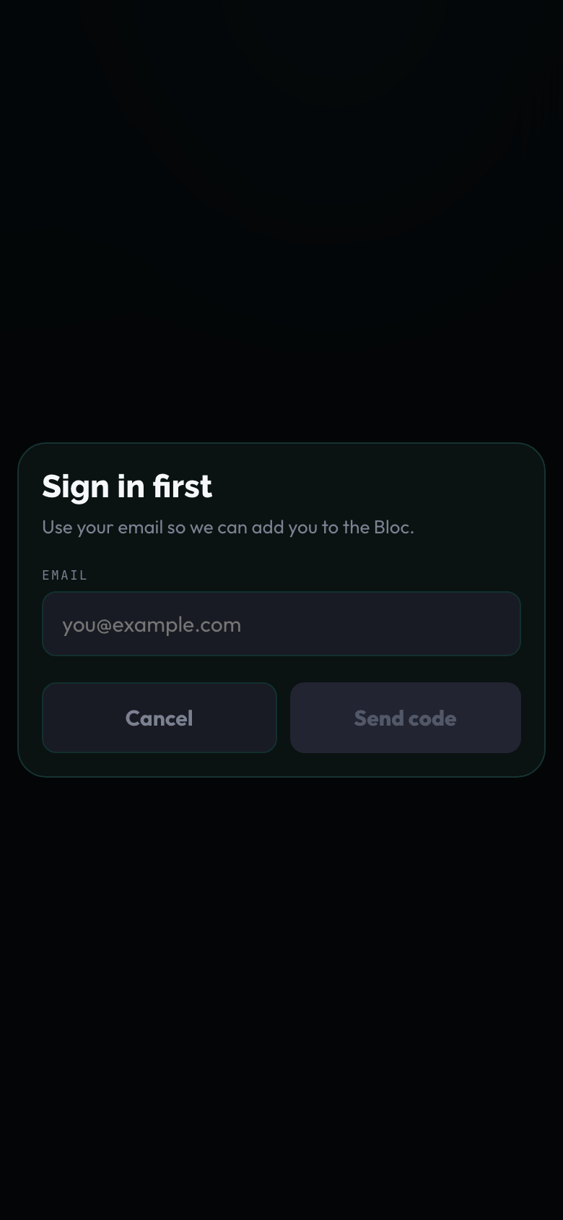
FERO
COLD USER: JOIN BY CODE
03 Sign In First Email
Captured from the real preview app UI
3 of 8

Slide 19

FERO
COLD USER: JOIN BY CODE
04 Otp Code
Captured from the real preview app UI
4 of 8

Slide 20
FERO
COLD USER: JOIN BY CODE
05 Display Name Photo Empty
Captured from the real preview app UI
5 of 8

Slide 21
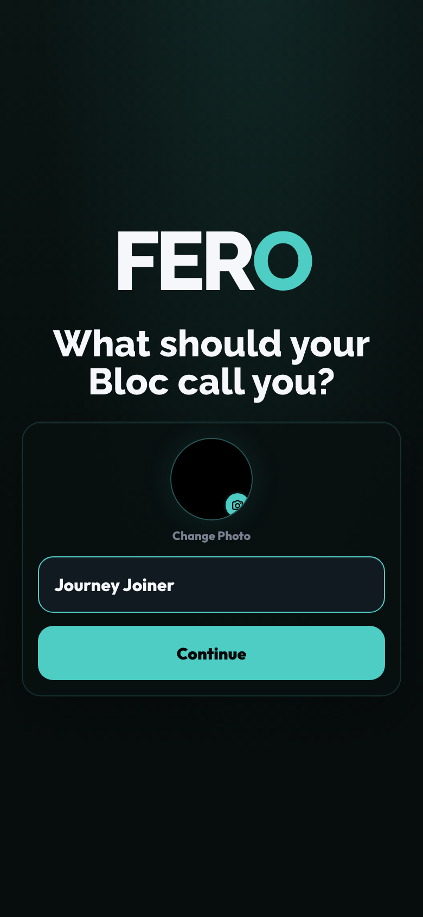
FERO
COLD USER: JOIN BY CODE
06 Display Name Photo Filled
Captured from the real preview app UI
6 of 8

Slide 22
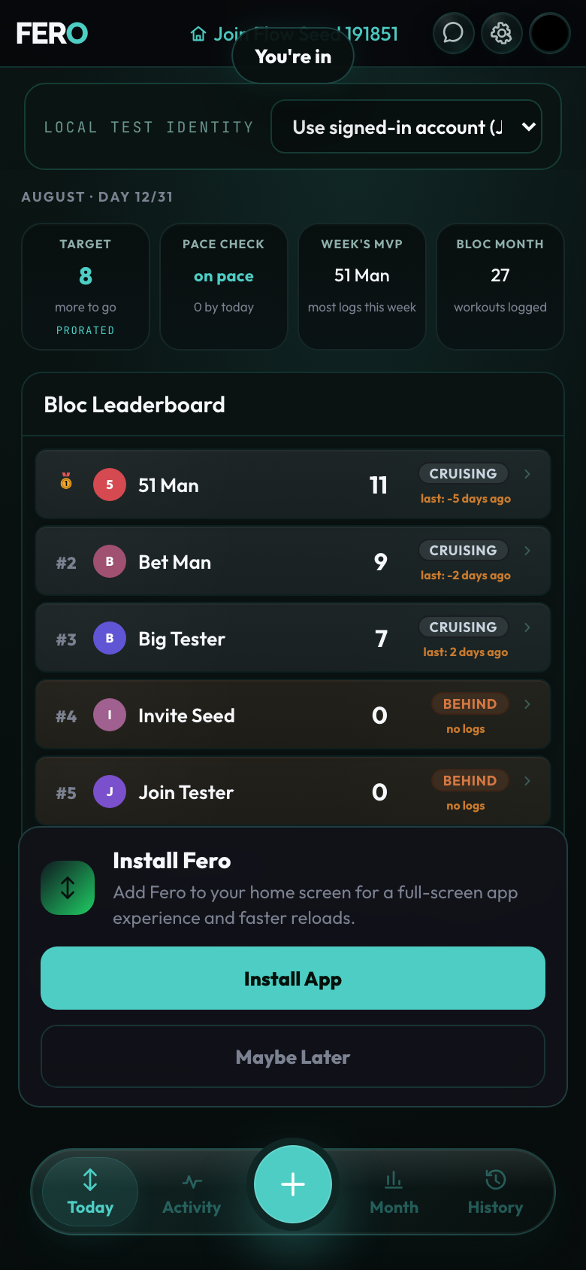
FERO
COLD USER: JOIN BY CODE
07 Progress Joining
Captured from the real preview app UI
7 of 8

Slide 23
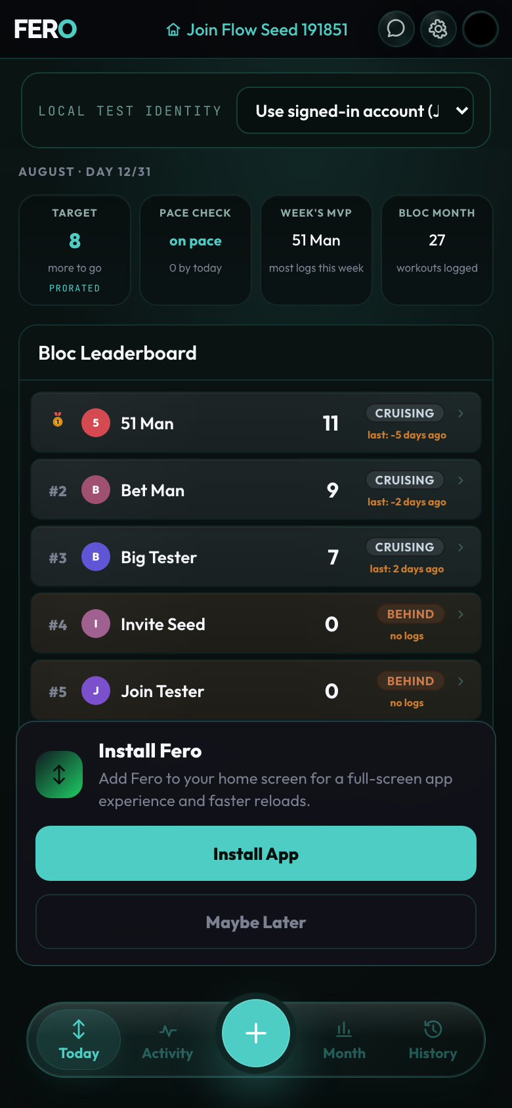
FERO
COLD USER: JOIN BY CODE
08 Landed In Joined Bloc
Captured from the real preview app UI
8 of 8

Slide 24
FERO USER JOURNEY
Invite Link: New User
Invite preview -> auth -> display name/photo -> lands inside invited Bloc
3 / 5

Slide 25
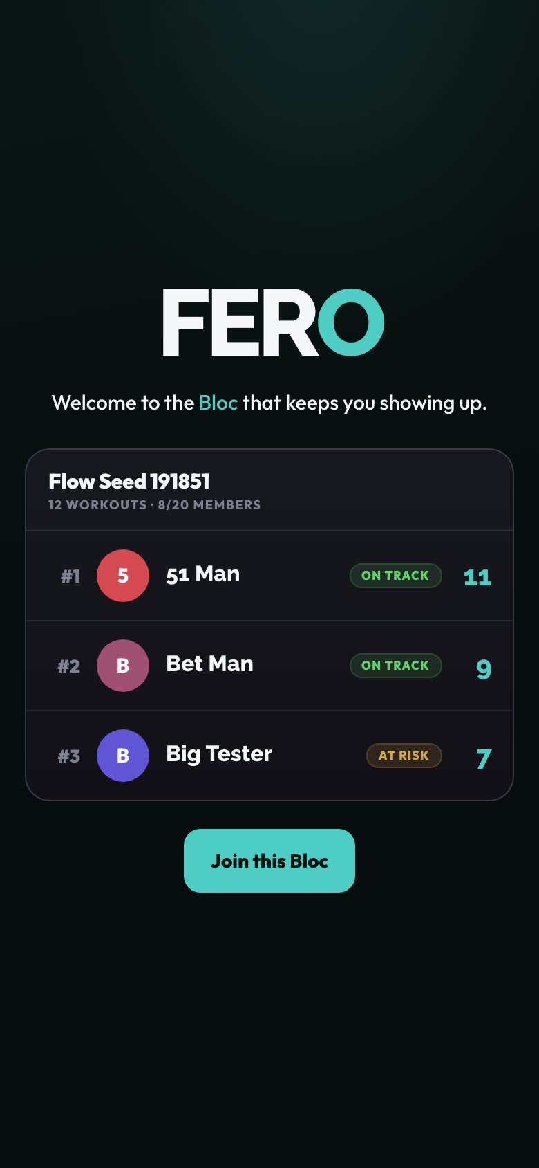
FERO
INVITE LINK: NEW USER
01 Invite Preview
Captured from the real preview app UI
1 of 7

Slide 26
FERO
INVITE LINK: NEW USER
02 Sign In First Email
Captured from the real preview app UI
2 of 7

Slide 27

FERO
INVITE LINK: NEW USER
03 Otp Code
Captured from the real preview app UI
3 of 7

Slide 28
FERO
INVITE LINK: NEW USER
04 Display Name Photo Empty
Captured from the real preview app UI
4 of 7

Slide 29
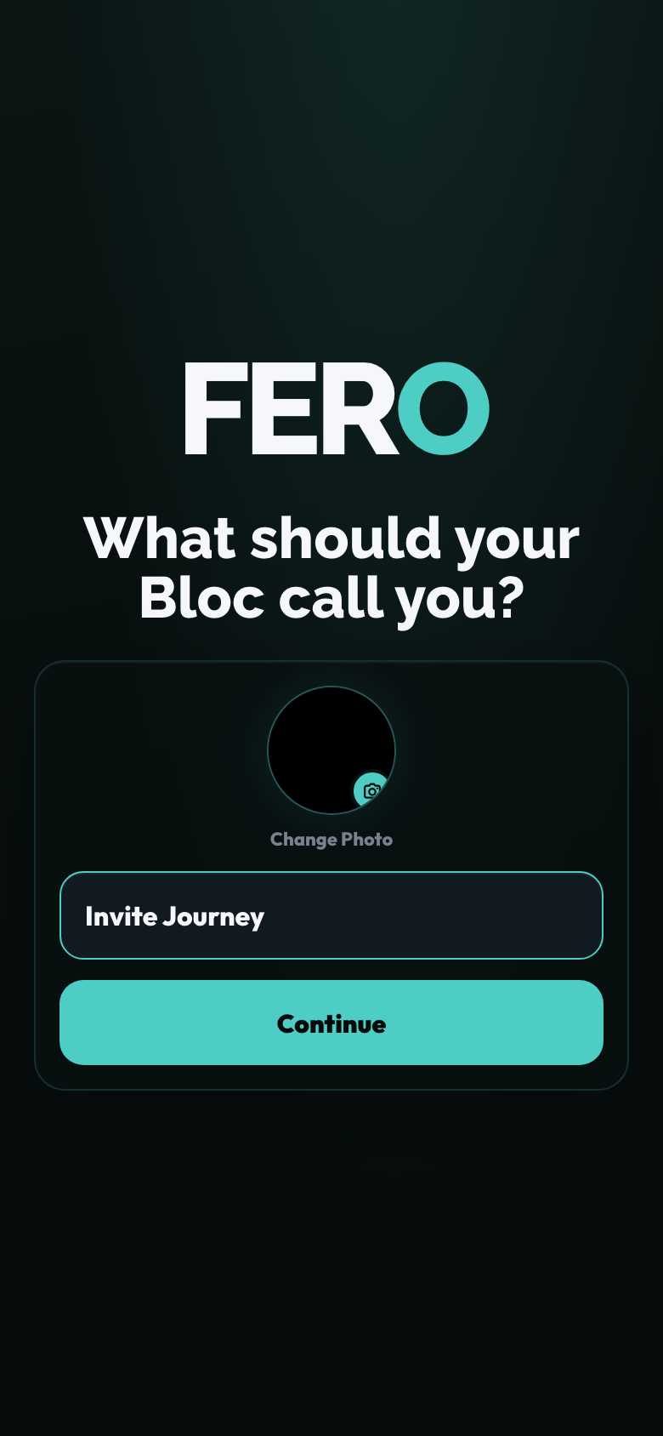
FERO
INVITE LINK: NEW USER
05 Display Name Photo Filled
Captured from the real preview app UI
5 of 7

Slide 30
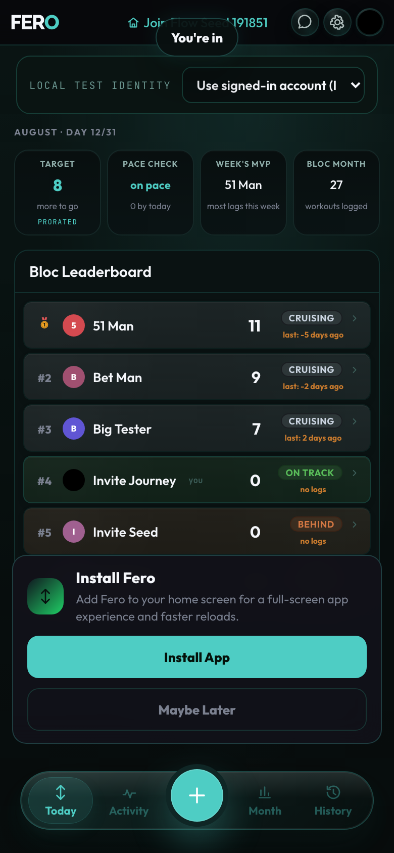
FERO
INVITE LINK: NEW USER
06 Progress Joining
Captured from the real preview app UI
6 of 7

Slide 31

FERO
INVITE LINK: NEW USER
07 Landed With Toast
Captured from the real preview app UI
7 of 7

Slide 32
FERO USER JOURNEY
Welcome Back: Create New Account
Signed-out welcome -> create account -> onboarding -> create Bloc -> lands inside Bloc
4 / 5

Slide 33
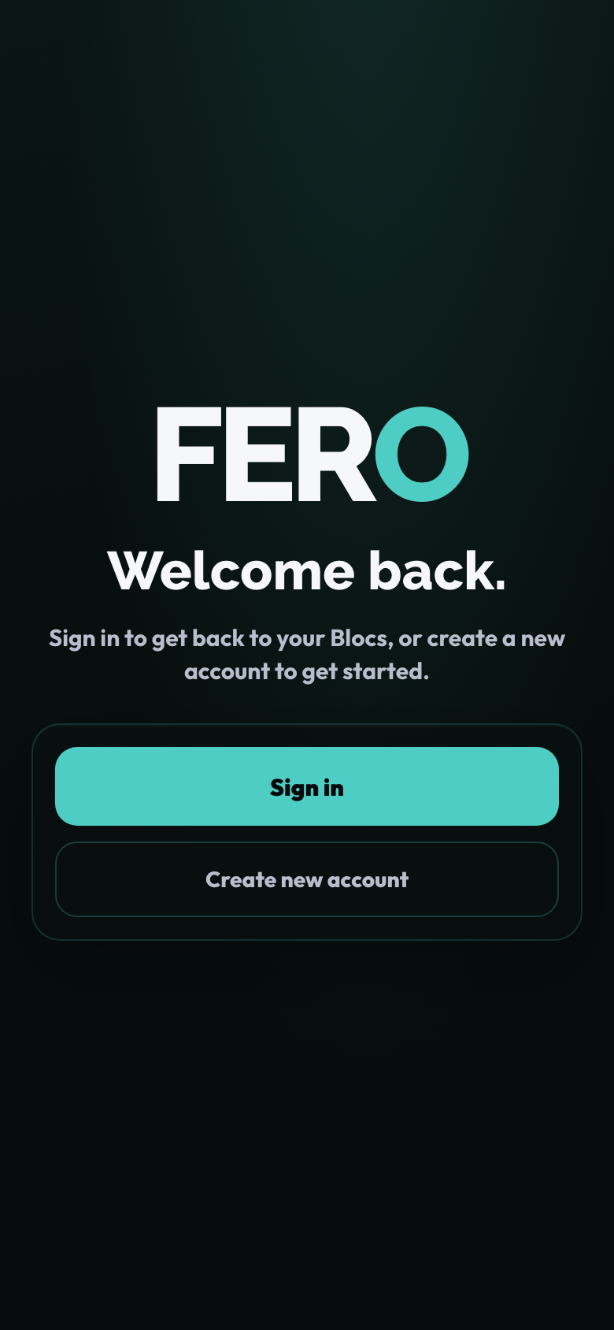
FERO
WELCOME BACK: CREATE NEW ACCOUNT
01 Welcome Back
Captured from the real preview app UI
1 of 9

Slide 34
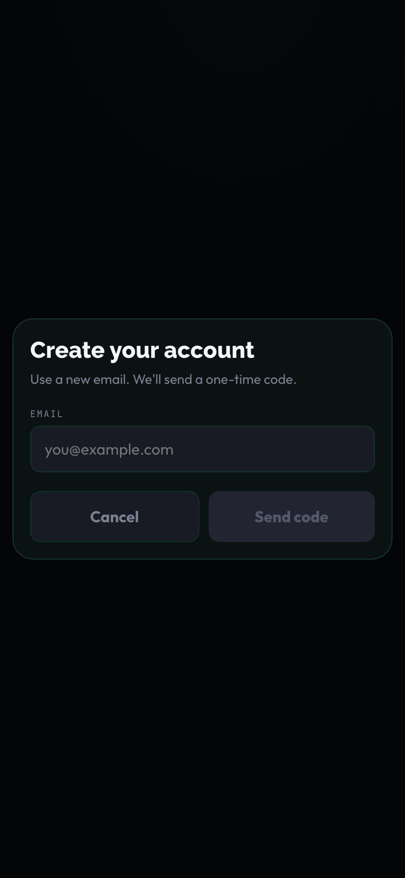
FERO
WELCOME BACK: CREATE NEW ACCOUNT
02 Create Account Email
Captured from the real preview app UI
2 of 9

Slide 35

FERO
WELCOME BACK: CREATE NEW ACCOUNT
03 Otp Code
Captured from the real preview app UI
3 of 9

Slide 36
FERO
WELCOME BACK: CREATE NEW ACCOUNT
04 Onboarding Start After Account
Captured from the real preview app UI
4 of 9

Slide 37
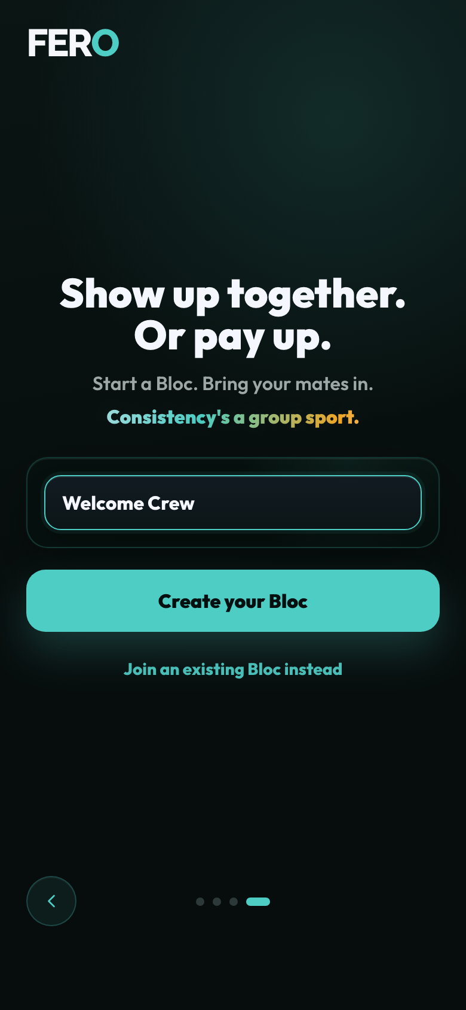
FERO
WELCOME BACK: CREATE NEW ACCOUNT
05 Onboarding Create Entry
Captured from the real preview app UI
5 of 9

Slide 38
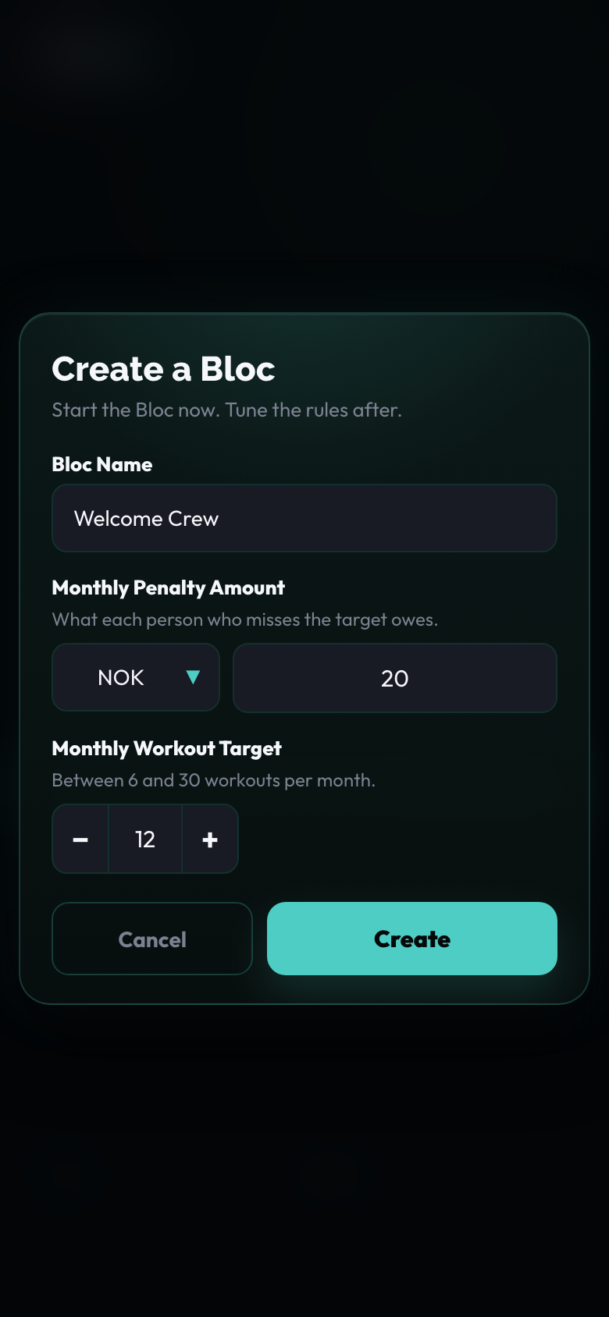
FERO
WELCOME BACK: CREATE NEW ACCOUNT
06 Create Bloc Modal
Captured from the real preview app UI
6 of 9

Slide 39

FERO
WELCOME BACK: CREATE NEW ACCOUNT
07 Display Name Photo Filled
Captured from the real preview app UI
7 of 9

Slide 40

FERO
WELCOME BACK: CREATE NEW ACCOUNT
08 Progress Creating
Captured from the real preview app UI
8 of 9

Slide 41
FERO
WELCOME BACK: CREATE NEW ACCOUNT
09 Landed In New Bloc
Captured from the real preview app UI
9 of 9

Slide 42
FERO USER JOURNEY
Edge States
Invalid invite and already-member handling frames
5 / 5

Slide 43

FERO
EDGE STATES
01 Invalid Invite
Captured from the real preview app UI
1 of 2

Slide 44
FERO
EDGE STATES
02 Already Member Or Otp
Captured from the real preview app UI
2 of 2

