Slide 1


An Explainable Machine Learning Framework for Diabetes Risk Prediction and Personalized Health Monitoring
M.P. NACHIMUTHU M. JAGANATHAN ENGINEERING COLLEGE, CHENNIMALAI
DEPARTMENT OF COMPUTER SCIENCE AND ENGINEERING
Guide By
Mrs.D.SUGANTHI, AP/CSE Presented by
AADHISESHAN K S (731725405001)

Slide 2
ABSTRACT
Diabetes is a chronic metabolic disorder that requires early risk assessment and continuous health monitoring. Conventional machine learning approaches can predict diabetes risk from patient health parameters, but many systems provide limited explanations and lack personalized monitoring capabilities.
This project proposes an explainable machine learning framework that uses patient health data to estimate diabetes risk. Algorithms such as Logistic Regression, Random Forest, and XGBoost will be trained and evaluated to identify a suitable predictive model. SHAP (SHapley Additive exPlanations) will be integrated to explain the contribution of individual features to the predictions.
The framework will also maintain historical health measurements, visualize changes in predicted risk over time, and provide general health-monitoring information through an interactive dashboard. The objective is to develop a transparent, interpretable, and user-friendly decision-support system for diabetes risk assessment and monitoring.

Slide 3
OBJECTIVES OF THE PROJECT
To develop a machine learning model for estimating diabetes risk using relevant patient health parameters.
To compare multiple machine learning algorithms and evaluate their predictive performance.
To apply Explainable AI techniques to identify the major factors influencing individual predictions.
To develop a personalized health-monitoring mechanism that stores measurements and tracks predicted risk over time.
To visualize risk estimates, feature contributions, and historical trends using an interactive dashboard.
To evaluate the framework using appropriate classification, calibration, and explainability metrics.

Slide 4
EXISTING SYSTEM
Existing diabetes prediction systems commonly use statistical and machine learning methods to estimate diabetes status or risk from health and demographic information.
Common approaches
Logistic Regression for baseline prediction.
Decision Tree and Random Forest for nonlinear classification.
SVM and KNN for classification.
XGBoost and other ensemble methods for predictive modelling.
Standalone dashboards that display the predicted class or probability.

Slide 5
DRAWBACKS OF EXISTING SYSTEM
Limited Interpretability: Some models provide predictions without explaining the individual factors that influenced the result.
One-time Prediction: Many prototypes assess a patient only once instead of maintaining historical measurements.
Limited Personalization: Generic outputs may not explain the most relevant factors for each individual.
Dataset Limitations: Small or population-specific datasets may limit generalization to other populations.
Incomplete Evaluation: Accuracy alone can hide poor recall or an excessive false-positive rate.
Limited Monitoring Interface: Some implementations do not provide historical trends or understandable visualizations.
Risk of overconfidence: A model-generated probability may be poorly calibrated and should not be interpreted as a clinical diagnosis.

Slide 6
PROPOSED SYSTEM
The proposed system integrates Machine Learning (ML), Explainable Artificial Intelligence (XAI), and personalized health monitoring to estimate diabetes risk and explain the factors influencing each prediction.
Collect patient health data such as age, BMI, glucose level, blood pressure, and other available clinical attributes.
Preprocess the data by handling missing values, invalid entries, and categorical variables.
Train and compare ML algorithms such as Logistic Regression, Random Forest, and XGBoost.
Predict diabetes risk using the selected model.
Apply SHAP (SHapley Additive exPlanations) to identify the features contributing to an individual prediction.
Store dated health measurements and prediction history to visualize changes over time.
Display risk estimates, feature explanations, and historical trends through a user-friendly dashboard.

Slide 7
ADVANTAGES OF PROPOSED SYSTEM
Improved Transparency: SHAP explains the contribution of individual input features.
Model Comparison: Multiple algorithms can be evaluated to identify the most suitable model.
Personalized Explanations: Users can see which features influenced their individual prediction.
Longitudinal Monitoring: Historical health measurements and risk estimates can be visualized over time.
Interactive Visualization: A dashboard makes results easier to understand.
Comprehensive Evaluation: Accuracy, precision, recall, F1-score, ROC-AUC and calibration can be assessed.
Extensible Architecture: Additional datasets, monitoring features and models can be integrated later.
Decision-support Potential: The system can help organize information for discussion with healthcare professionals.

Slide 8
PROPOSED SYSTEM ARCHITECTURE
Patient Health Data
Age, BMI, Glucose, Blood Pressure and other available features
Data Preprocessing
Validation, Missing-value Handling, Encoding and Scaling where required
Machine Learning Models
Logistic Regression – Random Forest - XGBoost
Risk Prediction
Estimated Probability or Risk Category
SHAP Explanation
Features contributing to the Prediction
Personalized Health Monitoring
Stored Data Measurements and Prediction History
Interactive Dashboard
Risk estimates, explanations and Historical trend charts

Slide 9
MODULE – 1 PATIENT HEALTH DATA COLLECTION
Objective: Collect the health-related information required to predict diabetes risk.
Module Description:
Collect patient health data from user input or a dataset.
Use relevant features such as age, BMI, glucose level, blood pressure, insulin level, and pregnancies, if available.
Validate input values and check whether required fields are provided.
Prepare the data for further processing by the machine learning pipeline.
Input: Patient health parameters or dataset records.
Output: Raw patient health data ready for preprocessing.

Slide 10
MODULE – 2 DATA PREPROCESSING
Objective: Improve data quality and prepare the dataset for machine learning.
Module Description:
Inspect the dataset for missing values, duplicate records, and inconsistent data.
Handle missing or invalid values using suitable preprocessing methods.
Encode categorical variables if present.
Apply feature scaling when required by the selected algorithm.
Split the dataset into training and testing sets.
Apply preprocessing consistently during both training and prediction.
Input: Raw patient health data.
Output: Cleaned and prepared dataset

Slide 11
MODULE – 3 MACHINE LEARNING MODELS
Objective: Train and compare machine learning algorithms for diabetes risk prediction.
Module Description:
Train Logistic Regression, Random Forest, and XGBoost models.
Learn patterns and relationships between health parameters and diabetes outcomes.
Compare model performance using accuracy, precision, recall, F1-score, and confusion matrix.
Select a suitable model based on evaluation results.
Save the trained model for use in the prediction application.
Input: Preprocessed training dataset.
Output: Trained machine learning model and evaluation results.

Slide 12
MODULE – 4 RISK PREDICTION AND SHAP EXPLANATION
Objective: Predict diabetes risk and explain the factors influencing the result.
Module Description:
Accept patient health parameters as input.
Use the selected trained model to generate a prediction.
Display the estimated probability or predicted class, depending on model support.
Apply SHAP (SHapley Additive exPlanations) to estimate the contribution of individual features.
Display important contributing factors using visualizations.
Help users understand why the model produced a particular result.
Input: Patient health parameters and trained model.
Output: Diabetes risk prediction and feature-contribution explanation.

Slide 13
MODULE – 5 PERSONALIZED HEALTH MONITORING
Objective: Help users review their health information and prediction history over time.
Module Description:
Store patient measurements and prediction history when storage is implemented.
Display previous predictions and recorded health measurements.
Compare current values with previously recorded values.
Provide general health-monitoring suggestions based on relevant parameters.
Encourage users to consult healthcare professionals when needed.
Protect stored health information through appropriate privacy and security measures.
Input: Patient measurements, prediction results, and historical records.
Output: Health history, trend information, and personalized monitoring insights.

Slide 14
MODULE – 6 INTERACTIVE DASHBOARD
Objective: Present predictions, explanations, and health information through a user-friendly interface.
Module Description:
Provide an interactive interface for entering patient health parameters.
Display diabetes risk predictions clearly.
Visualize model explanations and important health features.
Show model evaluation metrics and relevant charts.
Present historical health trends when records are available.
Enable users to navigate between prediction, explanation, and monitoring sections.
Input: Prediction results, SHAP explanations, evaluation metrics, and stored health records.
Output: Interactive dashboard with prediction results, explanations, and health visualizations.

Slide 15
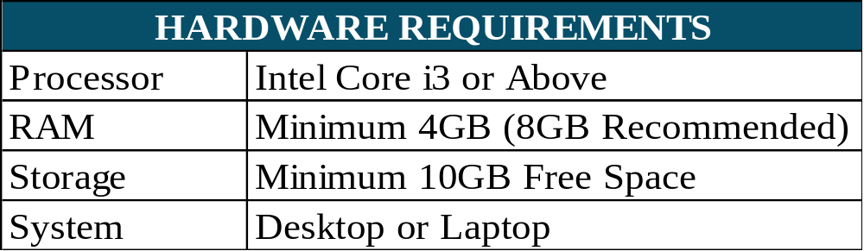
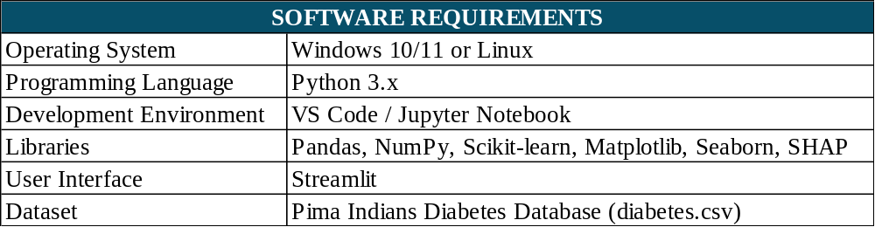
SYSTEM REQUIREMENTS

Slide 16
CONCLUSION
The project “An Explainable Machine Learning Framework for Diabetes Risk Prediction and Personalized Health Monitoring” aims to develop an intelligent system for predicting diabetes risk using machine learning techniques. The framework analyzes important health parameters such as glucose level, body mass index (BMI), blood pressure, insulin level, age, and other relevant attributes to estimate an individual's diabetes risk.
The system uses machine learning algorithms such as Logistic Regression, Decision Tree, and Random Forest to classify diabetes risk. Model performance can be evaluated using accuracy, precision, recall, F1-score, and a confusion matrix to identify a suitable prediction model. Explainable AI techniques such as SHAP and LIME can help users understand how individual health parameters influence the prediction, improving the transparency and interpretability of the system.

Slide 17
FUTURE SCOPE
Real-Time Monitoring: Integrate IoT devices and wearable health trackers.
Advanced Algorithms: Explore XGBoost, LightGBM, and ensemble learning.
Personalized Recommendations: Provide tailored lifestyle and health-monitoring suggestions.
Mobile Application: Develop an Android or iOS application for easy access.
Long-Term Tracking: Monitor health trends using historical data.
Clinical Validation: Test the framework on larger, diverse, clinically validated datasets.
Data Security: Implement encryption and secure health-data management.
Multilingual Support: Provide Tamil and other regional language options.

Slide 18
REFERENCES
P. Netayawijit, W. Chansanam, and K. Sorn-In, “Interpretable Machine Learning Framework for Diabetes Prediction: Integrating SMOTE Balancing with SHAP Explainability for Clinical Decision Support,” Healthcare, vol. 13, no. 20, article 2588, 2025. https://doi.org/10.3390/healthcare13202588
“A Comparative Study of Explainable Machine Learning Models with Shapley Values for Diabetes Prediction,” Healthcare Analytics, vol. 7, article 100390, 2025. https://doi.org/10.1016/j.health.2025.100390
M. Sree Vani et al., “Personalized Health Monitoring Using Explainable AI: Bridging Trust in Predictive Healthcare,” Scientific Reports, vol. 15, article 31892, 2025. https://doi.org/10.1038/s41598-025-15867-z
B. Barman, H. K. Choudhury, and B. Jajodia, “Interpretable Machine Learning for Diabetes Risk Prediction: A Large-Scale Analysis of Indian National Survey Data,” Discover Public Health, vol. 22, article 832, 2025. https://doi.org/10.1186/s12982-025-01236-8
“Explainable Machine Learning for Diabetes Classification and Web-Based Implementation,” Intelligence-Based Medicine, 2026. https://doi.org/10.1016/j.ibmed.2026.100400
R. Reátegui, L. Ramírez-Cerna, and E. Bautista-Valarezo, “Interpretable Diabetes Risk Prediction: A Comparative Study of Tree-Based Algorithms Using SHAP and LIME,” Scientific Reports, 2026. https://www.nature.com/articles/s41598-026-62441-2
“Explainable Reinforcement Learning for Glucose Monitoring Based on Shapley Value Analysis,” Computer Methods and Programs in Biomedicine, vol. 278, article 109266, 2026. https://doi.org/10.1016/j.cmpb.2026.109266

Slide 19
THANK YOU

