Slide 1
AMBA APB Protocol (Advanced Peripheral Bus)
Prepared byAadhithyaSB

Slide 2
Agenda
What is APB?
Signal Description
Master-Slave Configuration
Transfer examples (read/write/ Write Followed by Read)
Error Response
Operating states & timing
APB versions & features
APB vs AHB/AXI
Advantages & Disadvantages
Reference

Slide 3
What is APB?
AMBA (Advanced Microcontroller Bus Architecture) was introduced by ARM in 1996. The first AMBA buses were the Advanced System Bus (ASB) and the Advanced Peripheral Bus (APB).
APB is a member of the AMBA protocol family.
It offers a low-cost interface designed for minimal power consumption and reduced interface complexity.
APB is suitable for connecting low-bandwidth peripherals that do not require the high performance of a pipelined bus interface.
The protocol is unpipelined.
All signal transitions are synchronized to the rising edge of the clock, simplifying the integration of APB peripherals into any design flow.

Slide 4
Signal Description
Clock, Reset, and Address Signals:
PCLK: The rising edge of PCLK synchronizes all transfers on the APB.
PRESETn: Active-low APB reset signal, typically connected directly to the system bus reset.
PADDR: APB address bus, driven by the peripheral bus bridge, with a width of up to 32 bits.
Control Signals:
PSELx: Generated by the APB bridge for each slave, indicating the device is selected and a data transfer is required.
PENABLE: Signifies the second and subsequent cycles of an APB transfer.
PWRITE: When HIGH, indicates a write access; when LOW, indicates a read access.

Slide 5
Data and Response Signals:
PWDATA: Driven by the bridge during write cycles (PWRITE HIGH), with a width of up to 32 bits.
PRDATA: Driven by the selected slave during read cycles (PWRITE LOW), with a width of up to 32 bits.
PREADY: Used by the slave to extend an APB transfer.
PSLVERR: Indicates a transfer failure. Note: APB peripherals are not required to support this pin. If unused, the bridge input should be tied LOW.

Slide 6
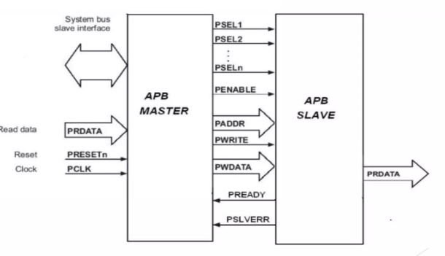
Master-Slave Configuration

Slide 7
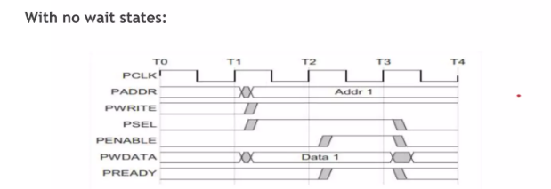
Write Transfers
SETUP: PSELx=1, PWRITE=1, PADDR, PWDATA stable (PENABLE=0)
ACCESS: PENABLE=1; slave samples PWDATA; PREADY=1; complete on this cycle

Slide 8
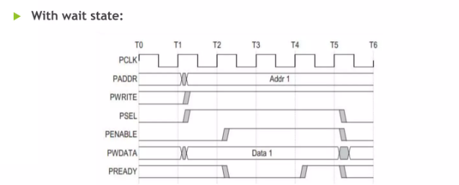
Write Transfers

Slide 9
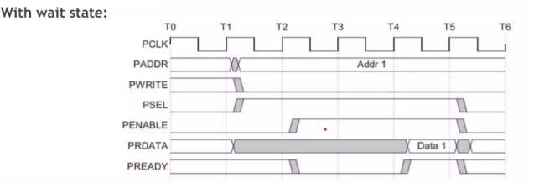
Read Transfers
1) SETUP: PSELx=1, PWRITE=0, PADDR stable (PENABLE=0)
2) ACCESS: PENABLE=1; slave drives PRDATA; PREADY=1; master samples PRDATA

Slide 10
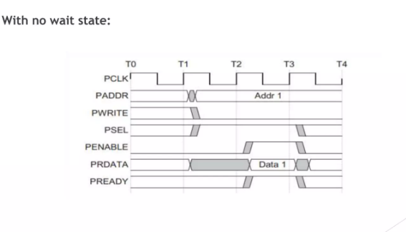
Read Transfers

Slide 11
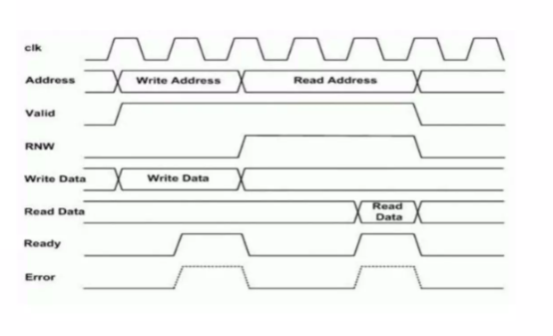
Write followed by read

Slide 12
Error response
APB Transfer Error Handling (PSLVERR)
PSLVERR indicates an error condition on both read and write APB transfers.
The error signal is only valid during the last cycle of a transfer, when PSEL, PENABLE, and PREADY are all HIGH.
It is recommended (but not mandatory) to drive PSLVERR LOW when not being sampled (i.e., when any of PSEL, PENABLE, or PREADY are LOW).
Error Implications:
Transactions with errors may or may not change the peripheral’s state (peripheral-specific).
For write transactions, an error does not guarantee that the peripheral register was left unchanged.
For read transactions, an error may return invalid data (no requirement to drive all 0s).

Slide 13
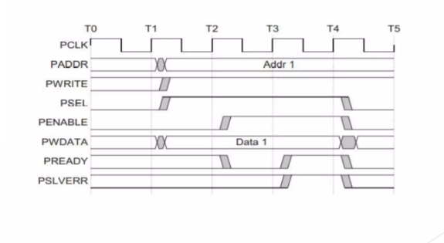
Failing Write Transfer

Slide 14
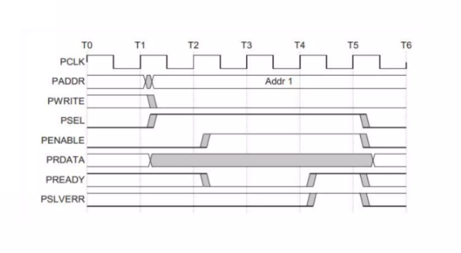
Failing Read Transfer

Slide 15
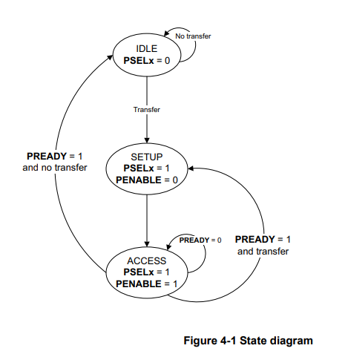
Operating States & Transfer Sequence
APB transfer has three main states:
• IDLE : default state, no transfer
• SETUP : master asserts PSELx and provides address/control (1 cycle)
• ACCESS : PENABLE asserted; data transferred; slave drives PREADY/PSLVERR
Notes: PREADY low extends ACCESS (wait states); signals must remain stable while PREADY is low.

Slide 16
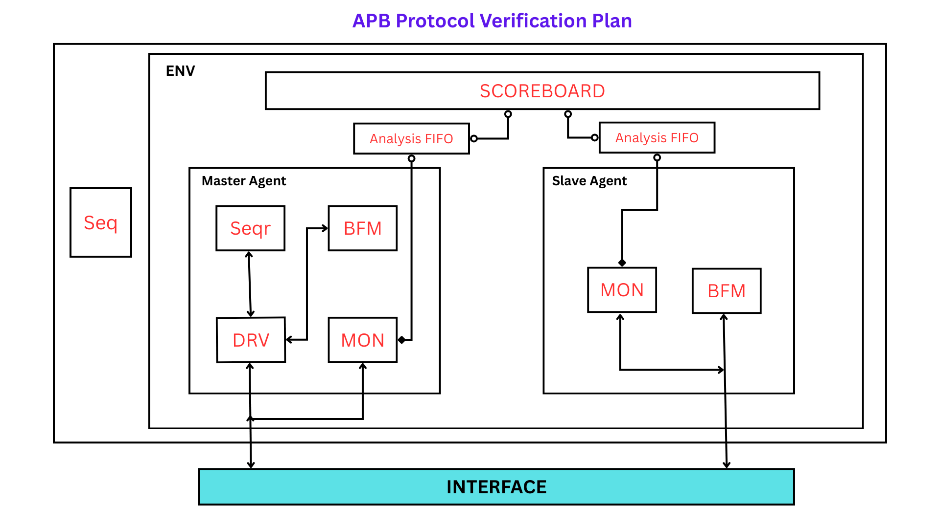
APB Verification Plan

Slide 17
APB Versions & Notable Features
APB2 / APB3 / APB4 / APB5 (AMBA evolution)
• APB3/APB4 added features: protection (PPROT), write strobes (PSTRB), wake-up, parity, user signaling (varies by version)
• APB4 is backward compatible with APB3; APB keeps interface simple for peripherals.

Slide 18
APB vs AHB / AXI (When to use)
• APB: low-bandwidth, low-power peripherals (register access)
• AHB/AXI: higher performance, burst transfers, pipelined and/or out-of-order (use for memories, DMA, high-speed peripherals)
• Use APB behind an interconnect fabric (bridged from AHB/AXI) for control registers

Slide 19
Advantages
Ideal for low-bandwidth peripherals: UART, I2C controllers, GPIO, timers, watchdogs.
Low logic overhead, easy to implement, low-power.
Slave-controlled wait states using PREADY for simple flow control.
Disadvantages
Low Bandwidth: Not for high-speed data transfers.
No Burst Support: Only single-word reads/writes.
High Latency: Requires at least 2 clock cycles per transfer.
Single Master Only: No multi-master support.

Slide 20
References
Key references used while preparing this presentation:
ARM AMBA APB Protocol Specification (ARM Developer)
Udemy: APB Protocol project

