Slide 1

Sentiment Analysis of social media 5th June 2024 To 25th July 2024
Presented by:
AADHYA GAJJAR
Computer Science and Engineering
Enrollment Number: 21cs002356
Supervisor: FULL NAME & AFFILIATION (Company Name)

Slide 2
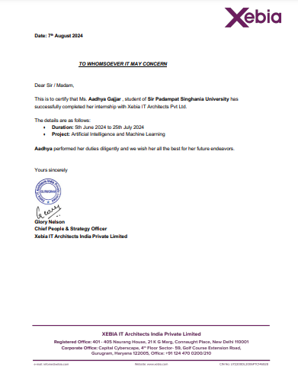
Internship Certificate

Slide 3
Introduction
Xebia is a global IT consultancy company that provides digital transformation services, with a focus on delivering high-quality software and IT solutions. Founded in 2001, Xebia has grown to become a leading player in the technology sector, known for its expertise in agile methodologies, DevOps, cloud computing, big data, artificial intelligence, and machine learning.
Mentorship from experienced professionals.
Networking with industry experts.
Experience in various technology used.
Hands-on experience
Real world problem solving
valuable stepping stone for a career in technology

Slide 4
Internship Objectives
Duration: 2 Months (5th June 2024 - 25th July 2024)
Location: Remote
Internship Type : Part-time
Company's Expectations: Power BI , Machine learning, Problem solving, logical thinking.
Internship Objective:

Slide 5
Key Responsibilities & Roles
Data Preprocessing
Feature Engineering
Model Selection and Training
Model Evaluation

Slide 6
List of skills
Tools used
Power BI
Jupyter notebook
Machine learning
Power BI
Problem solving
Logical thinking

Slide 7
Project Description
The Sentiment Analysis of Social Media Using Python project aims to harness the power of natural language processing (NLP) and machine learning to analyze and classify the sentiments expressed in social media posts. The project is designed to process large volumes of text data from platforms such as Twitter, Facebook, Instagram, or Reddit, identifying whether the expressed sentiments are positive, negative, or neutral.
Focus on Impact
The tool's impact is significant, as it can help businesses monitor public sentiment towards their brand, identify potential crises, and inform marketing strategies. Additionally, researchers can use it to study societal trends and public opinion on various topics.

Slide 8
Lessons Learned
1. Data Quality and Preprocessing
Data Cleaning
Data Labeling
2. Model Selection and Tuning
Algorithm Suitability
Hyperparameter Tuning
3. Feature Engineering
Text Representation
Balancing Feature Complexity and Model Interpretability

Slide 9
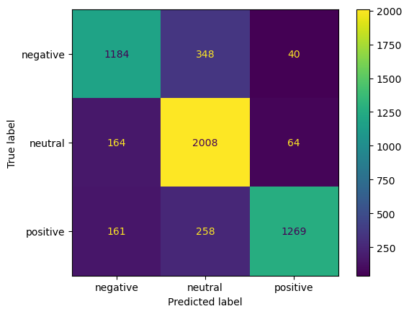
Conclusion and Results

Slide 10
Future Work
Experiment with state-of-the-art deep learning architectures such as BERT, GPT, and transformers to improve sentiment detection.
Optimize models and algorithms for scalability to handle large volumes of social media data efficiently.
Implement systems for real-time sentiment analysis to monitor and respond to social media trends and public opinion as they evolve
Developing models that not only predict sentiment but also provide explanations for their predictions.

Slide 11
Mentor Contact Information
Mentor / Coordinator :- Sevy
Email :- sevysingh2223@gmail.com
Software development, Xebia.
Address :- Gurugram,India.

