Slide 1

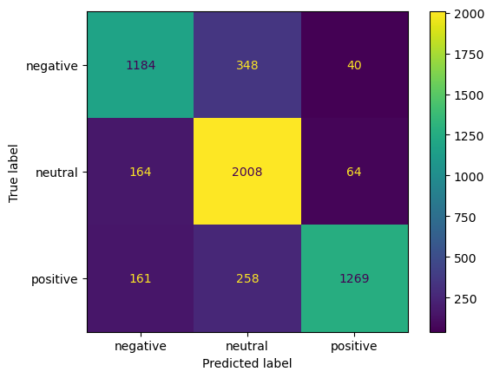
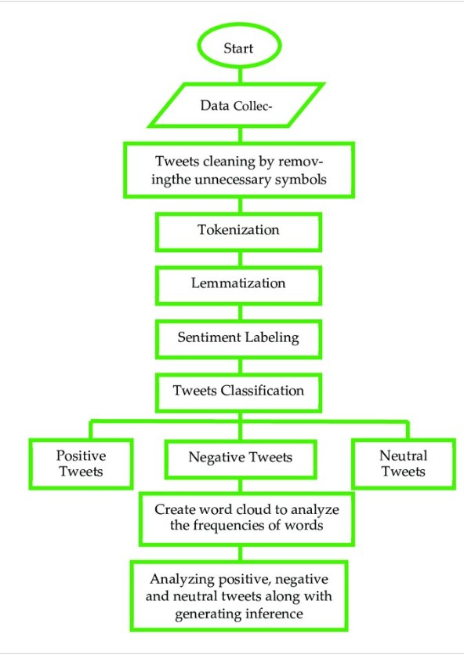
Sentiment Analysis of social media
By Aadhya Gajjar
Abstract/Intro/Motivation
Objectives
Results/Discussion
Develop a system to accurately classify social media sentiment (positive, negative, neutral).
Utilize machine learning techniques such as logistic regression and random forest.
Analyze large-scale user content to extract insights into public opinion.
Support decision-making in market research, customer feedback, and political trends.
The project "Sentiment Analysis of Social Media Using Python" focuses on classifying the sentiment of social media text as positive, negative, or neutral using machine learning techniques like logistic regression and random forest. Leveraging Python libraries such as NLTK, TextBlob, and scikit-learn, the project preprocesses data through tokenization and vectorization. The effectiveness of the models is evaluated using metrics like accuracy, precision, recall, and F1 score. The results indicate that these methods can accurately predict public sentiment, offering valuable insights for applications in market research, customer feedback, and political analysis.
Methods
Background
Future Directions
Recent research aims to enhance sentiment analysis accuracy using advanced machine learning models.
Techniques include logistic regression, random forest, CNNs, and RNNs.
Challenges faced:-
Managing the informal and diverse language used on social media.
Incorporating context and multimodal data (e.g., images, videos) for a more nuanced understanding of public sentiment.
Experiment with state-of-the-art deep learning architectures such as BERT, GPT, and transformers to improve sentiment detection.
Optimize models and algorithms for scalability to handle large volumes of social media data efficiently.
Implement systems for real-time sentiment analysis to monitor and respond to social media trends and public opinion as they evolve.
.
Notes:
feel free to change background colors & text boxes and use sections for difference purposes!

