Slide 1
FPGA based controller design for CMOS camera sensor

Slide 2
Contents:
FPGAs and LUTs
Zynq Ultra scale plus
GSENSE2020 Camera sensor
SPI Protocol
Block diagram
LVDS
Pin mapping
Sensor Config
SPI O/P

Slide 3
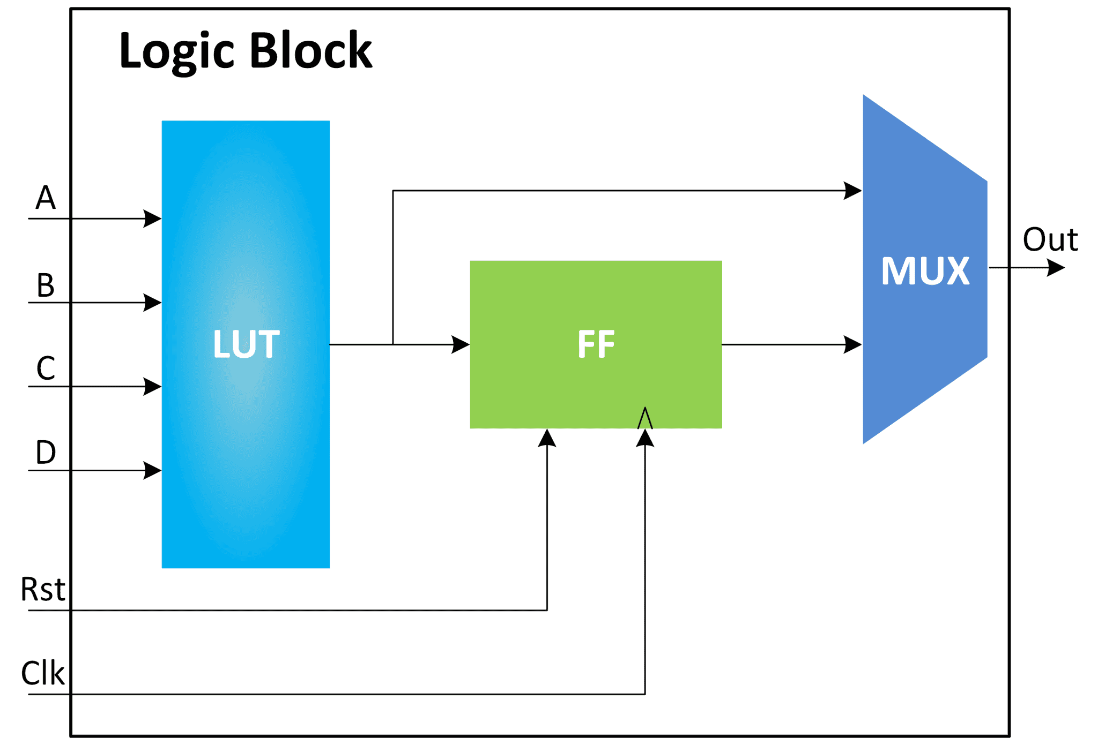
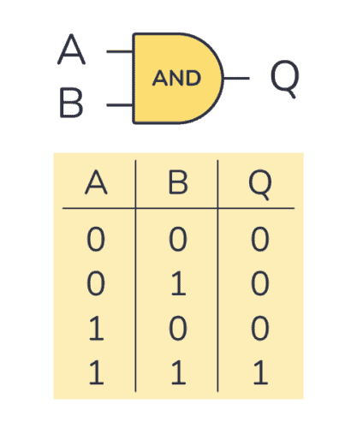

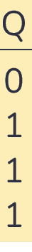
FPGAs and LUTs
A field-programmable gate array (FPGA) is a type of configurable integrated circuit that can be repeatedly programmed after manufacturing.
0
1
0
A
O/P
1
0
1
B
A
Total possible functions: 2^{(2^2)} = 2^4 = 16 unique functions
Total possible functions: 2^{(2^6)} = 2^{64} \approx 18,446,744,073,709,551,616 unique functions,18 quintillion functions

Slide 4
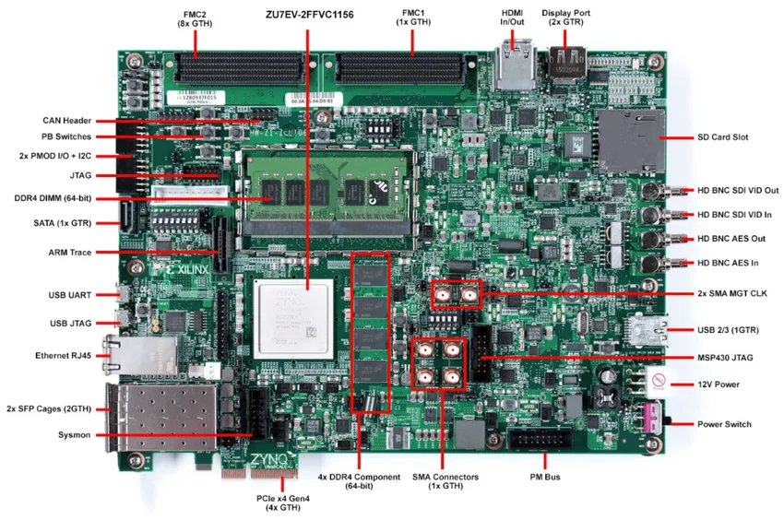
FPGA Board — Zynq UltraScale+ MPSoC
Features:
System logic cells 504,000
DSP Slices 1728
2x FPGA mezzanine card (FMC) interfaces
Dual DDR4 Memory
It includes a hardwired H.265 video codec

Slide 5
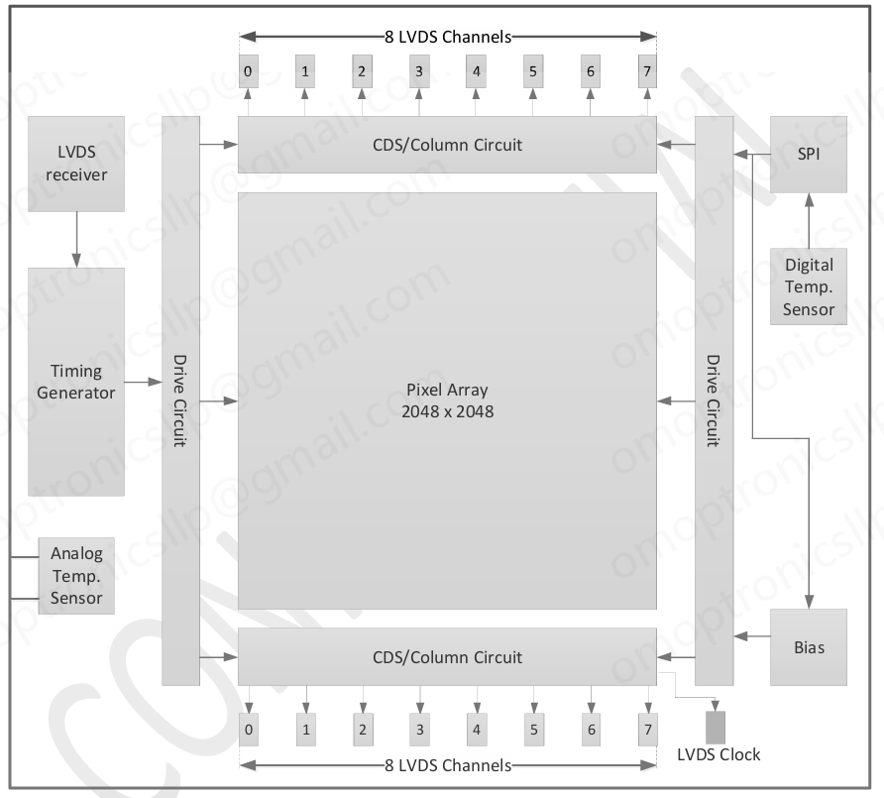
GSENSE2020 BSI camera sensor
Pixel Array 2048 x 2048 (6.5μm Square Pixels )
The sensor uses a maximum of 16 LVDS output pairs.
On chip Analog Temp. Sensor and Digital Temp. Sensor.
11 bit and 12 bit ADC.
For configuring data it uses SPI protocol
Shutter type: Rolling shutter with Global reset.

Slide 6
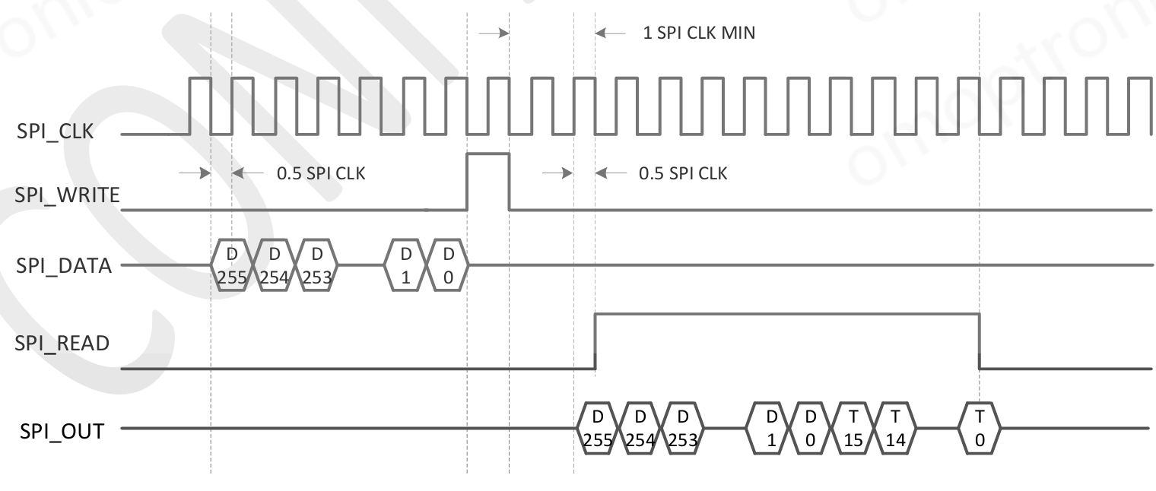
SPI protocol to configure data
Serial peripheral interface is a full duplex, master slave serial communication protocol here it is used for short comm b/w FPGAs and camera sensor.
It is used to do register mapping of camera sensor which controls bias voltages, ADC gains, exposure time and much more.
It also reads out the same register mapped data before exposure.

Slide 7
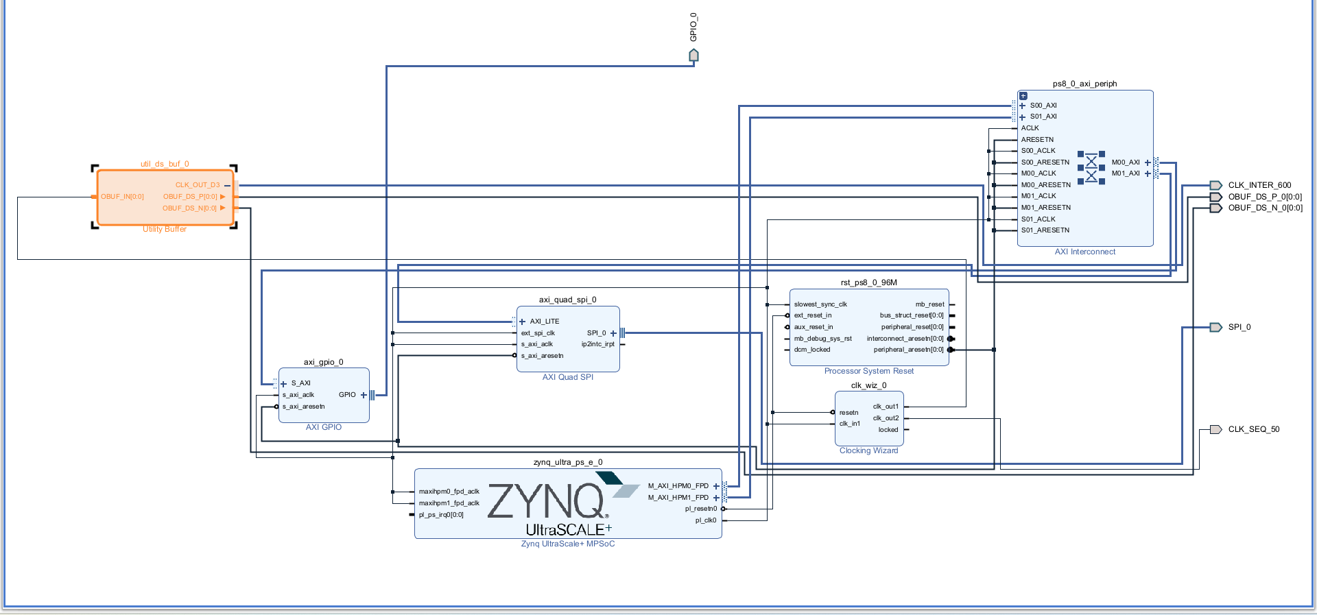
SPI Protocol Block diagram

Slide 8
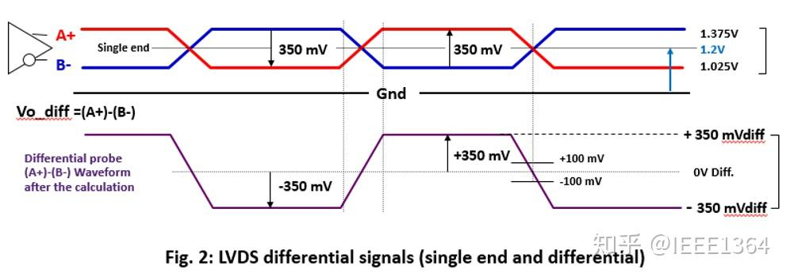
LVDS O/P
Let’s look at a standard LVDS output running with a base voltage (common-mode voltage) of 1.2V and a tiny swing of just 0.35V (350mV).
Sending a Logic "1" (High):
The transmitter drives the _P wire slightly up to 1.375V.
Simultaneously, it drives the _N wire slightly down to 1.025V.
The receiver subtracts the two: 1.375V - 1.025V = +0.350V.
Seeing a positive difference, the receiver registers a "1".
Sending a Logic "0" (Low):
The transmitter drives the _P wire slightly down to 1.025V.
Simultaneously, it drives the _N wire slightly up to 1.375V.
The receiver subtracts the two: 1.025V - 1.375V = -0.350V.
Seeing a negative difference, the receiver registers a "0".
Imagine your camera board is next to a noisy motor, and it injects a massive spike of +0.5V onto your data lines right as you are sending a logic "1".
The _P wire jumps from 1.375V to 1.875V.
The _N wire jumps from 1.025V to 1.525V.
What does the receiver see? It subtracts the two wires: 1.875V - 1.525V = +0.350V.

Slide 9
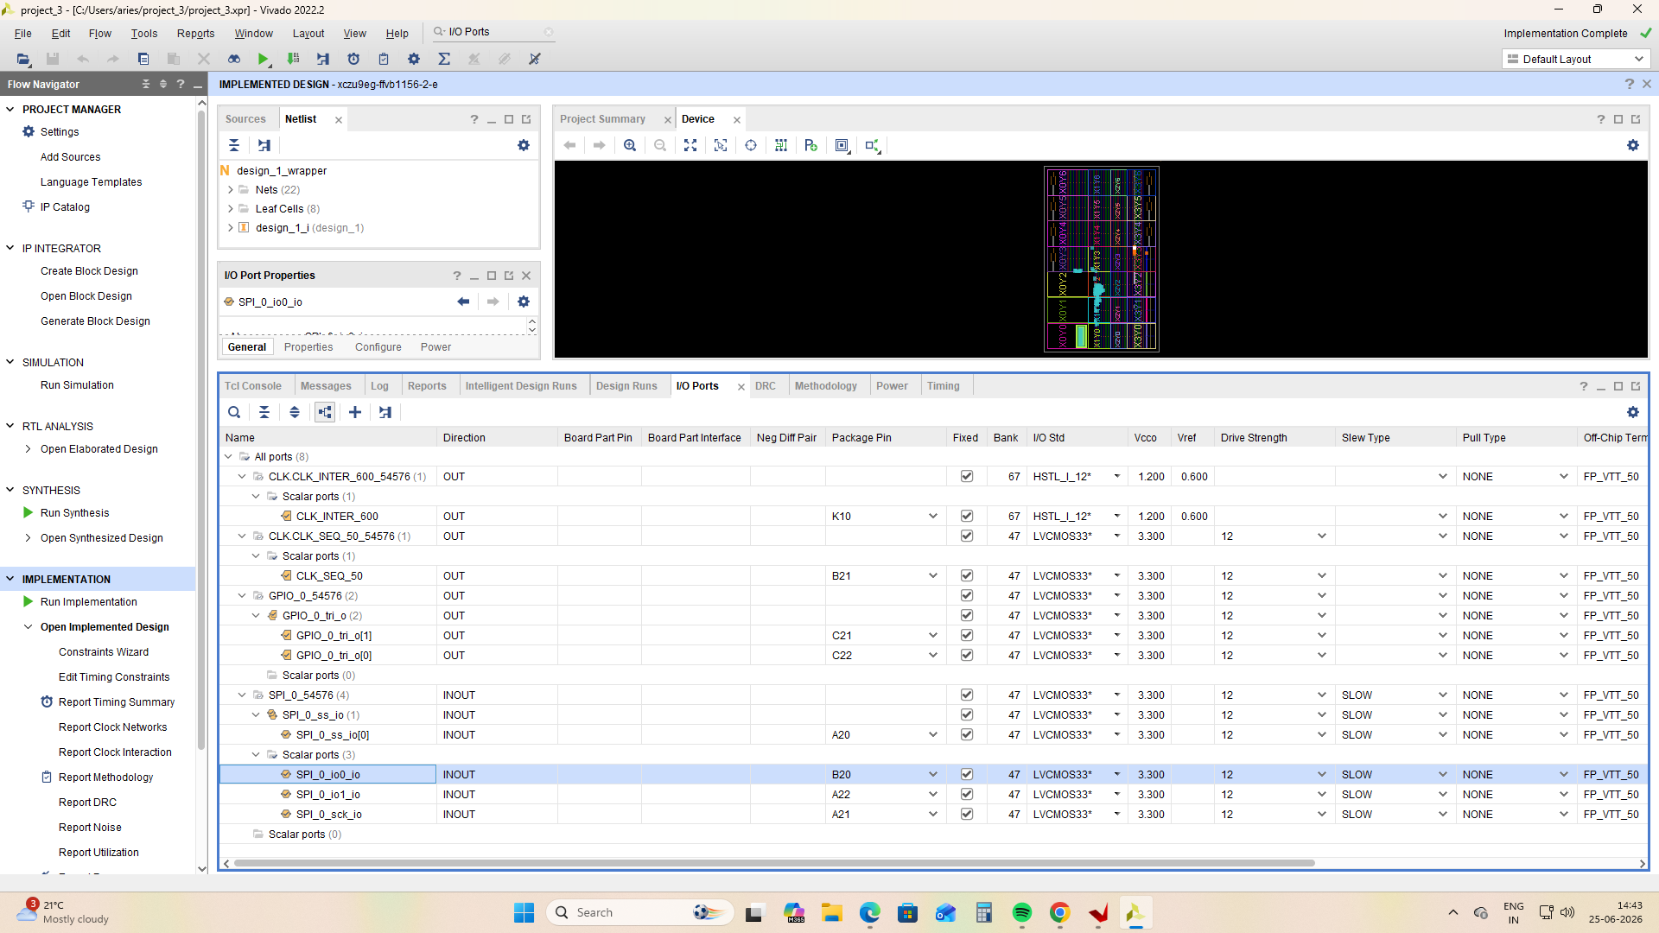
Pin mapping
So here I have assigned the package pins to the output ports that we decided in the block diagram.
After assigning the ports we run synthesis and implementation so that the circuit gets implemented in the LUTs.
After that we generate bitstream and transfer the bitstream .XSA file to the vits software.

Slide 10
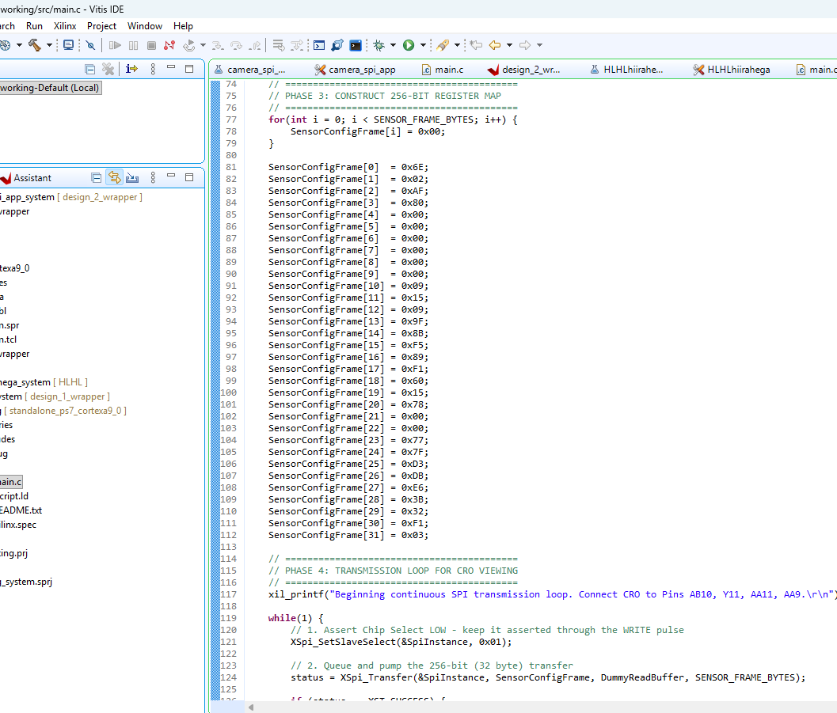
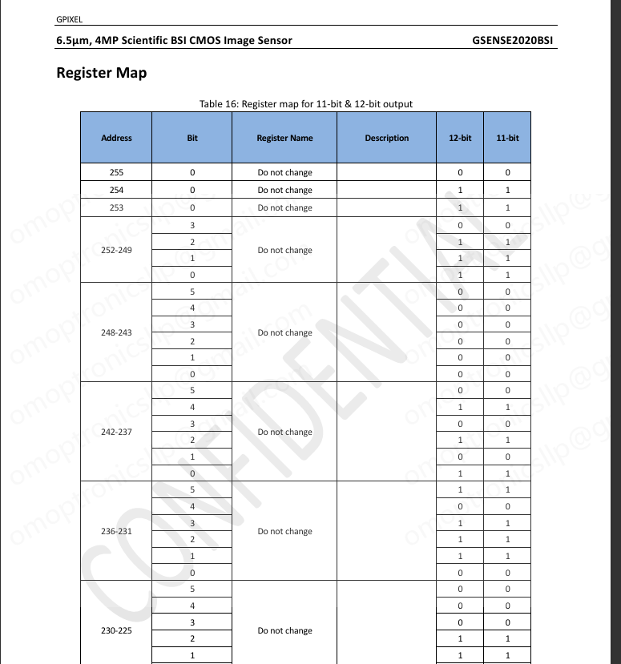
Sensor Config

Slide 11
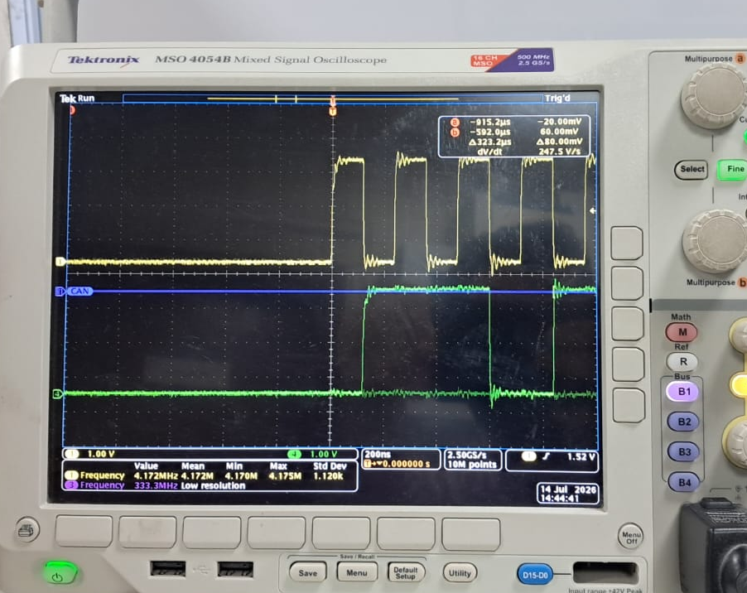
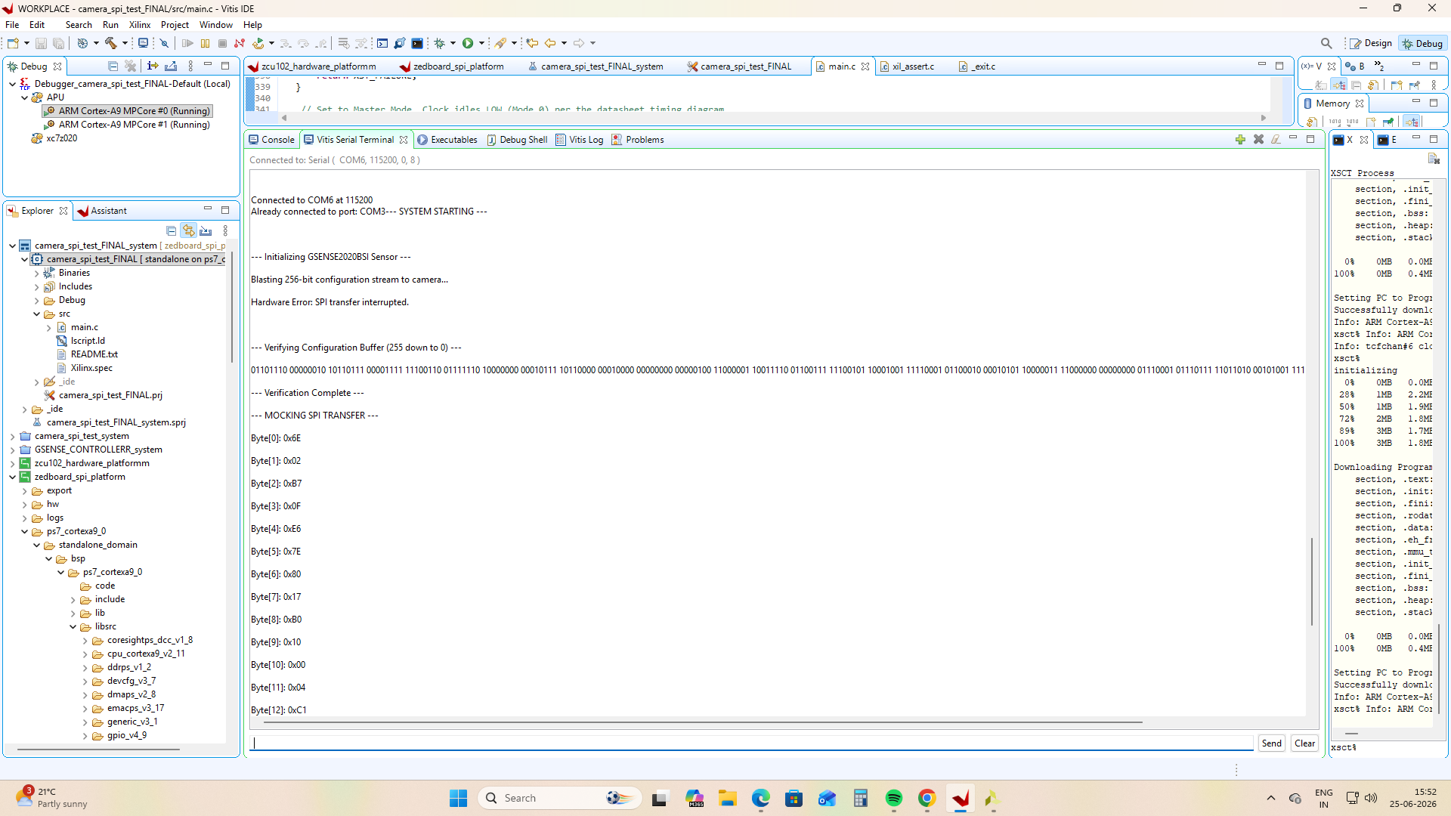
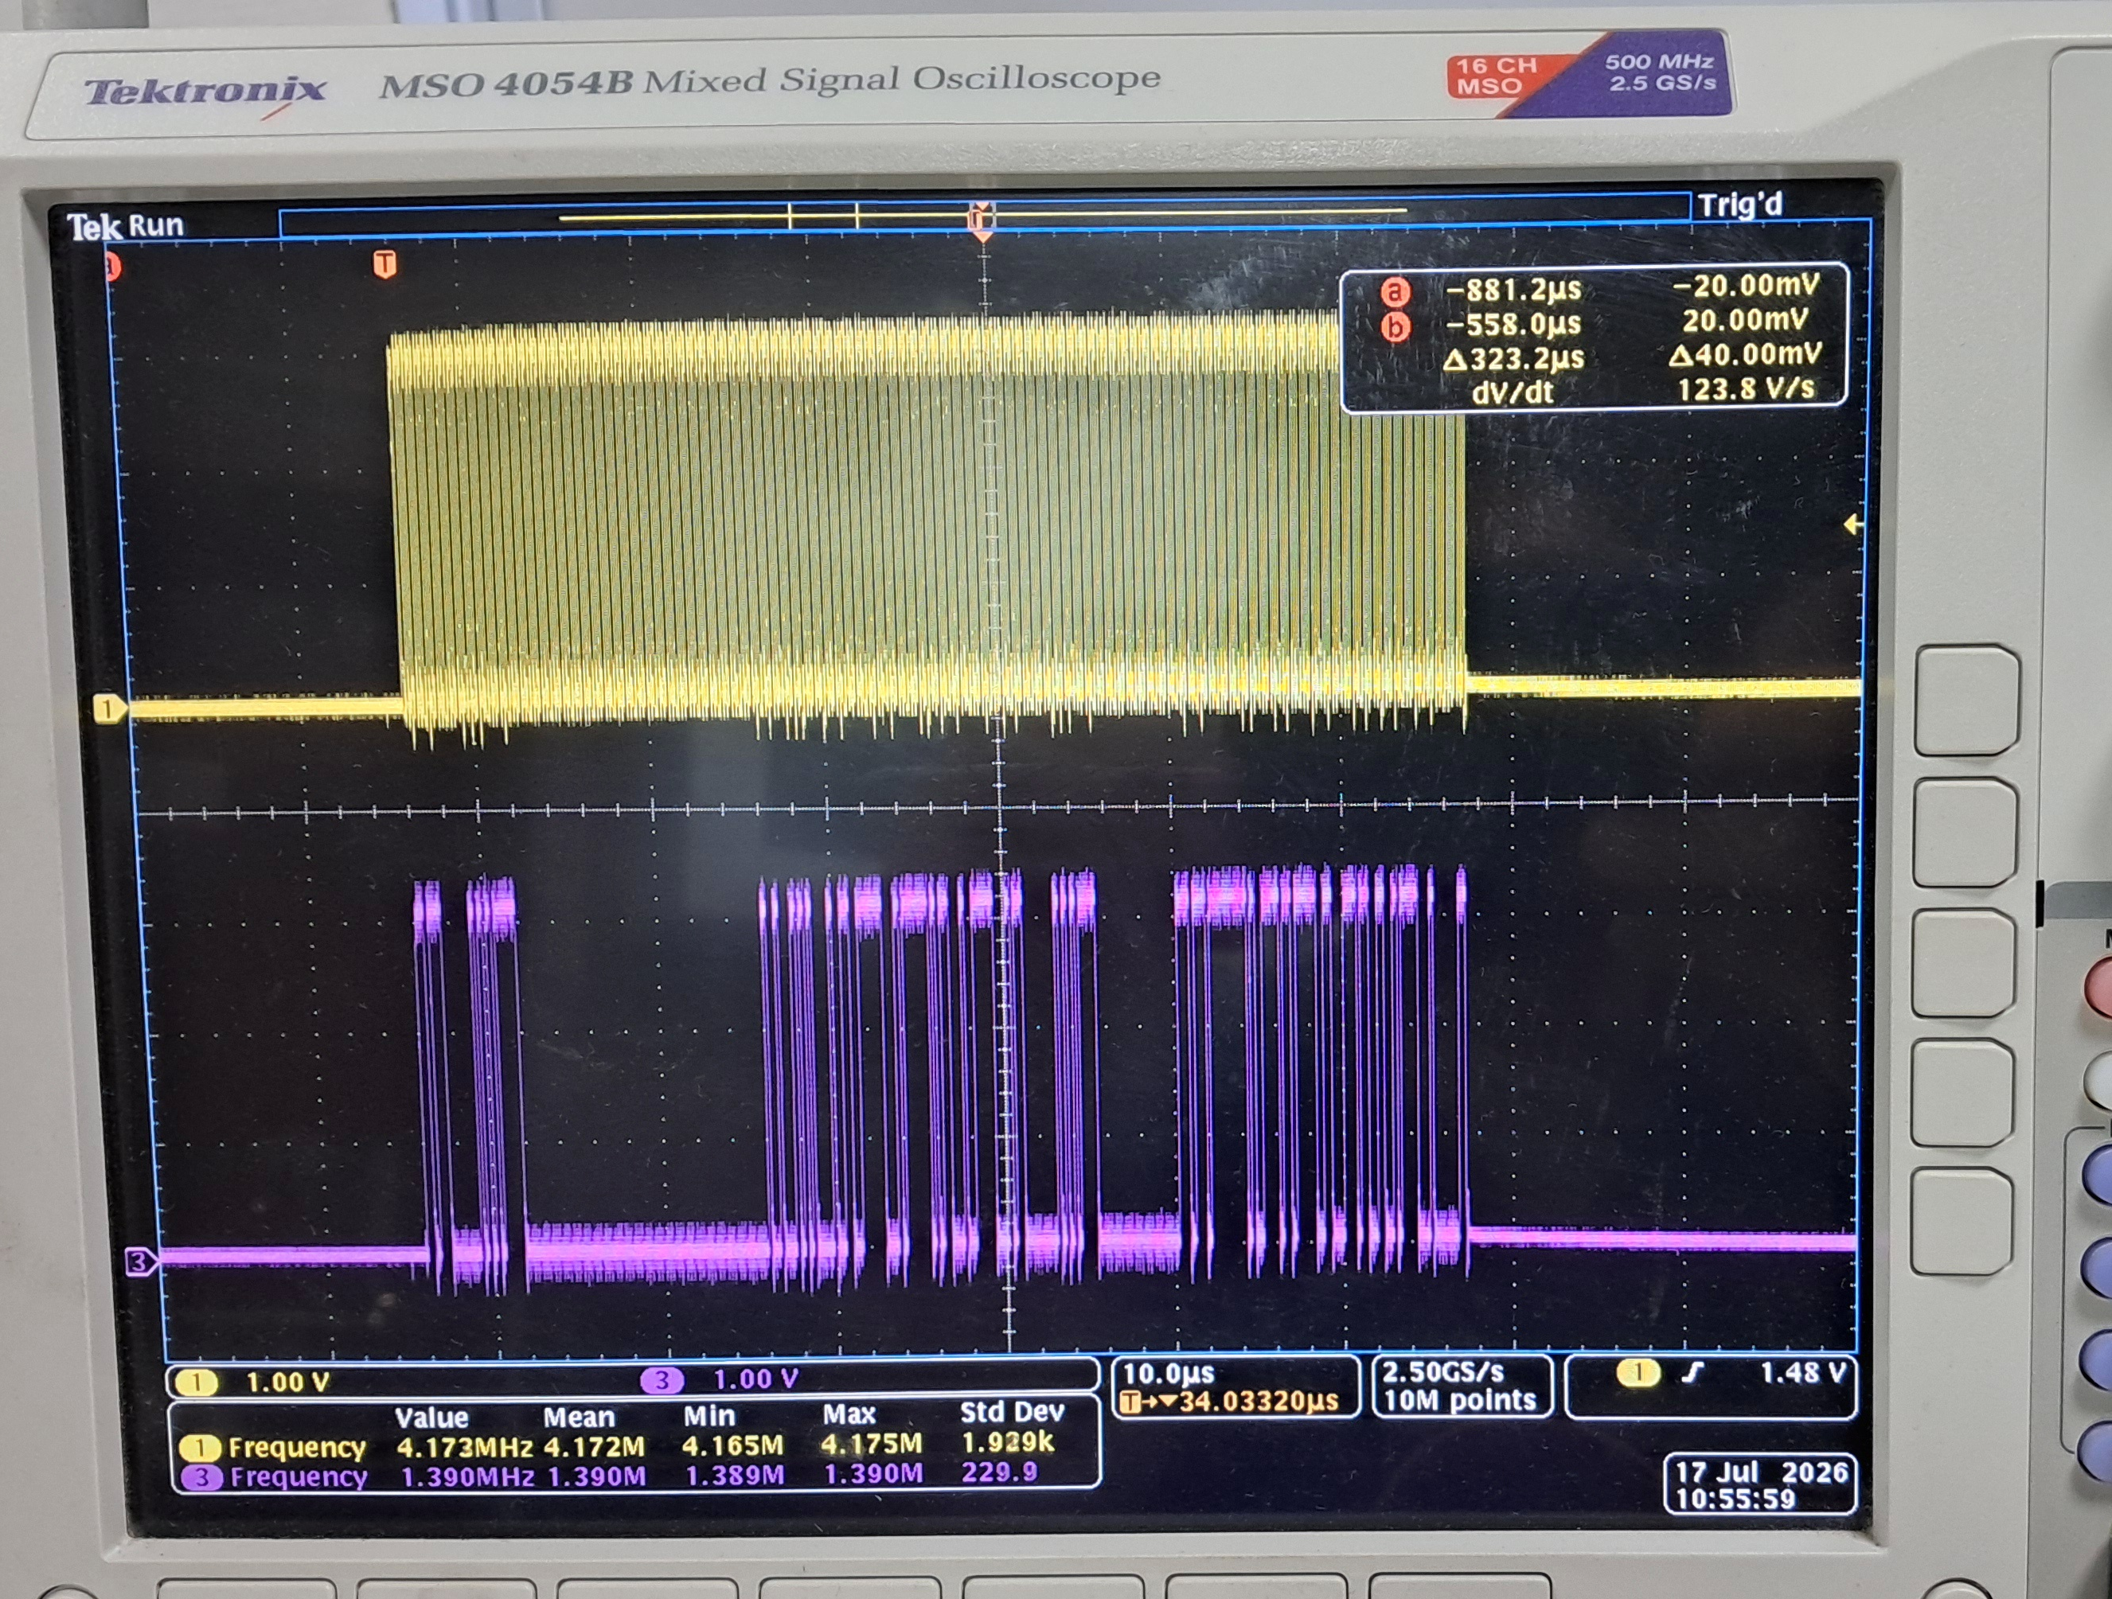
SPI output (SCLK and MOSI line)
Fig B
SPI O/P
Fig A
UART o/p
Fig C
SPI O/P

Slide 12
Thank you

