Slide 1
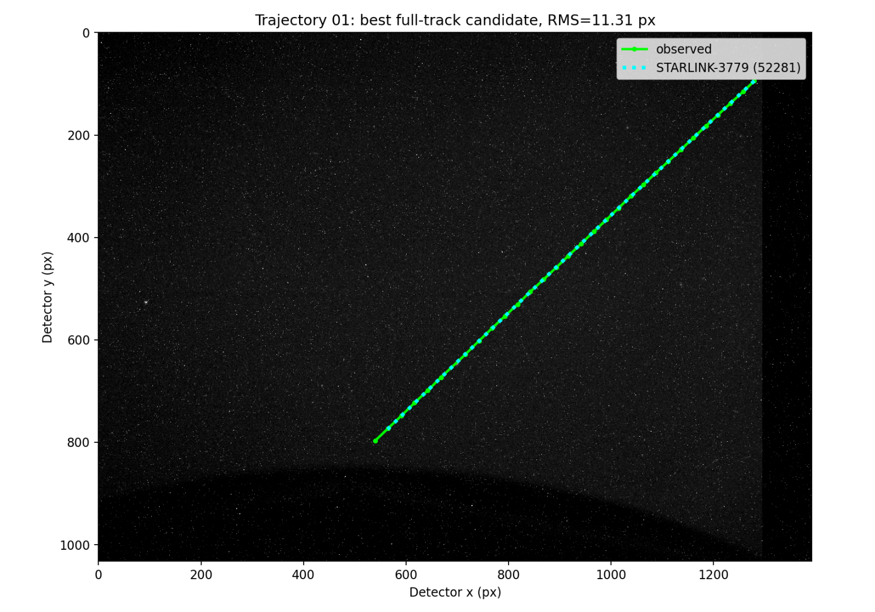
TRAJECTORY 1
Metric | Observed / best candidate
Best candidate | STARLINK-3779 / 52281
Observed UTC | 14:54:24 – 14:54:54
Observed date | 2026-06-12
Detected frames | 554 – 584
Measurements | 30
Duration | 30.062 s
Observed travel | 1020.36 px
Observed mean speed | 33.942 px/s
Predicted mean speed | 32.972 px/s
Speed difference | 0.969 px/s (2.86%)
Position RMS | 11.312 px
Travel residual | 29.144 px
TLE age | 0.623 days
Mean elevation | 46.79°
Mean range | 714.4 km
01 / 36
Notes:
Trajectory 1: values are copied from the saved full-track correlation outputs.
[Sources]
trajectory_01/best_candidate_actual_image_detector_overlay.png
trajectory_01/top10_candidates.csv
outputs/revised_trajectory_master_summary.csv

Slide 2
TRAJECTORY 1
Top three full-track candidates
Rank | Candidate / NORAD | Position RMS | Speed residual | Travel residual | TLE age | Mean elevation
1 | STARLINK-3779 / 52281 | 11.312 px | 0.969 px/s | 29.144 px | 0.623 d | 46.79°
2 | HJS-9A / 68831 | 12.125 px | 0.743 px/s | 22.325 px | 2.066 d | 44.52°
3 | STARLINK-36735 / 68976 | 36.174 px | 1.018 px/s | 30.617 px | 0.332 d | 47.48°
Rank 1: STARLINK-3779 / 52281
02 / 36
Notes:
Trajectory 1: values are copied from the saved full-track correlation outputs.
[Sources]
trajectory_01/top10_candidates.csv

Slide 3
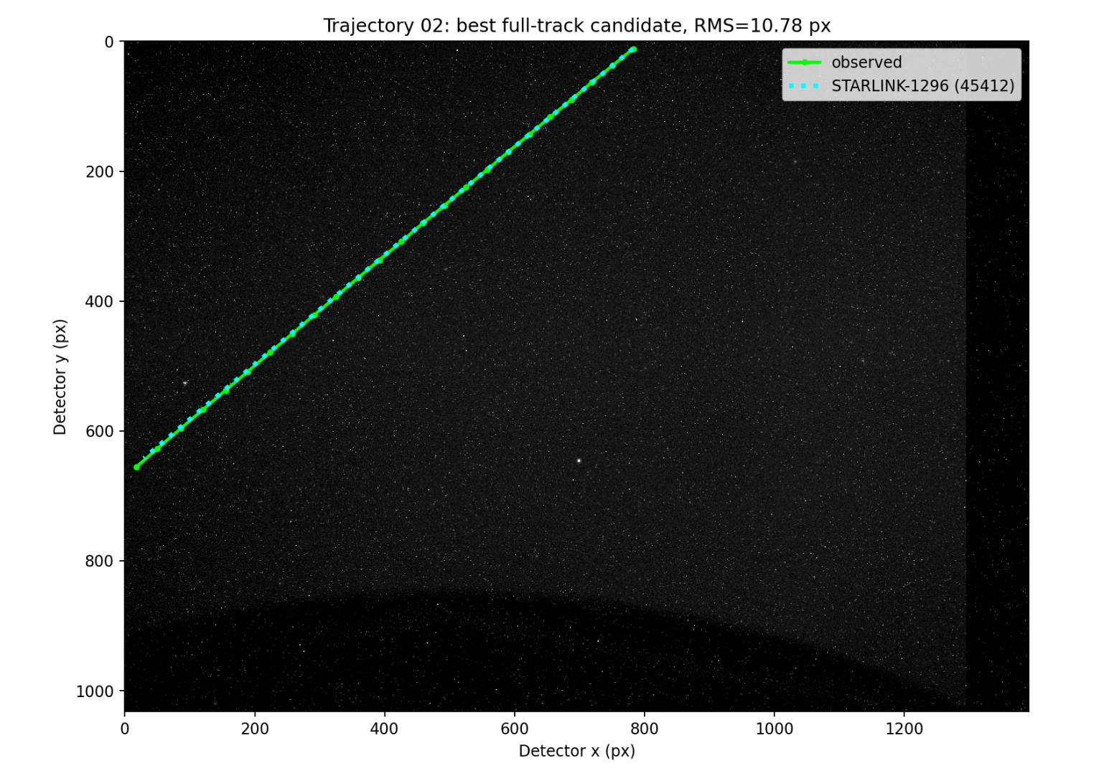
TRAJECTORY 2
Metric | Observed / best candidate
Best candidate | STARLINK-1296 / 45412
Observed UTC | 14:56:09 – 14:56:32
Observed date | 2026-06-12
Detected frames | 659 – 682
Measurements | 24
Duration | 23.052 s
Observed travel | 1000.59 px
Observed mean speed | 43.407 px/s
Predicted mean speed | 42.635 px/s
Speed difference | 0.772 px/s (1.78%)
Position RMS | 10.777 px
Travel residual | 17.790 px
TLE age | 0.675 days
Mean elevation | 52.69°
Mean range | 551.1 km
03 / 36
Notes:
Trajectory 2: values are copied from the saved full-track correlation outputs.
[Sources]
trajectory_02/best_candidate_actual_image_detector_overlay.png
trajectory_02/top10_candidates.csv
outputs/revised_trajectory_master_summary.csv

Slide 4
TRAJECTORY 2
Top three full-track candidates
Rank | Candidate / NORAD | Position RMS | Speed residual | Travel residual | TLE age | Mean elevation
1 | STARLINK-1296 / 45412 | 10.777 px | 0.772 px/s | 17.790 px | 0.675 d | 52.69°
2 | STARLINK-6218 / 57368 | 18.298 px | 1.103 px/s | 25.417 px | 0.612 d | 61.74°
3 | STARLINK-31675 / 59548 | 22.369 px | 2.036 px/s | 46.926 px | 0.335 d | 73.76°
Rank 1: STARLINK-1296 / 45412 • Rank-2 / Rank-1 RMS ratio: 1.698
04 / 36
Notes:
Trajectory 2: values are copied from the saved full-track correlation outputs.
[Sources]
trajectory_02/top10_candidates.csv

Slide 5
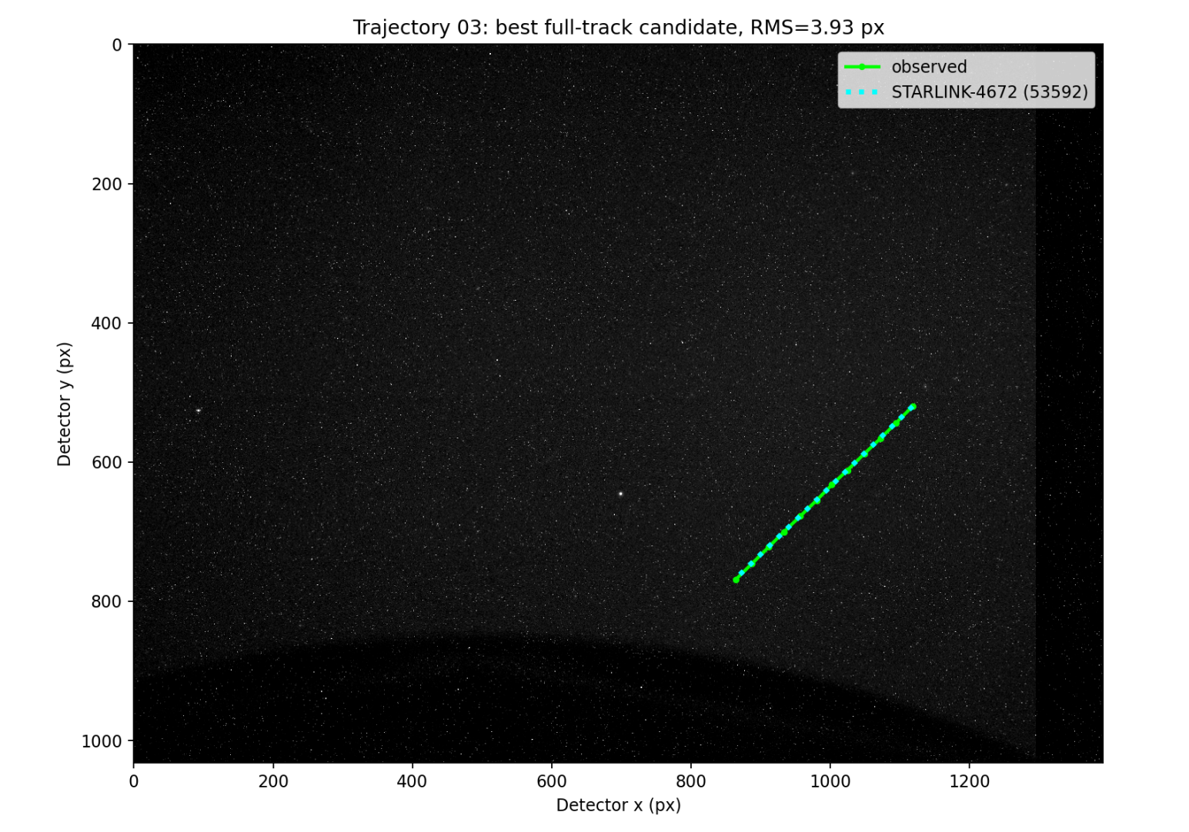
TRAJECTORY 3
Metric | Observed / best candidate
Best candidate | STARLINK-4672 / 53592
Observed UTC | 14:57:57 – 14:58:08
Observed date | 2026-06-12
Detected frames | 767 – 778
Measurements | 12
Duration | 11.022 s
Observed travel | 355.27 px
Observed mean speed | 32.233 px/s
Predicted mean speed | 32.138 px/s
Speed difference | 0.096 px/s (0.30%)
Position RMS | 3.927 px
Travel residual | 1.055 px
TLE age | 0.338 days
Mean elevation | 54.40°
Mean range | 649.7 km
05 / 36
Notes:
Trajectory 3: values are copied from the saved full-track correlation outputs.
[Sources]
trajectory_03/best_candidate_actual_image_detector_overlay.png
trajectory_03/top10_candidates.csv
outputs/revised_trajectory_master_summary.csv

Slide 6
TRAJECTORY 3
Top three full-track candidates
Rank | Candidate / NORAD | Position RMS | Speed residual | Travel residual | TLE age | Mean elevation
1 | STARLINK-4672 / 53592 | 3.927 px | 0.096 px/s | 1.055 px | 0.338 d | 54.40°
2 | GUANGCHUAN 01 / 62111 | 4.131 px | 0.550 px/s | 6.057 px | 0.402 d | 42.98°
3 | STARLINK-36250 / 68513 | 4.348 px | 0.889 px/s | 9.803 px | 0.677 d | 45.81°
Rank 1: STARLINK-4672 / 53592 • Rank-2 / Rank-1 RMS ratio: 1.052
06 / 36
Notes:
Trajectory 3: values are copied from the saved full-track correlation outputs.
[Sources]
trajectory_03/top10_candidates.csv

Slide 7
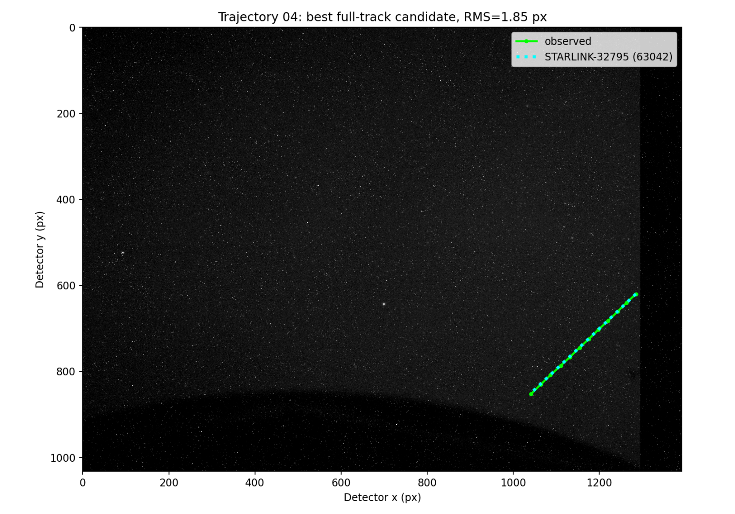
TRAJECTORY 4
Metric | Observed / best candidate
Best candidate | STARLINK-32795 / 63042
Observed UTC | 15:16:31 – 15:16:42
Observed date | 2026-06-12
Detected frames | 1878 – 1889
Measurements | 12
Duration | 11.024 s
Observed travel | 336.61 px
Observed mean speed | 30.534 px/s
Predicted mean speed | 30.512 px/s
Speed difference | 0.022 px/s (0.07%)
Position RMS | 1.846 px
Travel residual | 0.243 px
TLE age | 0.333 days
Mean elevation | 33.70°
Mean range | 776.6 km
07 / 36
Notes:
Trajectory 4: values are copied from the saved full-track correlation outputs.
[Sources]
trajectory_04/best_candidate_actual_image_detector_overlay.png
trajectory_04/top10_candidates.csv
outputs/revised_trajectory_master_summary.csv

Slide 8
TRAJECTORY 4
Top three full-track candidates
Rank | Candidate / NORAD | Position RMS | Speed residual | Travel residual | TLE age | Mean elevation
1 | STARLINK-32795 / 63042 | 1.846 px | 0.022 px/s | 0.243 px | 0.333 d | 33.70°
2 | STARLINK-1263 / 45405 | 3.846 px | 0.647 px/s | 7.129 px | 0.677 d | 33.75°
3 | CENTISPACE-2 S3 / 68352 | 3.961 px | 0.649 px/s | 7.156 px | 1.186 d | 64.92°
Rank 1: STARLINK-32795 / 63042 • Rank-2 / Rank-1 RMS ratio: 2.084
08 / 36
Notes:
Trajectory 4: values are copied from the saved full-track correlation outputs.
[Sources]
trajectory_04/top10_candidates.csv

Slide 9
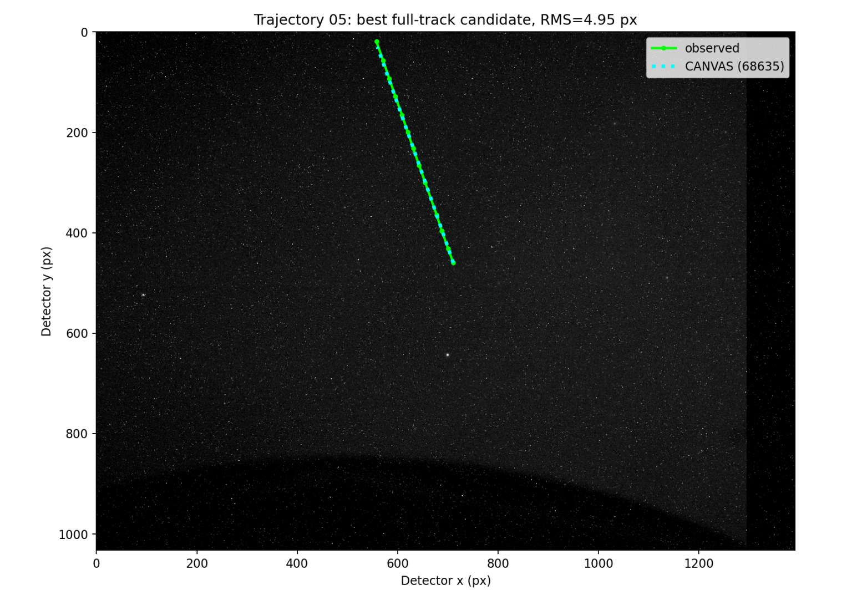
TRAJECTORY 5
Metric | Observed / best candidate
Best candidate | CANVAS / 68635
Observed UTC | 15:16:53 – 15:17:06
Observed date | 2026-06-12
Detected frames | 1900 – 1913
Measurements | 13
Duration | 13.032 s
Observed travel | 467.07 px
Observed mean speed | 35.839 px/s
Predicted mean speed | 34.983 px/s
Speed difference | 0.856 px/s (2.39%)
Position RMS | 4.953 px
Travel residual | 11.162 px
TLE age | 0.333 days
Mean elevation | 45.50°
Mean range | 638.1 km
09 / 36
Notes:
Trajectory 5: values are copied from the saved full-track correlation outputs.
[Sources]
trajectory_05/best_candidate_actual_image_detector_overlay.png
trajectory_05/top10_candidates.csv
outputs/revised_trajectory_master_summary.csv

Slide 10
TRAJECTORY 5
Top three full-track candidates
Rank | Candidate / NORAD | Position RMS | Speed residual | Travel residual | TLE age | Mean elevation
1 | CANVAS / 68635 | 4.953 px | 0.856 px/s | 11.162 px | 0.333 d | 45.50°
2 | STARLINK-4652 / 53736 | 8.051 px | 0.514 px/s | 6.692 px | 0.338 d | 57.87°
3 | STARLINK-33715 / 63441 | 13.836 px | 0.057 px/s | 0.749 px | 0.348 d | 47.57°
Rank 1: CANVAS / 68635 • Rank-2 / Rank-1 RMS ratio: 1.625
10 / 36
Notes:
Trajectory 5: values are copied from the saved full-track correlation outputs.
[Sources]
trajectory_05/top10_candidates.csv

Slide 11
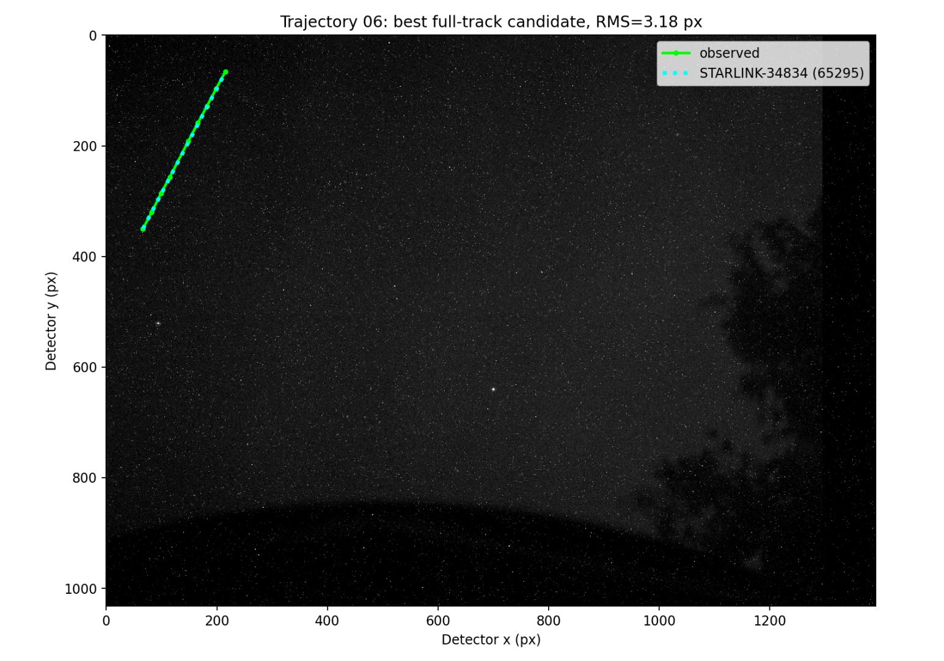
TRAJECTORY 6
Metric | Observed / best candidate
Best candidate | STARLINK-34834 / 65295
Observed UTC | 15:39:56 – 15:40:06
Observed date | 2026-06-12
Detected frames | 3281 – 3290
Measurements | 9
Duration | 9.026 s
Observed travel | 320.57 px
Observed mean speed | 35.515 px/s
Predicted mean speed | 35.108 px/s
Speed difference | 0.406 px/s (1.14%)
Position RMS | 3.176 px
Travel residual | 3.668 px
TLE age | 0.537 days
Mean elevation | 48.60°
Mean range | 712.4 km
11 / 36
Notes:
Trajectory 6: values are copied from the saved full-track correlation outputs.
[Sources]
trajectory_06/best_candidate_actual_image_detector_overlay.png
trajectory_06/top10_candidates.csv
outputs/revised_trajectory_master_summary.csv

Slide 12
TRAJECTORY 6
Top three full-track candidates
Rank | Candidate / NORAD | Position RMS | Speed residual | Travel residual | TLE age | Mean elevation
1 | STARLINK-34834 / 65295 | 3.176 px | 0.406 px/s | 3.668 px | 0.537 d | 48.60°
2 | CARTOSAT-2C / 41599 | 5.415 px | 0.597 px/s | 5.390 px | 0.400 d | 47.44°
3 | STARLINK-35032 / 65382 | 7.465 px | 0.950 px/s | 8.577 px | 0.426 d | 54.03°
Rank 1: STARLINK-34834 / 65295 • Rank-2 / Rank-1 RMS ratio: 1.705
12 / 36
Notes:
Trajectory 6: values are copied from the saved full-track correlation outputs.
[Sources]
trajectory_06/top10_candidates.csv

Slide 13
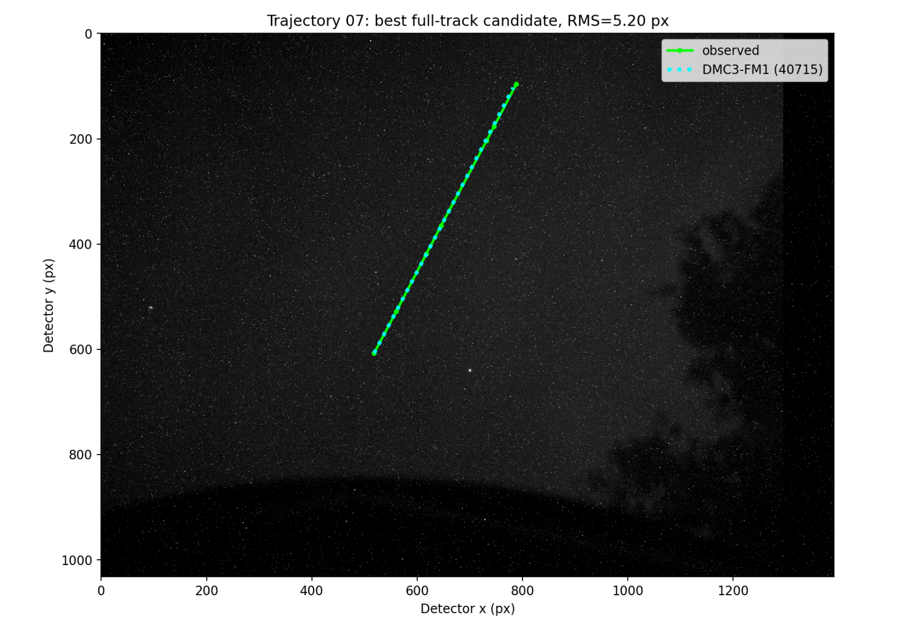
TRAJECTORY 7
Metric | Observed / best candidate
Best candidate | DMC3-FM1 / 40715
Observed UTC | 15:41:53 – 15:42:12
Observed date | 2026-06-12
Detected frames | 3397 – 3416
Measurements | 7
Duration | 19.043 s
Observed travel | 578.39 px
Observed mean speed | 30.373 px/s
Predicted mean speed | 29.922 px/s
Speed difference | 0.451 px/s (1.48%)
Position RMS | 5.198 px
Travel residual | 8.588 px
TLE age | 0.365 days
Mean elevation | 53.28°
Mean range | 746.4 km
13 / 36
Notes:
Trajectory 7: values are copied from the saved full-track correlation outputs.
[Sources]
trajectory_07/best_candidate_actual_image_detector_overlay.png
trajectory_07/top10_candidates.csv
outputs/revised_trajectory_master_summary.csv

Slide 14
TRAJECTORY 7
Top three full-track candidates
Rank | Candidate / NORAD | Position RMS | Speed residual | Travel residual | TLE age | Mean elevation
1 | DMC3-FM1 / 40715 | 5.198 px | 0.451 px/s | 8.588 px | 0.365 d | 53.28°
2 | STARLINK-34344 / 64159 | 7.166 px | 0.509 px/s | 9.699 px | 0.537 d | 39.17°
3 | STARLINK-4417 / 53200 | 8.181 px | 0.217 px/s | 4.134 px | 0.471 d | 46.07°
Rank 1: DMC3-FM1 / 40715 • Rank-2 / Rank-1 RMS ratio: 1.379
14 / 36
Notes:
Trajectory 7: values are copied from the saved full-track correlation outputs.
[Sources]
trajectory_07/top10_candidates.csv

Slide 15
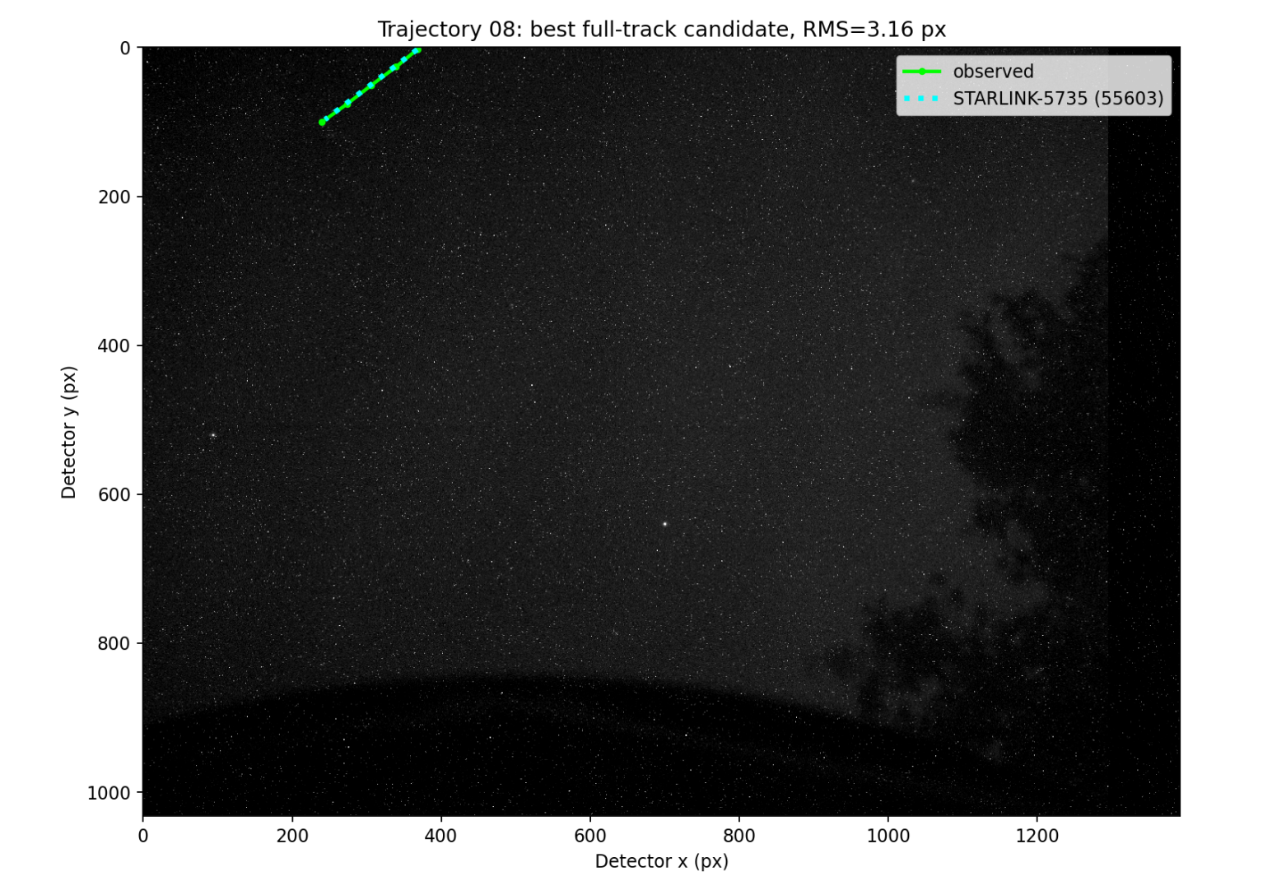
TRAJECTORY 8
Metric | Observed / best candidate
Best candidate | STARLINK-5735 / 55603
Observed UTC | 15:42:14 – 15:42:18
Observed date | 2026-06-12
Detected frames | 3418 – 3422
Measurements | 5
Duration | 4.008 s
Observed travel | 161.27 px
Observed mean speed | 40.239 px/s
Predicted mean speed | 38.810 px/s
Speed difference | 1.429 px/s (3.55%)
Position RMS | 3.162 px
Travel residual | 5.726 px
TLE age | 1.316 days
Mean elevation | 59.99°
Mean range | 549.9 km
15 / 36
Notes:
Trajectory 8: values are copied from the saved full-track correlation outputs.
[Sources]
trajectory_08/best_candidate_actual_image_detector_overlay.png
trajectory_08/top10_candidates.csv
outputs/revised_trajectory_master_summary.csv

Slide 16
TRAJECTORY 8
Top three full-track candidates
Rank | Candidate / NORAD | Position RMS | Speed residual | Travel residual | TLE age | Mean elevation
1 | STARLINK-5735 / 55603 | 3.162 px | 1.429 px/s | 5.726 px | 1.316 d | 59.99°
2 | STARLINK-33638 / 63436 | 4.444 px | 1.294 px/s | 5.185 px | 0.477 d | 47.61°
3 | STARLINK-34862 / 65180 | 6.875 px | 3.115 px/s | 12.485 px | 0.426 d | 55.50°
Rank 1: STARLINK-5735 / 55603 • Rank-2 / Rank-1 RMS ratio: 1.405
16 / 36
Notes:
Trajectory 8: values are copied from the saved full-track correlation outputs.
[Sources]
trajectory_08/top10_candidates.csv

Slide 17
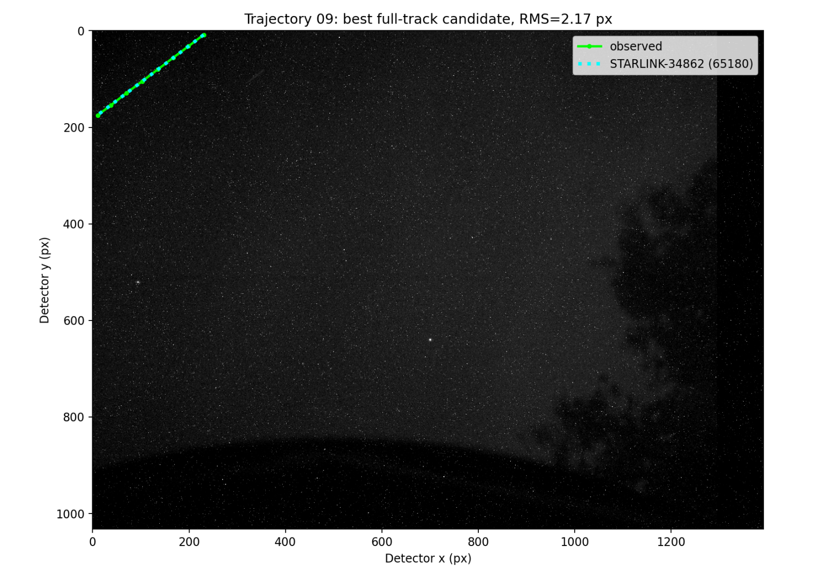
TRAJECTORY 9
Metric | Observed / best candidate
Best candidate | STARLINK-34862 / 65180
Observed UTC | 15:42:35 – 15:42:42
Observed date | 2026-06-12
Detected frames | 3439 – 3446
Measurements | 8
Duration | 7.016 s
Observed travel | 275.68 px
Observed mean speed | 39.295 px/s
Predicted mean speed | 39.459 px/s
Speed difference | 0.164 px/s (0.42%)
Position RMS | 2.170 px
Travel residual | 1.154 px
TLE age | 0.427 days
Mean elevation | 58.13°
Mean range | 638.4 km
17 / 36
Notes:
Trajectory 9: values are copied from the saved full-track correlation outputs.
[Sources]
trajectory_09/best_candidate_actual_image_detector_overlay.png
trajectory_09/top10_candidates.csv
outputs/revised_trajectory_master_summary.csv

Slide 18
TRAJECTORY 9
Top three full-track candidates
Rank | Candidate / NORAD | Position RMS | Speed residual | Travel residual | TLE age | Mean elevation
1 | STARLINK-34862 / 65180 | 2.170 px | 0.164 px/s | 1.154 px | 0.427 d | 58.13°
2 | STARLINK-32260 / 61522 | 2.492 px | 0.240 px/s | 1.682 px | 0.613 d | 58.70°
3 | 2024-199BE / 61787 | 2.804 px | 0.738 px/s | 5.180 px | 0.418 d | 57.31°
Rank 1: STARLINK-34862 / 65180 • Rank-2 / Rank-1 RMS ratio: 1.148
18 / 36
Notes:
Trajectory 9: values are copied from the saved full-track correlation outputs.
[Sources]
trajectory_09/top10_candidates.csv

Slide 19
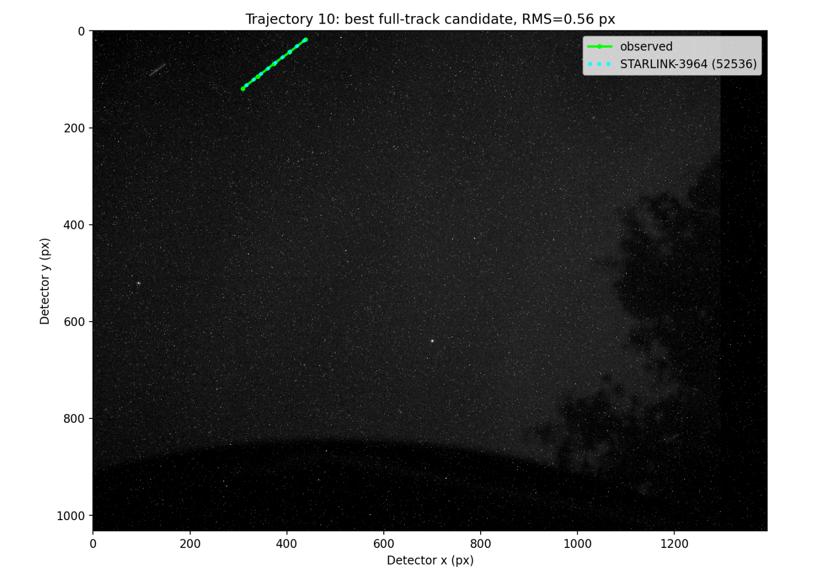
TRAJECTORY 10
Metric | Observed / best candidate
Best candidate | STARLINK-3964 / 52536
Observed UTC | 15:42:36 – 15:42:40
Observed date | 2026-06-12
Detected frames | 3440 – 3444
Measurements | 5
Duration | 4.010 s
Observed travel | 164.74 px
Observed mean speed | 41.085 px/s
Predicted mean speed | 41.169 px/s
Speed difference | 0.084 px/s (0.20%)
Position RMS | 0.560 px
Travel residual | 0.337 px
TLE age | 0.689 days
Mean elevation | 71.70°
Mean range | 564.7 km
19 / 36
Notes:
Trajectory 10: values are copied from the saved full-track correlation outputs.
[Sources]
trajectory_10/best_candidate_actual_image_detector_overlay.png
trajectory_10/top10_candidates.csv
outputs/revised_trajectory_master_summary.csv

Slide 20
TRAJECTORY 10
Top three full-track candidates
Rank | Candidate / NORAD | Position RMS | Speed residual | Travel residual | TLE age | Mean elevation
1 | STARLINK-3964 / 52536 | 0.560 px | 0.084 px/s | 0.337 px | 0.689 d | 71.70°
2 | STARLINK-36621 / 67561 | 1.732 px | 0.663 px/s | 2.657 px | 0.528 d | 49.89°
3 | STARLINK-30832 / 58354 | 1.827 px | 0.739 px/s | 2.961 px | 1.317 d | 59.50°
Rank 1: STARLINK-3964 / 52536 • Rank-2 / Rank-1 RMS ratio: 3.094
20 / 36
Notes:
Trajectory 10: values are copied from the saved full-track correlation outputs.
[Sources]
trajectory_10/top10_candidates.csv

Slide 21
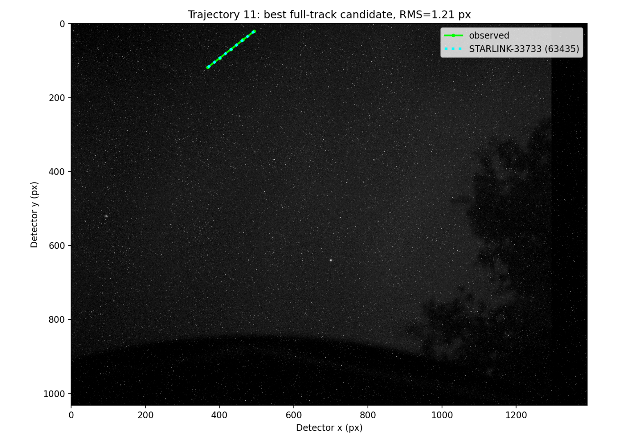
TRAJECTORY 11
Metric | Observed / best candidate
Best candidate | STARLINK-33733 / 63435
Observed UTC | 15:43:19 – 15:43:23
Observed date | 2026-06-12
Detected frames | 3483 – 3487
Measurements | 5
Duration | 4.001 s
Observed travel | 157.80 px
Observed mean speed | 39.441 px/s
Predicted mean speed | 39.927 px/s
Speed difference | 0.486 px/s (1.23%)
Position RMS | 1.212 px
Travel residual | 1.944 px
TLE age | 0.671 days
Mean elevation | 45.66°
Mean range | 567.2 km
21 / 36
Notes:
Trajectory 11: values are copied from the saved full-track correlation outputs.
[Sources]
trajectory_11/best_candidate_actual_image_detector_overlay.png
trajectory_11/top10_candidates.csv
outputs/revised_trajectory_master_summary.csv

Slide 22
TRAJECTORY 11
Top three full-track candidates
Rank | Candidate / NORAD | Position RMS | Speed residual | Travel residual | TLE age | Mean elevation
1 | STARLINK-33733 / 63435 | 1.212 px | 0.486 px/s | 1.944 px | 0.671 d | 45.66°
2 | STARLINK-2358 / 47898 | 2.748 px | 1.180 px/s | 4.721 px | 0.399 d | 48.12°
3 | STARLINK-5735 / 55603 | 4.051 px | 1.422 px/s | 5.689 px | 1.317 d | 63.52°
Rank 1: STARLINK-33733 / 63435 • Rank-2 / Rank-1 RMS ratio: 2.268
22 / 36
Notes:
Trajectory 11: values are copied from the saved full-track correlation outputs.
[Sources]
trajectory_11/top10_candidates.csv

Slide 23
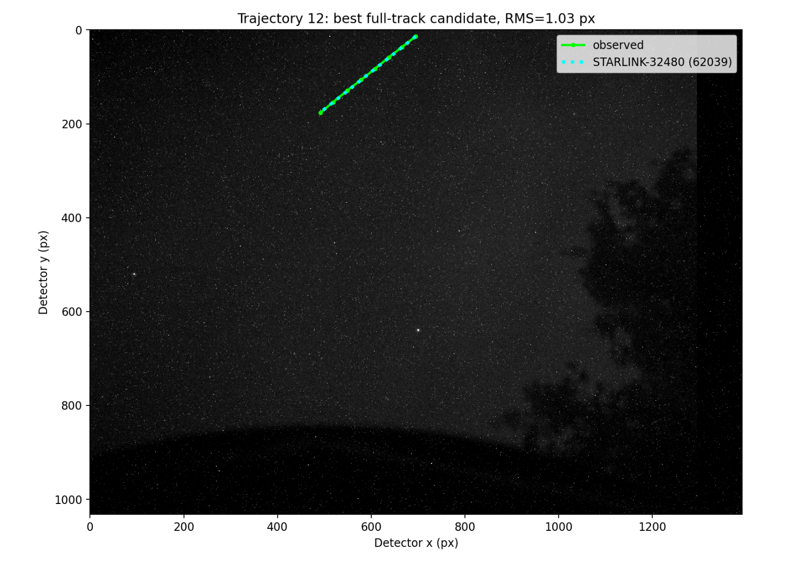
TRAJECTORY 12
Metric | Observed / best candidate
Best candidate | STARLINK-32480 / 62039
Observed UTC | 15:44:44 – 15:44:51
Observed date | 2026-06-12
Detected frames | 3568 – 3575
Measurements | 8
Duration | 7.015 s
Observed travel | 260.59 px
Observed mean speed | 37.149 px/s
Predicted mean speed | 37.347 px/s
Speed difference | 0.198 px/s (0.53%)
Position RMS | 1.033 px
Travel residual | 1.387 px
TLE age | 1.592 days
Mean elevation | 50.62°
Mean range | 608.5 km
23 / 36
Notes:
Trajectory 12: values are copied from the saved full-track correlation outputs.
[Sources]
trajectory_12/best_candidate_actual_image_detector_overlay.png
trajectory_12/top10_candidates.csv
outputs/revised_trajectory_master_summary.csv

Slide 24
TRAJECTORY 12
Top three full-track candidates
Rank | Candidate / NORAD | Position RMS | Speed residual | Travel residual | TLE age | Mean elevation
1 | STARLINK-32480 / 62039 | 1.033 px | 0.198 px/s | 1.387 px | 1.592 d | 50.62°
2 | STARLINK-33756 / 63458 | 1.112 px | 0.084 px/s | 0.587 px | 0.413 d | 42.38°
3 | STARLINK-30519 / 57985 | 1.973 px | 0.224 px/s | 1.569 px | 0.336 d | 52.19°
Rank 1: STARLINK-32480 / 62039 • Rank-2 / Rank-1 RMS ratio: 1.076
24 / 36
Notes:
Trajectory 12: values are copied from the saved full-track correlation outputs.
[Sources]
trajectory_12/top10_candidates.csv

Slide 25
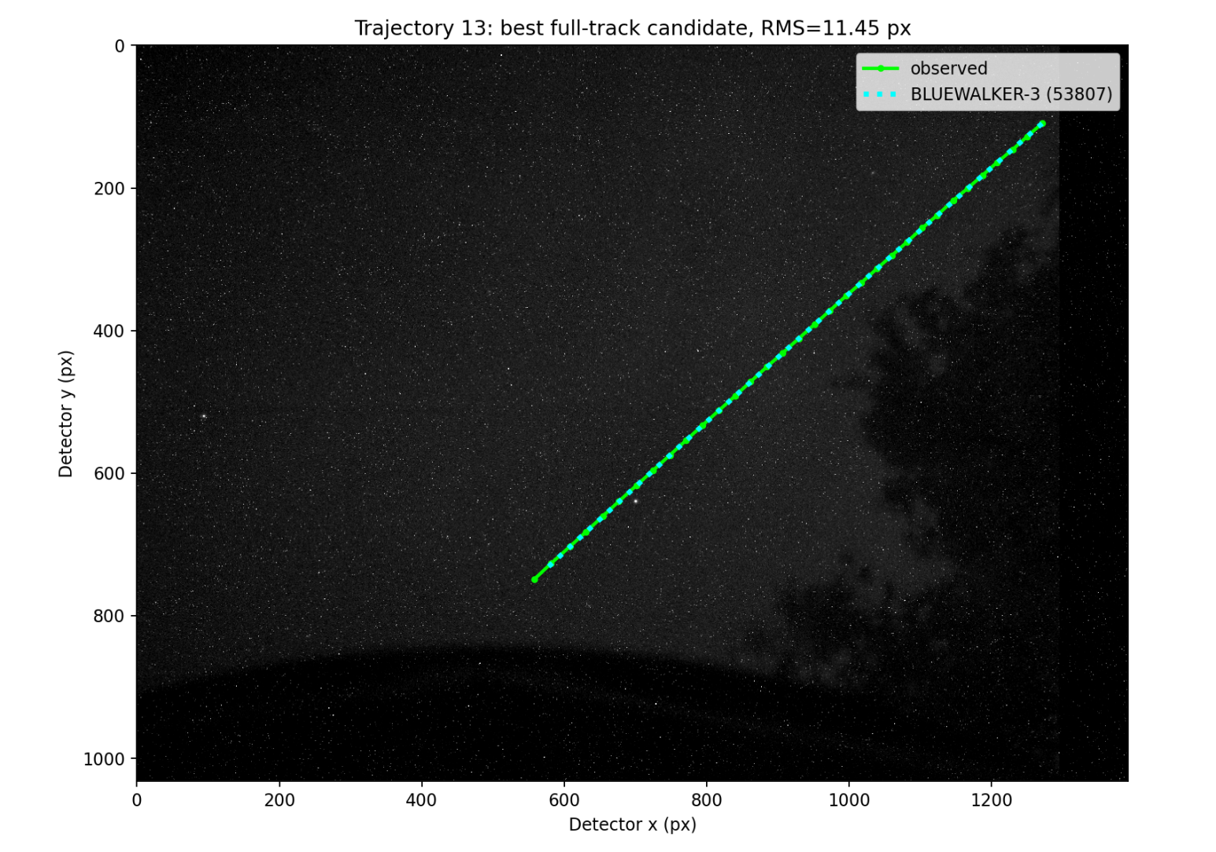
TRAJECTORY 13
Metric | Observed / best candidate
Best candidate | BLUEWALKER-3 / 53807
Observed UTC | 15:46:37 – 15:47:09
Observed date | 2026-06-12
Detected frames | 3681 – 3713
Measurements | 33
Duration | 32.069 s
Observed travel | 957.42 px
Observed mean speed | 29.855 px/s
Predicted mean speed | 29.210 px/s
Speed difference | 0.645 px/s (2.16%)
Position RMS | 11.447 px
Travel residual | 20.677 px
TLE age | 0.676 days
Mean elevation | 33.56°
Mean range | 755.2 km
25 / 36
Notes:
Trajectory 13: values are copied from the saved full-track correlation outputs.
[Sources]
trajectory_13/best_candidate_actual_image_detector_overlay.png
trajectory_13/top10_candidates.csv
outputs/revised_trajectory_master_summary.csv

Slide 26
TRAJECTORY 13
Top three full-track candidates
Rank | Candidate / NORAD | Position RMS | Speed residual | Travel residual | TLE age | Mean elevation
1 | BLUEWALKER-3 / 53807 | 11.447 px | 0.645 px/s | 20.677 px | 0.676 d | 33.56°
2 | YAOGAN-39 05B / 58558 | 11.714 px | 0.124 px/s | 3.984 px | 0.414 d | 41.04°
3 | STARLINK-2418 / 48097 | 14.481 px | 0.783 px/s | 25.101 px | 0.612 d | 33.09°
Rank 1: BLUEWALKER-3 / 53807 • Rank-2 / Rank-1 RMS ratio: 1.023
26 / 36
Notes:
Trajectory 13: values are copied from the saved full-track correlation outputs.
[Sources]
trajectory_13/top10_candidates.csv

Slide 27
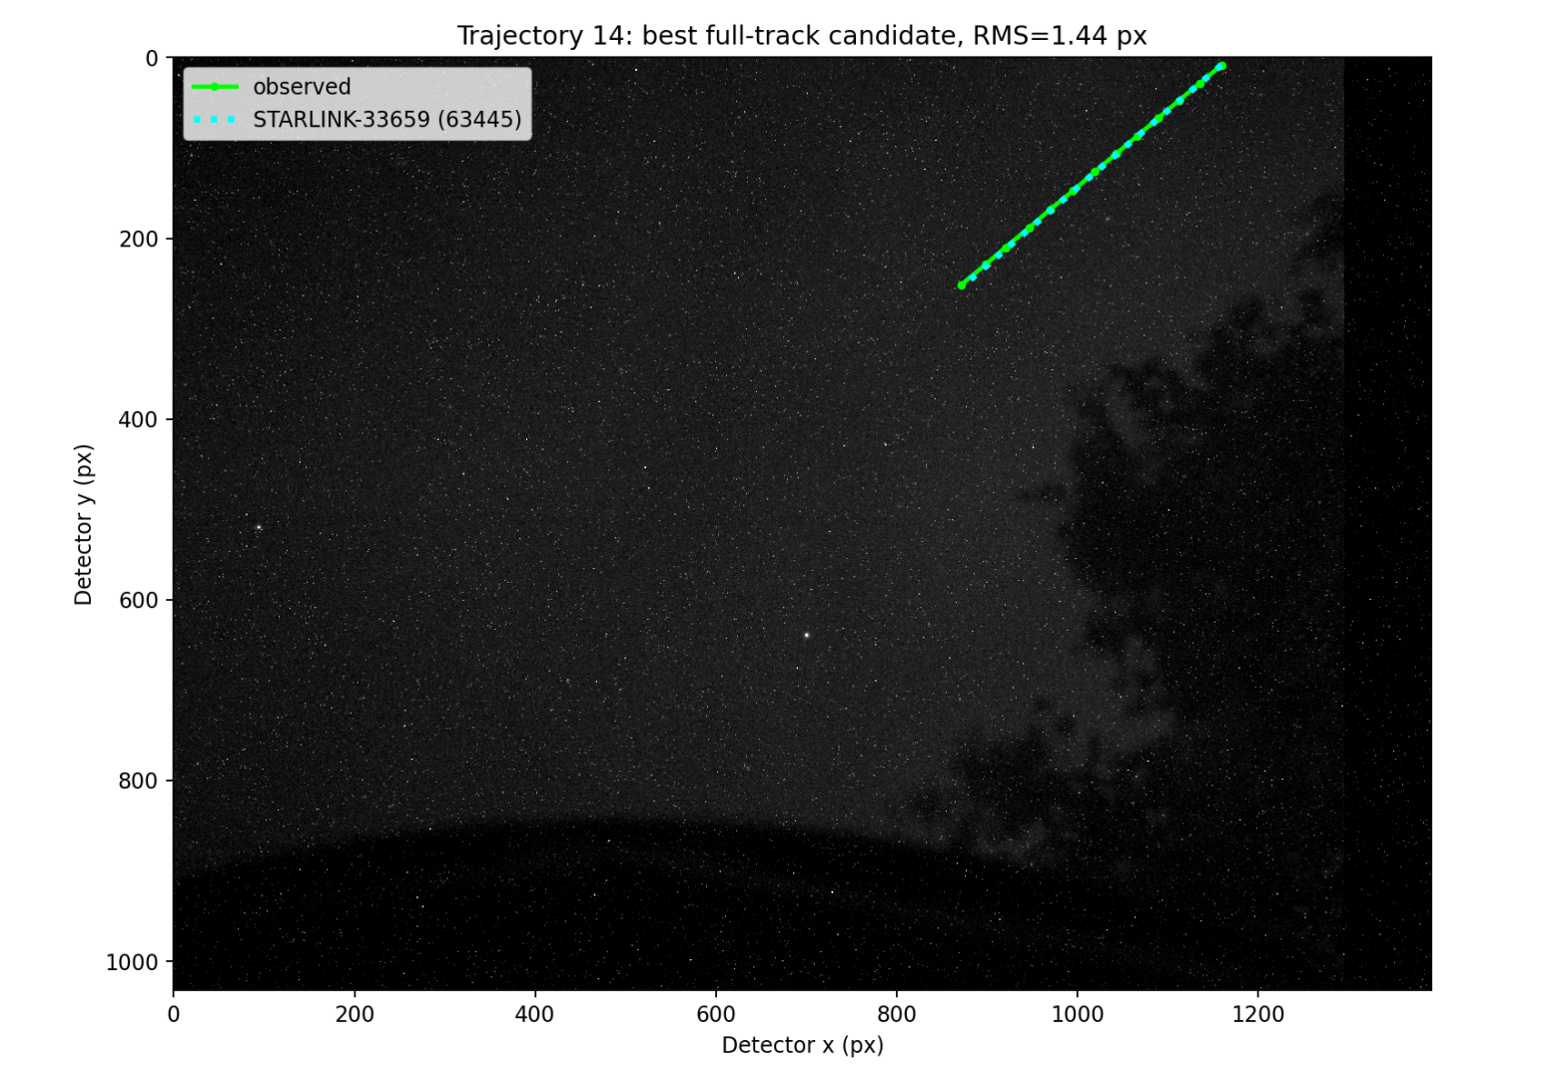
TRAJECTORY 14
Metric | Observed / best candidate
Best candidate | STARLINK-33659 / 63445
Observed UTC | 15:49:21 – 15:49:33
Observed date | 2026-06-12
Detected frames | 3844 – 3856
Measurements | 13
Duration | 12.025 s
Observed travel | 376.67 px
Observed mean speed | 31.324 px/s
Predicted mean speed | 31.251 px/s
Speed difference | 0.074 px/s (0.24%)
Position RMS | 1.436 px
Travel residual | 0.888 px
TLE age | 0.671 days
Mean elevation | 34.48°
Mean range | 694.2 km
27 / 36
Notes:
Trajectory 14: values are copied from the saved full-track correlation outputs.
[Sources]
trajectory_14/best_candidate_actual_image_detector_overlay.png
trajectory_14/top10_candidates.csv
outputs/revised_trajectory_master_summary.csv

Slide 28
TRAJECTORY 14
Top three full-track candidates
Rank | Candidate / NORAD | Position RMS | Speed residual | Travel residual | TLE age | Mean elevation
1 | STARLINK-33659 / 63445 | 1.436 px | 0.074 px/s | 0.888 px | 0.671 d | 34.48°
2 | STARLINK-36391 / 67591 | 5.031 px | 0.912 px/s | 10.963 px | 0.527 d | 32.57°
3 | STARLINK-37342 / 68752 | 5.517 px | 1.162 px/s | 13.977 px | 0.484 d | 31.65°
Rank 1: STARLINK-33659 / 63445 • Rank-2 / Rank-1 RMS ratio: 3.503
28 / 36
Notes:
Trajectory 14: values are copied from the saved full-track correlation outputs.
[Sources]
trajectory_14/top10_candidates.csv

Slide 29
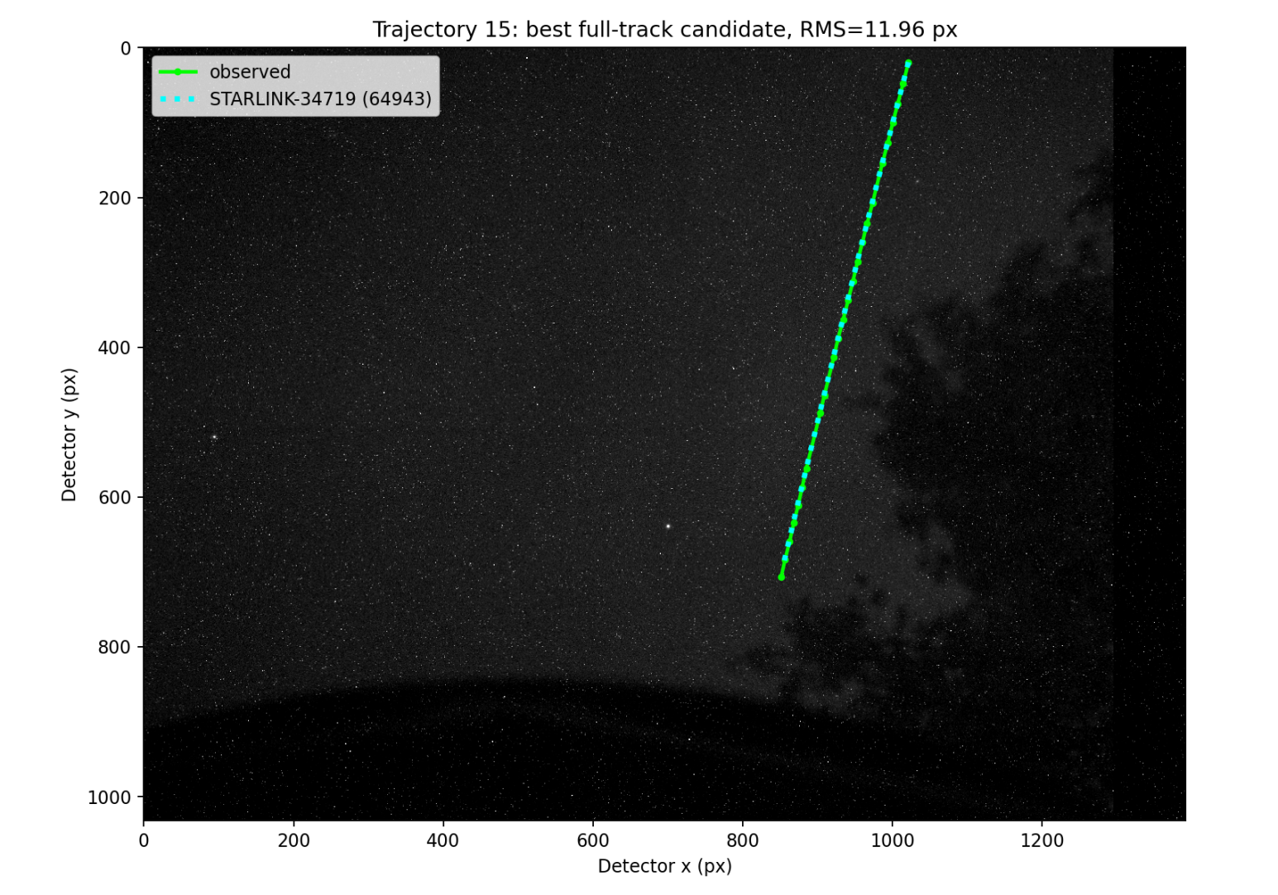
TRAJECTORY 15
Metric | Observed / best candidate
Best candidate | STARLINK-34719 / 64943
Observed UTC | 15:49:39 – 15:50:06
Observed date | 2026-06-12
Detected frames | 3862 – 3889
Measurements | 24
Duration | 27.067 s
Observed travel | 707.96 px
Observed mean speed | 26.156 px/s
Predicted mean speed | 25.429 px/s
Speed difference | 0.727 px/s (2.78%)
Position RMS | 11.959 px
Travel residual | 19.674 px
TLE age | 0.493 days
Mean elevation | 32.94°
Mean range | 930.8 km
29 / 36
Notes:
Trajectory 15: values are copied from the saved full-track correlation outputs.
[Sources]
trajectory_15/best_candidate_actual_image_detector_overlay.png
trajectory_15/top10_candidates.csv
outputs/revised_trajectory_master_summary.csv

Slide 30
TRAJECTORY 15
Top three full-track candidates
Rank | Candidate / NORAD | Position RMS | Speed residual | Travel residual | TLE age | Mean elevation
1 | STARLINK-34719 / 64943 | 11.959 px | 0.727 px/s | 19.674 px | 0.493 d | 32.94°
2 | STARLINK-3192 / 49767 | 23.048 px | 0.605 px/s | 16.378 px | 0.621 d | 33.78°
3 | STARLINK-33924 / 64149 | 24.624 px | 1.031 px/s | 27.904 px | 0.537 d | 30.39°
Rank 1: STARLINK-34719 / 64943 • Rank-2 / Rank-1 RMS ratio: 1.927
30 / 36
Notes:
Trajectory 15: values are copied from the saved full-track correlation outputs.
[Sources]
trajectory_15/top10_candidates.csv

Slide 31
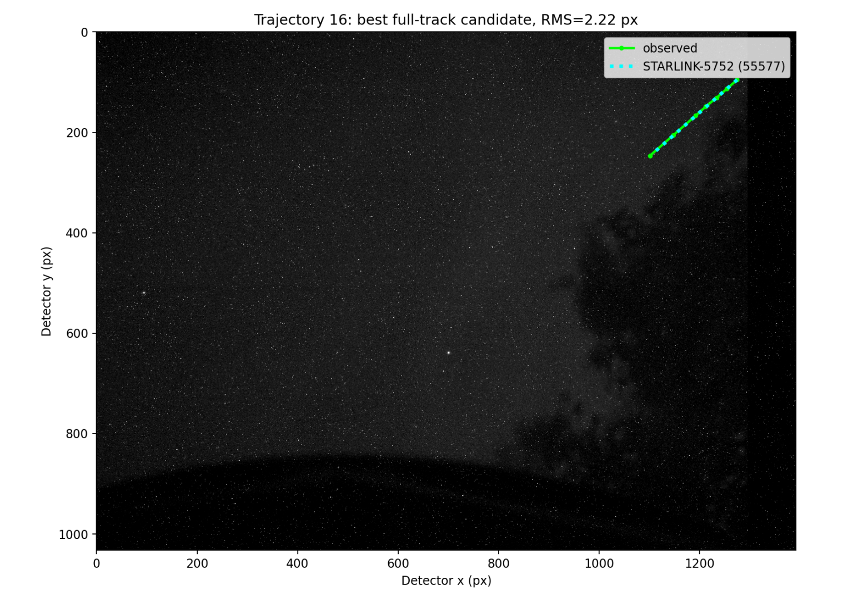
TRAJECTORY 16
Metric | Observed / best candidate
Best candidate | STARLINK-5752 / 55577
Observed UTC | 15:51:17 – 15:51:25
Observed date | 2026-06-12
Detected frames | 3960 – 3968
Measurements | 7
Duration | 8.014 s
Observed travel | 229.95 px
Observed mean speed | 28.693 px/s
Predicted mean speed | 28.020 px/s
Speed difference | 0.672 px/s (2.34%)
Position RMS | 2.221 px
Travel residual | 5.389 px
TLE age | 1.118 days
Mean elevation | 37.75°
Mean range | 743.8 km
31 / 36
Notes:
Trajectory 16: values are copied from the saved full-track correlation outputs.
[Sources]
trajectory_16/best_candidate_actual_image_detector_overlay.png
trajectory_16/top10_candidates.csv
outputs/revised_trajectory_master_summary.csv

Slide 32
TRAJECTORY 16
Top three full-track candidates
Rank | Candidate / NORAD | Position RMS | Speed residual | Travel residual | TLE age | Mean elevation
1 | STARLINK-5752 / 55577 | 2.221 px | 0.672 px/s | 5.389 px | 1.118 d | 37.75°
2 | STARLINK-31582 / 59545 | 3.060 px | 0.718 px/s | 5.754 px | 1.318 d | 31.30°
3 | STARLINK-31388 / 59565 | 3.222 px | 0.569 px/s | 4.559 px | 1.838 d | 31.96°
Rank 1: STARLINK-5752 / 55577 • Rank-2 / Rank-1 RMS ratio: 1.378
32 / 36
Notes:
Trajectory 16: values are copied from the saved full-track correlation outputs.
[Sources]
trajectory_16/top10_candidates.csv

Slide 33
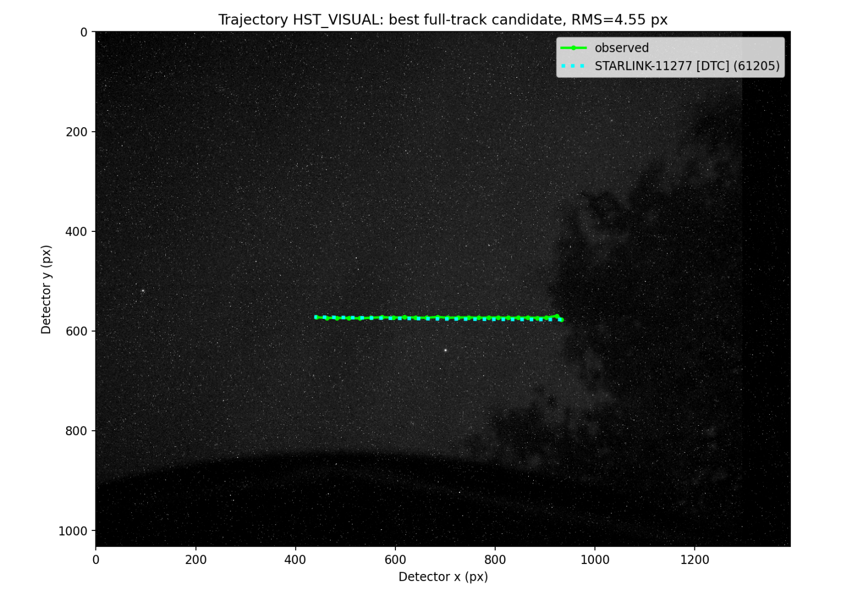
TRAJECTORY 17
Metric | Observed / best candidate
Best candidate | STARLINK-11277 [DTC] / 61205
Observed UTC | 15:54:13 – 15:54:37
Observed date | 2026-06-12
Detected frames | 4136 – 4160
Measurements | 25
Duration | 24.045 s
Observed travel | 494.60 px
Observed mean speed | 20.570 px/s
Predicted mean speed | 20.602 px/s
Speed difference | 0.032 px/s (0.15%)
Position RMS | 4.545 px
Travel residual | 0.758 px
TLE age | 0.662 days
Mean elevation | 26.67°
Mean range | 731.8 km
35 / 36
Notes:
Trajectory 18: values are copied from the saved full-track correlation outputs.
[Sources]
trajectory_18/best_candidate_actual_image_detector_overlay.png
trajectory_18/top10_candidates.csv
outputs/revised_trajectory_master_summary.csv

Slide 34
TRAJECTORY 17
Top three full-track candidates
Rank | Candidate / NORAD | Position RMS | Speed residual | Travel residual | TLE age | Mean elevation
1 | STARLINK-11277 [DTC] / 61205 | 4.545 px | 0.032 px/s | 0.758 px | 0.662 d | 26.67°
2 | STARLINK-34976 / 65209 | 5.189 px | 0.019 px/s | 0.463 px | 0.611 d | 29.08°
3 | HST / 20580 | 6.473 px | 0.087 px/s | 2.093 px | 0.410 d | 34.32°
Rank 1: STARLINK-11277 [DTC] / 61205 • Rank-2 / Rank-1 RMS ratio: 1.142
36 / 36
Notes:
Trajectory 18: values are copied from the saved full-track correlation outputs.
[Sources]
trajectory_18/top10_candidates.csv

Slide 35
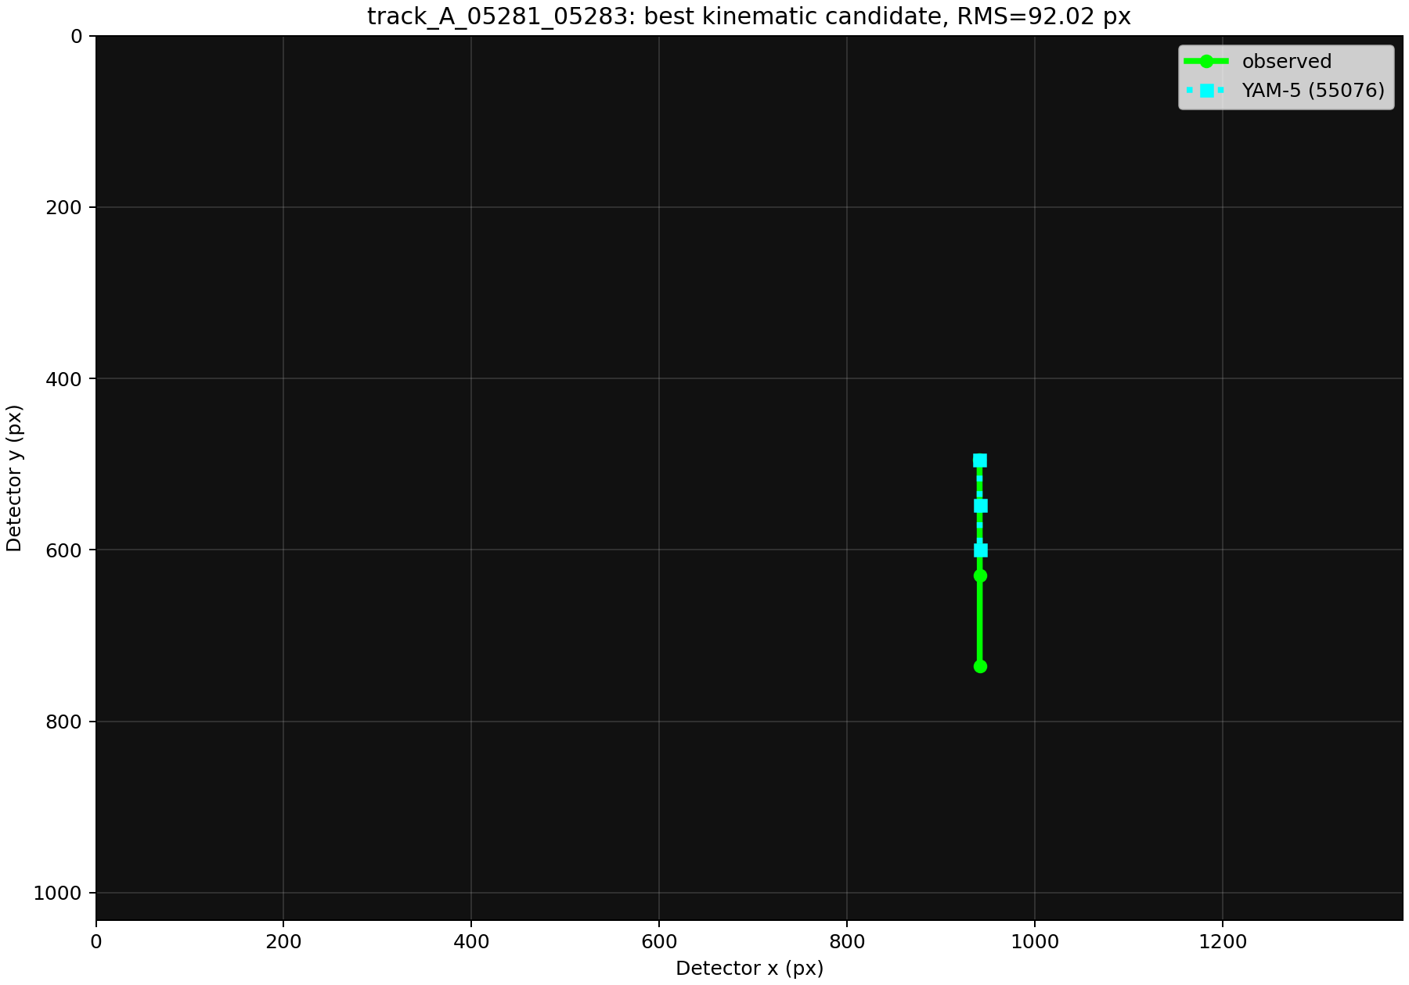
TRAJECTORY 18
Metric | Observed / candidate
Best candidate | YAM-5 / 55076
Interpretation | Ambiguous; unsupported ID
Observed UTC | 16:13:20.221–16:13:22.234
Frames / epochs | 05281–05283 / 3
Duration | 2.012 s
Observed travel | 240.808 px
Observed mean speed | 119.665 px/s
Observed direction | 89.964°
Predicted travel | 104.315 px
Predicted mean speed | 51.837 px/s
Direction residual | 0.051°
Speed residual | 67.828 px/s
Position RMS | 92.017 px
Travel residual | 136.493 px
TLE age | 0.526 days
35 / 36
Notes:
Trajectory 18: values are copied from the saved full-track correlation outputs.
[Sources]
trajectory_18/best_candidate_actual_image_detector_overlay.png
trajectory_18/top10_candidates.csv
outputs/revised_trajectory_master_summary.csv

Slide 36
TRAJECTORY 18
Top three full-track candidates
Rank | Candidate / NORAD | Position RMS | Speed residual | Travel residual | TLE age | Mean elevation
1 | YAM-5 / 55076 | 92.017 px | 67.828 px/s | 136.493 px | 0.526 d | 71.10°
2 | STARLINK-36351 / 67607 | 92.501 px | 68.246 px/s | 137.334 px | 0.528 d | 78.64°
3 | STARLINK-35854 / 68214 | 92.640 px | 68.307 px/s | 137.457 px | 0.484 d | 75.67°
Rank 1: YAM-5 / 55076 • ratio 1.005 • gap 0.484 px • AMBIGUOUS / UNSUPPORTED
36 / 36
Notes:
Trajectory 18: values are copied from the saved full-track correlation outputs.
[Sources]
trajectory_18/top10_candidates.csv

Slide 37
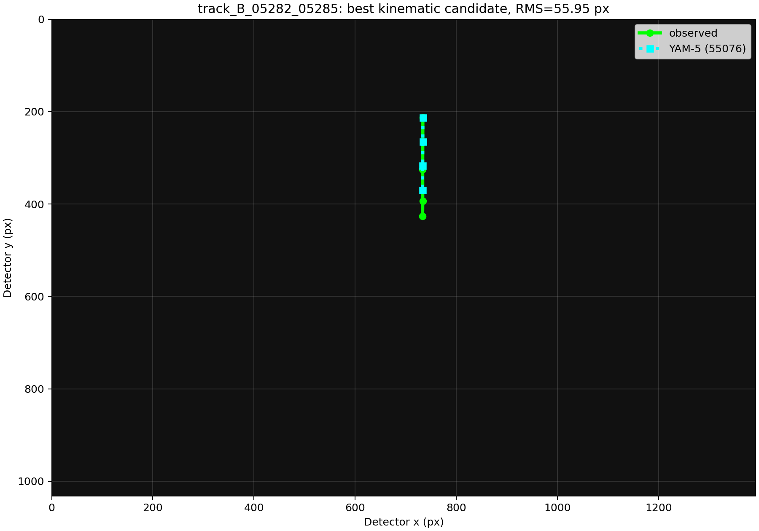
TRAJECTORY 19
Metric | Observed / candidate
Best candidate | YAM-5 / 55076
Interpretation | Ambiguous; unsupported ID
Observed UTC | 16:13:21.232–16:13:24.238
Frames / epochs | 05282–05285 / 4
Duration | 3.006 s
Observed travel | 213.347 px
Observed mean speed | 70.973 px/s
Observed direction | 90.133°
Predicted travel | 156.681 px
Predicted mean speed | 52.122 px/s
Direction residual | 0.089°
Speed residual | 18.851 px/s
Position RMS | 55.955 px
Travel residual | 56.666 px
TLE age | 0.526 days
35 / 36
Notes:
Trajectory 18: values are copied from the saved full-track correlation outputs.
[Sources]
trajectory_18/best_candidate_actual_image_detector_overlay.png
trajectory_18/top10_candidates.csv
outputs/revised_trajectory_master_summary.csv

Slide 38
TRAJECTORY 19
Top three full-track candidates
Rank | Candidate / NORAD | Position RMS | Speed residual | Travel residual | TLE age | Mean elevation
1 | YAM-5 / 55076 | 55.955 px | 18.851 px/s | 56.666 px | 0.526 d | 71.42°
2 | STARLINK-35854 / 68214 | 56.751 px | 19.312 px/s | 58.054 px | 0.484 d | 76.14°
3 | STARLINK-36351 / 67607 | 57.427 px | 19.845 px/s | 59.654 px | 0.528 d | 77.48°
Rank 1: YAM-5 / 55076 • ratio 1.014 • gap 0.796 px
36 / 36
Notes:
Trajectory 18: values are copied from the saved full-track correlation outputs.
[Sources]
trajectory_18/top10_candidates.csv

