Slide 1
RESEARCH MINI-PROJECT
Can gene expression predict cancer-drug sensitivity?
649
286
160,512
matched cell lines
drug-name groups
observed response pairs
Question: What generalizes to new cells, and what generalizes to new drugs?
CHALLENGE 27 / GENE EXPRESSION & DRUG SENSITIVITY
01
Notes:
Begin with the challenge: cell lines differ in genomic activity and can react differently to the same drug. We predict a laboratory inhibition response, not patient treatment.

Slide 2
CHALLENGE & BACKGROUND
What is being predicted?
Cell profile
Drug information
Response
Gene expression
Mutation records
Gene copy number
Compound identity if known
Putative targets
Pathway labels
Continuous LN_IC50
Fitted laboratory IC50
Lower = less concentration
A prediction is one cell-line and one drug combination.
CHALLENGE 27 / GENE EXPRESSION & DRUG SENSITIVITY
02
Notes:
Gene expression measures activity of genes via RNA; mutation and copy number describe other genomic variation. The target is LN_IC50, the natural logarithm of fitted inhibitory concentration. A lower value generally means less compound is needed in the cell assay, not a recommended clinical dose.

Slide 3
DATASET
How did we prepare the data?
649
286
160,512
Molecular profiles
Drug groups
Observed responses
cross-omics matched cells
source-normalized names
86.5% of matched grid
No missing response values were invented. Only verified, available measurements were modeled.
CHALLENGE 27 / GENE EXPRESSION & DRUG SENSITIVITY
03
Notes:
CCLE/DepMap provides expression, mutation and copy-number files; GDSC2 provides fitted drug response. We matched exact cell identifiers, excluded name conflicts and combined source-normalized duplicated drug identifiers. This yields 649 matched cells, 286 drugs and 160,512 measured response pairs, about 86.5 percent coverage. The original source uses different years for genomics and response.

Slide 4
METHODOLOGY
The prediction pipeline
01
02
03
04
05
Match sources
Hold out entities
Build features
Fit model
Evaluate
COSMIC / DepMap IDs
Cells or drugs
100 expression + 20 genomic + drug
Training-only preprocessing, Ridge
Held-out RMSE, MAE, per-drug r
Predictor: scaled Ridge regression (alpha = 100); baseline models are fitted only to training responses.
CHALLENGE 27 / GENE EXPRESSION & DRUG SENSITIVITY
04
Notes:
The workflow starts with exact source joins, then generates folds over unique entities. Within each training fold it selects 100 expression features, includes the same ten-gene mutation/copy-number panel, encodes the appropriate drug information and fits Ridge. Then it predicts and audits previously excluded entities. No test response is used for feature selection.

Slide 5
EVALUATION
Three held-out tests
New cell lines
New drugs
Train: different cell lines
Test: cell IDs never used in training
Fair baseline: mean for each familiar drug
Original: disjoint drug-name groups
Revised: disjoint known PubChem CIDs
50 drug codes remain unverified
Revised BOTH NEW (32,149 pairs): RMSE 2.501 combined vs 2.554 annotations-only.
CHALLENGE 27 / GENE EXPRESSION & DRUG SENSITIVITY
05
Notes:
Original drug-name-grouped and cell-ID benchmarks are retained. Additional post-hoc CID-grouped five-fold experiments keep compounds sharing known PubChem identities together. New drug CID RMSE is 2.452 vs 2.550 annotation-only; both new RMSE 2.501 vs 2.554 annotation-only on 32,149 pairs. The 50 unresolved compounds still prevent a fully chemistry-disjoint claim.

Slide 6
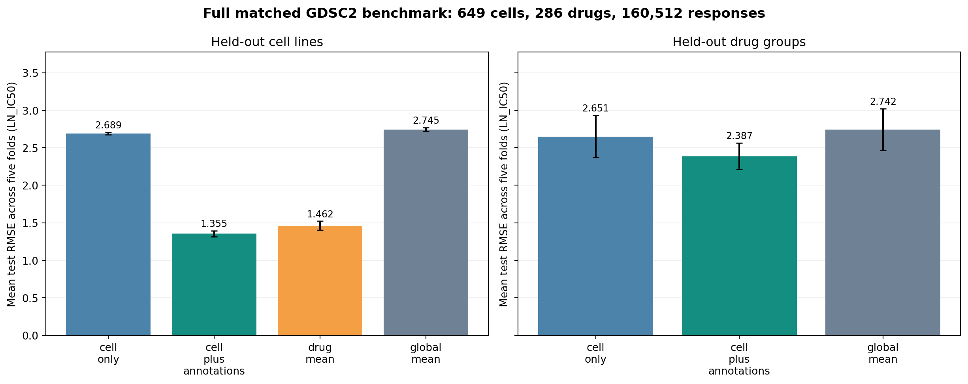
RESULTS
What did the model achieve?
1.355
Unseen-cell RMSE
vs 1.462 baseline
2.452
CID-grouped drug RMSE
vs 2.550 annotation-only
Figure: original normalized-name folds. CID-grouped result shown at right.
CHALLENGE 27 / GENE EXPRESSION & DRUG SENSITIVITY
06
Notes:
Original new-cell RMSE 1.355 versus 1.462 per-drug mean. Original cold-drug RMSE 2.387 versus 2.488 annotations-only. Revised CID-grouped drug RMSE 2.452 versus 2.550, and joint cold RMSE 2.501 versus 2.554. All are internal results; the first two use the original normalized-name grouping.

Slide 7
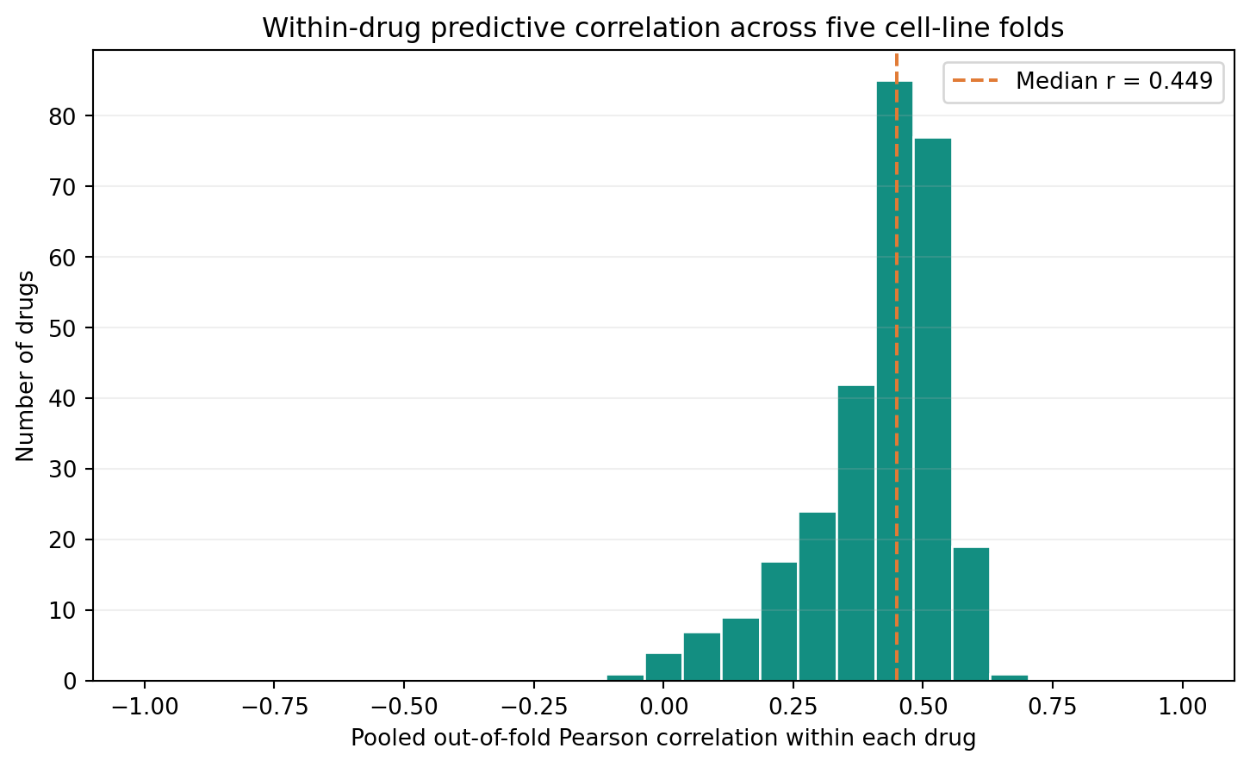
MEANING OF ACCURACY
Pooled correlation is not the whole story
0.449
Median within-drug r
229/286
Drugs with lower RMSE
than their training mean
CHALLENGE 27 / GENE EXPRESSION & DRUG SENSITIVITY
07
Notes:
The pooled unseen-cell correlation is high, but it can reward predicting average drug effects. The median Pearson correlation calculated separately for each drug is only 0.449, a fairer measure of differences between cell lines for the same drug. The model beats the per-drug mean on 229 of 286 drug groups, but fails on 57.

Slide 8
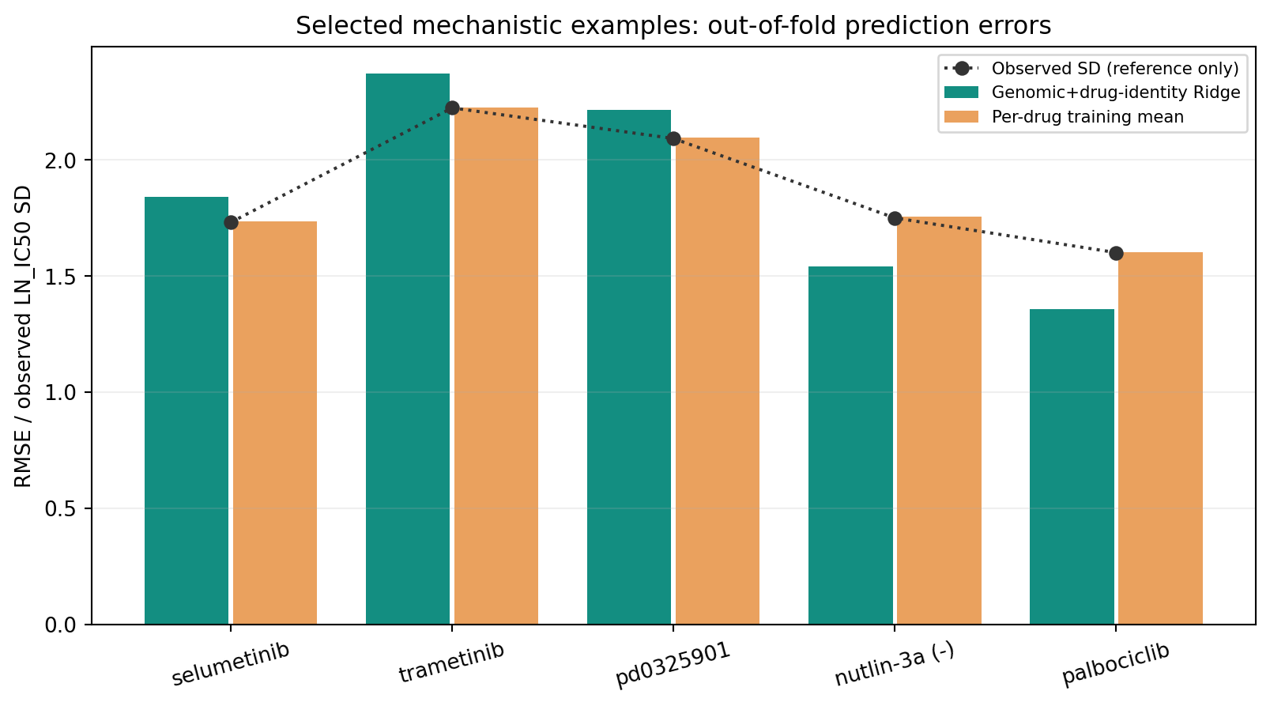
ERROR ANALYSIS
Which drugs remain difficult?
Key observation
A known drug identity does not ensure accurate variation between cell lines.
MEK inhibitors remain challenging.
CHALLENGE 27 / GENE EXPRESSION & DRUG SENSITIVITY
08
Notes:
Some MEK inhibitors are still poorly predicted compared with their within-drug means, despite distinct input identities for familiar drugs. We show selumetinib, trametinib and PD0325901 next to the Nutlin-3a and palbociclib examples. A good global metric cannot guarantee good estimates for each compound.

Slide 9
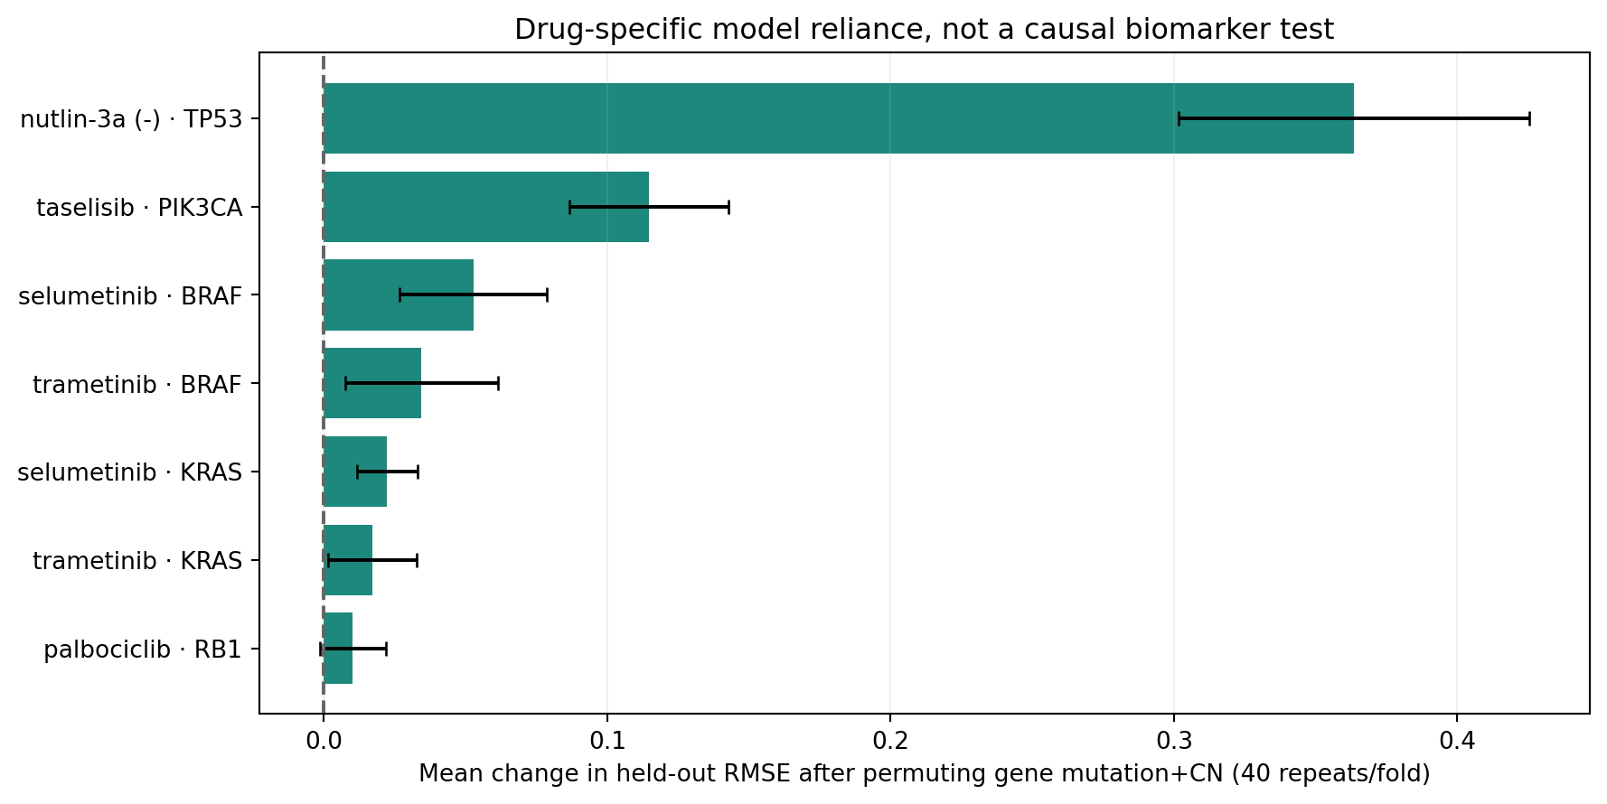
BIOLOGICAL DISCUSSION
Can genomic variables explain some responses?
Nutlin-3a / TP53
Mechanism-linked model reliance on held-out cells.
Biological association, not a validated treatment biomarker.
CHALLENGE 27 / GENE EXPRESSION & DRUG SENSITIVITY
09
Notes:
We predeclared Nutlin-3a/TP53, selumetinib and trametinib/KRAS-BRAF, palbociclib/RB1 and taselisib/PIK3CA. Each drug had its own held-out-cell Ridge model. In Nutlin-3a the TP53 mutation-and-copy-number group showed predictive reliance, consistent with published MDM2-p53 pharmacology. Permutation importance is not proof of causality.

Slide 10
INTEGRITY, DISCUSSION & LIMITATIONS
What can we conclude safely?
Finding
Assumptions
Limitations & uncertainty
Better than appropriate baselines on both grouped holdout tasks; within-drug performance varies.
Cross-source cell IDs and supplied drug target/pathway annotations are meaningful.
Scientific risks: 50 missing CIDs; 2 chemical-form conflicts; retrospective tests; unverified salt forms; source-year mismatch; no external screen.
Nonclinical research; incomplete chemical aliases; AI-assisted development disclosed.
CHALLENGE 27 / GENE EXPRESSION & DRUG SENSITIVITY
10
Notes:
State conclusions and limits explicitly. Genomic profiles and drug features improve regression within the matched preclinical cohort, but performance differs by compound. Assumptions: matched identities and source target/pathway labels are reliable. Limitations: mismatched data-release years, incomplete drug structure canonicalization, only single-dataset cross-validation, and no clinical/wet-lab validation. Final answer is a robust college-level proof of concept, not a clinical prediction tool.

