Slide 1
Smart Home IoT Network Risk Assessment
Using Bayesian Networks
A Python implementation demonstrating the methodology for assessing security risks in a Smart Home IoT network using a Bayesian Network (BN), based on the research paper: "Smart Home IoT Network Risk Assessment Using Bayesian Networks"
Authors : Miguel Flores,
Diego Heredia,
Roberto Andrade,
Mariam Ibrahim
Publication : Entropy 2022, 24, 668
Presented By : Aadi Bhaskaruni
Department Of CSE(Artificial Intelligence)
Amrita School Of Computing,
Amrita Vishwa Vidyapeetham

Slide 2
Introduction & Motivation
The Rise of IoT : Rapid growth of Smart Home IoT networks (interconnected devices,
e.g., smart lights, cameras).
The Security Problem : High interconnectivity and device heterogeneity (e.g., varied
authentication mechanisms) create a large attack surface.
Consequence : Increased susceptibility to cyber attacks leading to potential privacy
breaches and economic impact.
Need for Assessment : Traditional security models are often insufficient; a robust
probabilistic risk assessment is necessary.

Slide 3
Project analysis slide 6
Research Objective
Goal : To implement a risk assessment model for a smart home IoT network.
Methodology : Utilizing a Bayesian Network (BN).
Focus : Quantify the risk of various attacks (especially DoS and MitM) to devices in the Field Devices Level (automation devices) which generally have lower individual security.

Slide 4
Background: Risk & Modeling
Risk Definition : Risk is defined as the probability of an undesirable event multiplied by
its level of impact.
Traditional Models (Deterministic) : Attack Trees, Petri Nets, and Attack Graphs. Attack
graphs describe the network attack process and
the paths an attacker can follow.
Probabilistic Approach : Bayesian Networks (BNs).
Why BNs??
Risk = Probability * Impact
Probabilistic : Suitable for modeling uncertainty in cyber security events and attack prediction.
Flexibility: Can combine different sources of knowledge (e.g., expert opinion, simulation data).
BNs are Probabilistic Graphical Models (PGMs) represented as a Directed Acyclic Graph (DAG).

Slide 5
Smart Home IoT Network Structure
Model Network Levels : The smart home IoT network structure is divided into four main
levels:
1) Access Point (AP) : Where the attacker is positioned.
2) Management Level (M/CP): Devices like cellphones (CP) that issue orders.
3) Router (R): Connects all devices.
4) Field Devices Level (F): Automation devices such as smart lights, shutters, and cameras (the target of the attack graph)

Slide 6
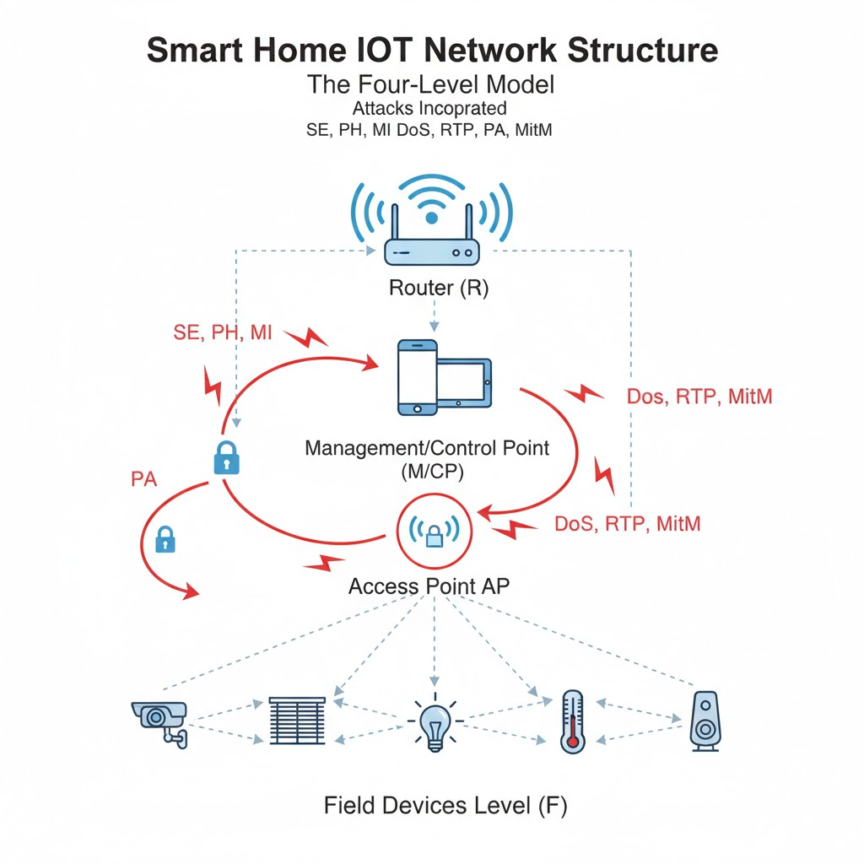
Smart Home IoT Network Structure
Attacks Incorporated :
Social Engineering (SE)
Phishing (PH)
Malware Injection (MI)
Denial of Service (DoS)
Routing Table Poisoning (RTP)
Persistent Attack (PA)
Man in the Middle (MitM)

Slide 7
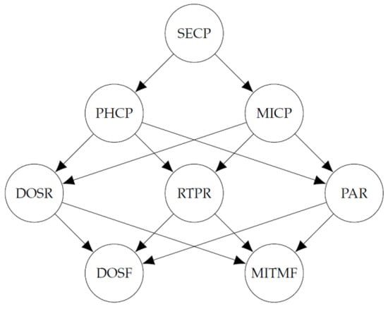
BN Construction: From Attack Graph to DAG
Prerequisite : An Attack Graph is first defined, detailing all possible paths an attacker can take from the AP to the Field Devices (F).
Mapping : The attack graph's sequential steps and dependencies are directly translated into the BN's DAG structure.
BN Nodes (Variables): Each node is a binary (Bernoulli) random variable:
Value 1 : The attack event occurs.
Value 0 : The attack event does not occur.
Example Nodes : SECP, DOSR, MITMF.

Slide 8
BN Construction: From Attack Graph to DAG
Prerequisite : An Attack Graph is first defined, detailing all possible paths an attacker can take from the AP to the Field Devices (F).
Mapping : The attack graph's sequential steps and dependencies are directly translated into the BN's DAG structure.
BN Nodes (Variables): Each node is a binary (Bernoulli) random variable:
Value 1 : The attack event occurs.
Value 0 : The attack event does not occur.
Example Nodes : SECP, DOSR, MITMF.

Slide 9
Parameter Estimation and CPTs
The Data Challenge : Lack of public, standardized real-world attack data.
Solution: Simulation: Attack events are simulated across five distinct scenarios to generate a
robust dataset.
Conditional Probability Tables (CPTs): These tables define the probability of a node being true
(attack success) given the state of its parent nodes.
Example: P(DOSR | MICP, RTPR)
Calculation: The Maximum Likelihood Method (MLM) is applied to the simulated data to
accurately approximate the CPTs.

Slide 10
Parameter Estimation and CPTs
Inference Goal : To determine the marginal probability of any node,
especially the target attack nodes (e.g., P(DOSF=1)).
Algorithm : The Junction Tree Algorithm is used to perform efficient inference calculations
within the BN.
The Power of Evidence : BNs allow for dynamic risk assessment: If "evidence" is
introduced (e.g., an antivirus system is active, or a specific
phishing attempt succeeded), the BN recalculates the
probabilities of all other nodes.

Slide 11
Project analysis slide 2
Simulation Scenarios & Assumptions
5 Scenarios Modeled : These reflect different attacker priorities and resource
allocations.
Scenario 1: Baseline (Equal probabilities).
Scenarios 2 & 4: Prioritize DoS attacks at the Router/Field Levels.
Scenarios 3 & 5: Prioritize MitM attacks at the Router/Field Levels.
Focus Areas : The ultimate risk assessment concentrates on DoS, MitM, and the
combined DoS/MitM attack on the Field Devices.

Slide 12
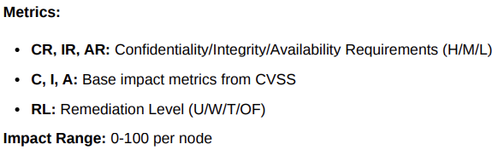

Project analysis slide 2
Quantification of Impact
Impact Metric : Defined as the total damage if a specific attack (or combination)
succeeds.
Scoring : Impact values (from 0 to 100) are assigned to each attack node based
on severity (potentially referencing industry standards like CVSS).
Total Impact : Calculated as the sum of the fixed impact values for all nodes
involved in the successful attack path.

Slide 13
Project analysis slide 2
Quantitative Risk Results
Risk Formula Revisited :
Risk = P(Attack Success) * I(Attack Impact)
Key Finding 1 : Dominant Risk: The Denial of Service (DoS) attack on the Field
Devices Level presents the highest quantified risk across the
majority of scenarios. (Due to high probability of success).
Key Finding 2 : The Double Attack: The combined DoS and MitM attack has the
highest impact value.

Slide 14
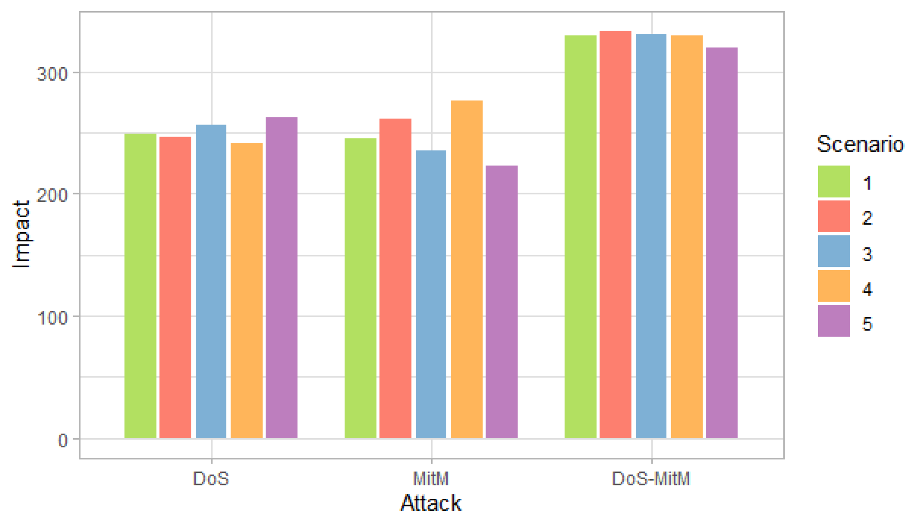
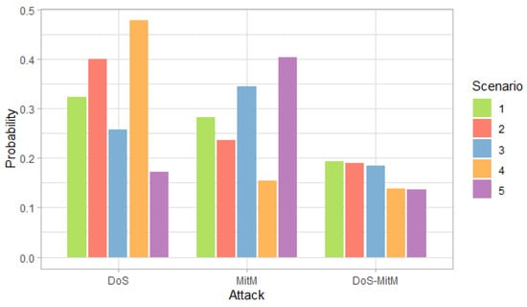
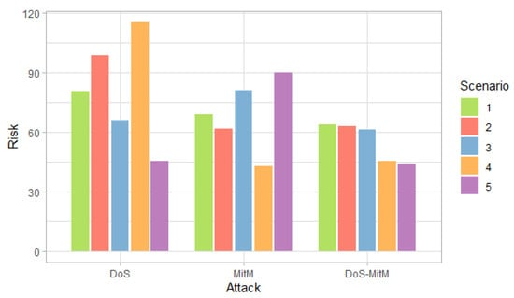
Project analysis slide 2
Quantitative Risk Results

Slide 15
Project analysis slide 2
Quantitative Risk Results Analysis
Crucial Distinction : However, its risk value is lower than the single DoS attack
because the probability of both attacks succeeding simultaneously is
significantly lower.
Insight : Risk management must prioritize the most probable and damaging events, not just the
most damaging potential events.

Slide 16
Project analysis slide 2
Practical Security Implications
Actionable Intelligence : The BN analysis dictates resource allocation.
Recommendation : Smart Home owners/operators should prioritize mitigation of DoS
attacks on the Field Devices Level (e.g., filtering unusual traffic,
rate limiting) over MitM countermeasures.
Benefit : Provides a clear, justifiable return on security investment based on quantified
risk figures.

Slide 17
Project analysis slide 2
Summary & Conclusion
Core Contribution : Successfully implemented a robust, quantitative risk assessment methodology using Bayesian Networks.
Model Success : The BN effectively modeled the complex, interdependent nature of cyber attack paths in an IoT environment.
Data Solution : Overcame data scarcity by effectively utilizing an attack simulation to feed the BN parameters.
Limitations : The model's accuracy is dependent on the quality of the simulated data and the defined impact values.
Future Research Avenues :
Applying the methodology to compare risk differences across various geographical regions (e.g., regulatory environments, common attack patterns).
Expanding the BN to include external factors like physical security compromises or device patching frequency.

Slide 18
Project analysis slide 2
References
Flores, M.; Heredia, D.; Andrade, R.; Ibrahim, M. Smart Home IoT Network Risk Assessment Using Bayesian Networks. Entropy 2022, 24(5), 668.
Rajab, H.; Cinkelr, T. IoT based smart cities. In Proceedings of the 2018 International Symposium on Networks, Computers and Communications (ISNCC), Rome, Italy, 12 November 2018.
Oliva, S.L.; Palmieri, A.; Invidia, L.; Patrono, L.; Rametta, P. Rapid Prototyping of a Star Topology Network based on Bluetooth Low Energy Technology. In Proceedings of the 2018 3rd International Conference on Smart and Sustainable Technologies (SpliTech), Split, Croatia, 26–29 June 2018; pp. 1–6.
Taştan, S.İ.; Dalkiliç, G. Smart Home System Using Internet of Things Devices and Mesh Topology. In Proceedings of the 2021 6th International Conference on Computer Science and Engineering (UBMK), Ankara, Turkey, 13 October 2021; pp. 407–412.
Johnson, D.; Ketel, M. IoT: The Interconnection of Smart Cities. In Proceedings of the 2019 SoutheastCon, Huntsville, AL, USA, 11–14 April 2019; pp. 1–2.

Slide 19
Link to the GitHub repository containing data and the implementation code
Link 🔗🔗

Slide 20
Thank You

