Slide 1
Solution on street light problem
Presented by:- SunStar
Members are :-
Aaditya
Samiksha Choudhary

Slide 2
Challenge:-
HOW TO DETECT/IDENTIFY THE DEFECTIVE/NON-FUNCTIONAL LIGHTS, NUMBER OF LIGHTS CONNECTED TO A PARTICULAR CCMS THAT ARE NOT FUNCTIONING AND THE WATTAGE OF THESE FAULTY LIGHTS.
COMPLAINT HANDLING SYSTEM (CHS) – THE PRESENT CONSUMER COMPLAINT DATA TO BE ANALYSED FOR PREDICTIVE ANALYSIS OF THE FAULTS AND UNDERSTANDING SO THAT EESL COULD TAKE PRE-EMPTIVE MEASURES AND ADDRESS THE COMPLAINTS BEFORE THEY EVEN OCCUR

Slide 3
Solution:- Detecting of damaged light.
Signal received
0
1
Damaged
Working

Slide 4
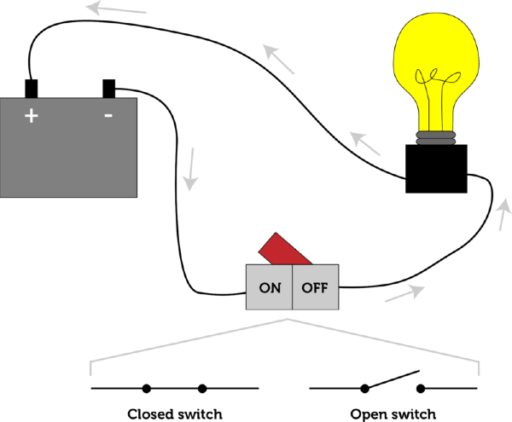
How the signal is sent by light:-
If (current at positive terminal && current at negative terminal) then return 1 (…. i. e working)
else return 0 (…. i. e defective).

Slide 5
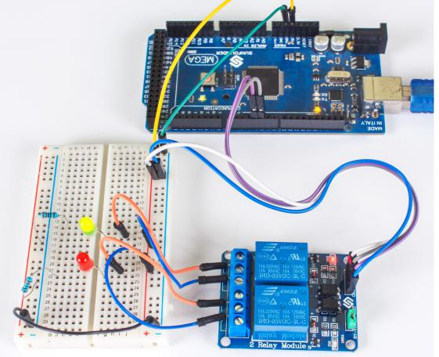
Signal sent by LED :-

Slide 6
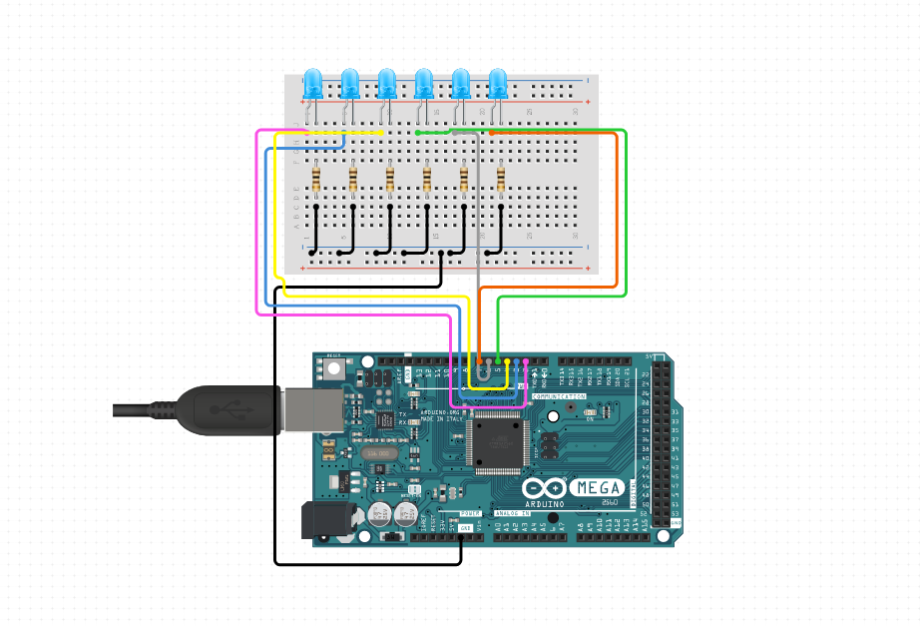

Slide 7
Consumers complaint:-
Prediction of damaging time
App
Traffic in an area
-> We will collect more features like temperature , voltage fluctuation, weather, time duration of switch-on, counting of on-off of switch from third party .
-> We will make an app with integration of government app for users to register their complaint regarding defective and unavailability of street light.
-> We can predict that if the traffic in a particular area is very less then the light of that area get switched off automatically . It will reduce energy consumption.

Slide 8
Battery Charger:-
We think about the implementation of battery charger station for vehicles near the pole . The station will take charge from the electric pole which can store energy from solar energy.
Use:-
-> Energy is saved because if the charger station is more far then the vehicle have to travel to that spot and come back. It will take more energy which is almost wastage.
-> Sufficient space is also available for making station near the pole as shown below:-

Slide 9
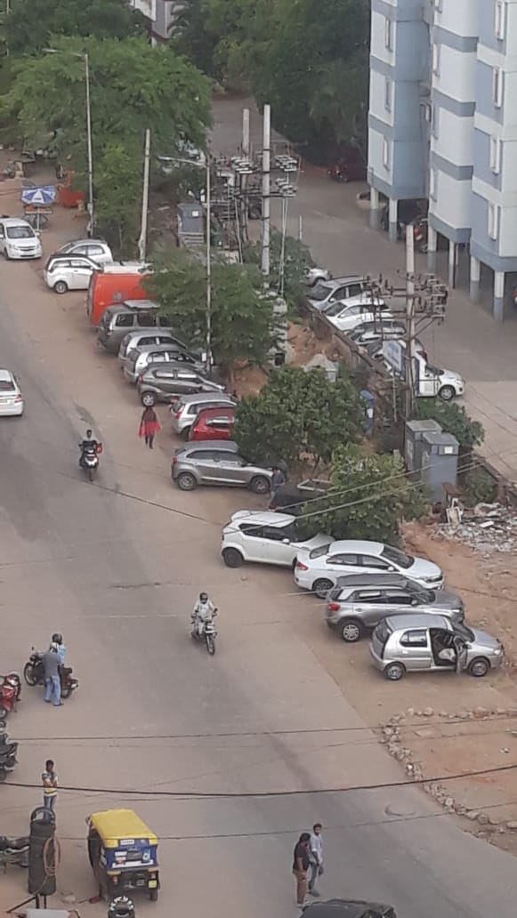

Slide 10
Installation of towers:-
We can also install the telecom tower on the street light pole.
Towers can create radiation which is harmful for organisms. That’s why people do not agree to install them on their house , in their field.
Sometimes during travelling there is a network issue. So to overcome that situation also we will install small towers on the pole so that the availability is better.
One big tower can cost of $92866 , but small scale can cost lesser than this.

Slide 11
Solar energy stored in battery:-According to ijeset--
12V solar plate generates 3-4.5kWh per day.
3-4.5 kWh
3.7kWh
0.18kWh is used by 15 watt LED in 12 hrs.
Tower
Electric Vehicle charging

Slide 12
If we use 100V solar plant ,it will generate more than 10kWh. We can also apply threshold value of energy which is available to a single client at a particular spot.

Slide 13
Uses/ Advantages:-
On automatic detection , the requirement of manpower is less.
Betterment for user is that the defect is to be repaired fastly.
On using prediction we can send the notification to electrical department that this light may be defective after this time period.
The availability of power station very effectively can reduce the energy consumption and less time taking.
Towers on the pole can provide easy network availability and doesnot effect the organism.

Slide 14
Future implementation:-
We will detect the traffic using photoelectric effect and then take decision whether the light is on or off. This is easily done by LDR sensor.
As we think of detection the damaged light for a meter , but it increases the complexity. So for later implementation we refine the detection process using big-data etc.
For future safety for telecom towers , we can prepare an anty-theft sensors to prevent theft.
We are also thinking about detecting the electricity in a particular locality by applying analysis on previous data and also by calculating the difference between the electricity supply rate and consumption rate.
If the current from positive terminal is passed but it does not reach to negative terminal then there is a wire issue. In future we also detect it.

Slide 15
Thank You

