Slide 1
Mumbai restaurant location recommendation using clustering.
Coursera capstone project
-Aadityaharan ganesh

Slide 2
The problem statement
Mumbai is one of the largest cities in the world with a population of 19.98 Million. For a restaurateur, opening a new branch in a city as big as this is not easy. The most difficult decision to make is the location where the new project is to be undertaken.
Location choice also depends upon the demographics, and the competition that they may face in a particular location.
Target Audience: This project is aimed at restaurateurs and small scale entrepreneurs for whom profit making is essential for success.
Problem Statement: “Where should a new restaurant in Mumbai be opened such that it will be a successful venture?"

Slide 3
Data acquisition and cleaning
The list of neighbourhoods was obtained from https://en.wikipedia.org/wiki/Category:Suburbs_of_Mumbai , using requests and BeautifulSoup. There are total 42 neighbourhoods.
The geographical coordinates for these neighbourhoods were obtained using geocoder package.
The venues in Mumbai were obtained using FourSquare API.
The venues were appended to the original dataframe with the neighbourhoods and coordinates. The venues were then one hot encoded.
After this, only restaurants were selected from the one hot encoded dataframe along with the neighbourhood and Latitude and Longitude data.

Slide 4
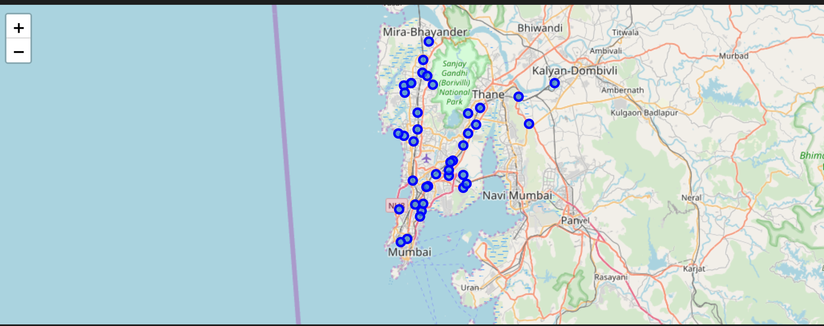
Map of Mumbai with the neighbourhoods

Slide 5
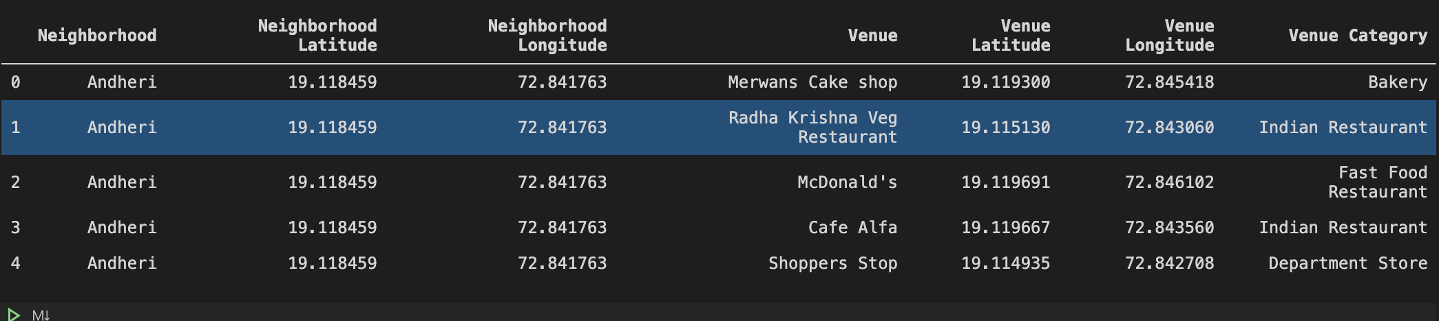
Dataframe obtained using foursquare api

Slide 6
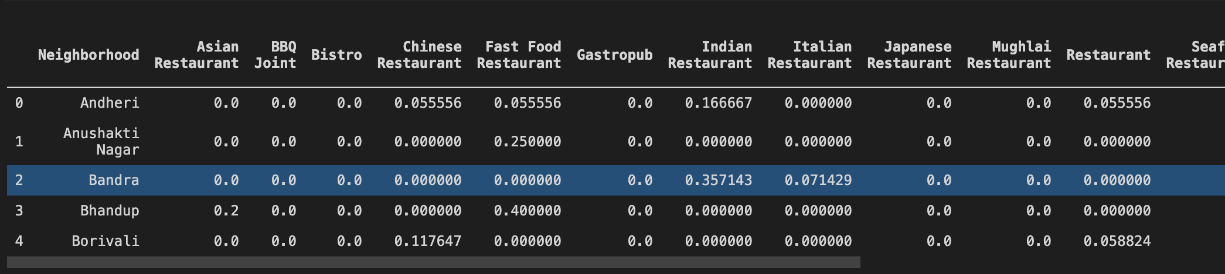
Final dataframe used for clustering

Slide 7
Clustering using k-means
K-Means was used for clustering the neighbourhoods.
Number of clusters was equal to 3.
The cluster value of the locations was merged with the dataset used for clustering, and then sorted according to the cluster values.
The Clusters were then visualized.

Slide 8
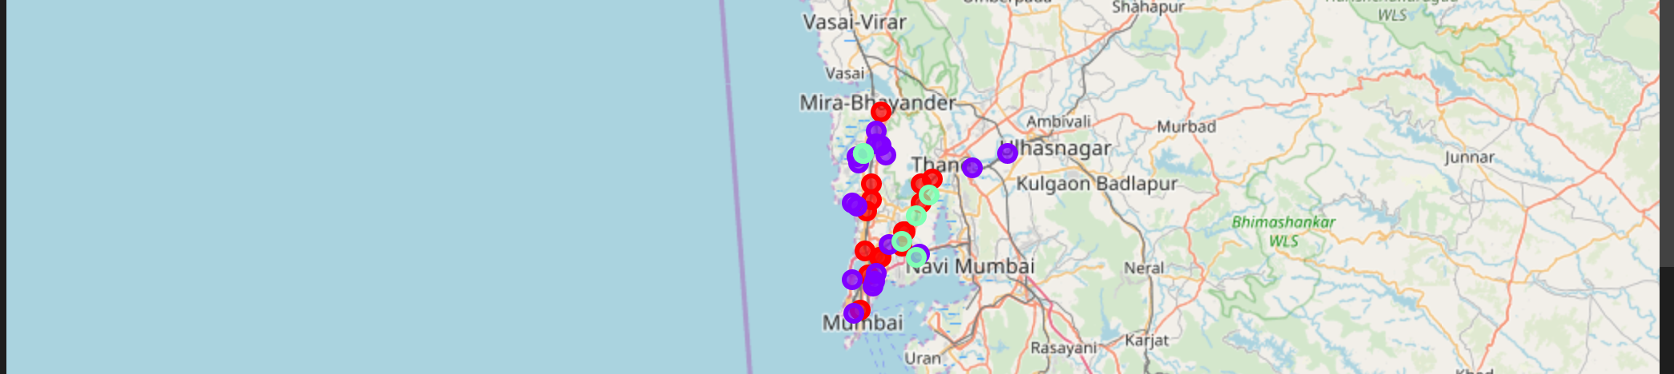
Clusters visualization

Slide 9
Observations
Most neighbourhoods were grouped into cluster 1(purple in the map), followed by cluster 0(red in the map) and the rest were grouped into cluster 2(green in the map).
Cluster 2 has the least number of neighbourhoods and does not have most types of restaurants. Restaurateurs can take advantage of this and open more restaurants in the locations present in cluster 2 as they will face far less competition.
All 3 clusters contain upmarket locations, which gives the scope of opening gastropubs,steakhouses,Sushi restaurants etc. that can cater to the upmarket crowd.

Slide 10
conclusion
Clustered location data successfully into Three different clusters.
There is a scope of improvement in this model.
Location demographics can be used to obtain better location clusters.

