Slide 1
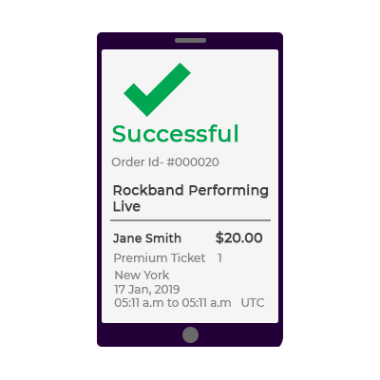
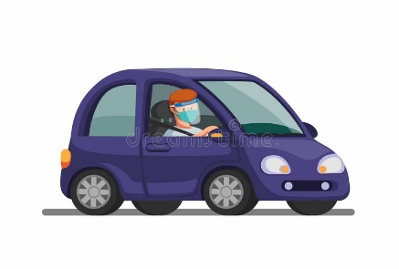

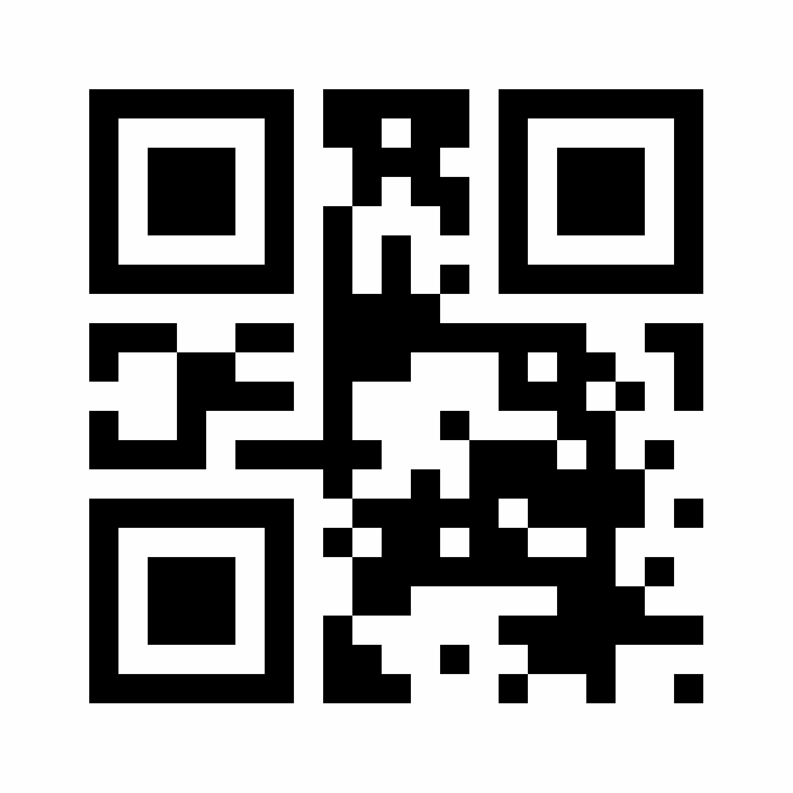

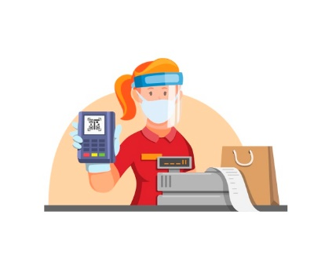
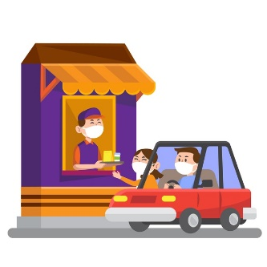
Menu
Cart
Checkout
Opens web app
getMenu (restaurantid)
placeOrder(itemList)
checkInventoryStatus (productId)
return Status
Temporary queue db
CDN
Pub/Sub
POS server
Progressive Web app architecture

