Slide 1

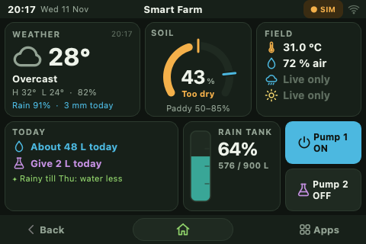
Smart Farm
An IoT irrigation, fertilizer and farm-assistant system with live sensors, weather-aware advice and Gemini AI
Raspberry Pi 4 · Arduino Mega 2560 · 3.5" touchscreen · Web dashboard · Gemini AI
Home screen on the 480 × 320 touchscreen
Notes:
Smart Farm is a complete IoT system: field sensors, two pumps, a rainwater tank, a touchscreen and web dashboard, daily weather-aware advice and an AI assistant.

Slide 2



Why a smart farm
The problem
Objectives
Watering by guesswork
Too much water wastes it and rots roots; too little stresses the crop.
Water automatically from live soil moisture, per crop
Give fertilizer by hand, safely time-limited
Warn when the rainwater tank is full
Turn the forecast into a daily water and fertilizer plan
Add an AI assistant for crop profiles and questions
Run on low-cost, open hardware a student can build
Weather is ignored
Fields are watered and fed just before rain that would have done the job.
Rainwater overflows
Nobody notices when the harvesting tank is full until it spills.
2
5
12
pumps
field sensors
apps
Notes:
Small farms often water on a fixed routine. This project replaces the routine with measurements, the forecast and simple rules.

Slide 3
System architecture
Field sensors
Soil moisture · A0
Rain drop · A1
Light (LDR) · A2
DHT11 temp / humidity · D2
Ultrasonic rain tank · D9 / D10
3.5" touchscreen
PyQt5 · 12 apps
USB serial
JSON every 1 s
Arduino Mega 2560
Reads sensors · runs AUTO watering
Raspberry Pi 4
Python · control, advice, AI
Web dashboard
FastAPI · port 8000
Watering keeps running on the Arduino even if the Pi restarts.
Weather forecast
Open-Meteo API
L298N motor driver
D5 / D7 · D6 / D8
Farm AI
Google Gemini API
Pump 1
water
Pump 2
fertilizer
Notes:
Two controllers: the Arduino does real-time sensing and pump switching, the Pi does the interface, the weather, the advice and the AI. They talk over USB serial with one JSON line per second.

Slide 4
Hardware specifications
Component | Part | Key specification
Main computer | Raspberry Pi 4 Model B | Quad-core 1.5 GHz, Wi-Fi, runs the UI, web server and AI
Field controller | Arduino Mega 2560 | ATmega2560, 16 MHz, 256 KB flash, 8 KB RAM
Display | 3.5" TFT with ADS7846 touch | 480 × 320 pixels, resistive touch, 16-point calibration
Soil moisture | Capacitive / resistive probe | Analog A0, mapped to 0–100 %
Air sensor | DHT11 | Temperature 0–50 °C, humidity 20–90 %
Rain tank level | HC-SR04 / JSN-SR04T ultrasonic | 2–400 cm range, median of 5 pings
Rain and light | Rain drop board, LDR | Analog A1, A2
Pump driver | L298N dual H-bridge | Two DC pumps, both inputs driven, direction in EEPROM
Pumps | 2 × 12 V DC pumps | Pump 1 water (AUTO / manual), pump 2 fertilizer (manual)
Notes:
All parts are low-cost and widely available. The Mega was chosen for its many pins and its 5 V logic for the sensors and driver.

Slide 5
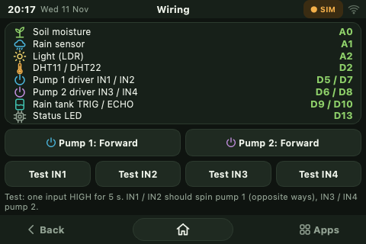
Wiring and pin map
Signal | Mega pin
Soil moisture · rain · light | A0 · A1 · A2
DHT11 data | D2
Pump 1 driver IN1 / IN2 | D5 / D7
Pump 2 driver IN3 / IN4 | D6 / D8
Rain tank TRIG / ECHO | D9 / D10
Status LED | D13
Raspberry Pi link | USB, 115200 baud
The Wiring app shows the pin map and tests each driver input
Pump OFF = both driver inputs LOW, so no input floats and the motor cannot creep. Pumps get their own 12 V supply; its ground joins the Mega ground.
Notes:
A floating driver input made a pump creep during testing; driving both inputs fixed it. The input test found two crossed wires, which were remapped in firmware.

Slide 6
Software and code structure
Technology stack
Arduino C++: sensing, AUTO watering, pump timers, EEPROM settings
Python 3: hardware manager, advice engine, Farm AI
PyQt5 on the Linux framebuffer for the touchscreen
FastAPI + HTML / JavaScript for the web dashboard
Open-Meteo forecast and Gemini REST API over HTTPS
systemd service: starts on boot, restarts on failure
Notes:
The touchscreen UI is the largest part because the resistive screen only delivers taps, so every control is a big button or stepper.

Slide 7






How it works
1
2
3
4
5
6
Sense
Report
Decide
Act
Advise
Show
The Mega reads soil, air, rain, light and tank level every second.
It sends one JSON line per second to the Pi over USB.
In AUTO, pump 1 starts below the dry cutoff and stops at the wet cutoff.
Pumps switch through the motor driver; every manual run has a timer.
The Pi combines forecast, crop and sensors into today's plan.
Touchscreen, web page and alerts show everything live.
If a setting is lost on the serial link, the Pi notices the mismatch in the next report and sends it again.
Notes:
The loop runs every second. Decisions that must never stop, like AUTO watering, live on the Arduino.

Slide 8
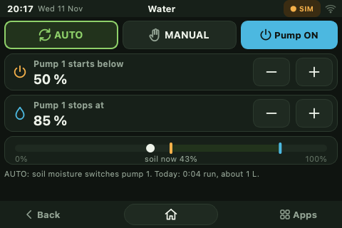

Pump 1: automatic watering
Two cutoffs, no flicker
Starts below the dry cutoff, stops only at the wet cutoff, so the pump never cycles on and off.
Crop presets
Choosing a crop sets both cutoffs; a custom crop can come from Farm AI.
Crop | Start below | Stop at
Paddy | 50 % | 85 %
Tomato | 35 % | 65 %
Onion | 40 % | 70 %
Chilli | 25 % | 55 %
Cactus | 15 % | 35 %
Water app: AUTO / MANUAL and the two cutoffs
Notes:
The gap between the two cutoffs is a hysteresis band: it stops the pump from switching rapidly around one threshold.

Slide 9
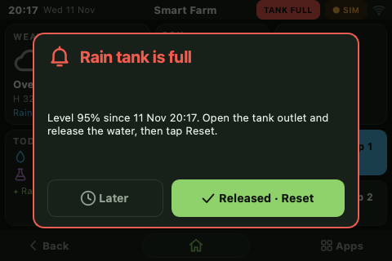
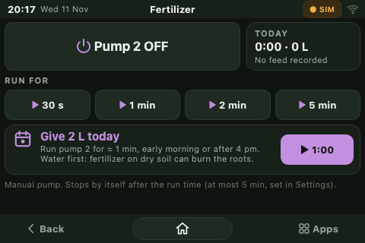
Rain tank alert and pump 2
Alert logic
Fires at the alert level (default 90 %)
Stays on, even after a restart, until someone releases water and taps Reset
Re-arms only after the level drops 10 % below
Full-tank alert on every page
Fertilizer app: timed manual runs
Pump 2 safety
Ultrasonic level sensing
Distance to the water becomes a fill level: level % = (tank height − distance) ÷ (tank height − gap when full).
Manual only: 30 s, 1, 2 or 5 min
The Mega stops it on time, even if the Pi crashes
Notes:
The rainwater tank is measured from above with sound. The alert is latched on purpose so it cannot be missed.

Slide 10
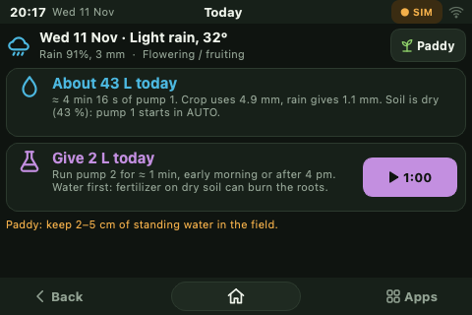
Daily advice from the forecast
Crop water need = ET0 × Kc − useful rain
FAO-56 method · 1 mm of water on 1 m² = 1 litre
Worked example (tomato, flowering)
ET0 from the forecast | 4.0 mm
× Kc for flowering tomato | × 1.15 = 4.6 mm
− useful rain (1.8 mm forecast) | − 0.4 mm
× 10 m² field ÷ 0.9 drip efficiency | ≈ 46 litres
÷ pump 1 flow of 10 L/min | ≈ 4.6 minutes
Fertilizer: fed every 7–30 days by crop, postponed when 10 mm+ of rain would wash it away
Notes:
ET0 is the reference evapotranspiration from the forecast; Kc adjusts it for the crop and its growth stage.

Slide 11
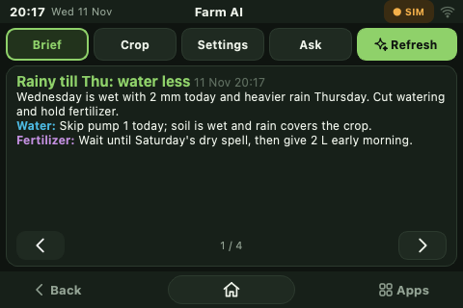


Farm AI with Gemini
Daily brief
Plan for today and the next days, with actions, reminders and warnings; refreshed every 3 hours.
Crop profile
Cutoffs, Kc, feeding interval and pests for any crop, applied in one tap.
Settings check
Reviews cutoffs, tank alert and feed size; each change needs Apply.
Ask
Free questions about the farm, answered with the live data.
A daily brief: weekday, rain ahead, water less, fertilizer timing
The AI never switches a pump. Answers are structured JSON, cached for offline use.
Notes:
The Pi sends Gemini the date, forecast, sensor readings, crop and settings, and asks for a JSON answer that the screens render.

Slide 12
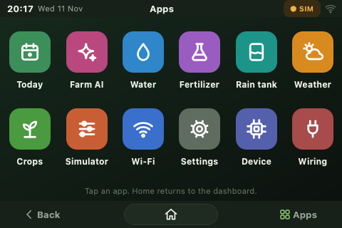
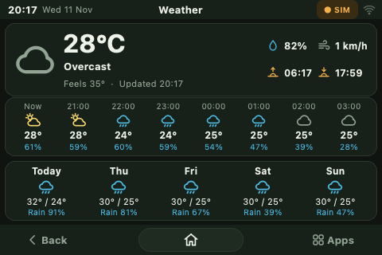
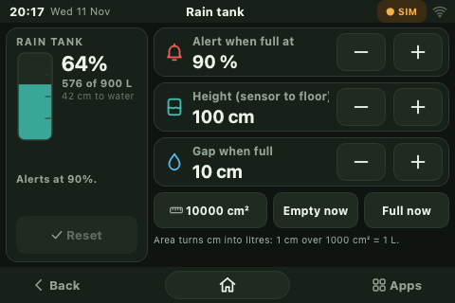

Tablet-style user interface
App drawer: 12 apps
Weather: hourly and 5-day
Rain tank calibration
Back · Home · Apps
Same features on the web
Every page has the same navigation bar, like a tablet.
Any phone or laptop on the network opens the dashboard in a browser.
Notes:
The resistive screen only reports taps, so there are no sliders or scrolling: every control is a large button, stepper or number pad.

Slide 13
Code highlights
Arduino C++ · firmware
Python · Raspberry Pi
// Pump OFF = both inputs LOW (nothing floats)
void motor_write(const Motor &m, bool on) {
digitalWrite(m.in_a, LOW);
digitalWrite(m.in_b, LOW);
if (on) digitalWrite(m.reverse ? m.in_b
: m.in_a, HIGH);
}
// AUTO watering with two cutoffs
if (soil < dry_cutoff && !pump_state)
set_pump(true);
else if (soil >= stop_cutoff && pump_state)
set_pump(false);
# Daily water amount (advisor.py)
need_mm = et0 * kc
net_mm = max(0, need_mm - effective_rain(rain_mm))
litres = net_mm * field_m2 / 0.9
minutes = litres / pump1_lpm
# Re-send settings if the Mega disagrees
if data['mode'] != expected_mode:
self._sync_arduino()
Notes:
Two small pieces carry most of the behaviour: the motor driver write and the two-cutoff rule on the Arduino, and the water formula on the Pi.

Slide 14
Test results
Test | Result
Touch calibration (16 points) | Average error 3.9 → 2.9 px, worst 7.4 px
Stray-touch filter | Ghost touch rejected; 0 taps in 20 s idle
One tap, one click | Duplicate touch reader removed
AUTO watering | Pump 1 started at 16 % soil (cutoff 25 %)
Serial reliability | 76-byte burst overflowed 64-byte buffer: fixed
Motor driver input test | Crossed wires found, remapped in firmware
Rain tank alert | Latched at 95 %, reset, re-armed, re-alerted
Farm AI | Brief returned; busy (503) replies retried
14.3 KB
460 B
firmware (5.6 % of flash)
RAM used of 8 KB
Notes:
Every result here was measured on the real Pi, touchscreen and Arduino during development.

Slide 15


Who benefits
Small farmers
Students and teachers
Community gardens
Water and fertilizer only when the crop needs it, with less labour and lower bills.
A hands-on STEM project covering sensors, electronics, code, data and AI.
One shared system that anyone can check from a phone.
Water conservation
Agri extension workers
The crop and the soil
Rainwater is collected, watched and used; less ground water is pumped.
Daily plans and crop profiles make advice easy to share.
Steady moisture and timed feeding mean less stress and less runoff.
Notes:
The system is cheap enough for a small farm and simple enough for a classroom.

Slide 16



Conclusion and future work
What we achieved
Next steps
Automatic, crop-aware watering that keeps running without the Pi
Safe manual fertilizer runs and a rain tank that cannot overflow unnoticed
Weather-aware daily advice and an AI assistant on a 3.5" screen
Tested on real hardware: touch, pumps, serial link, alerts and AI
Solar power for remote fields
Flow meter to measure litres given
Several zones and soil sensors
History charts and data logging
SMS or app notifications
Measure, decide, act and explain: a small farm that looks after itself.
Notes:
Close with the main idea: the system measures, decides, acts and explains its advice.

Slide 17
References
1.
Allen, R. G., Pereira, L. S., Raes, D. and Smith, M. (1998). Crop evapotranspiration: guidelines for computing crop water requirements. FAO Irrigation and Drainage Paper 56. FAO, Rome.
2.
Open-Meteo. Weather Forecast API documentation. open-meteo.com/en/docs
3.
Google. Gemini API documentation: text generation and structured output. ai.google.dev/gemini-api/docs
4.
Arduino. Arduino Mega 2560 Rev3 documentation. docs.arduino.cc/hardware/mega-2560
5.
Raspberry Pi Ltd. Raspberry Pi 4 Model B documentation. raspberrypi.com/documentation
6.
STMicroelectronics. L298 dual full-bridge driver datasheet.
7.
Texas Instruments. ADS7846 touch-screen controller datasheet.
8.
Aosong Electronics. DHT11 temperature and humidity sensor datasheet.
9.
ElecFreaks. HC-SR04 ultrasonic ranging module user guide.
10.
Riverbank Computing. PyQt5 reference guide; S. Ramírez, FastAPI documentation (fastapi.tiangolo.com).
Notes:
Crop water figures follow FAO-56. Hardware details come from the manufacturers' datasheets.

