Slide 1
Angular With Nodejs
Team Members,
Aadil AA
Athulya Vijayan

Slide 2
What is Nodejs
NodeJS is generally an asynchronous event-driven framework of JavaScript for server-side applications.
It enables developers to build scalable and high-performance applications using JavaScript on both the client-side and server-side.
It is used for creating server-side and networking web applications.
It is open source and free to use.
Node.js also provides a rich library of various JavaScript modules to simplify the development of web applications.
Node.js = Runtime Environment + JavaScript Library

Slide 3
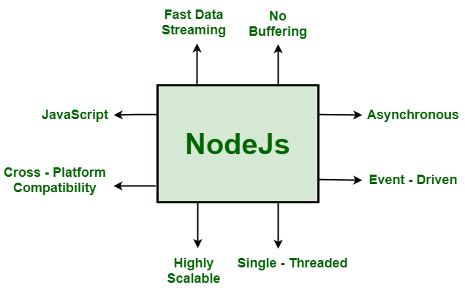
Features Of Node js

Slide 4
Features Of Node js
Asynchronous and Event-Driven: The Node.js library’s APIs are all asynchronous (non-blocking) in nature.
Single-Threaded: Node.js employs a single-threaded architecture with event looping, making it very scalable.
Scalable: NodeJs addresses one of the most pressing concerns in software development: scalability.
Quick execution of code: Node.js makes use of the V8 JavaScript Runtime motor, which is also used by Google Chrome.

Slide 5
Features Of Node js
Cross-platform compatibility: NodeJS may be used on a variety of systems, including Windows, Unix, Linux, Mac OS X, and mobile devices.
Uses JavaScript: JavaScript is used by the Node.js library, which is another important aspect of Node.js from the engineer’s perspective.
Fast data streaming: When data is transmitted in multiple streams, processing them takes a long time. Node.js processes data at a very fast rate.
No Buffering: In a Node.js application, data is never buffered.

Slide 6
Applications of Node.js
1)Single Page Applications
2) Data-Intensive Real-time Applications
3) I/O bound Applications
4) JSON APIs based Applications
5) Data Streaming Applications

Slide 7
Node commands
npm init
npm install express sequelize mysql2 cors –save
node server.js

Slide 8
References
Reference Website- https://www.bezkoder.com/angular-15-node-js-express-mysql/
Reference video- https://www.youtube.com/watch?v=O76FbfTbPH4&feature=youtu.be
Reference Github- https://github.com/aadil-zeyn/Angular-NodeJs-TutorialManagement

