Slide 1
Memory Forensics: Recovering Deleted Browser History
Name:
Course:

Slide 2
Introduction
Digital forensic investigations deal with the examination of digital evidence together with its analysis.
Deleting browser history does not eliminate its presence from RAM's memory space.
The project shows step-by-step how to recover erased Firefox history by using different memory investigation tools.

Slide 3
Scenario & Objective
Users browse websites in Firefox, and then clear history.
We obtain a memory dump to extract both deleted search queries along with URLs that were visited.
Demonstrates real-world forensic investigation techniques.

Slide 4
Tools Used
Kali Linux (Virtual Machine)
AVML functions as a memory leak tool for volatile memory acquisition.
The data extraction requires the use of the strings utility together with the grep command to retrieve URLs from memory.
Python Script – Automate history extraction

Slide 5
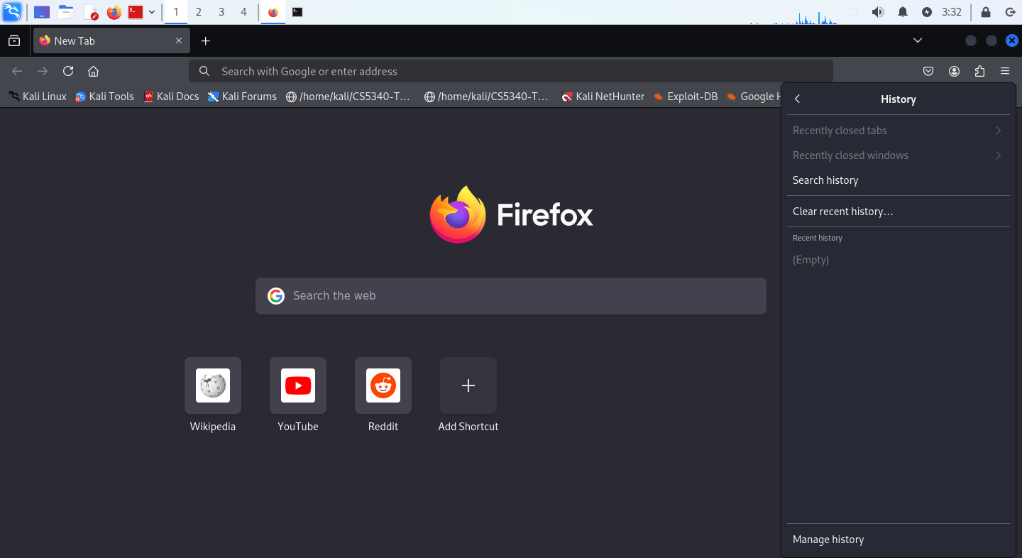
Step 1 – Browsing & Clearing History
Users open various websites within Firefox before using the history-clearing feature.
Open Firefox while visiting different websites and carrying out multiple searches.
Clear history->Menu → History → Clear Recent History

Slide 6
Step 2 – Capturing Memory Dump with AVML
Running the Firefox_memory.img file using AVML
The user needs to run AVML through the command line interface to generate a RAM dump file.
cd /opt
sudo ./avml firefox_memory.img

Slide 7
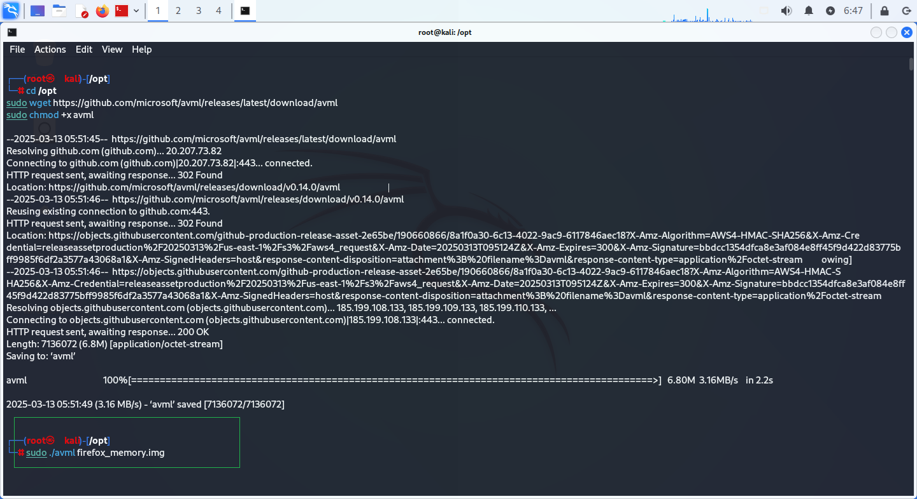
Dump file created

Slide 8
Step 3 – Extracting Deleted History
A search using Run_command will show which websites Firefox has stored in system memory.
The grep command searches the firefox_memory.img image for HTTPS URLs.
Extracted Search query ‘https’
strings firefox_memory.img | grep -E "q=|reddit?"

Slide 9
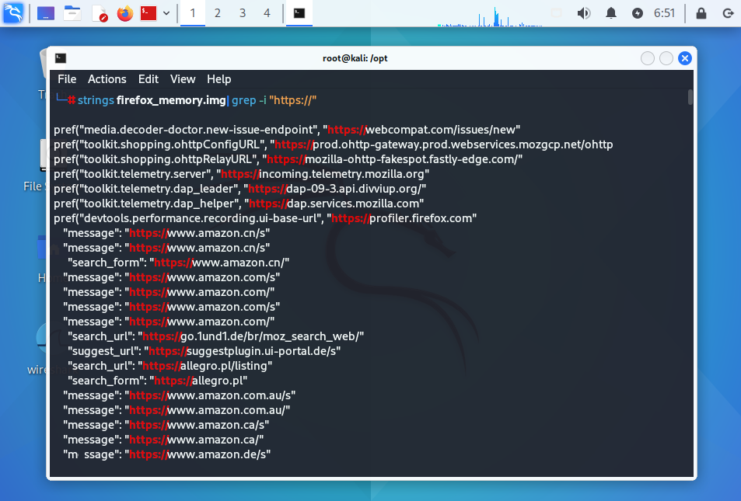
Extracted Search query ‘https’

Slide 10
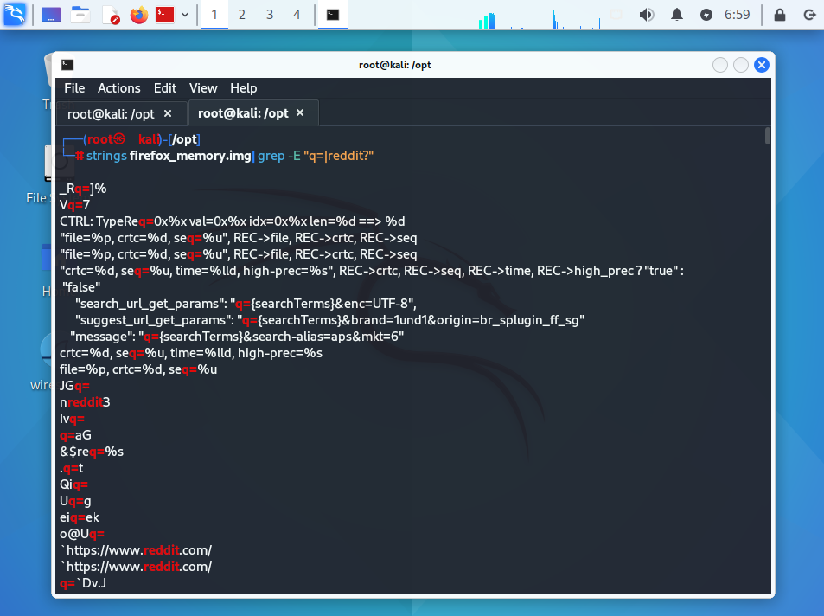
Extracted search query ‘reddit’

Slide 11
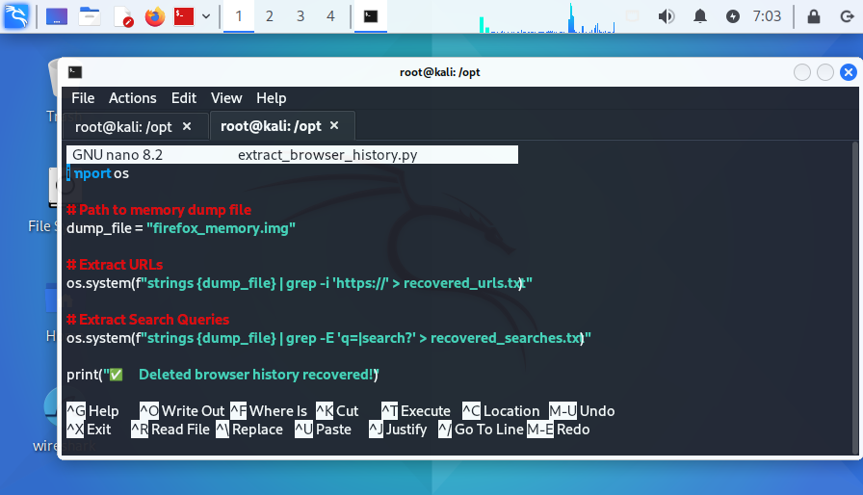
Step 4 – Automating Extraction (Python Script)
The following step enables automated extraction through the development of a Python script.
A code written in Python functions to retrieve eliminated history automatically.

Slide 12
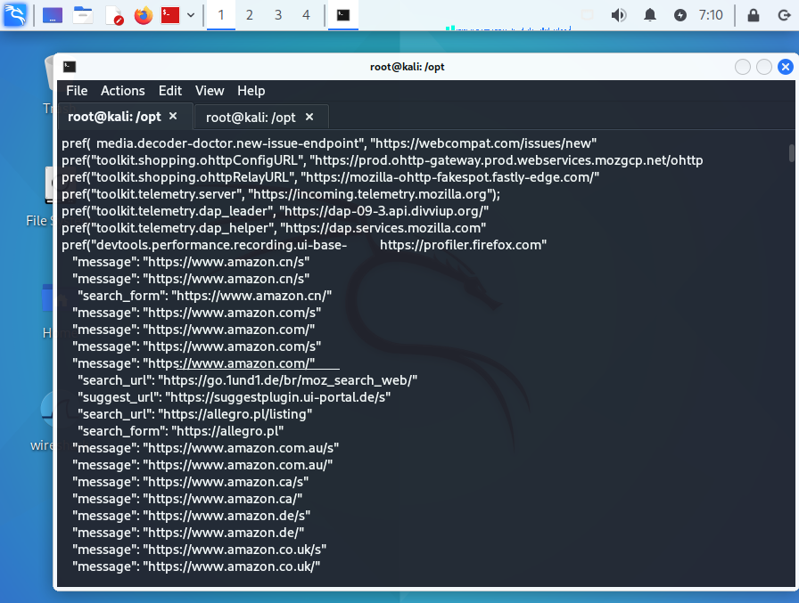
Findings & Results
The recovery of erased browser history data was successful from RAM.
The clear history process does not remove URLs and search queries that remain stored in system memory.
This evidence shows why memory analysis is vital in digital investigations.

Slide 13
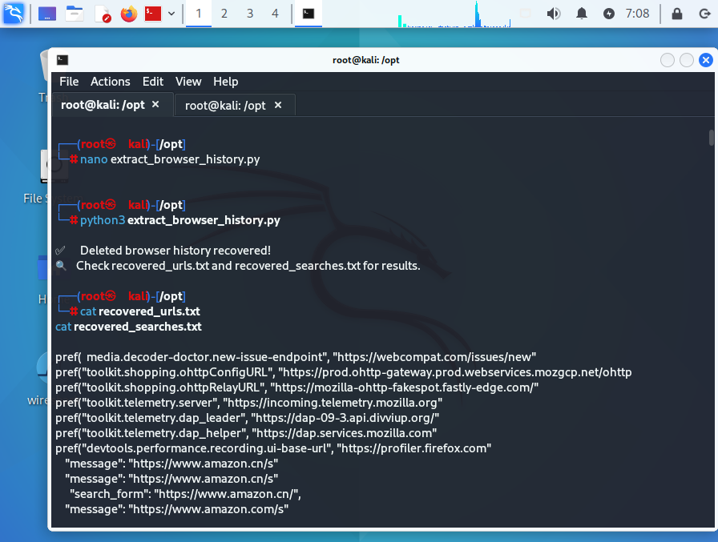
Output Files containing extracted Browser URLs and Search Queries.

Slide 14
Security & Countermeasures
To prevent forensic retrieval:
Use private browsing (Incognito Mode).
Regularly restart the system (flush RAM).
Use RAM encryption tools.
Disable disk caching in Firefox.

Slide 15
Conclusion
Examination of memory systems stands vital for conducting cyber incident investigations.
Analysis of Random Access Memory enables experts to recover browser data that users have deleted.
Knowing forensic methods serves to defend both privacy and security elements.

Slide 16
Thank You

