Slide 1

North South University
PERSONAL DIARY MANAGEMENT SYSTEM
CSE 115, Section 4
Group 07
• Muhammad Fahimul Hoque (2621584042)
• Aadila Zaheen (2622214042)
• Samia Meharin Lisa (2623705042)
• MD. Ashrafuzzaman (2625096042)
Group 7 (CSE115, Section 4) | Muhammad Fahimul Hoque • Aadila Zaheen • Samia Meharin Lisa • MD. Ashrafuzzaman

Slide 2
Why a Digital Diary?
PAPER DIARY
OUR SYSTEM
Easy to lose or damage
Always saved to disk (users.dat / entries.dat)
No way to search old pages
Instant search by entry serial number
Editing means crossing out
Entries can be edited or deleted cleanly
Anyone can read it
Access gated behind username & password
Group 7 (CSE115, Section 4) | Muhammad Fahimul Hoque • Aadila Zaheen • Samia Meharin Lisa • MD. Ashrafuzzaman

Slide 3




Project Objectives
User Accounts
Full CRUD on Entries
Allow multiple users to register and log in with a private username / password.
Add, view, search, edit and delete diary entries by serial number.
Persistent Storage
Privacy-Aware Design
Save every entry and account to disk using binary file handling, so data survives a restart.
Gate all diary access behind login, with encryption of sensitive data as a design goal.
Group 7 (CSE115, Section 4) | Muhammad Fahimul Hoque • Aadila Zaheen • Samia Meharin Lisa • MD. Ashrafuzzaman

Slide 4

System Architecture
→
→
→
Welcome Menu
Authenticate
Diary Menu
File Storage
Log in / Register / Exit
Match credentials against stored users
Add · View · Search · Edit · Delete
users.dat & entries.dat on disk
The whole program runs as a single C executable (main.c). Two binary data files persist state between runs, loaded at startup and re-saved after every change.
Group 7 (CSE115, Section 4) | Muhammad Fahimul Hoque • Aadila Zaheen • Samia Meharin Lisa • MD. Ashrafuzzaman

Slide 5
Core Data Structures
struct entry
struct users
int serial;
char title[200];
char content[5000];
char name[100];
char user[30];
char pass[20];
char copass[20];
Stored in a fixed array addentry[10000]; each entry is written to entries.dat as a raw struct.
Stored in numberofUsers[10000]; usernames are checked for uniqueness at registration.
Group 7 (CSE115, Section 4) | Muhammad Fahimul Hoque • Aadila Zaheen • Samia Meharin Lisa • MD. Ashrafuzzaman

Slide 6

Authentication System
REGISTRATION
LOGIN
Prompt for username and password
Scan stored accounts for a matching pair
Grant access to the diary menu on match
Show an error and return to the menu otherwise
Collect name, username and password
Reject the username if it already exists
Require password confirmation to match
Append the new account to numberofUsers[]
Persist immediately via saveUsers()
Group 7 (CSE115, Section 4) | Muhammad Fahimul Hoque • Aadila Zaheen • Samia Meharin Lisa • MD. Ashrafuzzaman

Slide 7




Core Features
Add Entry
View Entries
Search
Create a new entry with a unique serial, title and content.
List every saved entry for the logged-in session.
Look up a single entry instantly by its serial number.
Edit Entry
Delete Entry
Secure Login
Update the title and content of an existing entry.
Remove an entry and shift remaining records to fill the gap.
Register and authenticate before any diary data is shown.
Group 7 (CSE115, Section 4) | Muhammad Fahimul Hoque • Aadila Zaheen • Samia Meharin Lisa • MD. Ashrafuzzaman

Slide 8
File Handling & Persistence
All state lives in two binary files, read once at startup and rewritten after every change:
users.dat
entries.dat
loadUsers() / saveUsers()
loadEntries() / saveEntries()
Holds every registered account (name, username, password).
Holds every diary entry (serial, title, content).
fread() / fwrite() move whole structs between memory and disk in one call — simple and fast, with no external database dependency.
Trade-off: fixed-size arrays (10000 records) and no relational structure — fine for a course project, limiting at real scale.
Group 7 (CSE115, Section 4) | Muhammad Fahimul Hoque • Aadila Zaheen • Samia Meharin Lisa • MD. Ashrafuzzaman

Slide 9
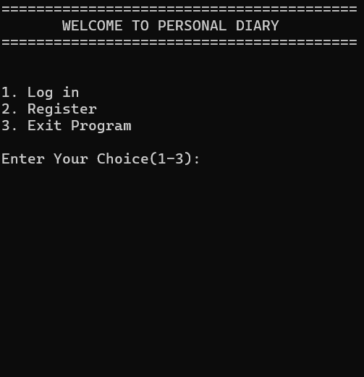
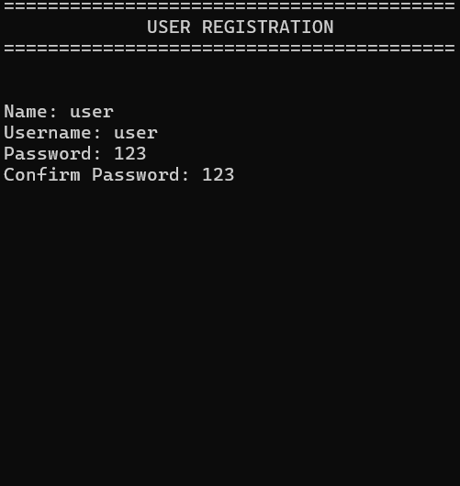
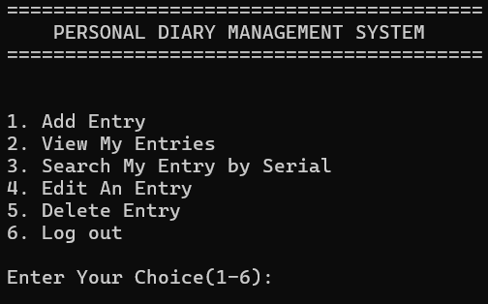
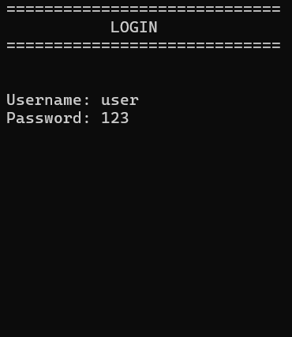
Interfaces Of The Program
Group 7 (CSE115, Section 4) | Muhammad Fahimul Hoque • Aadila Zaheen • Samia Meharin Lisa • MD. Ashrafuzzaman

Slide 10
Conclusion
We built a working, file-persistent Personal Diary Management System in C, with multi-user accounts and full add / view / search / edit / delete functionality — a solid foundation for the privacy features planned next.
Thank You —
Muhammad Fahimul Hoque (2621584042)
Aadila Zaheen (2622214042)
Samia Meharin Lisa (2623705042)
MD. Ashrafuzzaman (2625096042)
Group 7 (CSE115, Section 4) | Muhammad Fahimul Hoque • Aadila Zaheen • Samia Meharin Lisa • MD. Ashrafuzzaman

