Slide 1
E-Commerce Data Analysis and Insights
A comprehensive exploration of sales patterns and customer behavior
Mohammed Aadiluddin Quamri(88317002)

Slide 2

Introduction
This analysis explores an e-commerce dataset to uncover key trends and actionable insights.
The Dataset contains 8 columns and 541910 rows.
The dataset includes transactional data such as product descriptions, quantities, invoice dates, customer locations, and order values. It also contains information about returns and repeat customers.
The data spans over a year and covers multiple geographic regions, with the majority of transactions originating from the UK.
Objective of this dataset is to Answer analytical questions to guide business strategies and improve customer retention.

Slide 3
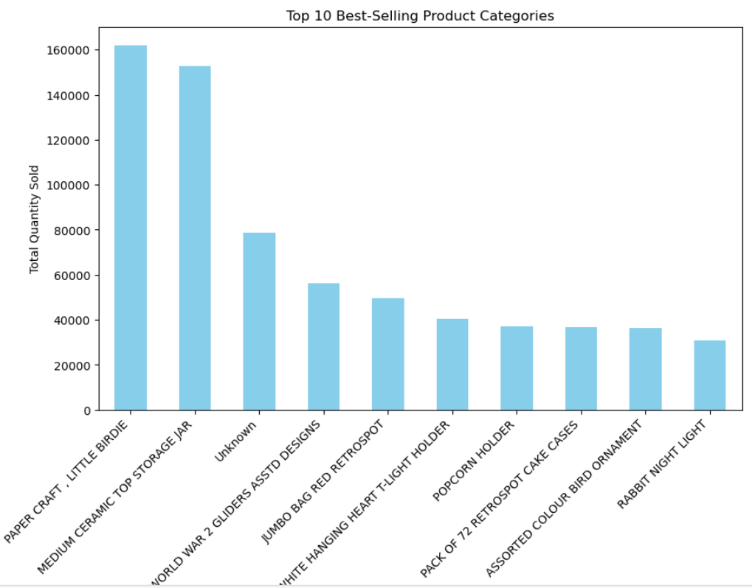
Best-Selling Product Categories
Top Products Dominate:
The product Paper Craft ,Little Birdie' is the highest seller, followed by ‘Medium Ceramic Top Storage Jar', indicating strong customer preferences for these items.
These two products alone contribute significantly to the total quantities sold.
Diverse Product Range:
Other top-performing items include practical products like 'Popcorn Holder' and 'Pack of 72 Retrospot Cake Cases', as well as decorative items such as 'Assorted Colour Bird Ornament' and 'Rabbit Night Light'.
Opportunities for Upscaling:
Consistent demand for cake cases and decorative items suggests opportunities to expand similar product lines or offer bundle deals.

Slide 4
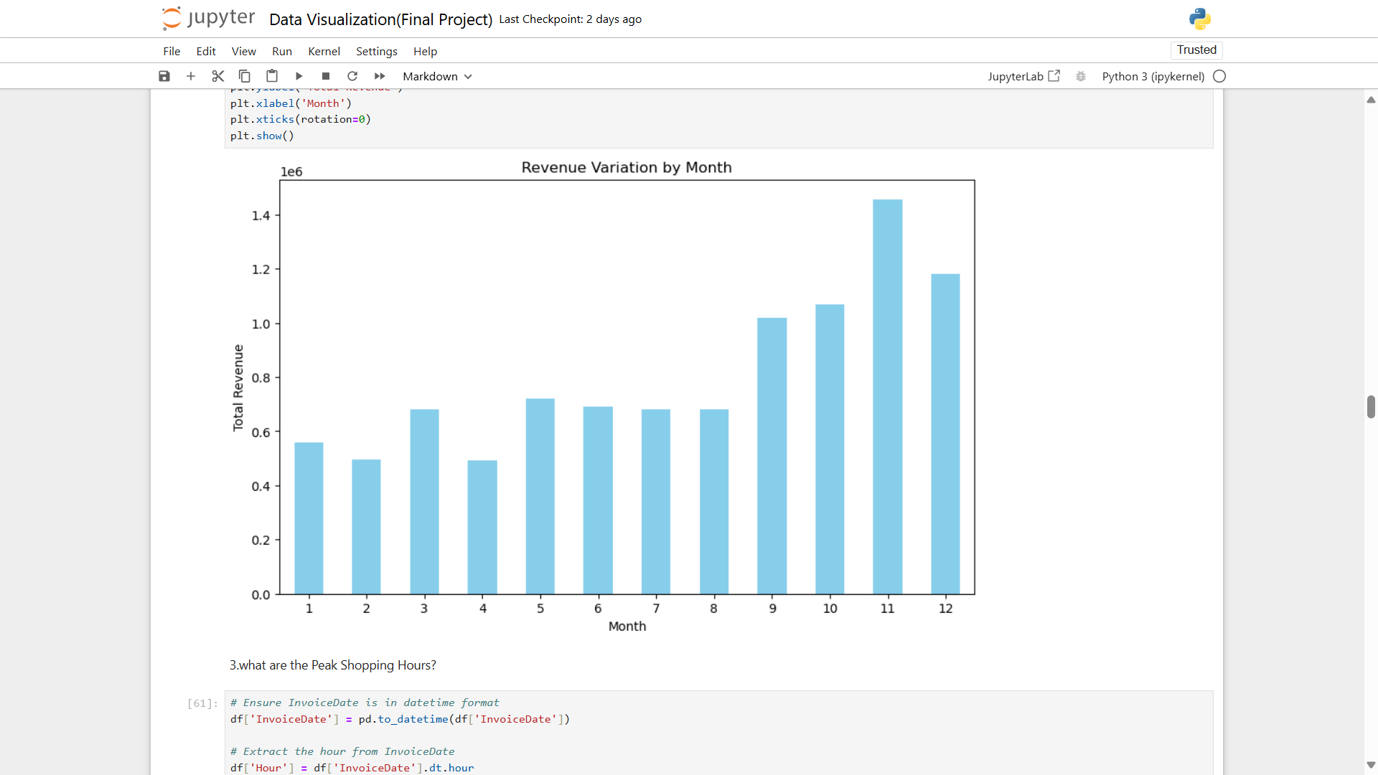
Revenue generated By Month
Seasonal Peaks:
Revenue significantly increases in the months of November (Month 11) and December (Month 12), indicating heightened shopping activity during the holiday season (e.g., Black Friday, Christmas).
Consistent Growth:
There is a gradual revenue increase from the middle of the year (Month 5 onwards), suggesting a ramp-up in sales leading to the holiday season.
Low Revenue Months:
The beginning of the year (Months 1-4) shows relatively lower sales, which might be due to post-holiday slowdowns or reduced consumer spending.

Slide 5
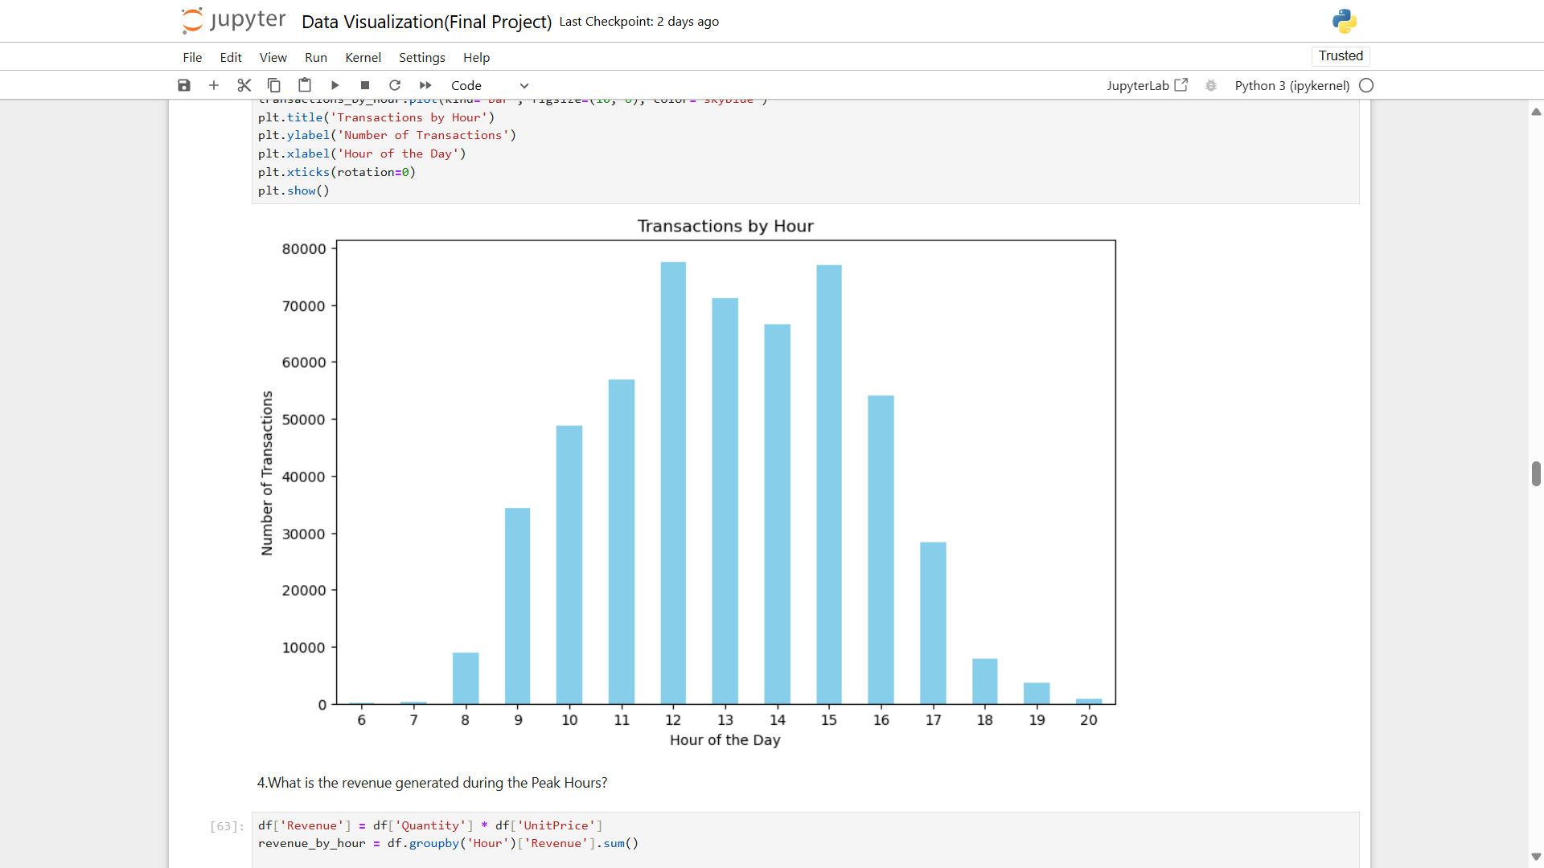
Peak Shopping Hours
High Activity Periods:
The majority of transactions occur between 10 AM and 3 PM, with peak activity at 11 AM and 12 PM.
This suggests that customers are most active during mid-morning and early afternoon.
Gradual Decline:
After 3 PM, there is a noticeable drop in transactions, with very few purchases occurring after 6 PM.
Early and Late Hours:
Minimal transactions are recorded before 9 AM or after 6 PM, indicating these are non-optimal times for sales activity.

Slide 6
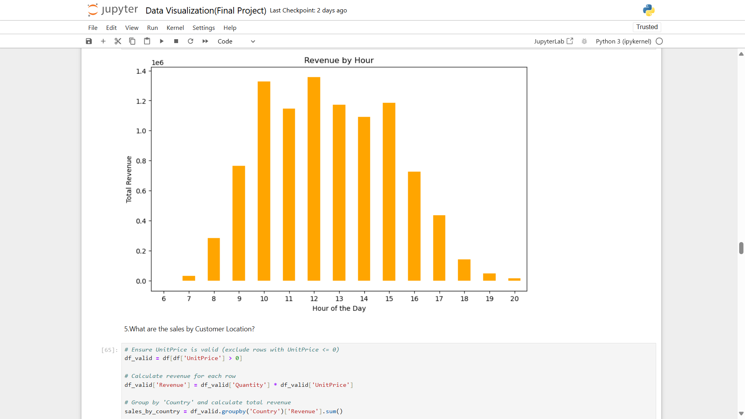
Revenue Generated During Peak Hours
Overall Revenue Trend:
Peak Revenue Hours: The highest revenue is generated between 10 AM and 2 PM. There's a noticeable dip in revenue after 2 PM, with a slight increase again around 4 PM.
Low Revenue Hours: The lowest revenue is observed in the early morning hours (6 AM to 8 AM) and late evening (after 8 PM).
Specific Observations:
Sharp Increase: Revenue sees a significant jump between 8 AM and 10 AM.
Consistent Revenue: There's a relatively consistent level of revenue from 10 AM to 2 PM.
Afternoon Dip: Revenue drops considerably after 2 PM, reaching a low point around 5 PM.
Evening Recovery: There's a slight increase in revenue again between 5 PM and 7 PM.

Slide 7
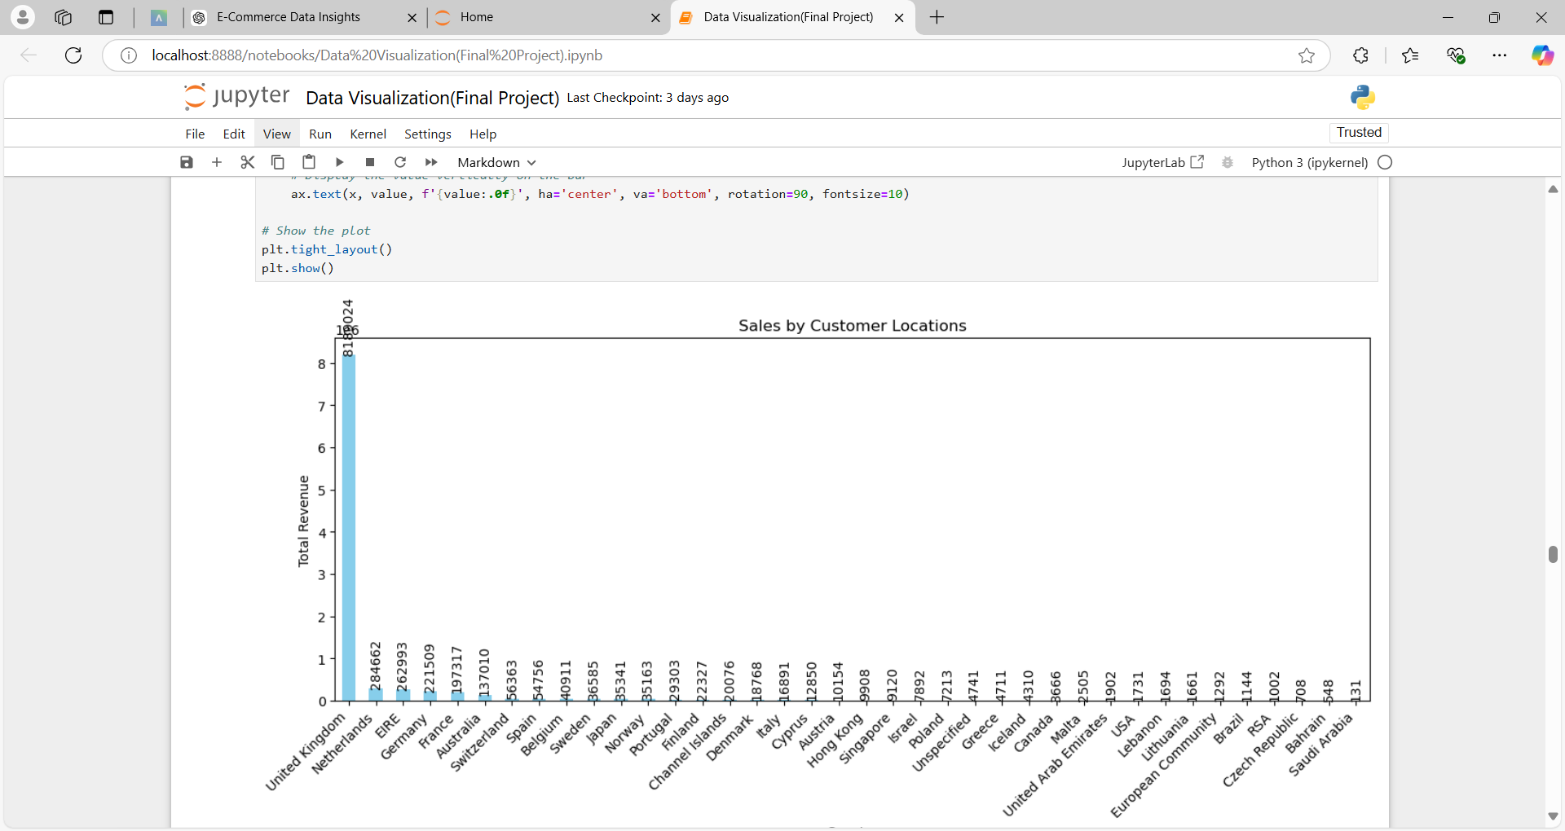
Sales by Customer Locations
United Kingdom Dominates: The United Kingdom has significantly higher revenue compared to other countries.
Netherlands and Germany: These two countries have the second and third-highest revenue, respectively.
Long Tail of Smaller Markets: There are numerous countries with relatively low revenue compared to the top performers.

Slide 8
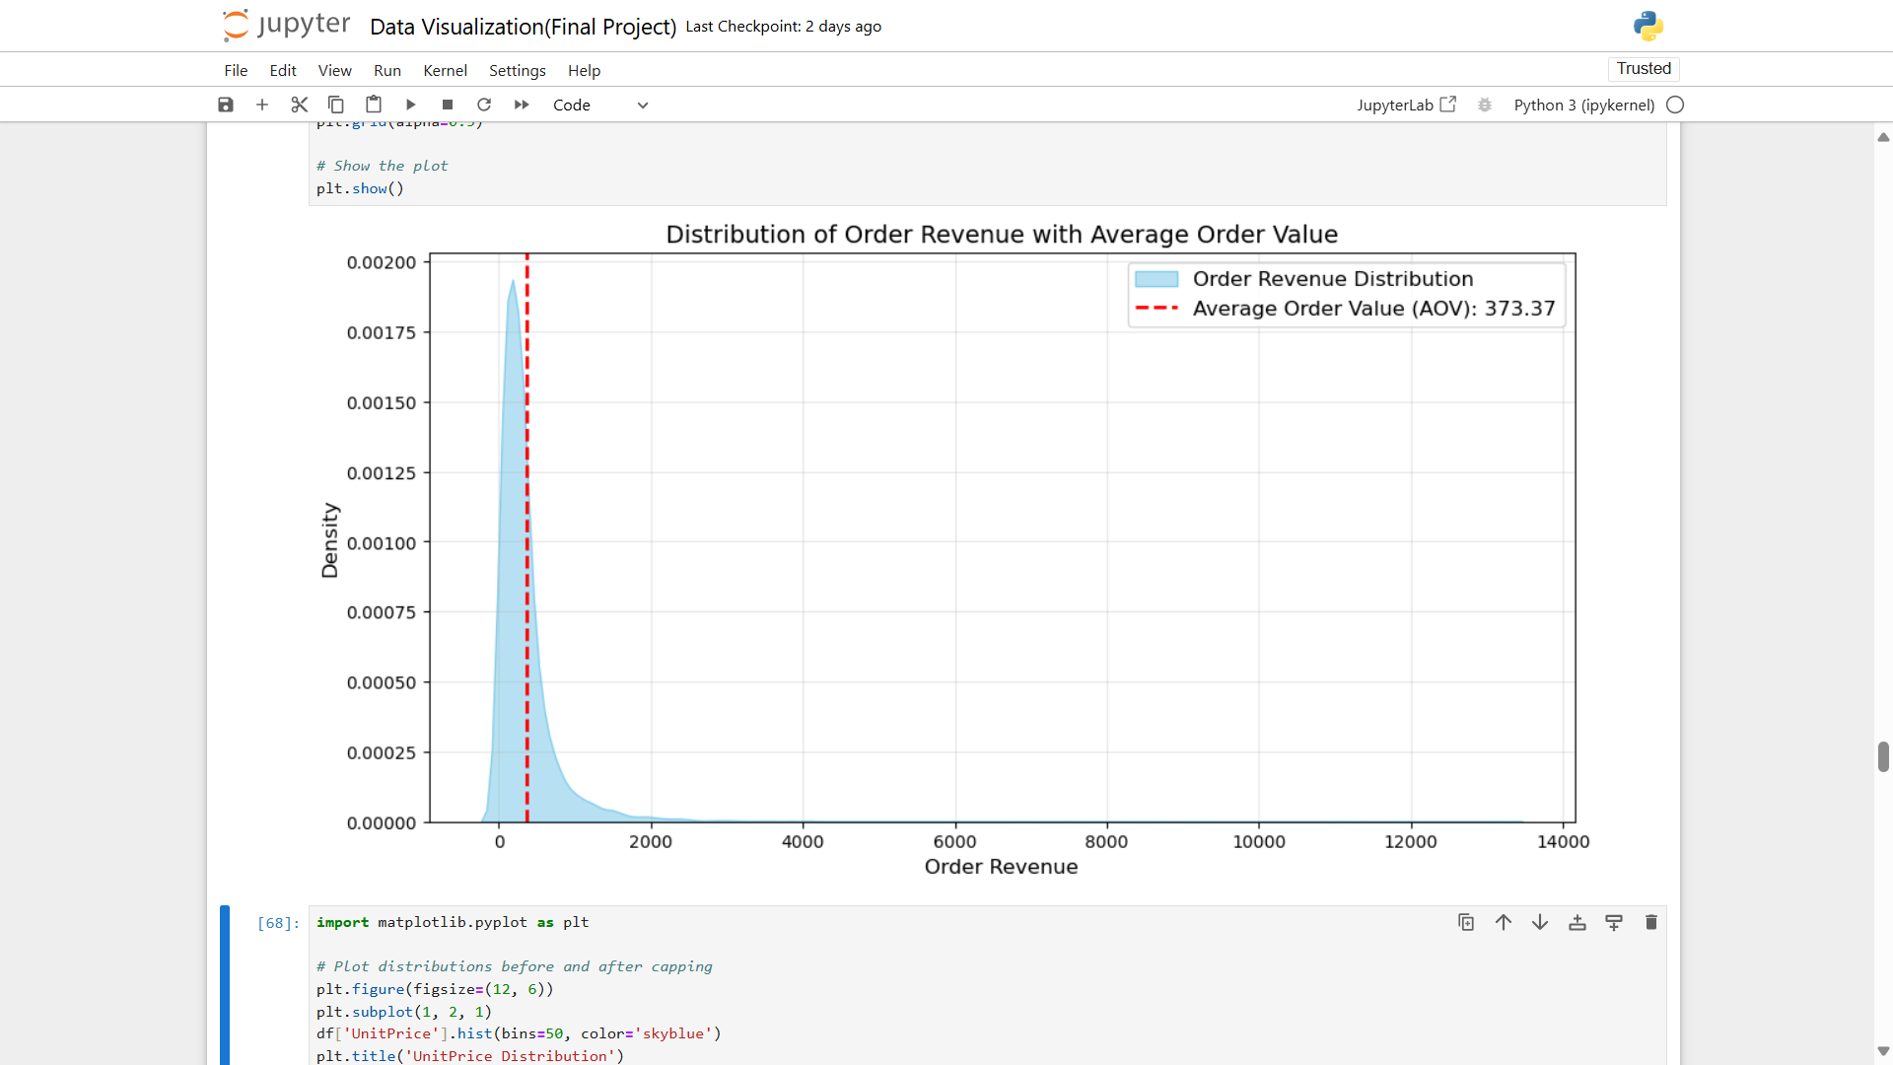
Average Order Value
Order Revenue Distribution: The distribution is right-skewed, meaning most orders have a lower revenue, while a smaller number of orders generate significantly higher revenue.
Average Order Value (AOV): The AOV is approximately 373.37. This value represents the average revenue generated per order.

Slide 9
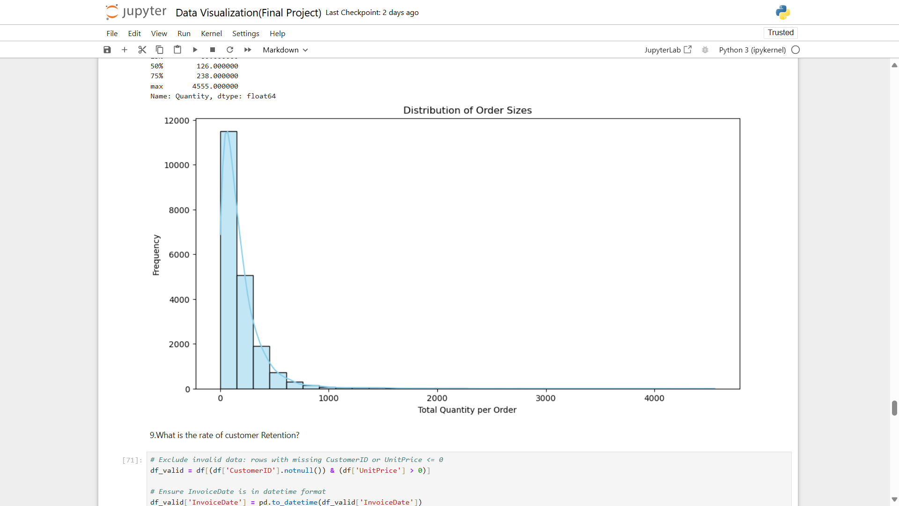
Distribution of Order Sizes
Right-Skewed Distribution: The histogram clearly shows a right-skewed distribution. This means that the majority of orders have a relatively small quantity of items, while a smaller portion of orders contain a significantly larger number of items.
Peak Around 100 Items: The distribution peaks somewhere around 100 items per order. This indicates that the most common order size falls in this range.
Long Tail: The distribution extends to the right with a long tail, suggesting that there are some orders with extremely high quantities of items.

Slide 10
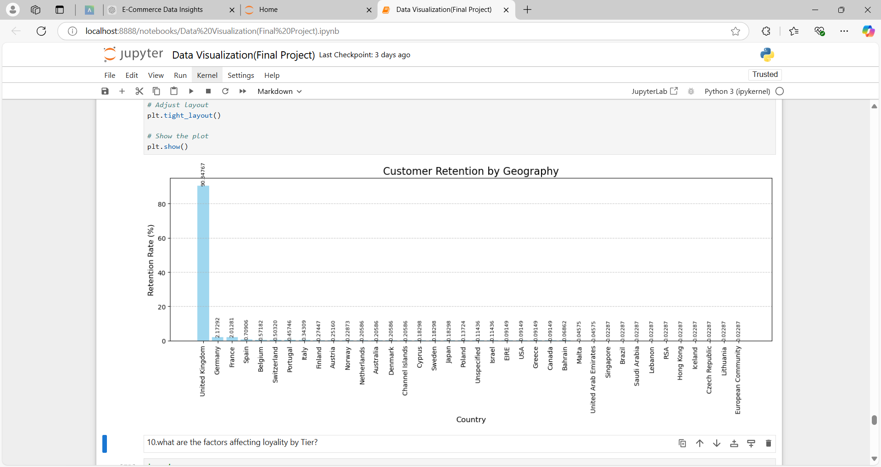
Customer Retention by Geography
High Retention in the United Kingdom: The United Kingdom stands out with significantly higher retention rates compared to other countries.
Low Retention in Most Countries: A majority of the countries listed have very low retention rates, with many even showing negative values. This suggests a high churn rate in these markets.
Notable Exceptions: A few countries like France, Germany, and Spain show slightly higher retention rates than the majority, but still significantly lower than the UK.

Slide 11
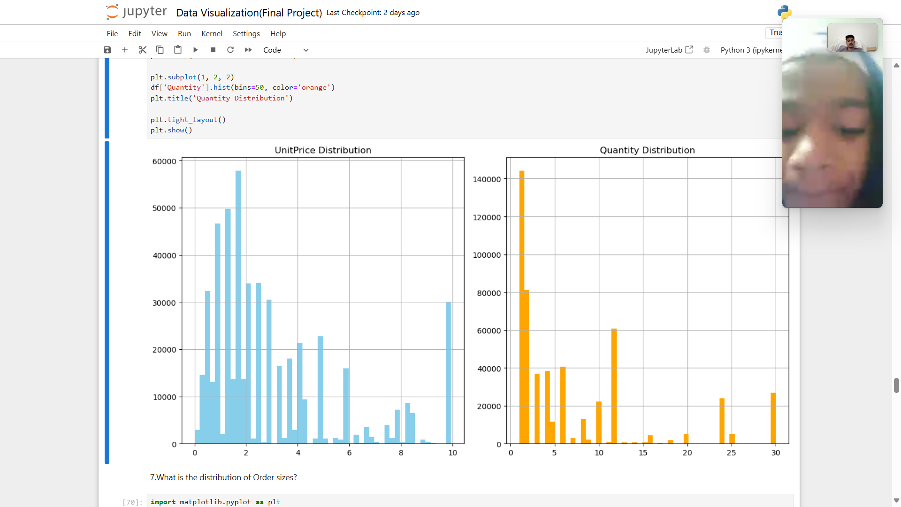
What is the most common price range for products?
Right-Skewed Distribution: The histogram shows a right-skewed distribution. This indicates that most unit prices are relatively low, while a smaller portion of unit prices are significantly higher.
Multiple Peaks: The distribution exhibits multiple peaks, suggesting that there might be different price ranges or categories of products with distinct price points.
Range of Unit Prices: The unit prices appear to range from 0 to around 10, with the majority of prices falling below 5.

Slide 12
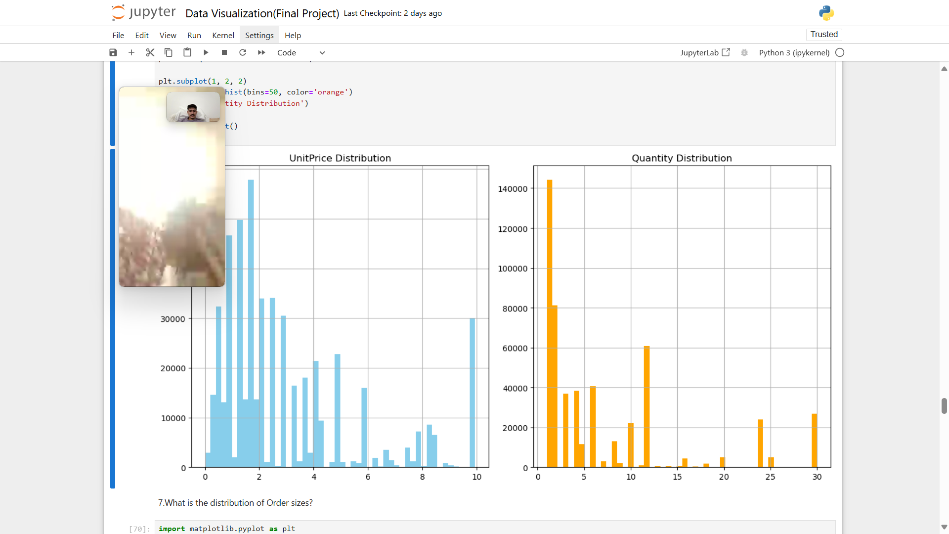
What is the most common quantity purchased in orders?
Right-Skewed Distribution: The histogram shows a right-skewed distribution. This indicates that most quantities are relatively low, while a smaller portion of quantities are significantly higher.
Multiple Peaks: The distribution exhibits multiple peaks, suggesting that there might be different quantity ranges or categories of products with distinct quantity levels.
Range of Quantities: The quantities appear to range from 0 to around 30, with the majority of quantities falling below 10.

Slide 13
Conclusion
Top-selling products account for a significant portion of revenue.
Seasonal trends and spikes in sales (e.g., holiday seasons) were observed, indicating high demand during specific periods.
Peak shopping hours highlight ideal times for promotions.
The distribution of order sizes showed that most orders were small, but outliers (large orders) contributed disproportionately to revenue.
The average order value (AOV) revealed significant spending patterns, with adjustments to outliers providing a realistic estimate
Geographic analysis shows the UK as the dominant market.
High-value customers are critical to revenue growth.

