Slide 1


Ragnarok
NATIONAL INSTITUTE OF TECHNOLOGY KARNATAKA, SURATHKAL INDIAN SOCIETY FOR TECHNICAL EDUCATION, NITK CHAPTER
Square 1
ISTE Concrete
+91 96867 49909 | www.istenitk.com | istenitkchapter@gmail.com

Slide 2
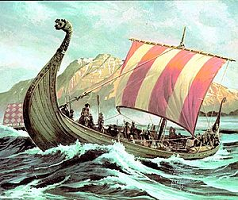
BACKSTORY
NATIONAL INSTITUTE OF TECHNOLOGY KARNATAKA, SURATHKAL INDIAN SOCIETY FOR TECHNICAL EDUCATION, NITK CHAPTER
Before the invention of modern-day concrete using Portland cement, the Romans, during the late 3rd Century BC developed Roman Concrete or opus caementicium when Roman builders used volcanic dust also called pozzolana to mortar a mixture of gypsum along with aggregates and water in a certain ratio to achieve greater strengths compared to mud-blocks used in construction.
You are a builder working for the Roman Empire. During the expansion of the Roman empire, you reach the Viking Kingdom and you are all set to revolutionize the construction techniques in this kingdom.
+91 96867 49909 | www.istenitk.com | istenitkchapter@gmail.com

Slide 3
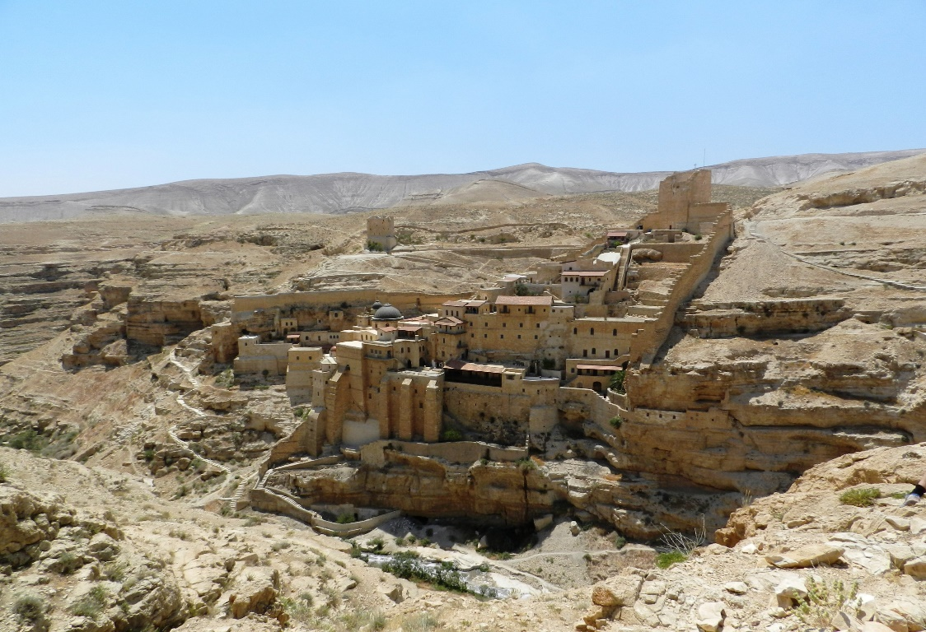
The Viking Kingdom
NATIONAL INSTITUTE OF TECHNOLOGY KARNATAKA, SURATHKAL INDIAN SOCIETY FOR TECHNICAL EDUCATION, NITK CHAPTER
The Viking Kingdom consists of 4 major regions
Asgard
Ragnarok
Jotunn
Valhalla
Each region has a unique landscape making it significant in the role it has for the development of the kingdom. The kingdom recently lost a war with the Romans and hence most of the regions are devastated and destructed in its structural capacity. Hence, there is high demand for building materials. The kingdom is blessed with enough resources to rebuild the powerful kingdom.
+91 96867 49909 | www.istenitk.com | istenitkchapter@gmail.com

Slide 4
Asgard
NATIONAL INSTITUTE OF TECHNOLOGY KARNATAKA, SURATHKAL INDIAN SOCIETY FOR TECHNICAL EDUCATION, NITK CHAPTER
Asgard is the home to some of the eye-catching volcanoes. It is also a source for volcanic dust, called pozzolana, used for construction. Asgard glows warm red under the sun due to the formations of volcanic rocks.
+91 96867 49909 | www.istenitk.com | istenitkchapter@gmail.com

Slide 5
Ragnarok
NATIONAL INSTITUTE OF TECHNOLOGY KARNATAKA, SURATHKAL INDIAN SOCIETY FOR TECHNICAL EDUCATION, NITK CHAPTER
Ragnarok is a swooping glen guarded by towering mountains. It is the kingdom’s capital in which reside the wealthy Vikings. It is also significant, owing to the potential aggregates that can be tapped from the mountains. When looked at from the skies, Ragnarok looks green due to abundant greenery surrounding the city.
+91 96867 49909 | www.istenitk.com | istenitkchapter@gmail.com

Slide 6
Jotunn
NATIONAL INSTITUTE OF TECHNOLOGY KARNATAKA, SURATHKAL INDIAN SOCIETY FOR TECHNICAL EDUCATION, NITK CHAPTER
Jotunn is Viking’s main source of water. It has the maximum water body cover and the water table level makes it extremely easy to tap freshwater. Being next to water bodies, Jotunn is also a populated area, hence the demand for building materials in this place is relatively higher. Jotunn looks blue when looked form the skies
+91 96867 49909 | www.istenitk.com | istenitkchapter@gmail.com

Slide 7
Valhalla
NATIONAL INSTITUTE OF TECHNOLOGY KARNATAKA, SURATHKAL INDIAN SOCIETY FOR TECHNICAL EDUCATION, NITK CHAPTER
The canyons of Valhalla are known for their potential to quarry out gypsum from the beautiful canyons. These canyons give a distinctive lustre to Valhalla, giving it the name The Golden City.
+91 96867 49909 | www.istenitk.com | istenitkchapter@gmail.com

Slide 8
Task at hand
NATIONAL INSTITUTE OF TECHNOLOGY KARNATAKA, SURATHKAL INDIAN SOCIETY FOR TECHNICAL EDUCATION, NITK CHAPTER
You have to produce concrete blocks to rebuild Viking. King Aronian has allocated an initial budget of 1,00,00,000 krona. You have to set up plants to manufacture concrete blocks to distribute and sell in the regions of Viking. There are a total of 10 locations available, 2-4 manufacturing plants inside the Viking Kingdom. Determine the cost efficient method of setting up the plants. You need to decide on:
The number of plants (minimum 2 and maximum 4)
Locations of the plants
Type of plant(Small, Medium or Large)
Percentage of produce in each plant to be distributed in each region
+91 96867 49909 | www.istenitk.com | istenitkchapter@gmail.com

Slide 9
Sourcing Cost
NATIONAL INSTITUTE OF TECHNOLOGY KARNATAKA, SURATHKAL INDIAN SOCIETY FOR TECHNICAL EDUCATION, NITK CHAPTER
Refer Sourcing Sheet
Sourcing cost is the cost of transporting raw materials to the plant site
Example: your site is in Visby, your total sourcing cost will be total kilometers travelled * 2000
+91 96867 49909 | www.istenitk.com | istenitkchapter@gmail.com

Slide 10
Production Cost
NATIONAL INSTITUTE OF TECHNOLOGY KARNATAKA, SURATHKAL INDIAN SOCIETY FOR TECHNICAL EDUCATION, NITK CHAPTER
Production cost depend on the type of plant and the capacity
Total Fixed cost is calculated by multiplying the fixed cost to the size of manufacturing plant.
Total Fixed Cost (TFC) = Fixed Costs x Size of Manufacturing Plant
Total Variable cost is calculated by multiplying the variable cost specified to the desired production capacity of the manufacturing plant.
Total Variable Cost (TVC) = Variable Cost x Production Capacity of Manufacturing Plant
Total Production Cost = TFC+TVC
+91 96867 49909 | www.istenitk.com | istenitkchapter@gmail.com

Slide 11
Example
NATIONAL INSTITUTE OF TECHNOLOGY KARNATAKA, SURATHKAL INDIAN SOCIETY FOR TECHNICAL EDUCATION, NITK CHAPTER
For instance, you decide to set up a Medium Size quarry at Ribe.
Total Fixed Cost= Fixed Cost x Size of Quarry = 114 x 10500 = 1197000 krona
Production capacity = 195000 blocks
Total Variable Cost= Variable Cost x Desired Production Capacity of Manufacturing Plant =0.63 x 195000 = 122850 krona
+91 96867 49909 | www.istenitk.com | istenitkchapter@gmail.com

Slide 12
Distribution Cost
NATIONAL INSTITUTE OF TECHNOLOGY KARNATAKA, SURATHKAL INDIAN SOCIETY FOR TECHNICAL EDUCATION, NITK CHAPTER
Distribution cost for each region =Kilometers travelled * Price per km
Example
Your Medium size quarry at Ribe is distributing
30% = 30% of 195000 = 58500 to Asgard = 2100*189 = 396900
20% = 20% of 195000 = 39000 to Ragnarok = 2100 *108 = 226800
45% = 45% of 195000 = 87750 to Jotunn = 2300*175 = 402500
5% = 5% of 195000 = 9750 to Valhalla = 1900 * 180 = 342000
Total distribution cost for Ribe medium size =1370000, similarly for other plants
+91 96867 49909 | www.istenitk.com | istenitkchapter@gmail.com

Slide 13
Evaluation Parameter
NATIONAL INSTITUTE OF TECHNOLOGY KARNATAKA, SURATHKAL INDIAN SOCIETY FOR TECHNICAL EDUCATION, NITK CHAPTER
The profit is the evaluating parameter
The Selling Price will be decided after all responses are taken. The supply and demand will drive the selling price. If there is more supply in Ragnarok, the price will drop and vice versa. The selling price will range from 20 krona to 35 krona
If you exceed the budget, the last plant will be removed
The savings on the budget will be added to profits
The person with maximum profits win
Using MS Excel for calculations is highly advised.
Link to the Google Form: https://forms.gle/4z65ZmYfhpUf7wkX7
Fill the Form by 4th Feb 10:30 pm.
+91 96867 49909 | www.istenitk.com | istenitkchapter@gmail.com

Slide 14
Importance Factor
NATIONAL INSTITUTE OF TECHNOLOGY KARNATAKA, SURATHKAL INDIAN SOCIETY FOR TECHNICAL EDUCATION, NITK CHAPTER
It is used in determining the final selling price of bricks depending on the demand related to the bricks in the Viking cities Asgard, Ragnarok, Jotunn and Valhalla.
Given details about the respective cities in previous slides can help determine the IF related to that area.
The value of IF can vary from 0.95-1.15 depending on their relative demand in those cities.
+91 96867 49909 | www.istenitk.com | istenitkchapter@gmail.com

