Slide 1

Project Report
On
Attendance Management System
Submitted in fulfillment for the award of the Degree
MASTERS IN COMPUTER APPLICATION
Submitted By: -
Afshana Ali (18045133009)
Aadil Hamid (18045133006)
Tahira Fayaz (18045133011)
Under the Guidance of:
Mr. Ummar Bashir
Department of computer science
Govt. Degree College Baramulla
BATCH 2018

Slide 2
Introduction
Build a web based application to maintain attendance of students, and reduce paper work.
It generates the attendance report of the students on the basis of presence in the class.
The goal is to maintain attendance of the students smoothly.
It increases accuracy and efficiency in attendance system.
The attendance management system is easy and is designed with user friendly interface.
The main purpose of this attendance management system is to help schools or colleges in keeping track of the students with in the campus.
Access data anywhere and anytime.

Slide 3
MOTIVATION
In most educational institutions the attendance is taken manually .
It is not only time consuming , but it is also unsecure and unreliable and it can be lost.
To overcome these problems we have to develop a better system which is web based application-attendance tracker. It is fully responsive where a user can use in mobile and different computer systems.
In this system records are kept safe and secure and the attendance information of particular student or all students of particular class can be accessed easily and without time consuming.

Slide 4
EXISTING SYSTEM
The existing system is a manual entry for the students.
Here the attendance will be carried out in the hand written registers.
It will be tedious job to maintain the record for the user.
The human efforts is more here.
The retrieval of the information is not easy as the records are maintained in the hand written registers.

Slide 5
Proposed system
To overcome the drawbacks of the existing system, the proposed system has been evolved.
Here our project aims to reduce the paper work and saving time to generate accurate result from the student’s attendance.
The system provides with the best user interface and no malpractice is entertained like proxy.
The efficient reports can be generated by using this proposed system.
We can retrieve data when ever it’s required with consuming less amount of time.

Slide 6
PROJECT DESCRIPTION
There will be three modules in our system.
Admin:
The Admin is a person who run and manage the system, in this project the head of department has rights of admin.
Admin functionalities are:-
Add user
Delete user
Modify information
View attendance
Generate report
Assign subjects
Activate user

Slide 7
Teacher :-
Staff have unique email and password to access the system.
Teacher functionality:
Add student
View the student detail
Take attendance
Manage reports
Login and logout

Slide 8
Student:
All students have unique roll number to access the system . After login into system student see profile , attendance detail.
Student functionality:
Student login
Student detail
Student register
View attendance

Slide 9
NON FUNCTIONAL REQUIREMENTS
Non-functional requirements are constraints that must be adhered to during development.
Performance
Easy tracking of records and updating can be done.
Efficiency:
Our application takes less time to accomplish a particular task .
Reliability:
The application that we are designing is designed to deliver set of services as expected by the user.
The application that we are developing is going to provide a high performance measures for example the data updates are done manually without loss of data that already exists.
Security
The security requirements deal with the primary security. The software should be handled only by the administrator and authorized users. Only the administrator has right to assign permission like creating new accounts and generating password. Only authorized users can access the system with email and password.

Slide 10
Login
Add/Manage Teacher
Add/Manage Student
Admin
Take Attendance
Teacher
Assign Subject
View/generate Attendance
Logout
Student

Slide 11
Add/delete Faculty/student
View detail
Admin login
logout
Attendance
Faculty login
Take attendance
View attendance
logout

Slide 12
Hardware Requirements
RAM:-2GB
Hard Disk:- 500GB
Processor:- Intel core i3
Software Requirements
Operating System: Windows 10
Front design : visual studio 2008
Front-End Language: html, css, javascript. Framework: bootstrap.
Back-End language: php, MySQL

Slide 13
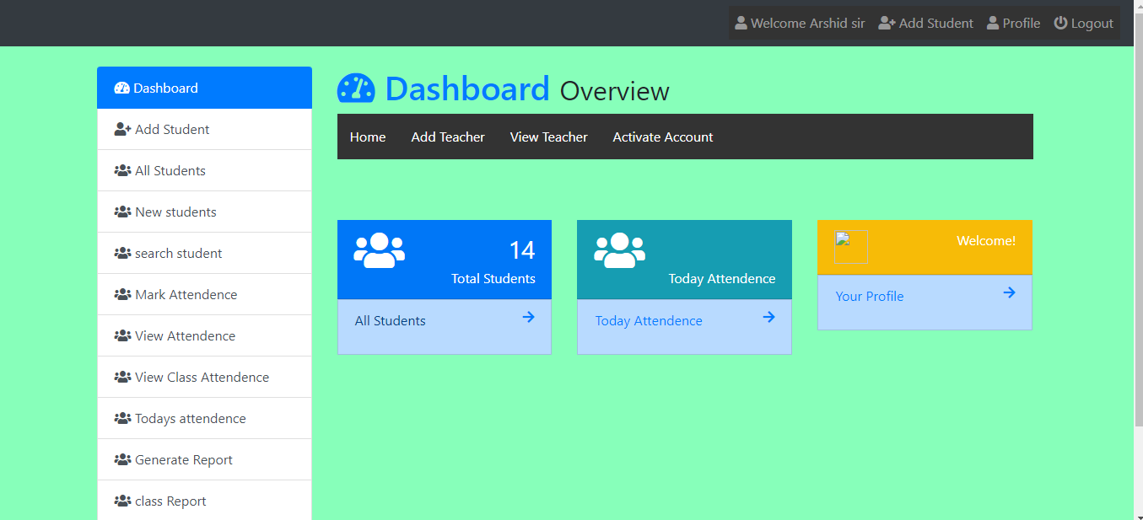
Admin Dashboard

Slide 14
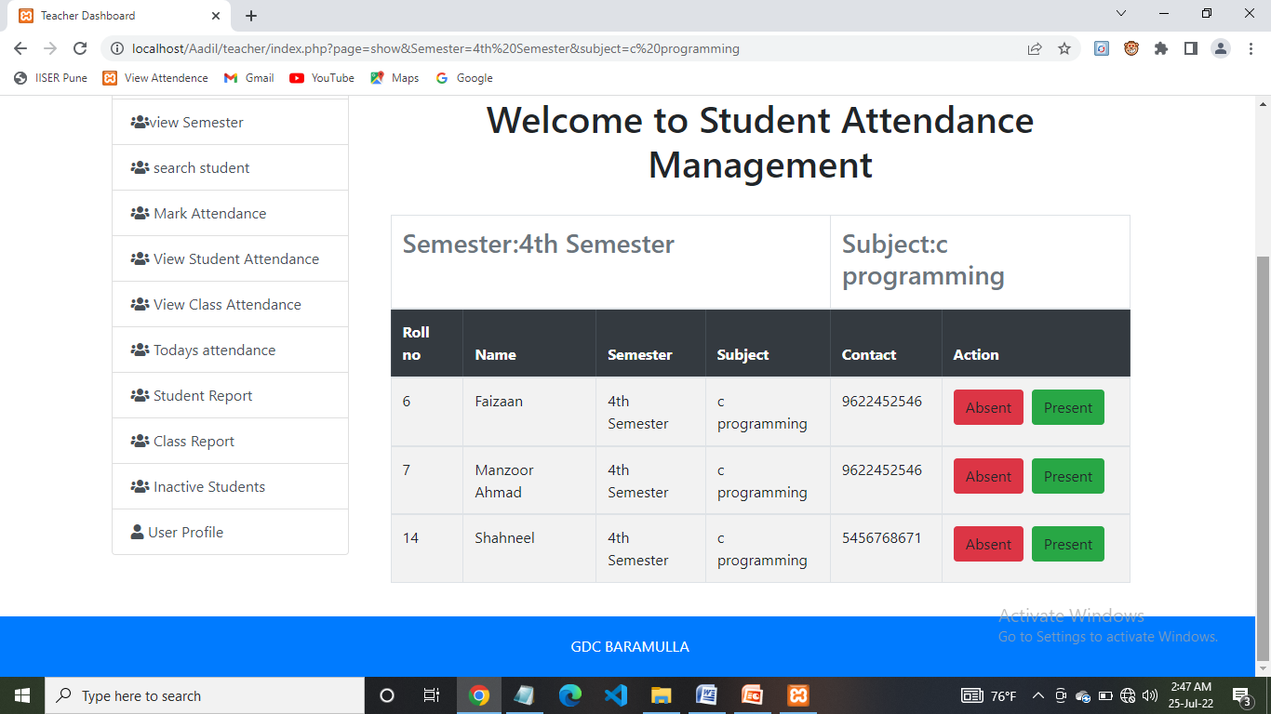
Mark Attendance

Slide 15
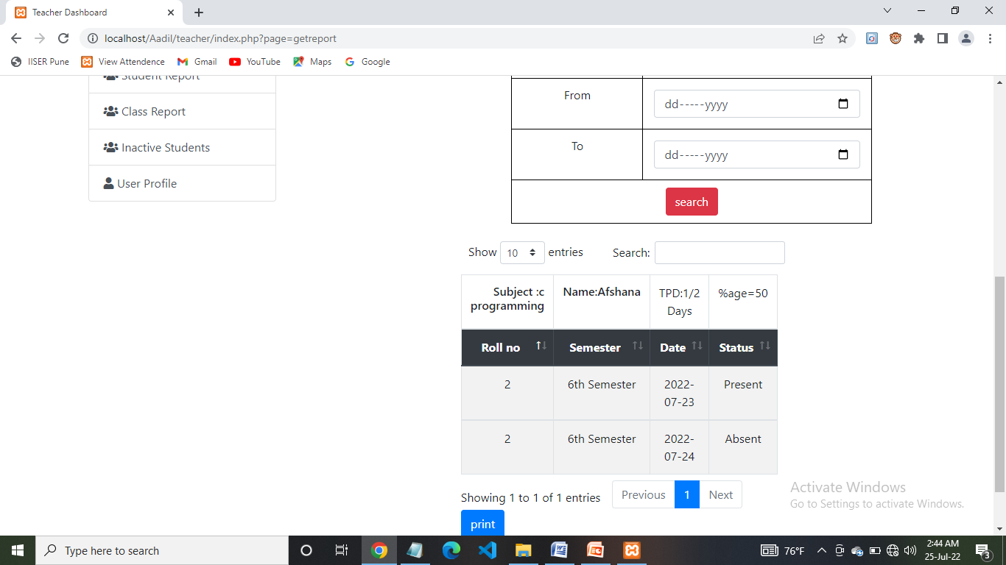
Attendance Report

Slide 16
THANk YOU

