Slide 1
CASE STUDY
ABDULLAHI A. IBRAHIM

Slide 2
Task
Predict income and expenses for a holdout sample of ~10k users for the month of August based on a training sample of ~10ks from February – July.
Based on your judgement of the usefulness of the results, either aggregate the data into incoming & outgoing flows, or predict base on the transaction type/category level

Slide 3
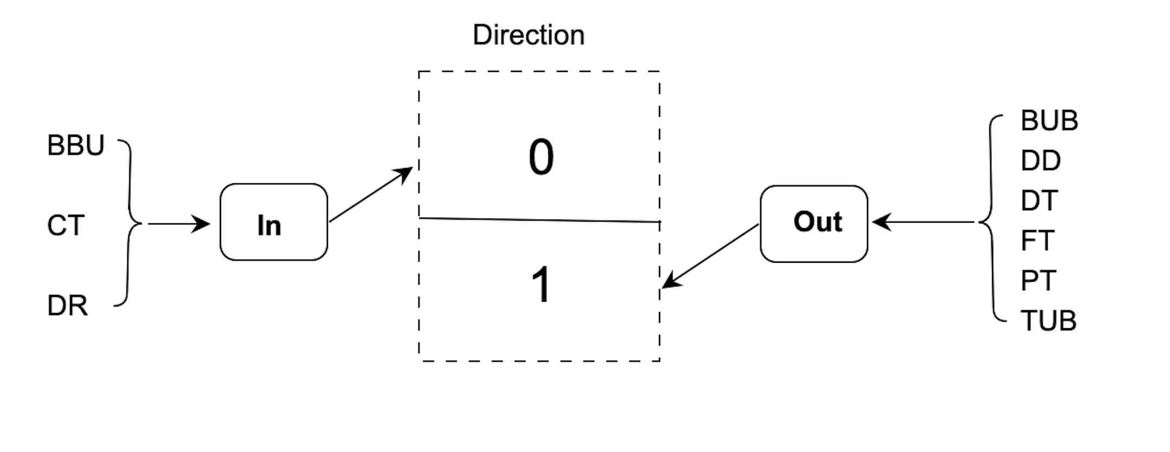
Assumptions
1. Aggregate data into In (incoming) and Out (outgoing) flows.

Slide 4
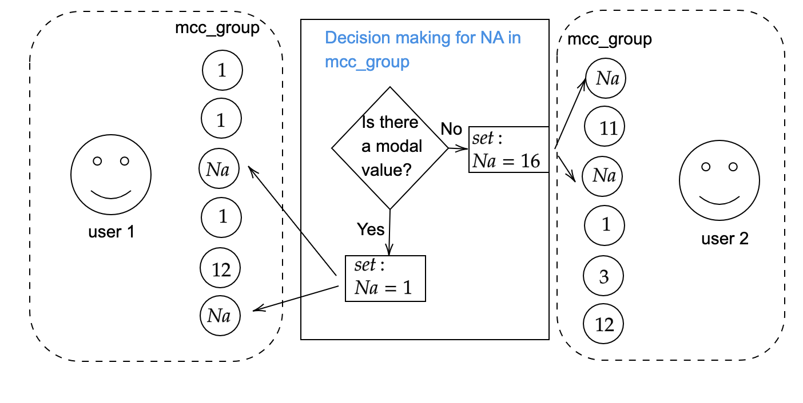
Fill missing values in mcc_group
~37%
NAs
Misc.
Currently 37% is missing and we fill it as shown here
Mode

Slide 5
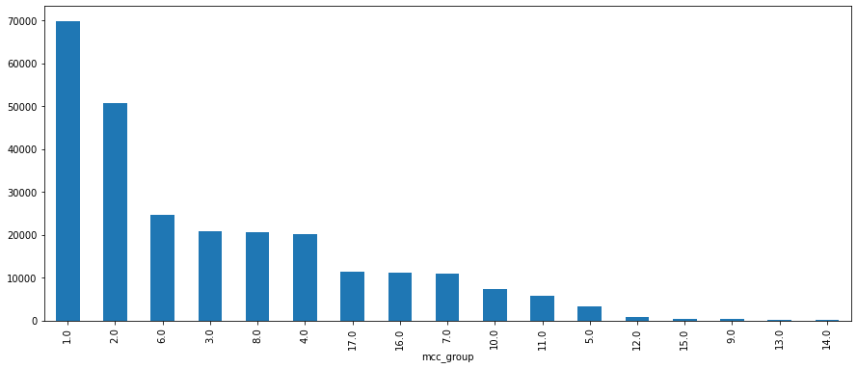
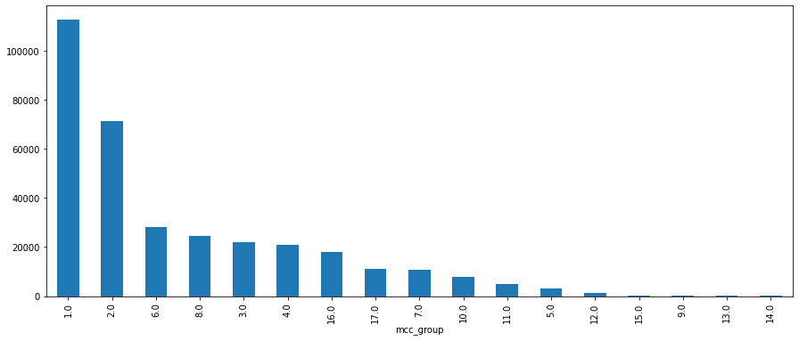
Impact of filling NAs
Before filling the NAs
After filling the Nas
The frequency of each class increased without favouring any group
11150
After filling the NAs
21238

Slide 6
Feature engineering
New Features
Transaction Agent
Transaction direction
Feature preprocessing
Encoding categorical features
Normalization
Transaction month and day
Train/valid/test split

Slide 7
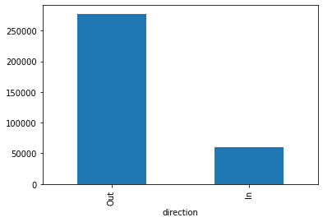
Data distribution & split
~82%
Shows imbalance distribution
To avoid skewed result towards Out group, we do not split randomly
Instead, we maintained this proportion across training, validation and test sets
count
~18%

Slide 8
ML methods
ML
LR
Baseline
Cost LR
MLP
RF
baseline
weighted Rf
Assume equal importance of the classes
To penaliize the cost function to ensure sensitivity to the minority class
Assume equal importance of the classes
Introduced class weights to prioritize minority class
LR: Logisitic regression
RF: Random forest
MLP: Multilayer perceptron

Slide 9
Metrics
Accuracy
To track the model performance during training and ensure it doesn’t overfit
F1 score
AUC
Sensitivity of the models to positive and negative class
Measure predictive performance using precision and recall

Slide 10
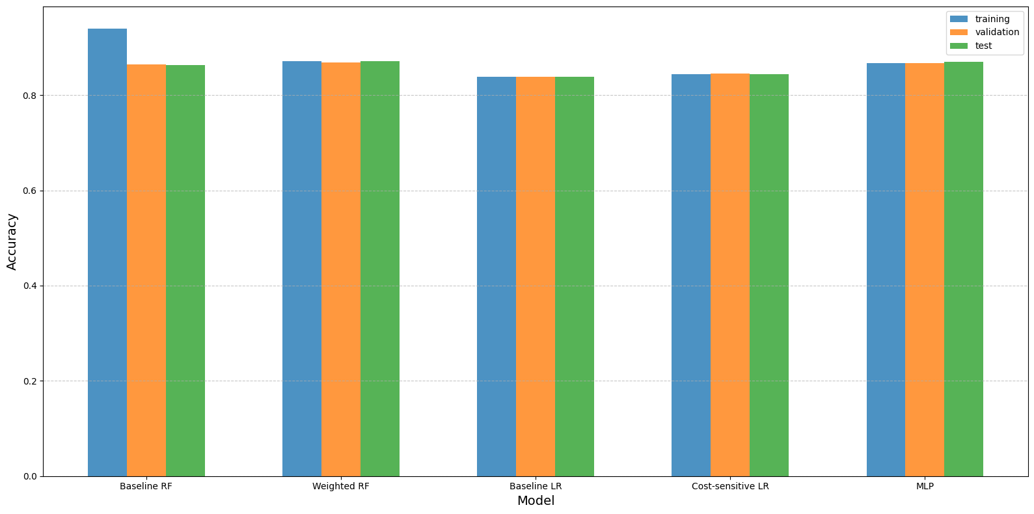
Accuracy of the models
Baseline RF
Weighted RF
Baseline LR
Cost-sensitive
LR
MLP

Slide 11
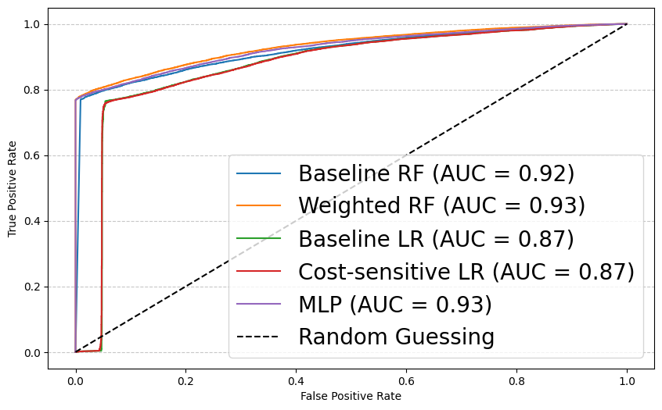
Sensitivity of the models

Slide 12
Summary
Our goal is to predict income and expenses of a user transaction.
To do this we compare the performace of different model (baseline and extended versions)
Our result shows that by adding penalities/weight the model performed better than the baseline model.
The best performing model(s) achieved upto 87% accuracy, 93% AUC and 92% f1 score with no overfitting.

Slide 13
Thank you

