Slide 1
CASE STUDY
ABDULLAHI ADINOYI IBRAHIM

Slide 2
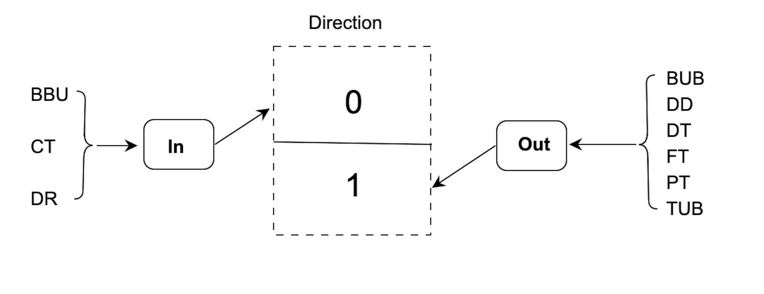
TASK
Predict income and expenses for a holdout sample of ~10k users for the month of August based on a training sample of ~10ks from February – July.
Aggregate data into
In (incoming) and
Out (outgoing) flows.

Slide 3
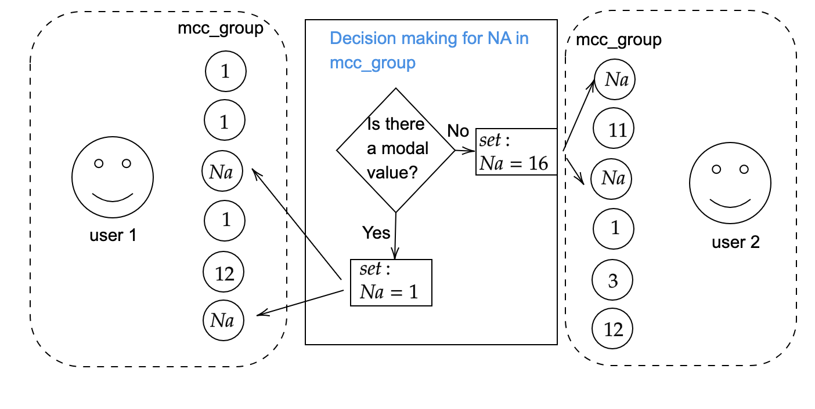
Mcc_group
~37%
NAs
Aggregate data into
In (incoming) and
Out (outgoing) flows.

Slide 4
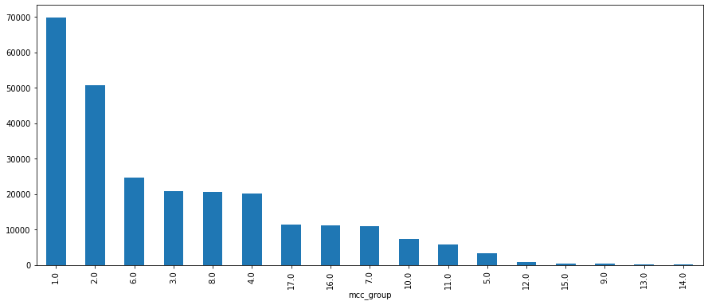
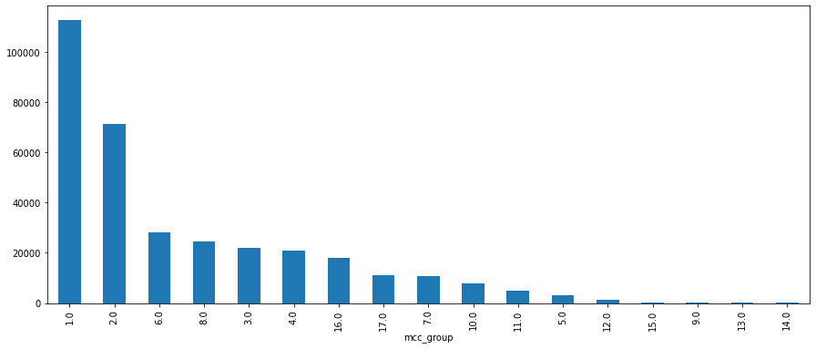
Handling missing values
Before filling the NAs
After filling the Nas
The frequency of each class increased without favouring any group
11150
After filling the NAs
21238

Slide 5
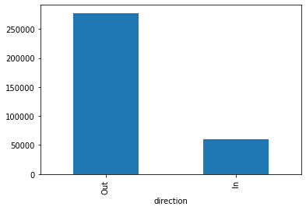
Data distribution & split
~82%
Shows imbalance distribution
To avoid skewed result towards Out group, we do not split randomly
Instead, we maintained this proportion across training, validation and test sets
count
~18%

Slide 6
Feature engineering

Slide 7
ML methods
ML
LR
Baseline
Cost LR
MLP
RF
baseline
weighted Rf
Assume equal importance of the classes
To penaliize the cost function to ensure sensitivity to the minority class
Assume equal importance of the classes
Introduced class weights to prioritize minority class
LR: Logisitic regression
RF: Random forest
MLP: Multilayer perceptron

Slide 8
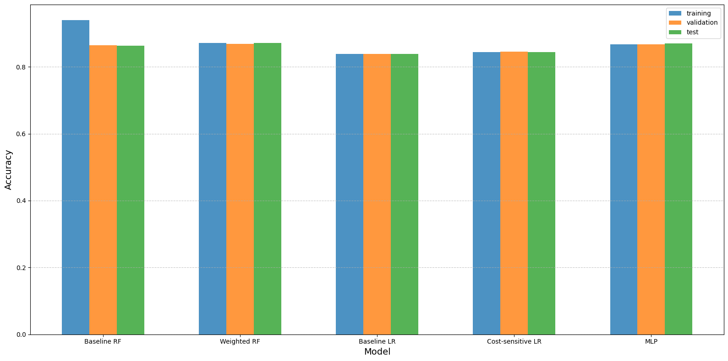
Accuracy
Baseline RF
Weighted RF
Baseline LR
Cost-sensitive
LR
MLP

Slide 9
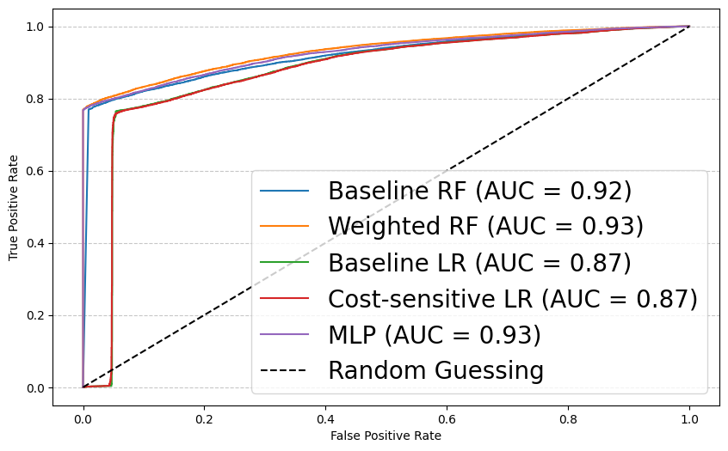
AUC (Area under curve)

Slide 10
Summary

