Slide 1

The interview
Ppt created By : Alka Vinod , Anjaleena

Slide 2
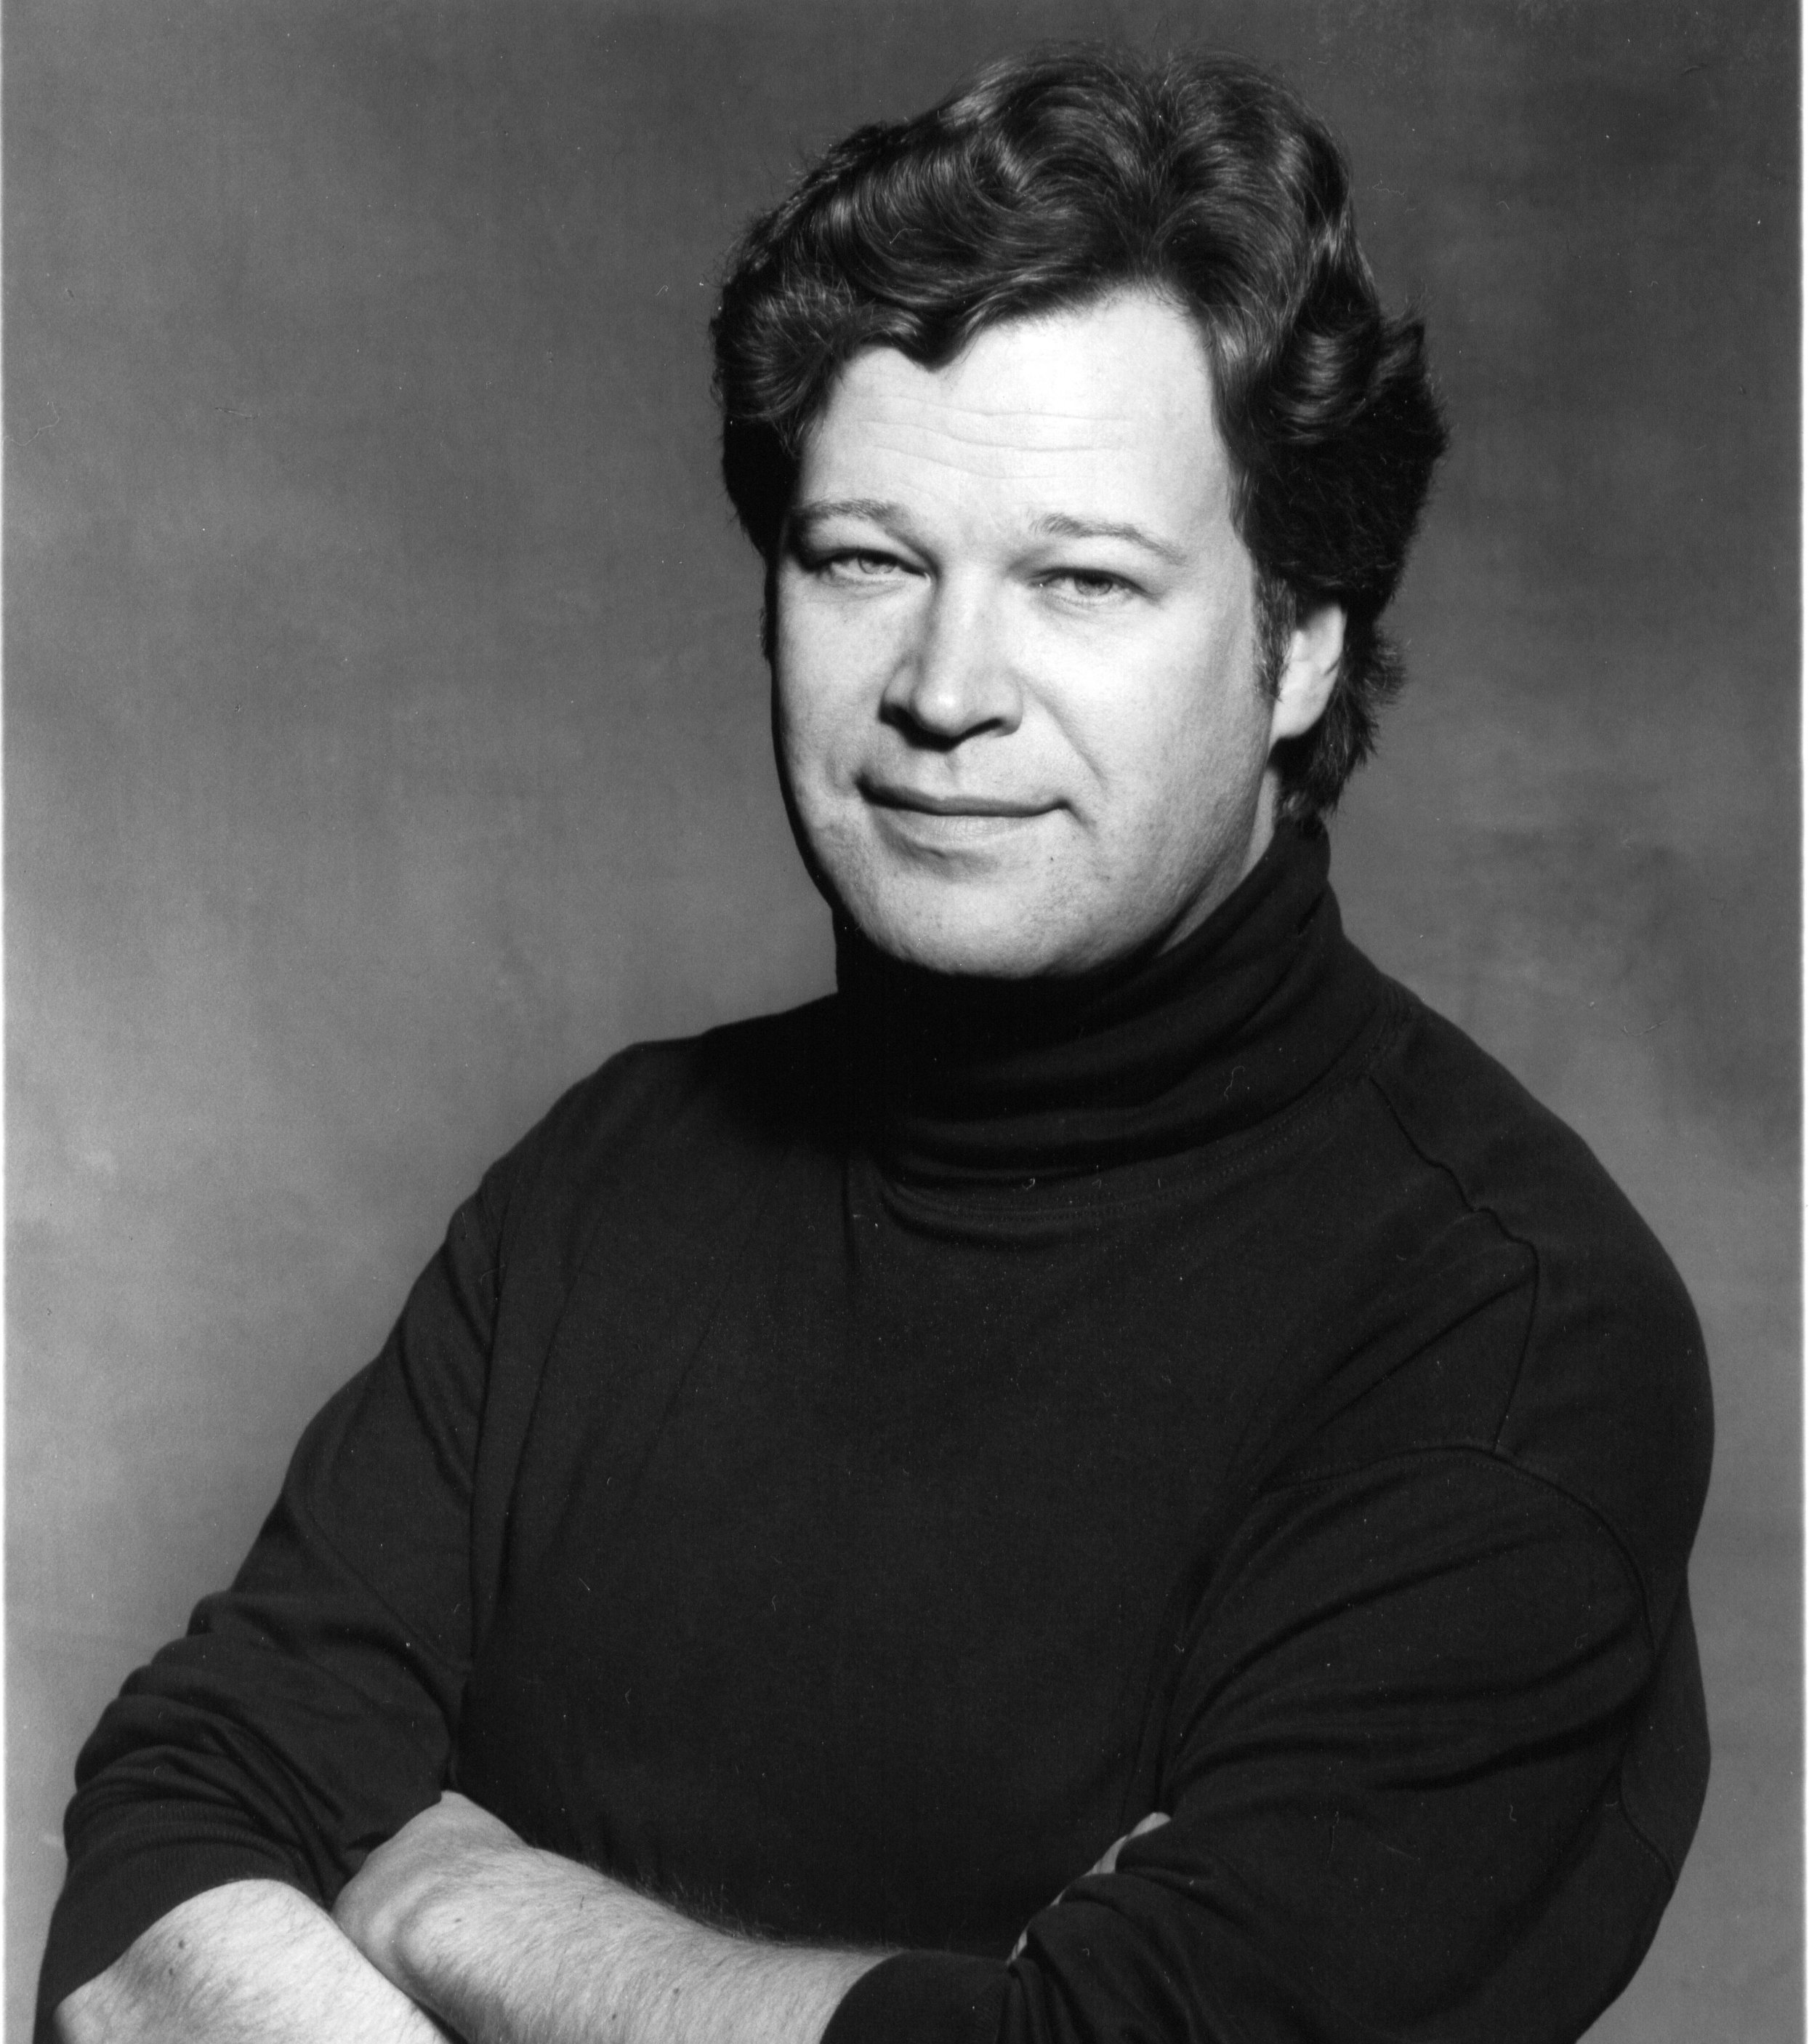
About the poet
Christopher Silvester
Christopher Silvester is a freelance journalist, author and consultant who writes for several UK newspaper and magazine publications.
He currently writes obituaries for The Times (of London), book reviews for the Financial times and spears ,and features for Newsweek and spears .since 1996 he has probably written more obituaries for The Times than any other person.

Slide 3
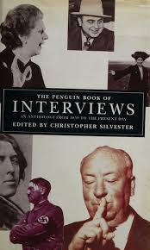
Introduction
The Interview by Christopher Silvester is an excerpt taken from his Penguin Book of interviews. In this, he talks about various opinions of the celebrities regarding an interview; its functions, methods and merits. It also consist of an excerpt from an interview with the infamous writer Umberto Eco

Slide 4
Summary
The Interview by Christopher Silvester talks about the importance of interviews and the role they play in communicating the affairs of the contemporary world to us. Christopher worked as a reporter for the Private Eye for 10 years. The Interview is an excerpt from his Penguin Book of Interviews, An Anthology from 1859 to the Present Day. The first part of the chapter talks about how interviews are perceived by various people. He cites famous personalities to exhibit different notions of interviews. He also advocates the importance of interviews in the field of journalism, and how they constitute important mediums of communication between the public and contemporary events and people of significance. The second part is an interview between famous writer and academician Umberto Eco and reporter from The Hindu, Mukund Padmanabhan. The Interview Summary gives us insights into Umberto’s opinion on his writing career and the reasons behind the success of his book – The Name of the Rose.

Slide 6
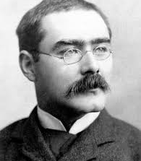
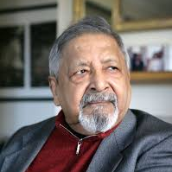
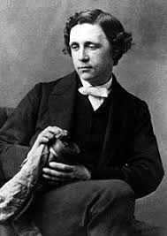

Slide 7


Slide 8
Theme of the story
The story The interview has two stories. In story one the narrator tells us about the reaction and views of celebrities towards an interview. Most of the famous personalities find them to intrude on their personal lives and some have never given an interview all their life. The story has the theme of how the freedom of the press can curtail an individual’s privacy.
The second story is a part of an interview of the famous writer and academician Umberto Eco. In this story we get to know the various qualities of time management used by the famous writer. These help him gather so many feathers in his hat. He gives the details of the various aspects which contribute to a person’s success.

Slide 9
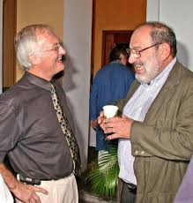

Slide 10
1.What was Lewis carroll's attitude towards being interviewed?
2.What drawsback of interview have been pointed out by lewis carrol?
3.State the reason for the huge success of the novel "The Name of the Rose"?
4.Umberto eco does many things, but says, I'm always doing the same thing but that is more difficult to explain.What does he mean to say?
5.What do you learn about Umberto Eco distinctive style in his doctoral dissertation?
6.What do you understand by the expression "thumbprints on his windpipe"?
7.Why do most celebrity writes despise being interviewed?
8.Why do Umberto Eco prefer himself to be called an academician than a novelist?
9.What is the belief in some primitive culture about being photographed?
10.Who, in today's world, is a chief source of information about personalities?

Slide 11
Mukund Padmanabhan was a reporter from ‘The Hindu’.In the context of the chapter,re-veal his traits as an interviewer
Give a character sketch of umberto eco on the basis of the chapter ‘The interviewer’
Several celebrities despise being interviewed .Is thus justified? Why not ?

Slide 12
Thank you

