Slide 1


Modern Education Society's Wadia College of Engineering (MESWCOE)
Department of Computer Engineering
Topic :-Career Connect
Presented by :-
Samyak Gaikwad (01)
Siddhi Lolge (04)
Pratik Dhawale (14)
Aadish Sonawane (41)
Ayush Butala (44)
Guided by :-
Mrs. K.S. Jojare

Slide 2
Introduction
The placement and internship process is a crucial aspect of a student’s academic journey, bridging the gap between education and professional careers. However, many colleges struggle with organizing and managing this process efficiently. Students often find it challenging to discover relevant job and internship opportunities, while placement officers face difficulties in handling large amounts of data. To address these challenges, this project proposes a college-specific placement and internship platform that enhances the experience for both students and administrators.

Slide 3
MOTIVATION
As competition intensifies in both academics and career placements, there is a growing need for institutions and recruiters to identify well-rounded candidates. CGPA, though important, doesn’t reflect practical skills, problem-solving abilities, or real-world experience. Many students excel in coding platforms like LeetCode or contribute to open-source but remain unnoticed due to a lack of visibility. This leaderboard system is designed to bring those accomplishments forward in a measurable and structured way.

Slide 4
PROBLEM STATEMENT
The placement and internship process in colleges is often disorganized, making it difficult for students to find relevant opportunities and for placement officers to manage data efficiently. This project aims to create a college-specific platform that recommends jobs and internships based on CGPA and skills, motivates students through a gamified leaderboard, and provides an admin dashboard for streamlined management.

Slide 5
Literature survey
Sr. no. | Paper Title | Year | Description
1. | Enhancing Job Recommendation Systems through Machine Learning | 2024 | • Supports AI-driven recommendations for better placements. • Helps refine job/internship suggestion algorithms. • Guides CGPA & skill-based matching.
2. | Examining the Effectiveness of Gamification as a Tool Promoting Intrinsic and Extrinsic Motivation Among Higher Education Students: A Systematic Review | 2023 | •Validates leaderboard-driven motivation. • Encourages skill improvement through competition • Supports long-term engagement strategies.

Slide 6
Literature survey
3. | The Use of Leaderboards in Education: A Systematic Review of Empirical Evidence in Higher Education | 2024 | • Justifies the competitive ranking system. • Provides a framework for gamification features. • Defines success metrics for engagement.
4. | Using Internship Management System to Improve the Relationship between Internship Seekers, Employers, and Educational Institutions | 2020 | • Supports real-time company listings. • Enhances employer-student interaction. • Inspired tracking & application features.

Slide 7
Literature survey
5. | A Survey on Student Performance Evaluation Metrics Authors: Dr. John Smith, Dr. Emily Johnson | 2020 | This survey reviews various metrics used to evaluate student performance, highlighting the limitations of traditional methods like GPA. It emphasizes the need for incorporating diverse assessment tools to capture a comprehensive view of student capabilities.
6. | A Multi-Criteria Assessment Framework for Academic Ranking Authors: Dr. Maria Gonzalez, Dr. Li Wei | 2019 | The paper proposes a framework that utilizes multiple criteria, including academic achievements and extracurricular activities, for ranking students. It demonstrates how a holistic approach can provide a more accurate assessment of student performance.

Slide 8
Literature survey
7. | Role of Open-Source Contributions in Modern Recruitment Authors: Dr. Ahmed Khan, Dr. Laura Chen | 2021 | This study explores how open-source contributions are increasingly valued in the recruitment process. It analyzes the impact of such contributions on hiring decisions, suggesting that they serve as indicators of practical skills and community engagement.
8. | Data-Driven Assessment Models Authors: Dr. Robert Lee, Dr. Priya Patel | 2018 | The paper discusses the development of assessment models that leverage data analytics to evaluate student performance. It emphasizes the importance of real-time data in creating adaptive learning environments.

Slide 9
Literature survey
9. | Performance Prediction Using Machine Learning in Education Authors: Dr. Elena Petrova, Dr. James O'Connor | 2020 | This research applies machine learning techniques to predict student performance. It highlights the effectiveness of algorithms in identifying at-risk students and tailoring educational interventions accordingly.
10. | Enhancing Student Visibility Beyond CGPA Authors: Dr. Hiroshi Tanaka, Dr. Aisha Mohammed | 2019 | The paper advocates for assessment methods that go beyond CGPA, incorporating factors like project work, internships, and peer evaluations to provide a more comprehensive view of student abilities.

Slide 10
Objective
Create a web-based platform for college-specific internship & job recommendations
Provide a gamified ranking system to encourage skill development
Offer an admin dashboard for placement officers to manage recruitment efficiently
Help students make data-driven decisions about career opportunities
Increase student participation through leaderboards & performance tracking

Slide 11
Proposed Methodology
The final product is designed to be a scalable, automated system that collects student data from verified sources, calculates their overall performance score, and displays a dynamic leaderboard through a web-based dashboard.
Data Collection
Data will be gathered via online forms or APIs, fetching academic records, coding platform scores (e.g., LeetCode, GitHub), and internship data.
Backend Processing
A server-side application (Python/Node.js) will process incoming data. A scoring algorithm will calculate each student's final score based on predefined weights.

Slide 12
Proposed Methodology
Database Integration
All data will be stored in a centralized database (e.g., MongoDB, MySQL) to ensure persistence, integrity, and easy querying.
Dynamic Leaderboard
A responsive frontend (React/Angular) will fetch data from the backend via APIs and display real-time rankings.
Admin Panel
Admins or faculty can manage records, tweak scoring weights, and export reports as needed.

Slide 13
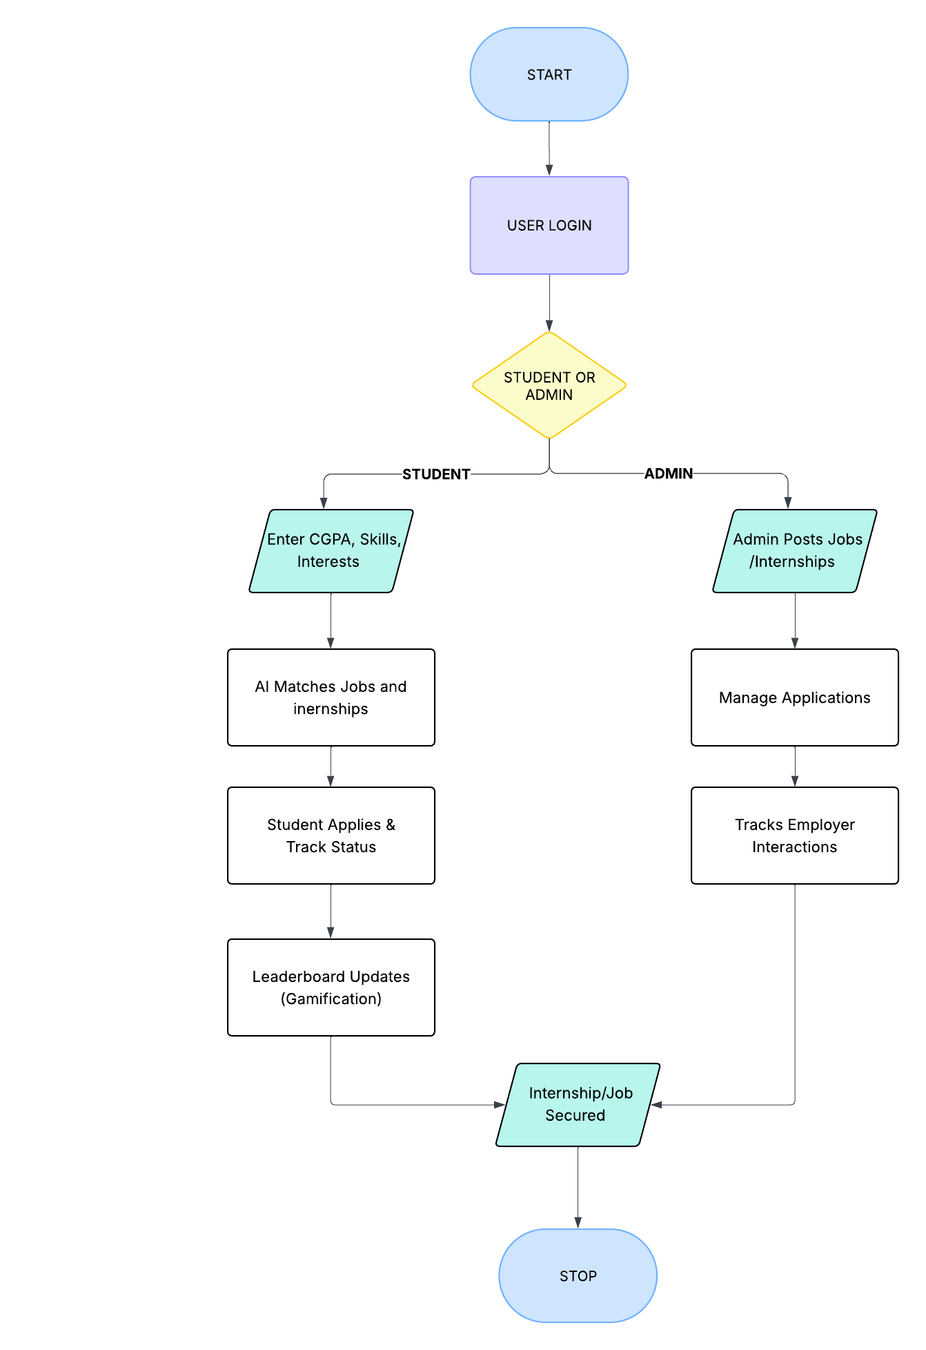
Proposed Methodology
Flowchart

Slide 14
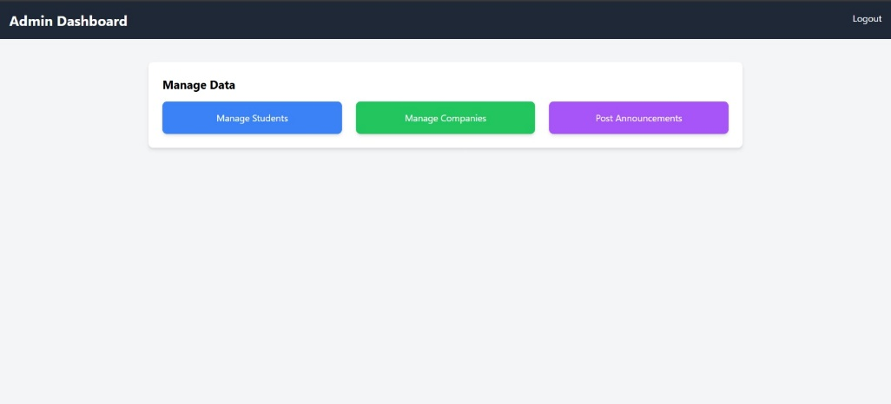
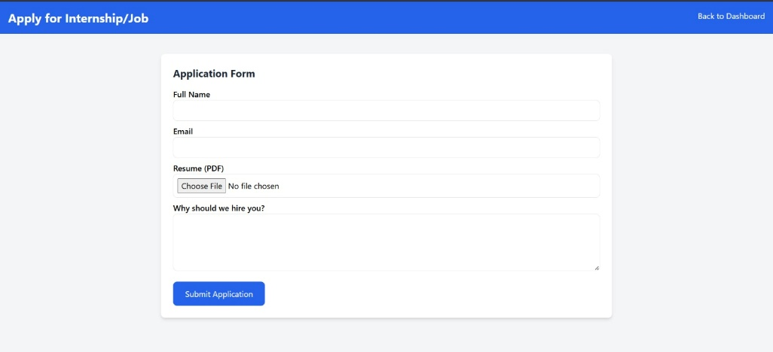
Implementation
The system is implemented using Python for score calculation and Excel/JSON handling.The frontend is built using HTML/CSS to display the updated leaderboard.The backend script updates Final Scores and leaderboard without requiring a full database server (prototype phase).

Slide 15
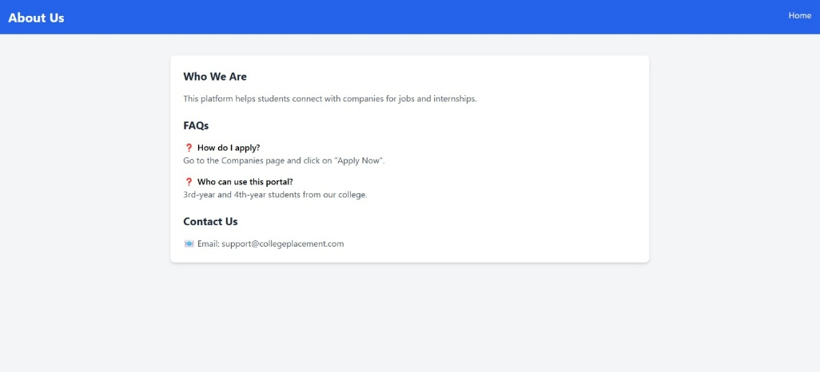
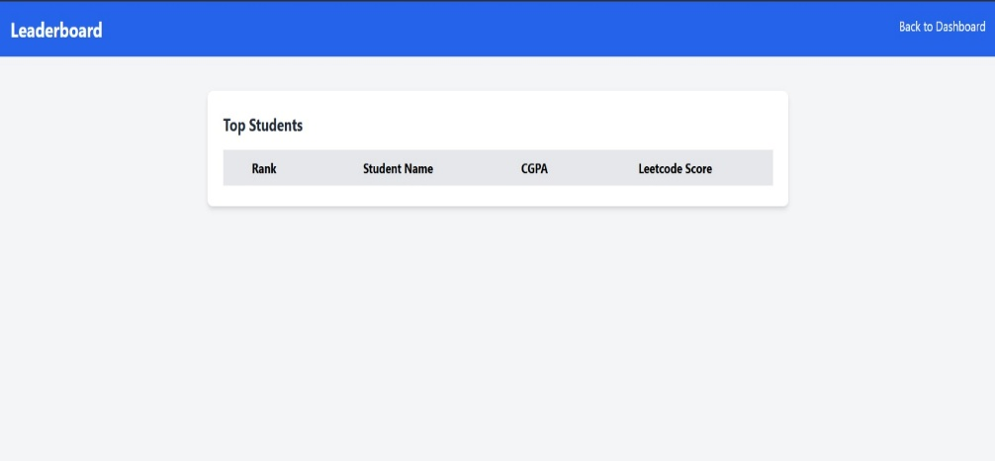
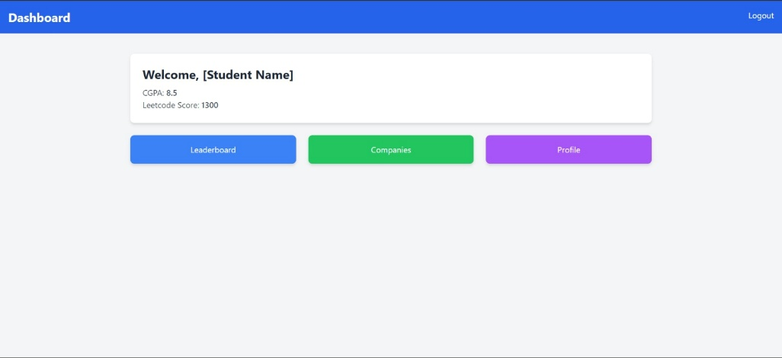
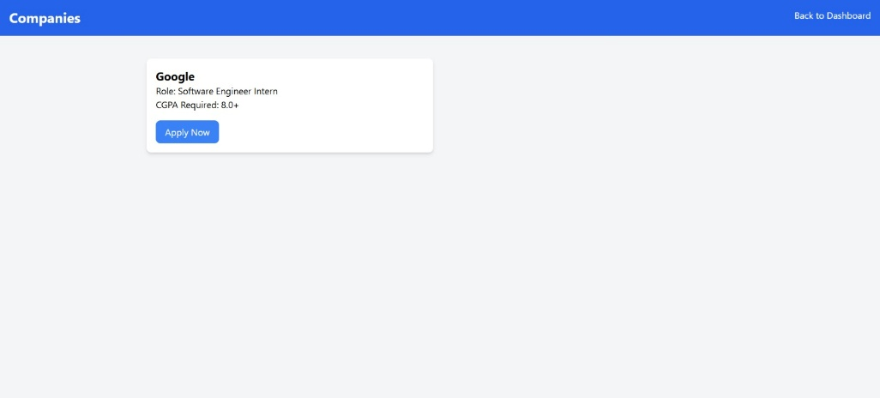
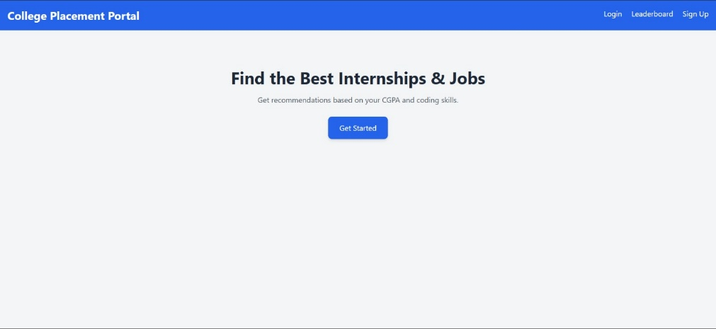
Implementation

Slide 16
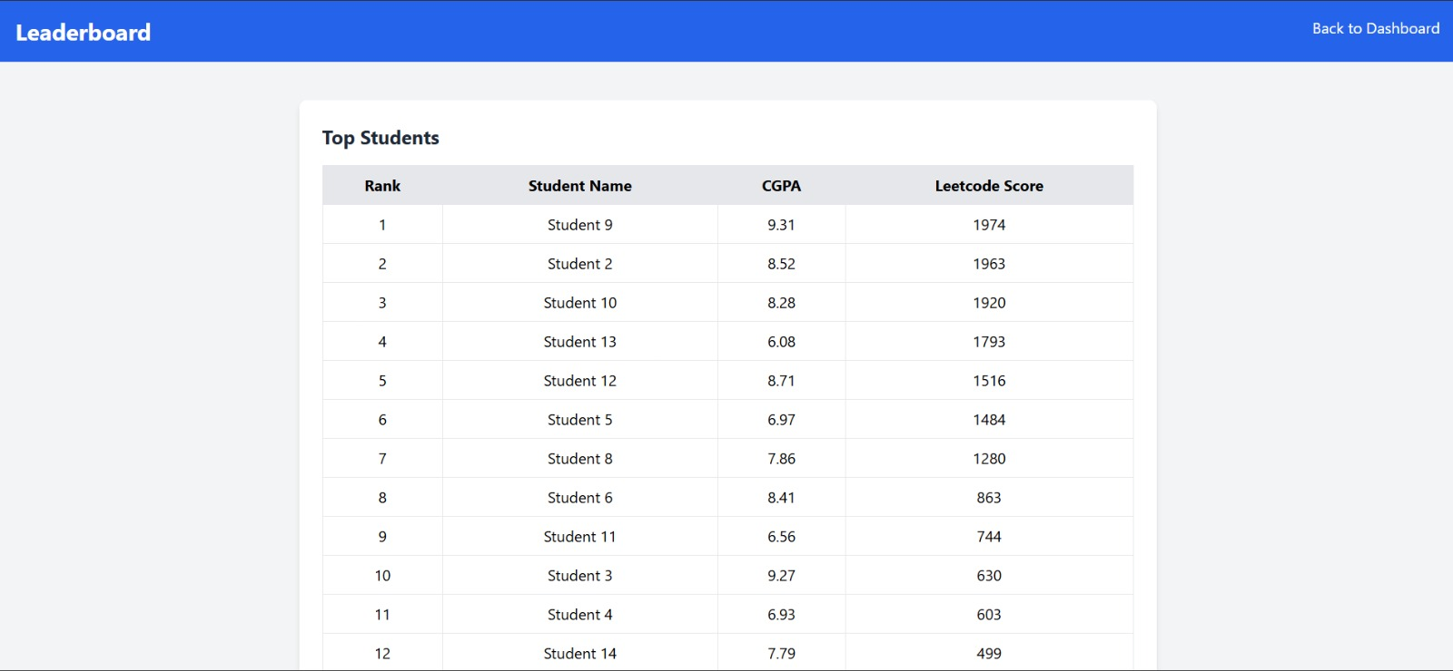
Experimental Results
📊 100 dummy students were generated with varying scores.
✅ Leaderboard accurately reflected top performers based on all metrics.
✅ The system dynamically updates the HTML leaderboard upon data change.

Slide 17
Conclusion
Career Connect provides a structured, efficient, and engaging way to manage college placements & internships
Gamification & data-driven insights ensure students stay motivated and competitive
Placement officers get a centralized system to handle recruitment more efficiently

Slide 18
THANK YOU!

