Slide 1
Fly Stock Finder
Prioritizing ‘GO Hits’
What are the relevant and common GO Terms from the ‘Allada+’ sleep/ wake gene sets?

Slide 2
Method
Allada+ Datasets (26 DGE experiments)
22 from Allada lab
4 from Swinderen Lab (THIP, 2023 paper)
Derive ‘consistent sleep/ wake’ gene sets
| log2b | >= 0.5
qval < 0.05
Filter out genes with experiment overlap of < 2
Create a .csv for each ‘experiment overlap’ (frequency) threshold
i.e. from 2 → max experiment overlap (within respective set), filter out genes with ‘experiment overlap’ less that the staggered threshold
6 Total ‘Consistent sleep gene sets’
Min experiment overlap >= 2,
Min experiment overlap >= 3,
…,
Min experiment overlap >= 7
5 Total ‘Consistent wake gene sets’
Min experiment overlap >= 2,
Min experiment overlap >= 3,
…,
Min experiment overlap >= 6
Conduct GO Analysis on each of the 6 gene sets
Conduct GO Analysis on each of the 5 gene sets
Aggregate GO Terms and count number of overlapping gene sets
Aggregate GO Terms and count number of overlapping gene sets
Sort in descending order of # overlapping gene sets
sleep_genes_GO_Analysis_summary_Table.csv
wake_genes_GO_Analysis_summary_Table.csv

Slide 3
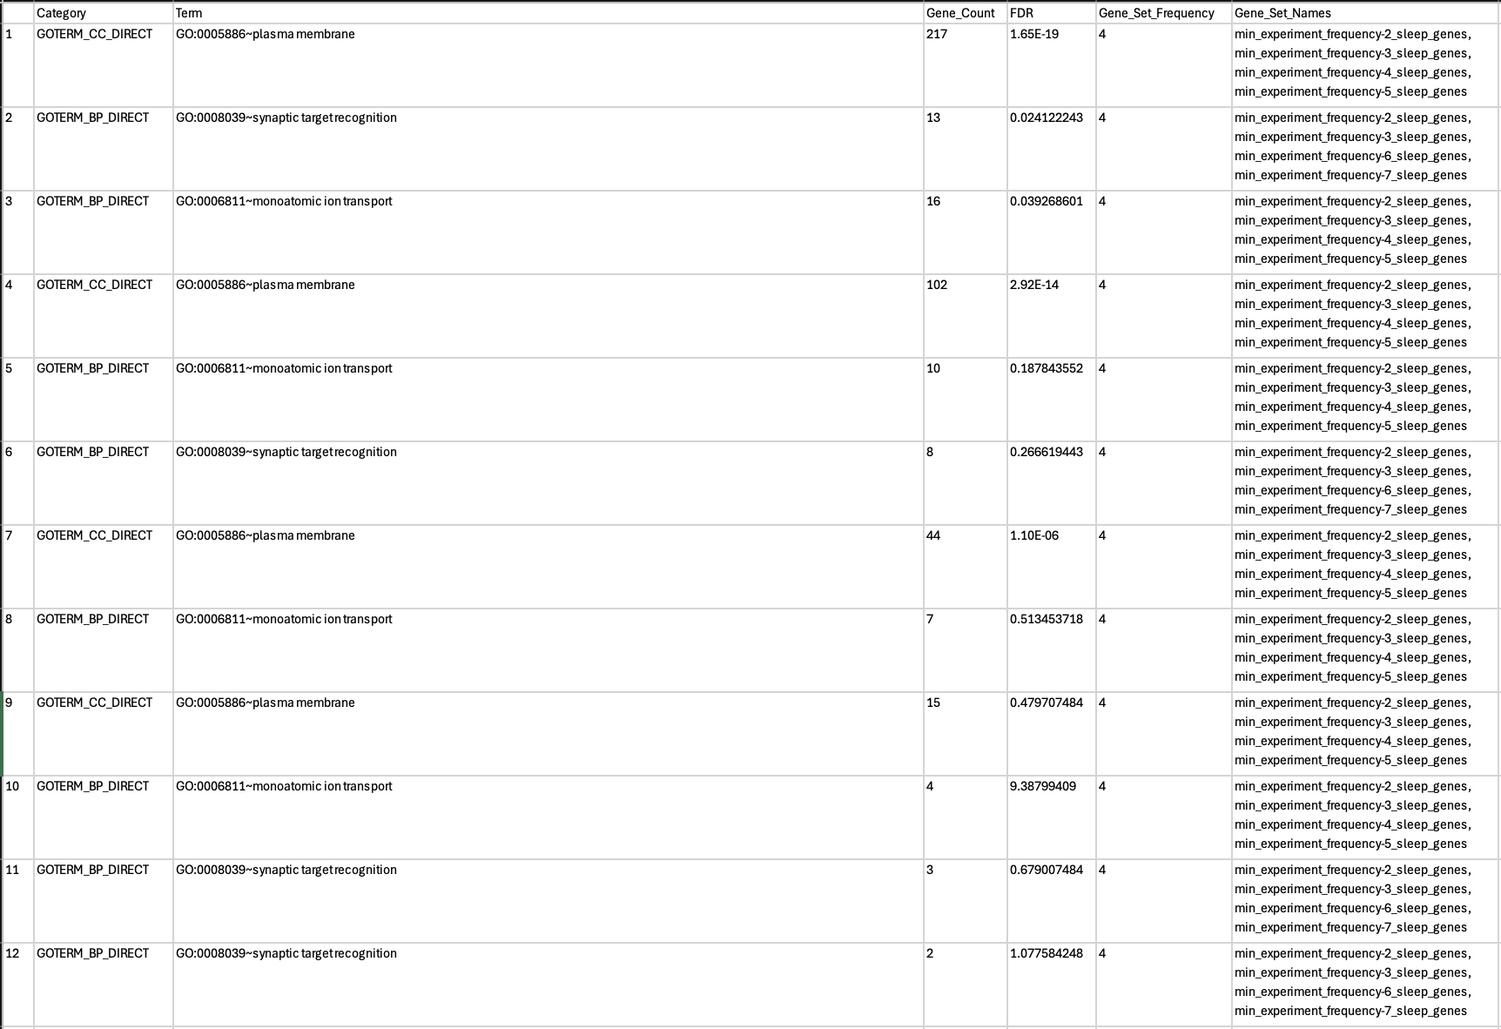
Sleep Gene Sets (min freq 2, 3…, 7) GO Terms Summary Table (log2b 0.5)

Slide 4
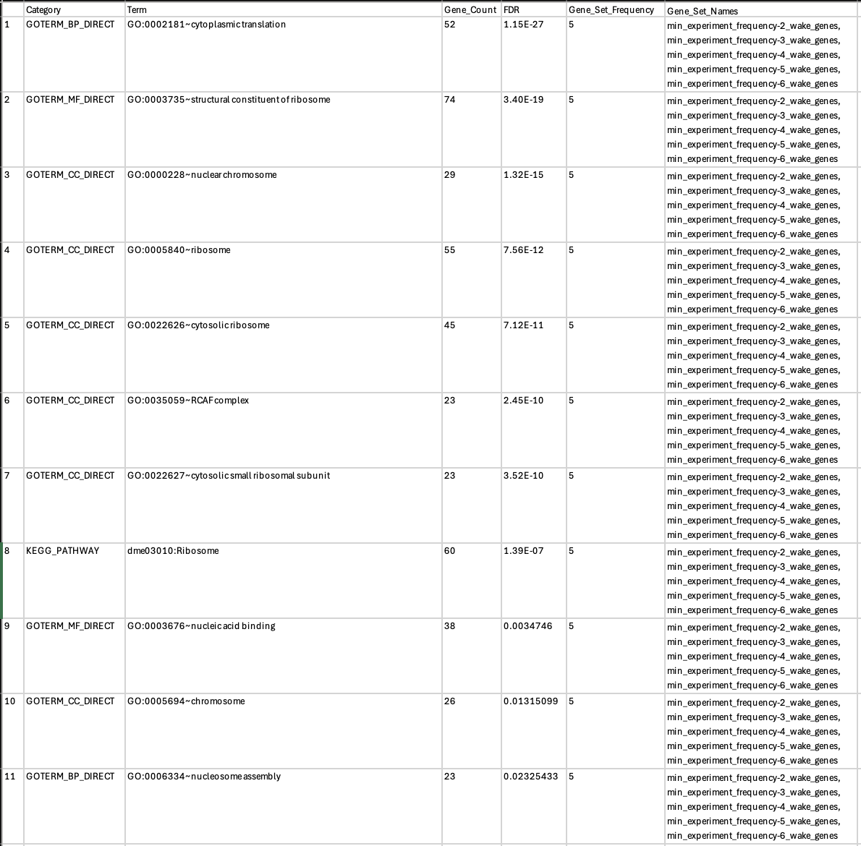
Wake Gene Sets (min freq 2, 3…, 6) GO Terms Summary Table (log2b 0.5)

