Slide 1
TX-OMICS REVISION
Tx-Omics Revision
Candidate Gene Lists
7
295
stocker CSVs
unique FBgns
Aadish
08/12/2026
4
3
publication sets
pathway sets
Rosensweig–Shah 2026 · curation summary

Slide 2
LIBRARY MAP
02
The final library at a glance
Four evidence-defined sets and three pathway-hit sets; 295 unique genes after FBgn deduplication.
01
02
03
04
6
20
97
4
genes
genes
genes
genes
Mechanistic
Homeostatic H×R
CSW 4+
HLH regulators
Publication core + screen ranks 1–6
15 History+/Rebound− + 5 opposite
Wake frequency ≥4, threshold-scoped
Four bHLH factors named in paper
05
06
07
Σ
99
167
5
295
genes
genes
genes
unique FBgns
Ribosomal
Mitochondrial
Immune
Seven-set union
DAVID term hits; approved keywords
DAVID mito/metabolism term hits
DAVID immune / Toll / Imd term hits
Deduplicated on flybase_gene_id
Rosensweig–Shah 2026 · flybase_gene_id is the membership key

Slide 3
CURATION PIPELINE
03
Two curation tracks converge on one controlled folder
The shared gates are identity resolution, FBgn deduplication, and a clean seven-file handoff.
TRACK A
Publication categories
Paper + breakdown tables
Apply set-specific rules
Resolve FlyBase identity
Publish sets 01–04
1
2
3
4
TRACK B
Pathway hits
Four CSW master tables
DAVID · FDR ≤10%
Review term keywords
Publish sets 05–07
1
2
3
4
902
source observations
791
unique source FBgns
≥2
minimum pathway frequency
7
experiments
Thresholds remain separate: FC0.5 and FC1 are never collapsed into a max-frequency field.

Slide 4
SETS 01–02
04
Publication sets use explicit, reproducible rules
Sets 01–02 preserve publication evidence and resolve one biologically important identity conflict.
SET 01 · 6 GENES
SET 02 · 20 GENES
Mechanistic
Homeostatic history × rebound
Publication core joined by FBgn to mechanistic screen ranks 1–6.
15
5
Carry forward mechanism, literature status, Tx-Omics evidence, and fl.ai confidence.
Evidence labels: consistent, correlated, or curated.
No rank or annotation is inferred outside the source tables.
History+ / Rebound−
History− / Rebound+
Identity correction
Source row trh / FBgn0262139 is resolved from publication context to Trhn / FBgn0035187 (tryptophan hydroxylase). The wrong FBgn is never retained.
unc79 · SIFa · rumpel · AstA-R2 · Trhn · RpL23
Rosensweig–Shah 2026 · flybase_gene_id is the membership key

Slide 5
SETS 03–04
05
Screen frequency and direct-regulator evidence stay separate
Set 03 is threshold-scoped screen evidence; Set 04 comes directly from the paper.
SET 03 · 97 GENES
SET 04 · 4 GENES
CSW 4+ wake-frequency union
HLH regulators
97
7
0
Named in Results / Table S1 after HOMER identified a CAGCTG E-box upstream of wake-induced genes.
FC0.5 wake frequency 4–6
also qualify at FC1
sleep genes at frequency 4
bigmax
FBgn0039509
Union rule
HLH3B
FBgn0011276
Take FC0.5 wake genes at frequency 4, 5, or 6.
Add FC1 wake frequency-4 genes; all seven are already in the FC0.5 set.
Keep FC0.5 and FC1 metadata in separate columns.
E(spl)m3-HLH
FBgn0002609
E(spl)mbeta-HLH
FBgn0002733
Rosensweig–Shah 2026 · flybase_gene_id is the membership key

Slide 6
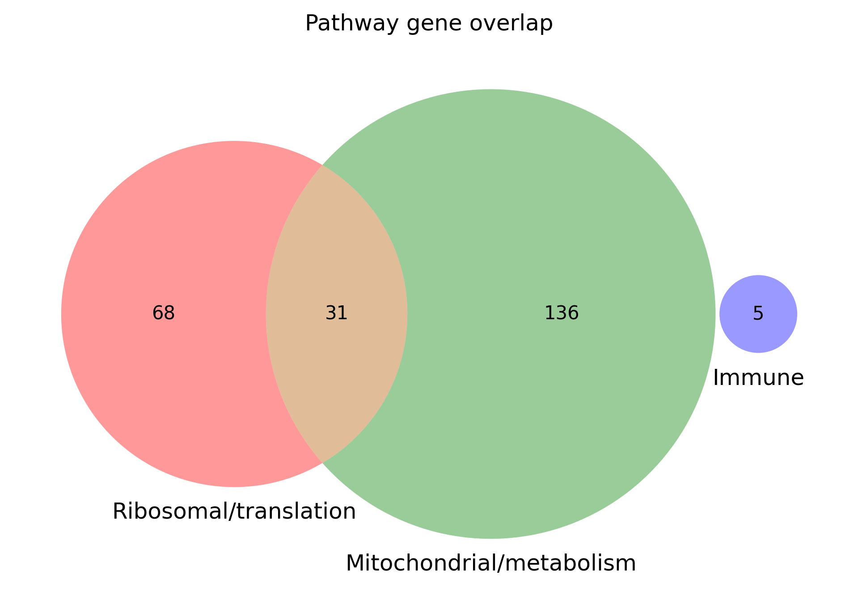
SETS 05–07
06
Pathway sets contain DAVID hits—not every annotated gene
Only hit genes from approved FDR-passing terms enter sets 05–07.
1
Submit four CSW masters
2
Keep FDR ≤10% terms
3
Review term keywords
4
Take hit FBgns
Mitochondrial / metabolism
167
Why the overlap is intentional
Mitochondrial translation and mitochondrial ribosomal-subunit terms match both keyword groups. Their hit genes are retained in every matched bucket.
Ribosomal / translation
99
Immune
5
31
ribo ∩ mito
All three lists are wake-only in this run.
Rosensweig–Shah 2026 · flybase_gene_id is the membership key

Slide 7
OVERLAP · 295 UNIQUE FBGNS
08
Most genes are set-specific; overlap concentrates in CSW and pathways
Exact intersections expose the reusable biological core without inflating membership.
Largest exact intersection blocks
What matters
Mitochondrial only
102
200
genes in exactly one set
Ribosomal only
40
87
genes in exactly two sets
CSW 4+ ∩ mitochondrial
34
8
genes in exactly three sets
CSW 4+ only
28
Ribosomal ∩ mitochondrial only
24
Largest pairwise overlaps
The immune and HLH sets remain fully distinct from the pathway core.
41 CSW 4+ ∩ mito
35 CSW 4+ ∩ ribo
31 ribo ∩ mito
Rosensweig–Shah 2026 · flybase_gene_id is the membership key

Slide 8
STOCKER HANDOFF
The contract is simple—and strict.
Seven inputs
01 Mechanistic
7
Exactly seven CSVs in the discovery folder
2
Required keys: ext_gene and flybase_gene_id
0
No overlap, GO, or audit CSVs beside the inputs
02 Homeostatic H×R
03 CSW 4+
04 HLH regulators
RUN
05 Ribosomal
06 Mitochondrial
python -m fl_ai_reagent_stocker run ./data/gene_sets/Tx-Omics_Revision/ \
--config ./data/config/stock_split_config_priority_example.json
07 Immune
Stability rule
Discovery is recursive: every extra *.csv changes the run. Keep analysis outputs elsewhere.
Rosensweig–Shah 2026 · Tx-Omics Revision

