Slide 1
TX-OMICS REVISION
Seven gene sets.
Seven clear definitions.
4
3
primary sets
GO-derived sets
Family 1 captures four primary evidence categories. Family 2 contains three CSW-derived GO term groups, with FC0.5 and FC1 provenance shown separately.
2
7
thresholds
stocker CSVs

Slide 2
CURATION MAP
02
Two families, seven non-interchangeable sets
Each set now receives one slide; overlap is reported separately within each family.
FAMILY 1 · PRIMARY EVIDENCE
FAMILY 2 · CSW-DERIVED GO
01
6
Mechanistic
Consistent/correlated + published homeostatic-consistent effect
99
Ribosomal
FC0.5 99 · FC1 12
05
02
20
Homeostatic genes
Opposing history versus rebound correlations
06
167
Mitochondrial
FC0.5 167 · FC1 23
03
97
CSW 4+ genes
Consistent in four or more of seven datasets
07
5
Immune
FC0.5 0 · FC1 5
04
4
HLH genes
Potential upstream regulators
FC0.5 and FC1 counts are GO-report provenance; a gene may be assigned by both reports.

Slide 3
FAMILY 1 · SET 01
03
Mechanistic · 6 genes
Consistent or correlated sleep/wake genes with published effects compatible with homeostatic feedback.
6
unc79
SIFa
NALCN complex
neuropeptide
paper-highlighted genes
Inclusion requires transcriptomic evidence plus published sleep/wake function.
rumpel
AstA-R2
glial transporter
neuropeptide receptor
Consistent across sleep/wake conditions or correlated with sleep/wake history
Published perturbation changes sleep/wake
Effect direction fits a potential homeostatic loop
Trhn
RpL23
serotonin synthesis
ribosome / translation
These six are not the 20 opposing history–rebound correlation genes.

Slide 4
FAMILY 1 · SET 02
04
Homeostatic genes · 20 genes
Genes correlated with pre-sampling sleep/wake history and post-sampling rebound in the opposite direction.
15
15 · HISTORY+ / REBOUND−
History+ / Rebound−
AstA-R2 · bumpel · CG33080 · CG41378 · CG7460
CG7601 · Chrac-14 · Cyp28c1 · dpr21 · kumpel
Obp44a · Sk1 · Ssk · Trhn · VGlut2
Positive correlation with prior sleep; negative correlation with rebound.
5
History− / Rebound+
5 · HISTORY− / REBOUND+
Negative correlation with prior sleep; positive correlation with rebound.
CG42323 · CG7079 · CG9313 · CG9377 · Gtpbp1

Slide 5
FAMILY 1 · SET 03
05
CSW 4+ genes · 97 genes
Consistent sleep/wake genes evident across four or more of the seven datasets.
97
Recurrence across seven datasets
FC0.5 wake genes
Frequency 4
82
The category rule is recurrence across datasets—not GO enrichment.
Frequency 5
14
7
Frequency 6
1
also qualify at FC1
All seven are already contained within the 97-gene FC0.5 set.
No sleep-upregulated gene met the ≥4-of-7 recurrence criterion.

Slide 6
FAMILY 1 · SET 04
06
HLH genes · 4 genes
Four bHLH factors identified as potential upstream regulators of wake-induced gene expression.
REGULATORY LOGIC
bigmax
HLH3B
CAGCTG
FBgn0039509
FBgn0011276
E-box enriched upstream of wake-induced genes
E(spl)m3-HLH
E(spl)mbeta-HLH
HOMER motif enrichment → candidate direct regulators
FBgn0002609
FBgn0002733
Results · Table S1
This set is regulatory evidence—not frequency or correlation evidence.

Slide 7
FAMILY 2 · CATEGORIZATION WORKFLOW
07
How CSW genes became three GO term–grouped sets
The workflow selects genes from enriched DAVID terms; it does not assign every annotated gene to a category.
1
Prepare CSW lists
2
Run DAVID
3
Filter enriched terms
4
Assign term buckets
5
Extract gene hits
Four master lists; every gene is consistent in ≥2 of 7 datasets.
Wake FC0.5 · 647
Wake FC1 · 98
Sleep FC0.5 · 141
Sleep FC1 · 16
Run each list separately.
Drosophila · 7227
Default species background
GO BP / CC / MF Direct + KEGG
EASE cutoff · 0.1
Min count · 1
Retain terms with:
FDR ≤ 10%
Sleep FC1 produced no passing terms.
Literal term-name patterns:
ribosom* / translat*
mitochondri* / metabolism
immune / defense / Toll / Imd
A term may match >1 bucket.
Take only FBgn hits listed in matched terms.
Dedupe by FBgn.
Preserve GO-report source.
Keep every matched bucket.
OUTPUT
99 Ribosomal · 167 Mitochondrial · 5 Immune
All outputs are wake-direction. Mitochondrial translation terms match both keyword groups, so 31 genes are retained in both Ribosomal and Mitochondrial.

Slide 8
FAMILY 2 · SET 05
08
Ribosomal / translation · 99 genes
GO-report assignment is shown here; experiment-level FC0.5 and FC1 regulation is shown on slide 13.
GO ASSIGNMENT SOURCE
Most frequent approved terms
99
93
Ribosome
unique genes in this set
Structural constituent of ribosome
92
FC0.5 GO
99
genes assigned
Translation
77
FC1 GO
12
genes assigned
Cytoplasmic translation
65
BOTH
12
assigned by both reports
Cytosolic ribosome
58
99 FC0.5 + 12 FC1 − 12 both = 99 unique
87 FC0.5-GO-only · 0 FC1-GO-only · 12 in both GO reports

Slide 9
FAMILY 2 · SET 06
09
Mitochondrial / metabolism · 167 genes
GO-report assignment is shown here; experiment-level FC0.5 and FC1 regulation is shown on slide 14.
GO ASSIGNMENT SOURCE
Most frequent approved terms
167
121
Mitochondrion
unique genes in this set
Mitochondrial inner membrane
72
FC0.5 GO
167
genes assigned
Oxidative phosphorylation
46
FC1 GO
23
genes assigned
Mitochondrial translation
30
BOTH
23
assigned by both reports
Mitochondrial matrix
24
167 FC0.5 + 23 FC1 − 23 both = 167 unique
144 FC0.5-GO-only · 0 FC1-GO-only · 23 in both GO reports

Slide 10
FAMILY 2 · SET 07
10
Immune · 5 genes
Assigned from FC1 GO enrichment; all five genes also meet FC0.5 regulation criteria (experiment view on slide 15).
GO ASSIGNMENT SOURCE
Five genes assigned by the FC1 GO report
Approved GO terms · genes per term
5
BomBc2
Defense response
4
unique genes in this set
BomS1
Antibacterial humoral response
4
FC0.5 GO
0
genes assigned
BomS2
Response to bacterium
4
FC1 GO
5
genes assigned
IM14
Thor
Genes may occur in more than one approved term.
BOTH
0
assigned by both reports
0 FC0.5-GO-only · 5 FC1-GO-only · 0 in both reports
0 FC0.5 + 5 FC1 − 0 both = 5 unique

Slide 11
FAMILY 1 · OVERLAP
11
Only three genes cross primary-set boundaries
Overlap is calculated among Mechanistic, Homeostatic, CSW 4+, and HLH only.
Observed shared genes
Family 1 union
Mechanistic × Homeostatic
2
Trhn · AstA-R2
124
unique FBgns
121
in exactly one set
Mechanistic × CSW 4+
1
RpL23
3
in exactly two sets
All other pairings
0
No shared FBgns
0
in three or four sets
HLH genes are fully disjoint.

Slide 12
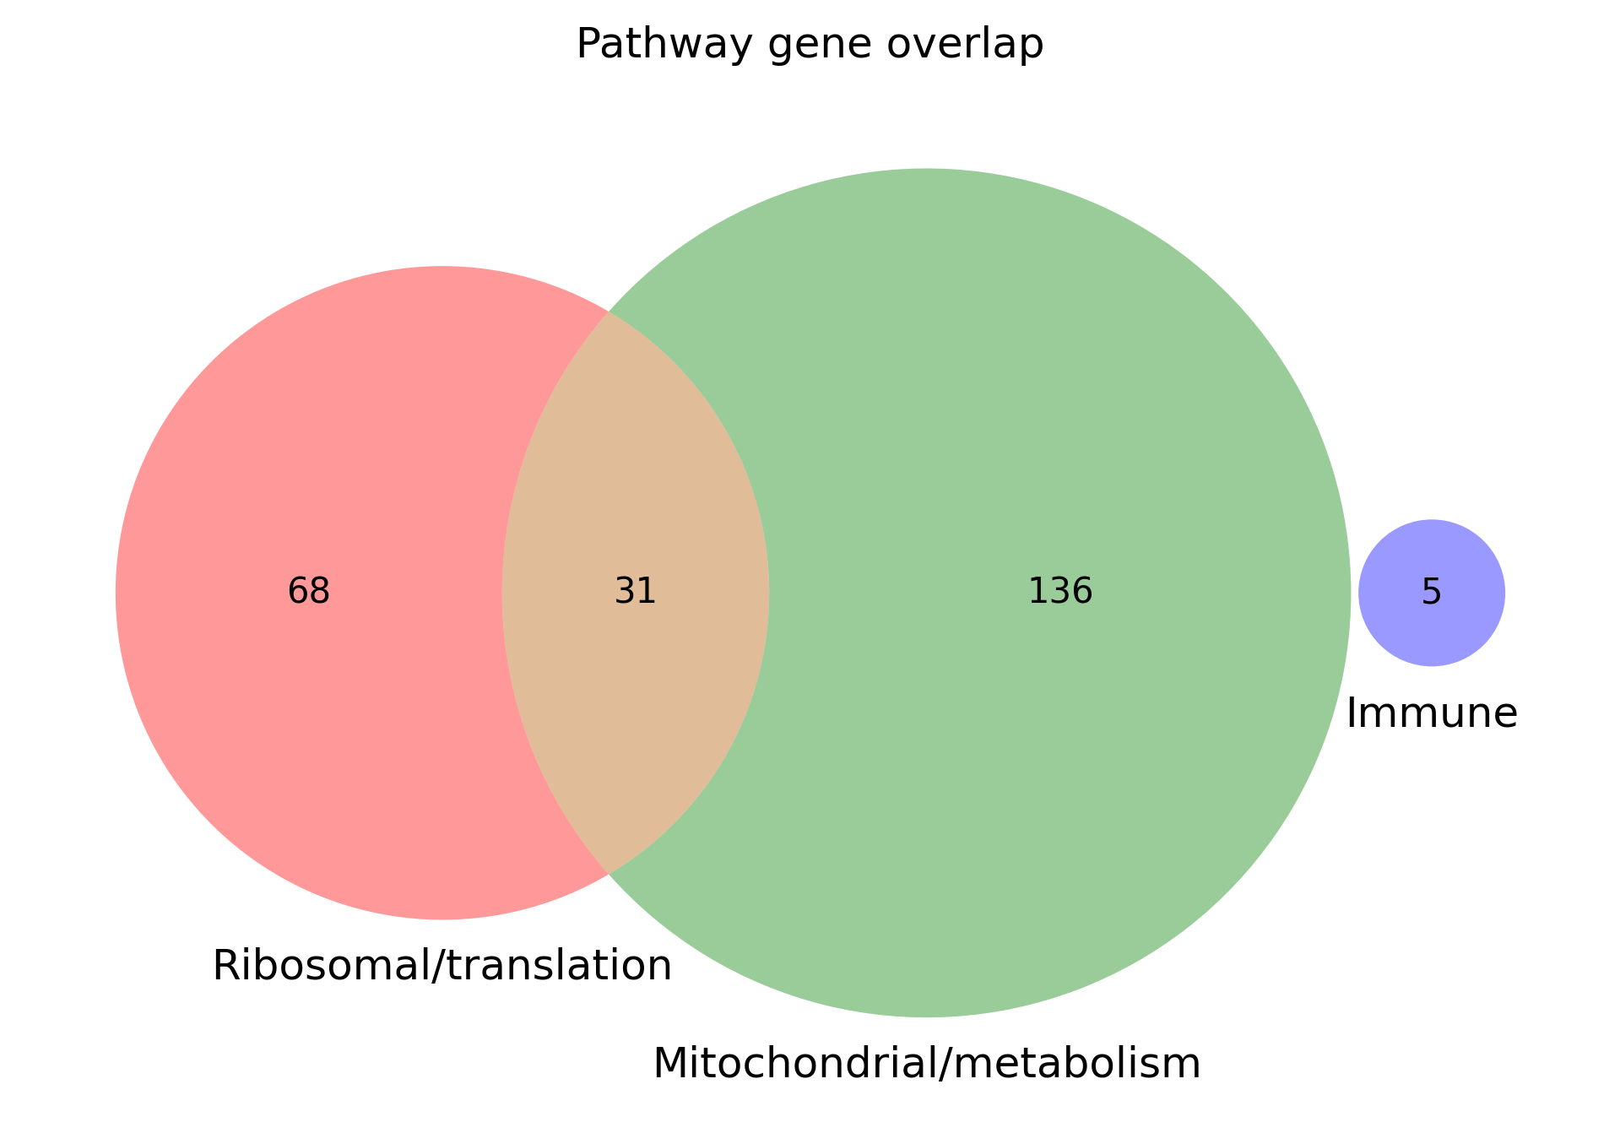
FAMILY 2 · OVERLAP
12
The GO-derived union contains 240 unique genes
99 ribosomal + 167 mitochondrial + 5 immune − 31 shared ribosomal/mitochondrial genes = 240 unique FBgns.
GO-assignment provenance
across the 240-gene union
203
FC0.5 GO only
32
both GO reports
5
FC1 GO only
240 = union of Ribosomal, Mitochondrial and Immune genes; each FBgn counted once.
Only the five Immune genes are assigned by FC1 GO alone.

Slide 13
FAMILY 2 · SET 05 · EXPERIMENTS
13
Ribosomal / translation · experiment-level regulation
Within each threshold-responsive subset, bars show genes with logFC > threshold and q < 0.05 per experiment; genes may appear in multiple bars.
FC0.5 · N=99
FC1 · N=12
Baseline
40 · 40%
Baseline
10 · 83%
MechSD 3h
68 · 69%
MechSD 3h
5 · 42%
MechSD 6h
97 · 98%
MechSD 6h
12 · 100%
MechSD 12h
48 · 48%
MechSD 12h
5 · 42%
R85C10>TrpA1
0 · 0%
R85C10>TrpA1
0 · 0%
R23E10>ChR
25 · 25%
R23E10>ChR
0 · 0%
THIP
37 · 37%
THIP
0 · 0%
n = category genes meeting threshold in ≥1 experiment; independent of GO-assignment count
n = category genes meeting threshold in ≥1 experiment; independent of GO-assignment count
MechSD6 regulates 97/99 FC0.5-responsive genes and all 12 FC1-responsive genes; FC1 signal is mechanical-deprivation focused.

Slide 14
FAMILY 2 · SET 06 · EXPERIMENTS
14
Mitochondrial / metabolism · experiment-level regulation
Within each threshold-responsive subset, bars show genes with logFC > threshold and q < 0.05 per experiment; genes may appear in multiple bars.
FC0.5 · N=167
FC1 · N=24
Baseline
88 · 53%
Baseline
20 · 83%
MechSD 3h
126 · 75%
MechSD 3h
10 · 42%
MechSD 6h
163 · 98%
MechSD 6h
24 · 100%
MechSD 12h
86 · 51%
MechSD 12h
6 · 25%
R85C10>TrpA1
1 · 1%
R85C10>TrpA1
0 · 0%
R23E10>ChR
9 · 5%
R23E10>ChR
0 · 0%
THIP
2 · 1%
THIP
0 · 0%
n = category genes meeting threshold in ≥1 experiment; independent of GO-assignment count
n = category genes meeting threshold in ≥1 experiment; independent of GO-assignment count
MechSD6 regulates 163/167 FC0.5-responsive genes and all 24 FC1-responsive genes; FC1 has no R85C10, ChR or THIP hits.

Slide 15
FAMILY 2 · SET 07 · EXPERIMENTS
15
Immune · experiment-level regulation
Within each threshold-responsive subset, bars show genes with logFC > threshold and q < 0.05 per experiment; genes may appear in multiple bars.
FC0.5 · N=5
FC1 · N=5
Baseline
1 · 20%
Baseline
1 · 20%
MechSD 3h
4 · 80%
MechSD 3h
4 · 80%
MechSD 6h
3 · 60%
MechSD 6h
3 · 60%
MechSD 12h
4 · 80%
MechSD 12h
4 · 80%
R85C10>TrpA1
0 · 0%
R85C10>TrpA1
0 · 0%
R23E10>ChR
0 · 0%
R23E10>ChR
0 · 0%
THIP
0 · 0%
THIP
0 · 0%
n = category genes meeting threshold in ≥1 experiment; independent of GO-assignment count
n = category genes meeting threshold in ≥1 experiment; independent of GO-assignment count
All five immune genes meet both thresholds in at least one experiment; MechSD3 and MechSD12 each regulate four of five.

