Slide 1

Walmart Stores Analysis And Prediction
Technologies used: Python, Spark, Mongodb, Machine Learning, Power BI

Slide 2
Presented By:
Aditya Shroff 220343025003
Usama Abdul Hadi Khan 220343025050
Rajat Choursia 220343025033
Kannawar Shubham Somnathrao 220343025019

Slide 3
Content:
Introduction
Objective
Data Prepration
Project Flow
Platform Used
Results
Data insights using PowerBi

Slide 4
Introduction
Walmart is a renowned retail corporation that operates a chain of hypermarkets. Here, Walmart has provided a data combining of 45 stores including store information and monthly sales. The data is provided on weekly basis. Walmart tries to find the impact of holidays on the sales of store. For which it has included four holidays weeks into the dataset which are Christmas, Thanksgiving, Super bowl, Labor day. Here we are owing to Analyze the dataset given. before doing that , let me point out the objective of this analysis. Our Main Objective is to predict sales of store in a week.

Slide 5
Objective
Predict the sales across various departments in each store.
predict effect of markdowns on sales during the holiday.

Slide 6
Data Preparation
train.csv : this file has 421570 rows and 5 columns.(https://raw.githubusercontent.com/kirtigupta10007/Walmart-Store-Sales-Forecasting/master/data/train.csv)
store.csv : this file has 45 rows and 3 columns.(https://raw.githubusercontent.com/kirtigupta10007/Walmart-Store-Sales-Forecasting/master/data/stores.csv
features.csv : this file 8190 rows and 12 columns(https://raw.githubusercontent.com/kirtigupta10007/Walmart-Store-Sales-Forecasting/master/data/features.csv)

Slide 7


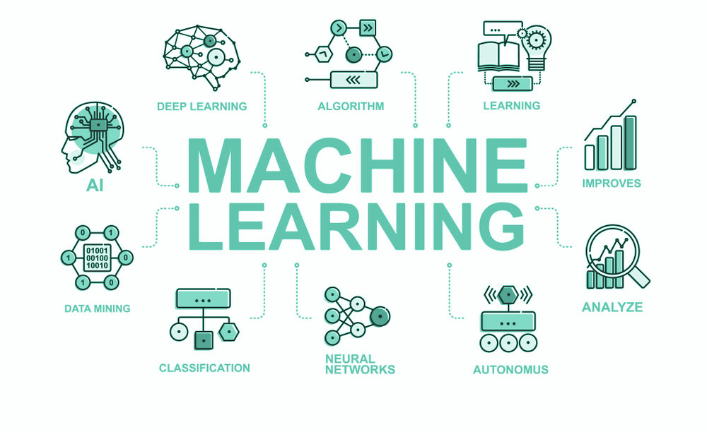

Project Flow:

Slide 8
Spark
Apache Spark is a multi-language engine for executing data engineering, data science, and machine learning on single-node machines or clusters.
It utilizes in-memory caching, and optimized query execution for fast analytic queries against data of any size.
For project work Spark was used to do perform Extract, Transform, Load(ETL) processes on the retrieved data. Later the data was dumped directy from Spark into Mongo DB.

Slide 9
MongoDB
MongoDB is a source-available cross-platform document-oriented database program. Classified as a NoSQL database program, MongoDB uses JSON-like documents with optional schemas.
After the ETL process the data was dumped into Mongo DB.

Slide 10
Machine Learning (using Python Pandas)
Machine learning is a branch of artificial intelligence (AI) and computer science which focuses on the use of data and algorithms to imitate the way that humans learn, gradually improving its accuracy.
Pandas is a fast, powerful, flexible and easy to use open source data analysis and manipulation tool, built on top of the Python programming language.
In Project Recommender System Model was trained using Vectorization Technique and using cosine similarity the results were generated.

Slide 11
Linear Regression
It is one of the very basic forms of machine learning where we train a model to predict the behaviour of your data based on some variables. In the case of linear regression as you can see the name suggests linear that means the two variables which are on the x-axis and y-axis should be linearly correlated.

Slide 12
Random Forest
Random forest is a Supervised Machine Learning Algorithm that is used widely in Classification and Regression problems. It builds decision trees on different samples and takes their majority vote for classification and average in case of regression. One of the most important features of the Random Forest Algorithm is that it can handle the data set containing continuous variables as in the case of regression and categorical variables as in the case of classification. It performs better results for classification problems

Slide 13
Decision Tree
Decision Tree algorithm belongs to the family of supervised learning algorithms. Unlike other supervised learning algorithms, the decision tree algorithm can be used for solving regression and classification problems too. The goal of using a Decision Tree is to create a training model that can use to predict the class or value of the target variable by learning simple decision rules inferred from prior data(training data).In Decision Trees, for predicting a class label for a record we start from the root of the tree. We compare the values of the root attribute with the record’s attribute. On the basis of comparison, we follow the branch corresponding to that value and jump to the next node.

Slide 14
Results :
Linear regression, random forest and decision tree machine learning algorithm were used to predict the weekly sales of wallmart. These are the scores in percentage.
 | Model | Score
1 | Decision Tree | 100.00
2 | Random Forest | 99.77
3 | Linear Regression | 8.86

Slide 15
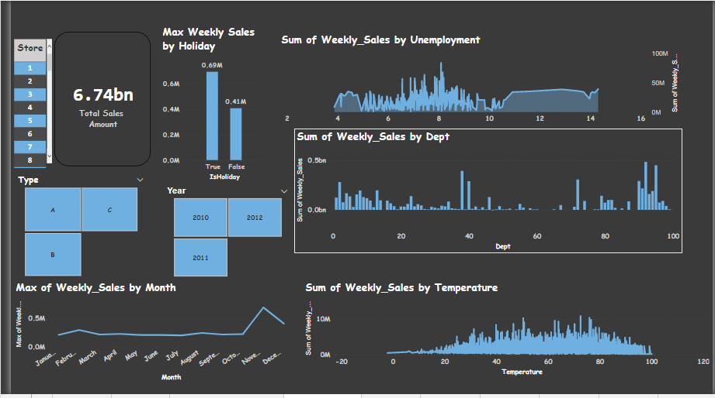
Data Insights using PowerBI

Slide 16
THANK YOU!!

