Slide 1
₹ FINFLOW (VYAPARSETU) • GRAPHIQUES INNOVATION CHALLENGE
FinFlow: Algorithmic Daily Capital & Parametric Climate Resilience
Replacing 300%+ APR predatory debt for 40M unbanked street vendors in India with 4:30 AM algorithmic working capital, daily UPI micro-skimming, and autonomous climate protection.
40M+
Informal Micro-Vendors in India Driving Daily Commerce
>300%
Effective APR Charged by Informal Loan Sharks
₹20
Flat Daily Cycle Fee for FinFlow Sunrise Capital
<60s
Parametric Weather Insurance Payout Without Paperwork

Slide 2
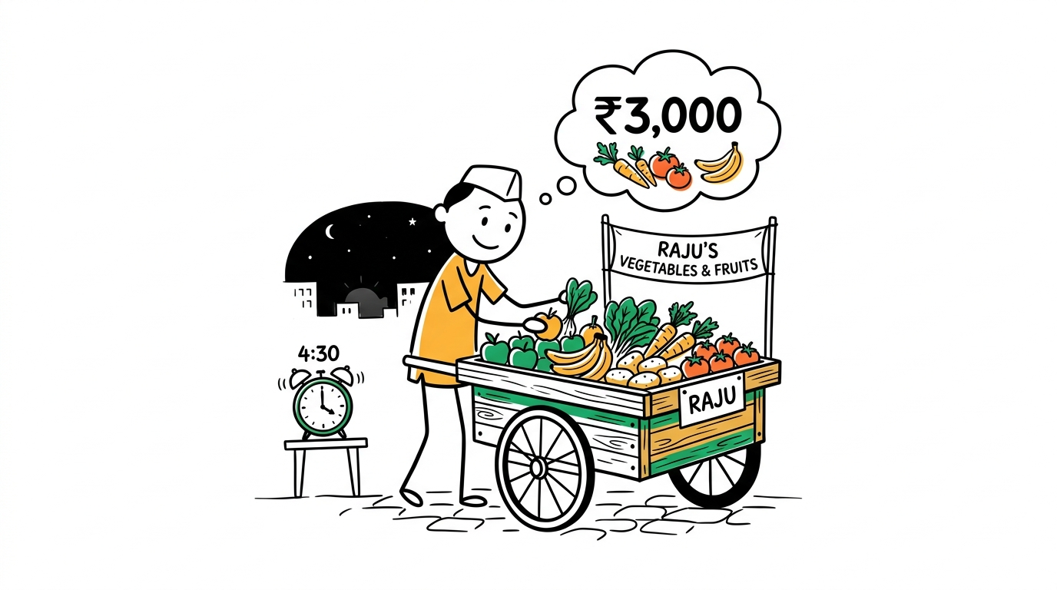
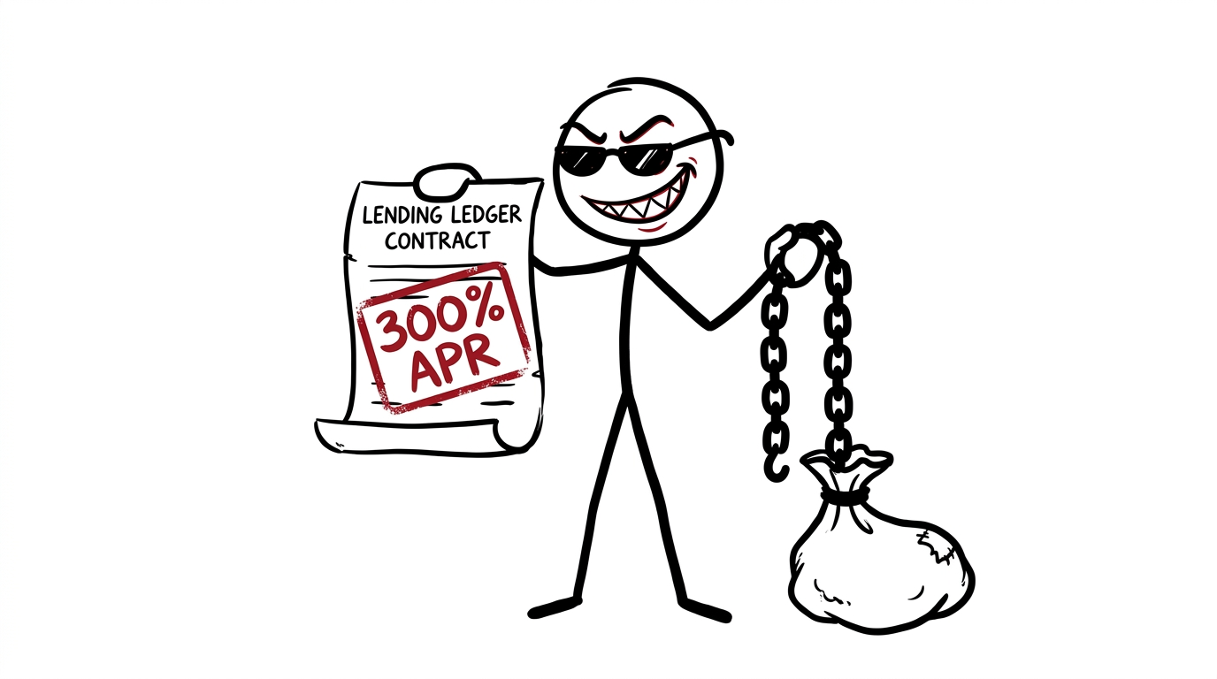
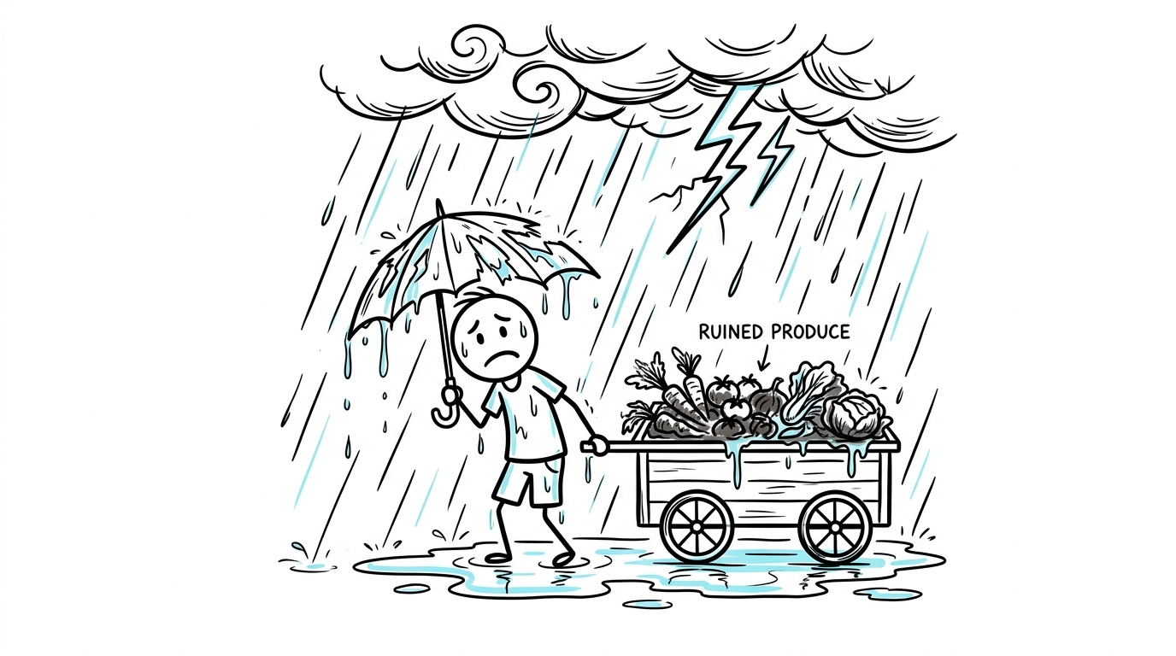
THE REAL-WORLD CRISIS • RAJU'S STORY
The Dawn Capital Deficit & The 300% APR Debt Trap
At 4:30 AM, Raju the fruit vendor needs ₹3,000 for wholesale Mandi inventory. Slow banking forces him into predatory lenders charging over 300% APR, trapping his family in debt.
🌅 4:30 AM Wholesale Mandi
Needs ₹3,000 wholesale inventory capital before dawn. Traditional banks open at 10 AM.
🩸 >300% APR Predatory Debt
Slow banking forces him into lenders ('Meter Vaddi') charging over 300% APR, trapping his family in debt.
⛈️ Zero Weather Relief
Monsoon floods and heatwaves rot perishable inventory. With zero relief from lenders, vendors face default.

Slide 3
STRUCTURAL FAILURE ANALYSIS
Why Traditional Banking & MFIs Fail Street Vendors
Traditional banks fail informal vendors by demanding collateral, tax returns, and rigid monthly EMIs. When heatwaves or floods hit, lenders offer zero relief, triggering default.
Dimension | Commercial Banks | Microfinance (MFIs) | FinFlow (VyaparSetu)
Underwriting Data | ITR, CIBIL, audited balance sheets | Joint liability group peer pressure | Velocity TrustScore (Zero Collateral)
Repayment Rhythm | Rigid monthly EMI | Bi-weekly mandatory meetings | Reverse Micro-Skimming (Daily QR Sales)
Disbursement Speed | 5 to 14 Business Days | 2 to 4 Weeks | Instant (<10s Disbursal at 4:30 AM)
Climate Defense | None (Default penalty applied) | None (Coercive collection agents) | Autonomous Parametric Weather Moratorium & Relief

Slide 4
THE CORE INNOVATION
The Four Pillars of the FinFlow Protocol
FinFlow introduces four pillars: Sunrise Capital for 4:30 AM advances, Reverse Micro-Skimming from daily UPI sales, Suraksha Goolak for emergency savings, and our Parametric Climate Shield for automated weather payouts.
🌅 1. Sunrise Capital [4:30 AM ADVANCES]
Pre-dawn inventory advances (₹1,500-₹5,000) triggered via regional voice in <5s at flat ₹20 fee (0.8% vs 15%+ loan sharks).
⚡ 2. Reverse Micro-Skimming [DAILY UPI SALES]
Algorithmic 8%-10% deduction per retail UPI sale. Advance is 100% repaid by dusk with zero debt rollover.
🏺 3. Suraksha Goolak [EMERGENCY SAVINGS]
Weekend sales surpluses automatically route into an interest-bearing liquid fund, building a family rainy-day reserve.
🛡️ 4. Parametric Climate Shield [WEATHER PAYOUTS]
Radar alerts (>35mm/hr rain or >43°C heat) auto-freeze daily repayments and disburse ₹600 emergency relief.

Slide 5
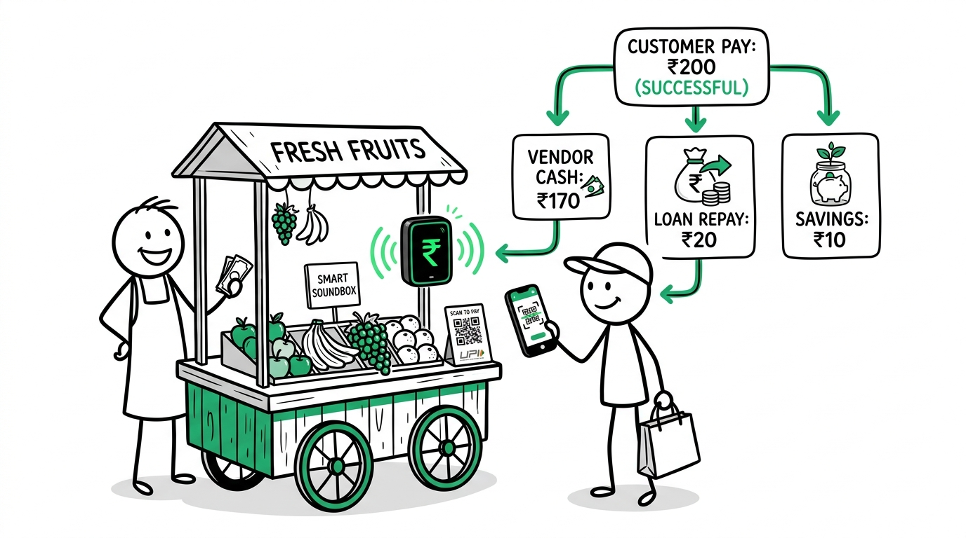
USER EXPERIENCE & DAILY JOURNEY
A Day in the Life: How Raju Vends with FinFlow
Raju's day: at 4:30 AM, his smart soundbox disburses 3,000 rupees in seconds. Customer UPI payments auto-settle the loan in micro-slices, leaving his balance clear by evening.
🌅 4:30 AM • Smart Soundbox Disburses ₹3,000 in Seconds
Soundbox announces: 'Namaste Raju bhai, ₹3,000 Sunrise loan taiyaar hai.' Raju confirms 'Haan'. Disbursed in 5 seconds.
🛒 11:30 AM • Customer UPI Payments Auto-Settle in Micro-Slices
Customer pays ₹200 via UPI QR. Soundbox chirps: '₹200 prapt hue. ₹18 loan chukta, ₹2 Goolak mein jama!'
⛈️ 2:00 PM • Monsoon Downpour: Weather Oracle Auto-Freezes Debt
45mm rain detected by IMD radar. Repayments pause automatically, zero penalty, ₹600 emergency payout credited.
🌙 8:30 PM • Zero-Debt Evening: Balance 100% Clear by Dusk
Advance 100% cleared. ₹114 saved in Goolak. TrustScore +6. Raju goes home with zero debt.

Slide 6
ENGINEERING & SYSTEM ARCHITECTURE
Engineered on India's Digital Public Infrastructure
Built on India's Digital Public Infrastructure, FinFlow integrates OCEN 4.0, real-time UPI settlement webhooks, and our Velocity TrustScore that replaces traditional credit scores.
⚡ Sub-250ms Real-Time Webhook Engine
Instantaneous multi-split routing between vendor spendable wallet, SFB loan vault, and Goolak on NPCI settlement webhooks.
🧠 Velocity TrustScore ML Model (Replaces Credit Scores)
Evaluates 90-day transaction regularity, mandi geo-location stamps, ticket size, and peer rings without CIBIL.
📡 Parametric Weather Oracle
Telemetry integration with Open-Meteo & IMD radar evaluates rainfall (mm/hr) and heat index across 1km² municipal polygons.

Slide 7
BUSINESS MODEL & UNIT ECONOMICS
High-Margin, Asset-Light Business Model
Our business model is high-margin and asset-light. A flat 20-rupee fee per daily cycle delivers an 86.8 percent net margin and a 14.8 times lifetime value to CAC ratio.
₹20
Flat Fee per Daily Cycle (₹3,000 Advance)
86.8%
Net Contribution Margin per Vendor Cycle
14.8x
Lifetime Value (LTV) to CAC Ratio
< 0.8%
Target NPL Default Rate via Micro-Skimming

Slide 8
MARKET OPPORTUNITY & REVENUE SCALE
40M Vendors • $18 Billion Daily Capital Demand
Forty million vendors represent an 18-billion-dollar working capital demand. Scaling to 250,000 merchants across eight trading hubs unlocks 18 million dollars in annual recurring revenue.
40M VENDORS DEMAND
$18 Billion
40 Million informal street vendors in India circulating over $12B daily with zero access to bank capital.
8 TRADING HUBS
8 Hubs
Dense metropolitan trading clusters: Delhi NCR, Mumbai, Bengaluru, Hyderabad, Ahmedabad, Kolkata, Lucknow, Indore.
ANNUAL RECURRING REVENUE
$18M ARR
Scaling to 250,000 active micro-merchants across 8 trading hubs unlocks $18 Million in high-margin ARR.

Slide 9
EXECUTION & GO-TO-MARKET
15-Month Scaled Implementation Roadmap
Our 15-month roadmap pilots with 1,000 vendors in Delhi's Azadpur Mandi, scales with Small Finance Banks, and expands nationally to 100,000 merchants across fifteen states.
Phase 1: Pilot with 1,000 Vendors in Delhi's Azadpur Mandi (M1-3)
Deploy pilot with 1,000 vendors in Azadpur Mandi (Delhi). Validate sub-250ms auto-split and vernacular voice models.
Phase 2: Scale with Small Finance Banks via OCEN 4.0 (M4-8)
Direct OCEN 4.0 integration with 2 Small Finance Banks; partner with micro-insurance underwriters for Parametric Rain Shield.
Phase 3: National Scale to 100,000 Merchants Across 15 States (M9-15)
Scale to 100,000 active vendors across 15 states. Introduce automated micro-pensions and group purchasing discounts.

Slide 10

GRAPHIQUES INNOVATION CHALLENGE • CONCLUSION
Redesigning the World: Dignity for the Hands That Feed Us
FinFlow saves vendors over ₹7,500 every month, restoring economic freedom and dignity to the backbone of our economy. Thank you.
💰 Restoring Economic Freedom
Saves the average street vendor over ₹7,500 every month in avoided loan shark interest—directly raising disposable income by 35%.
🛡️ Climate Resilience & Protection
Autonomous weather safety net ensures heatwaves and floods no longer push micro-entrepreneurs into bankruptcy.
🤝 Dignity for the Backbone of Our Economy
Voice-first vernacular interaction empowers 40M+ non-literate vendors as equal participants in digital finance.

