Slide 1
Predicting Accident Severity

Slide 2
Introduction
There are a lot of accidents which can be avoided by making people aware of certain accident-prone areas. So, to reduce the frequency of vehicle collisions, an algorithm or a model must be developed to predict the severity of an accident given the current weather, road conditions, street lights conditions.
By doing so we can alert the drivers beforehand so as to be more careful and drive accordingly if the model predicts high severity. Hence, reducing the frequency of accidents in the community and saving the lives of people. This model targets all the people in the community.
The people and the government would be most likely interested in a model that predicts the severity of an accident in particular areas. This would help reduce the accidents and save lives.

Slide 3
Data Acquisition and Cleaning
The dataset that we have used has been provided by IBM in their course named Applied Data science. It has 194673 rows and 37 columns. This means that it has 194672 samples and 37 features.
There are a lot of missing and unknown values in the dataset which had to be removed. ‘SPEEDING’ feature was dropped as a whole because it had around 180000 missing values.
I built the model on the features ROADCOND, LIGHTCOND and WEATHER. I believed that these are the conditions on which a large number of road accidents would depend upon and then we could predict the severity of an accident in a particular area and alert the drivers beforehand.
Then the data was made categorical to predict the SEVERITYCODE using machine learning models. All the text values in the features that we have used were replaced by numerical values.

Slide 4
Unbalanced and balanced data
We have used both imbalanced and balanced data for prediction.
This is done so that we can observe the difference between balancing and not balancing.
The imbalanced data has a large samples for ‘SEVERITYCODE=1’.
The balancing of data was done in two ways:
Random under sampling and Random over sampling.

Slide 5
Methodology
Classifiers Used to build models
Decision Tree
Random Forest
Logistic Regression
K Nearest Neighbours
Support Vector Machine

Slide 6
Results
Different Metrics Used:
Confusion matrix
Classification report
Accuracy

Slide 7
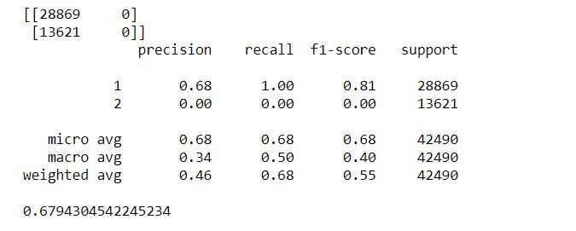
Results
Snapshots of best results in different situations.
Imbalanced data
Decision Tree

Slide 8
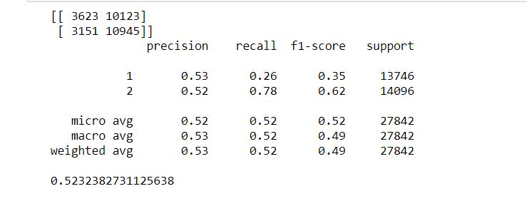
Random Under sampling
Support Vector Machine

Slide 9
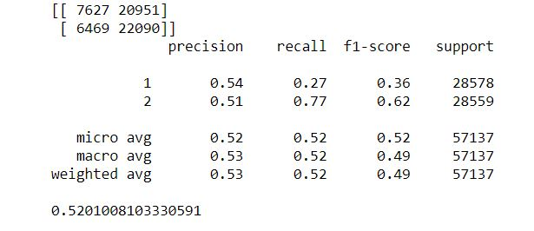
Random Over Sampling
Decision Tree

Slide 10
Conclusion
The accuracy of models was not satisfactory in any of our case. We expected that some insight could be taken out of the data by using the features that we selected but the accuracy of models is required to be high in order to predict something with assurance.
If a dataset is heavily unbalanced, we need to balance it as in the unbalanced data, we saw that the predictions were bound to be partial to one class.

