Slide 1

Script
of
Scripts
Configure Remote Hosts for the Execution of External Tasks
Configuration of a remote workstation and a PBS cluster
http://vatlab.github.io/sos

Slide 2

SoS Task Model
input: “c:\Users\bpeng1\Project\f1.fastq”
output: “c:\Users\bpeng1\Project\f1.bam”
sh: expand=True
process {_input}
Local Host
77e3c2ef7079a236e7404cf6c2f343d3.def
c:\Users\bpeng1\Project\f1.fastq
c:\Users\bpeng1\Project\f1.bam
Translate task
Transfer input files
Remote Host
input: “/scratch/bcb/bpeng1/Project/f1.fastq”
output: “/scratch/bcb/bpeng1/Project/f1.bam”
sh: expand=True
process {_input}
Return Result Files
77e3c2ef7079a236e7404cf6c2f343d3.task
/scratch/bcb/bpeng1/Project/f1.fastq
Submit job
PBS/LSF/…
#PBS –N 77e3c2ef7079a236e7404cf6c2f343d3
#PBS –l nodes=1:ppn=1:mem=10G
#PBS –l walltime=24:00:00
cd /scratch/bcb/bpeng1/Project
sos execute 77e3c2ef7079a236e7404cf6c2f343d3
Execute job
77e3c2ef7079a236e7404cf6c2f343d3.sh
/scratch/bcb/bpeng1/Project/f1.bam

Slide 3
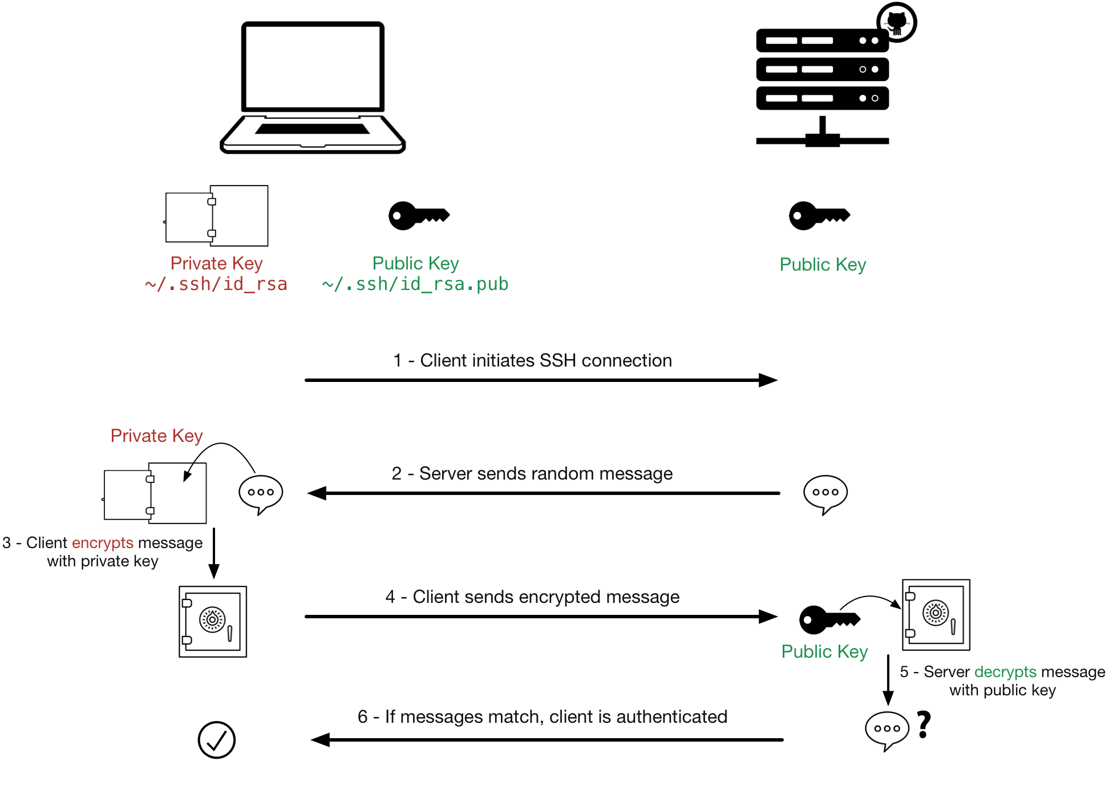


One-time Host Configuration
Set up public key authentication between local and remote host
Install SoS on both local and remote hosts
Make sure you have ssh, scp, and rsync installed. For windows, install msys2 (recommended) or enable Ubuntu Linux Shell (windows 10, developer mode)
Set up $PATH to make sure sos (and other commands you would like to execute on remote hosts) could be executed remotely with commands like
% ssh remote-host “bash --login –c ‘sos status’”

Slide 4
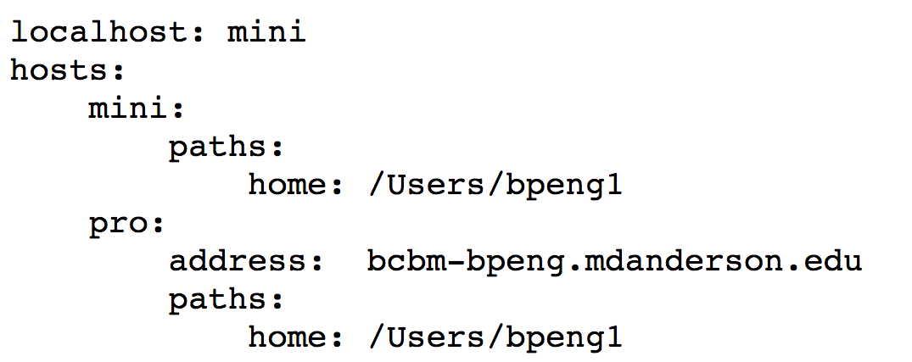
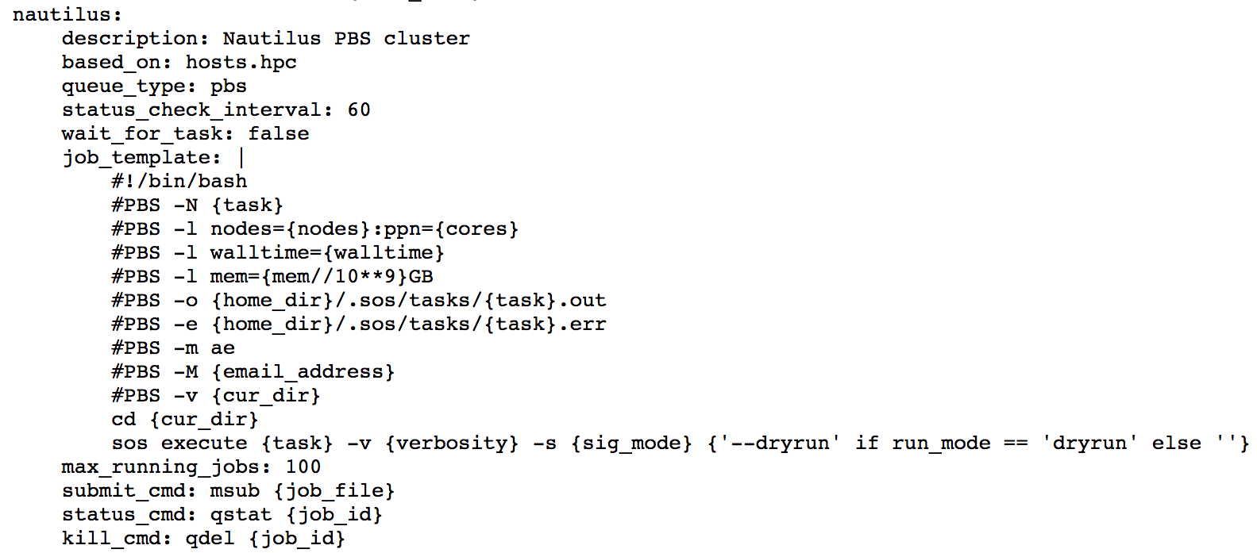
One-time Host Configuration
Define all hosts in ~/.sos/hosts.yml:
Define local host for each host:
% sos config --global --set localhost mini

