Slide 2
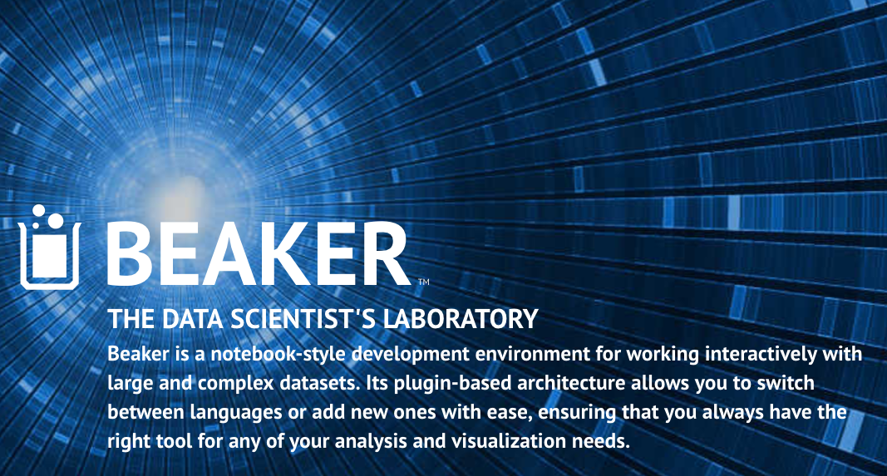
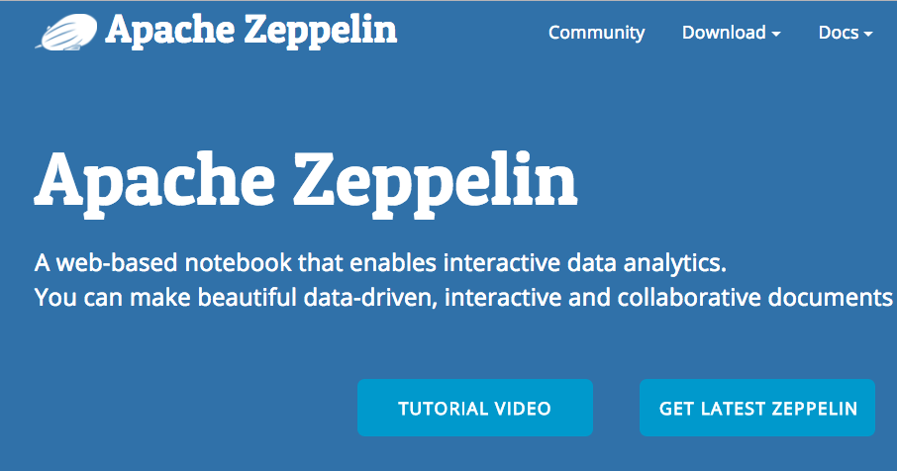

snakemake
Notebooks are limited if they can not crunch big data
Workflows are counter-productive if they require you to use another environment even language

