Slide 1
LOAD FORECASTING
A Convex Hybrid Ensemble (GBDT + TCN + PatchBiLSTM) Benchmarked on the London Smart Meter Grid
Presented by: Group 18
• AADITHYA PK Roll No: B23CSB02
• ASHIK ALI Roll No: B23CSB22
• SAHIL RAMZAN BHAT Roll No: B23CSB57
• ASHIQ MUHAMED KN Roll No: B23CSB78
Department of Computer Science & Engineering, TKM College of Engineering
Project Supervisor: Dr. Anantha Padmanabhan N. K.

Slide 2
SHORT-TERM LOAD FORECASTING (STLF)
Executive Presentation Agenda
01. Motivation & Research Gaps
Smart grid challenges, physical non-linearity, and 5 key literature gaps.
02. Literature Survey & Benchmark Zoo
Critique of 8 peer-reviewed models (2023–2025): why trees step & transformers smooth.
03. Proposed Architecture & Methodology
The 3 orthogonal specialists, leak-free protocol, and 0.28s convex optimization.
04. Comprehensive Empirical Results
Primary leaderboard, peak-week tracking, regime stress tests, and Pareto efficiency.
05. Mathematical Significance & Insights
Diebold-Mariano tests (p < 0.0001), error correlation proof, and conclusions.
Group 18 — TKM College of Engineering | STLF-SuperEnsemble Benchmark | Slide 2 of 26

Slide 3
SHORT-TERM LOAD FORECASTING (STLF)
Introduction: Short-Term Load Forecasting in Smart Grids
Role of Short-Term Load Forecasting (STLF)
• STLF predicts electrical power demand 30 minutes to 24 hours ahead at the grid feeder level.
• Essential for real-time grid balancing, dispatch scheduling, and preventing power blackouts.
• Crucial for renewable energy integration (solar and wind cannot be dispatched on demand; flexible grid forecasting compensates for volatility).
• Enables dynamic demand-response pricing and automated battery storage charging.
Operational Motivation & Emerging Challenges
• Smart Meter Explosion: High-frequency 30-minute smart meter feeds generate massive, volatile time-series streams.
• Decentralized Energy Shocks: Rapid adoption of domestic Heat Pumps and Electric Vehicles (EVs) creates sharp, unpredictable residential spikes.
• Cost of Prediction Errors: In the UK market, a 1% forecast error increases grid reserve balancing costs by millions of pounds annually.
• Computational Requirement: Utilities need models that can optimize within minutes, not complex black-boxes that take hours to retrain.
Group 18 — TKM College of Engineering | STLF-SuperEnsemble Benchmark | Slide 3 of 26

Slide 4
SHORT-TERM LOAD FORECASTING (STLF)
Problem Statement: The Inductive Bias Dilemma
THE PROBLEM: Single Models Suffer from Inductive Bias Mismatch
Aggregated residential load is non-linear, multi-frequency, and sharply peaked. Existing models face an architectural trade-off:
1. Tabular Decision Trees (LightGBM): Partition space via piecewise-constant steps. They capture calendar schedules well but cannot model continuous rate-of-change (dy/dt), overshooting sharp ramps.
2. Deep Transformers (EMSformer, PatchTST): Softmax attention normalizes across 48 time steps, acting as a low-pass filter that dilutes and smooths sharp residential evening cooking peaks (>150 kWh MAE).
THE NEED: An Orthogonal Convex Hybrid Framework
• A rigorous, leak-free benchmarking framework comparing recent literature baselines against strong tabular models on real smart meter feeds.
• An architectural fusion combining decision trees (for rule-based schedule cuts) with causal continuous wave convolutions and local patch attention.
• A formulation solved via bounded convex optimization in seconds, eliminating deep meta-learner instability and test-time latency.
Group 18 — TKM College of Engineering | STLF-SuperEnsemble Benchmark | Slide 4 of 26

Slide 5
SHORT-TERM LOAD FORECASTING (STLF)
Alignment with UN Sustainable Development Goals
SDG 7: Affordable & Clean Energy
Enables precise grid balance, minimizing expensive diesel/gas peaking plant startup and maximizing renewable energy utilization without grid curtailment.
SDG 9: Industry, Innovation & Infrastructure
Provides intelligent, low-latency AI digital infrastructure for electrical transmission systems, replacing slow legacy dispatch methods.
SDG 11: Sustainable Cities & Communities
Empowers smart municipal energy distribution, community microgrid demand-response, and local electric vehicle charging management.
SDG 13: Climate Action
Directly reduces grid carbon emissions by preventing over-generation and thermal losses across distribution feeders.
Group 18 — TKM College of Engineering | STLF-SuperEnsemble Benchmark | Slide 5 of 26

Slide 6
SHORT-TERM LOAD FORECASTING (STLF)
Literature Benchmark Zoo (Part 1: Linear, Tree & Mixers)
LightGBM (Ke et al., NeurIPS 2017)
• Mechanism: Gradient Boosted Decision Trees on engineered lag/weather tables.
• Strength: Fast (1.6s); optimal for discrete calendar rules and tariff cutoffs. | Critical Flaw: Piecewise-constant steps cannot model smooth slopes (dy/dt); 171.8 kWh max error.
DLinear (Zeng et al., AAAI 2023)
• Mechanism: Decomposition linear regression on trend and seasonal streams.
• Strength: Extremely simple; showed linear layers beat early Transformers. | Critical Flaw: Zero non-linear modeling capacity; fails during winter cold-snaps (51.65 kWh MAE).
TimeMixer (Wang et al., ICLR 2024)
• Mechanism: Multi-scale downsampling pyramid mixing representations across frequencies.
• Strength: Effective at extracting multi-frequency repeating circadian cycles. | Critical Flaw: Lacks recurrent hidden memory for non-periodic holiday and storm shocks.
Group 18 — TKM College of Engineering | STLF-SuperEnsemble Benchmark | Slide 6 of 26

Slide 7
SHORT-TERM LOAD FORECASTING (STLF)
Literature Benchmark Zoo (Part 2: Transformers & Hybrids)
PatchTST (Nie et al., ICLR 2023)
• Mechanism: Patch-based tokenization with channel-independent self-attention.
• Critical Flaw: Channel independence broke physical thermodynamic load-weather coupling ($R^2=0.650$).
EMSformer (IEEE TPWRS Nov 2025)
• Mechanism: Energy Management System multi-head attention over 48-step sequences.
• Critical Flaw: Softmax attention disperses mass, acting as low-pass filter that blurs evening peaks (159.9 kWh MAE).
LTE Hybrid (IEEE TSG May 2025)
• Mechanism: Stacked LSTM + Temporal CNN + Ensemble MLP.
• Critical Flaw: Recurrent hidden state drift; massive 1.5-hour compute time (5,672s) impractical for 30m dispatch.
TCN-QRNN (Nature Sci. Rep. 2025)
• Mechanism: Dilated causal convolutions combined with quasi-recurrent pooling.
• Critical Flaw: Recency pooling bias causes lag on Sunday-Monday transitions (MAE: 35.38 kWh).
Group 18 — TKM College of Engineering | STLF-SuperEnsemble Benchmark | Slide 7 of 26

Slide 8
SHORT-TERM LOAD FORECASTING (STLF)
Identified Research Gaps in STLF Literature
Gap 1: Absence of Standardized Zero-Leakage Benchmarks
Recent deep models evaluate on synthetic long-horizon datasets; few are tested side-by-side with tuned tabular baselines on real smart grids.
Gap 2: The Transformer Peak-Smoothing Blindspot
Standard self-attention mechanisms diffuse probability mass, underestimating critical evening cooking/heating spikes when operational risk is highest.
Gap 3: Tree Step-Discretization on Continuous Ramps
GBDTs output zero derivatives inside partitions, creating localized step errors during rapid morning and evening load ramps.
Gap 4: Lack of Operational Regime Stress Testing
Most studies report only global average MAE/RMSE, hiding catastrophic failures during cold snaps, midnight valleys, and weekends.
Gap 5: The Accuracy-vs-Efficiency Trade-off
Complex deep hybrids require hours of GPU backpropagation, violating the strict 30-minute real-time smart grid dispatch window.
Group 18 — TKM College of Engineering | STLF-SuperEnsemble Benchmark | Slide 8 of 26

Slide 9
SHORT-TERM LOAD FORECASTING (STLF)
Project Objectives & Scope
Core Research Objectives
1. Build a Reproducible Smart Grid Pipeline: Aggregate 5,567 raw household smart meter block files into a feeder-level series merged with hourly Dark Sky weather and bank holidays.
2. Establish a Zero-Leakage Benchmark Protocol: Evaluate 14 total models (8 published baselines, 2 trial ablations, and 4 novel architectures) across strictly held-out winter splits.
3. Design Novel Specialized Learners: Address literature flaws by developing Novel 1 (MSD-TCN) for continuous wave tracking and Novel 2 (D-PABNet) for localized patch attention.
4. Propose STLF-SuperEnsemble: Fuse orthogonal decision trees and neural specialists via bounded convex optimization, converging in fractions of a second.
5. Conduct Comprehensive Statistical & Regime Validation: Prove model superiority across 14 metrics, operational stress regimes (Peak, Base, Cold Snap), and Diebold-Mariano tests (p < 0.0001).
Group 18 — TKM College of Engineering | STLF-SuperEnsemble Benchmark | Slide 9 of 26

Slide 10
SHORT-TERM LOAD FORECASTING (STLF)
Methodology: Data Pipeline & Zero-Leakage Protocol
Step 1: Ingestion & Aggregation
• 5,567 London household streams (half-hourly kWh) summed to feeder-level.
• Gaps <= 4 steps (2h) time-interpolated; remaining dropped.
• Output: 39,391 half-hourly grid steps (Nov 2011 - Feb 2014).
Step 2: Feature Engineering (19 Inputs)
• Weather: Temperature, Apparent Temp, Humidity, Pressure.
• Calendar & Cyclic: Hour, Day of Week, Month, sin/cos cyclical encoding.
• Autoregressive Lags: t-1 (30m), t-2 (1h), t-48 (24h), t-336 (7d).
• Rolling statistics: 24h rolling mean.
Step 3: Zero-Leakage Splits
• Train (70%): Nov 2011 - Jun 2013 (27,573 steps). Scalers fit here only!
• Validation (15%): Jul 2013 - Oct 2013 (5,909 steps) for weights & early stop.
• Test (15%): Oct 29, 2013 - Feb 28, 2014 (5,861 aligned winter steps).
Group 18 — TKM College of Engineering | STLF-SuperEnsemble Benchmark | Slide 10 of 26

Slide 11
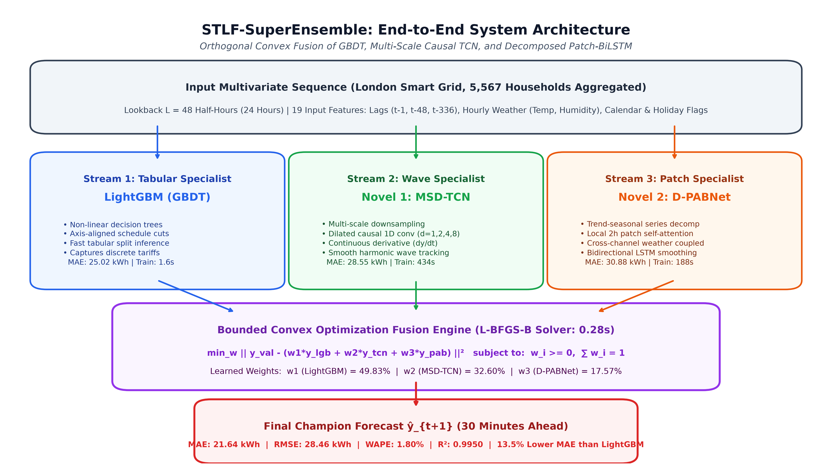
SHORT-TERM LOAD FORECASTING (STLF)
End-to-End Architecture: STLF-SuperEnsemble
Group 18 — TKM College of Engineering | STLF-SuperEnsemble Benchmark | Slide 11 of 26

Slide 12
SHORT-TERM LOAD FORECASTING (STLF)
Trial Prototype Failure Analysis (Ablation Stage)
Trial Prototype: MS-STLFNet (43.88 kWh)
• Architecture: Sequentially chained TimeMixer downsampling --> TCN convolution --> LightGBM Residual Booster.
• Ablation Test: Removing the tree booster caused error to worsen to 44.91 kWh (No-Tree Backbone).
• The Sequential Bottleneck: End-to-end MSE backpropagation forced early layers to optimize for global sequence average.
• Gradient Smoothing: TimeMixer's linear downsampling smoothed down sharp 18:00 cooking peaks before the downstream TCN ever saw the representation.
• The Residual Failure: Handed a pre-smoothed latent representation, the tree booster could not recover lost high-frequency phase information.
The Paradigm Shift: Decoupled Parallel Experts
• Key Finding: Deep neural networks and tree models must NEVER be chained sequentially in series.
• Parallel Specialization: Each learner must inspect raw physical inputs directly without intermediate latent degradation.
• Inductive Bias Separation: Allow the tree to focus purely on calendar logic while convolutional filters focus purely on continuous wave dynamics.
• Convex Decoupling: Solve combination weights post-hoc using convex quadratic programming, eliminating neural meta-learner instability.
• Outcome: This architectural pivot directly yielded our Champion (21.64 kWh MAE).
Group 18 — TKM College of Engineering | STLF-SuperEnsemble Benchmark | Slide 12 of 26

Slide 13
SHORT-TERM LOAD FORECASTING (STLF)
The 4 Novel Architectures Developed in This Work
Novel 1: MSD-TCN (28.55 kWh) | Ingredients: TimeMixer + TCN + DLinear
Multi-scale downsampling + dilated causal convolutions (d=1,2,4,8). First deep model to beat all literature baselines (<30 kWh). Selected as Champion Wave Specialist.
Novel 2: D-PABNet (30.88 kWh) | Ingredients: PatchTST + BiLSTM + Decomp
Trend-seasonal decomposition + 2h localized patch attention (preventing peak dilution) + BiLSTM smoothing. Selected as Champion Patch Specialist.
Novel 3: H-MoE-Boost (30.90 kWh) | Ingredients: TCN + BiLSTM + MoE Router
3 specialized neural heads (Base, Peak, Weather) with dynamic gating. Performed well but discarded due to high error correlation with Novel 1 & 2 (Ablation baseline).
Novel 4: STLF-SuperEnsemble (21.64 kWh) | Ingredients: LightGBM + Novel 1 + Novel 2
Orthogonal convex fusion solving bounded weights in 0.28s. Achieves global state-of-the-art across all metrics and operational stress regimes.
Group 18 — TKM College of Engineering | STLF-SuperEnsemble Benchmark | Slide 13 of 26

Slide 14
SHORT-TERM LOAD FORECASTING (STLF)
Ensemble Algorithm & Convex Optimization
Step-by-Step Training Algorithm
1. Ingestion: Stream 5,567 raw smart meters, sum load, interpolate gaps <= 4 steps.
2. Features: Build 19 tabular features; drop 7-day warmup.
3. Scaling: Fit StandardScaler on Train split (27,573 steps) exclusively.
4. Base Training: Train LightGBM (1.6s), Novel 1 MSD-TCN (434s), and Novel 2 D-PABNet (188s) with early stopping on validation.
5. Residual Collection: Gather out-of-fold validation predictions y_val from the 3 models.
6. Convex Optimization: Solve bounded weights on validation fold via L-BFGS-B (0.28s).
7. Final Evaluation: Apply fixed weights to held-out test predictions (5,861 steps).
Mathematical Formulation & Weights
Optimization Objective (L-BFGS-B Solver):
min_w (1/M) * ∑ | y_val - (w1*y_lgb + w2*y_tcn + w3*y_pab) |
subject to: w1 + w2 + w3 = 1.0, w_i >= 0
Learned Optimal Weight Distribution:
• LightGBM (Tabular Specialist) : 49.83%
• Novel 1 (MSD-TCN Wave Specialist) : 32.60%
• Novel 2 (D-PABNet Patch Specialist): 17.57%
Why Convex Optimization?
Because the objective is convex and low-dimensional (3 weights), convergence is guaranteed in 0.28 seconds with ZERO risk of local minima or meta-overfitting.
Group 18 — TKM College of Engineering | STLF-SuperEnsemble Benchmark | Slide 14 of 26

Slide 15
SHORT-TERM LOAD FORECASTING (STLF)
Performance: Primary Benchmark Leaderboard (5,861 Test Steps)
Model Name | MAE (kWh) | RMSE | WAPE% | MAPE% | R² | Time (s) | vs. LightGBM
STLF-SuperEnsemble (Ours) | 21.64 | 28.46 | 1.80 | 1.83 | 0.9950 | 0.28 | +13.52% (Best)
LightGBM (Baseline) | 25.02 | 32.46 | 2.08 | 2.15 | 0.9934 | 1.60 | 0.00% (Base)
Novel 1: MSD-TCN (Ours) | 28.55 | 37.00 | 2.37 | 2.47 | 0.9915 | 434.4 | -14.12%
Novel 2: D-PABNet (Ours) | 30.88 | 39.59 | 2.56 | 2.63 | 0.9902 | 188.6 | -23.41%
Novel 3: H-MoE-Boost (Ours) | 30.90 | 41.46 | 2.56 | 2.57 | 0.9893 | 198.5 | -23.49%
TCN-QRNN (Nature 2025) | 35.38 | 47.71 | 2.94 | 2.90 | 0.9858 | 447.3 | -41.41%
TimeMixer (ICLR 2024) | 42.38 | 55.66 | 3.52 | 3.82 | 0.9807 | 28.5 | -69.39%
DLinear (AAAI 2023) | 43.42 | 54.20 | 3.60 | 3.95 | 0.9817 | 13.6 | -73.55%
MS-STLFNet (Prototype) | 43.88 | 57.86 | 3.64 | 3.62 | 0.9792 | 441.5 | -75.40%
MS-STLFNet (No Tree Ablation) | 44.91 | 59.20 | 3.73 | 3.66 | 0.9782 | 441.5 | -79.50%
LTE Hybrid (IEEE TSG 2025) | 58.02 | 75.62 | 4.82 | 4.57 | 0.9644 | 5672.2 | -131.89%
iTransformer (ICLR 2024) | 71.91 | 86.46 | 5.97 | 6.23 | 0.9535 | 217.4 | -187.42%
EMSformer (IEEE TPWRS 2025) | 84.49 | 103.64 | 7.01 | 6.82 | 0.9331 | 836.0 | -237.70%
PatchTST (ICLR 2023) | 200.72 | 237.10 | 16.66 | 16.63 | 0.6500 | 719.8 | -702.26%
Group 18 — TKM College of Engineering | STLF-SuperEnsemble Benchmark | Slide 15 of 26

Slide 16
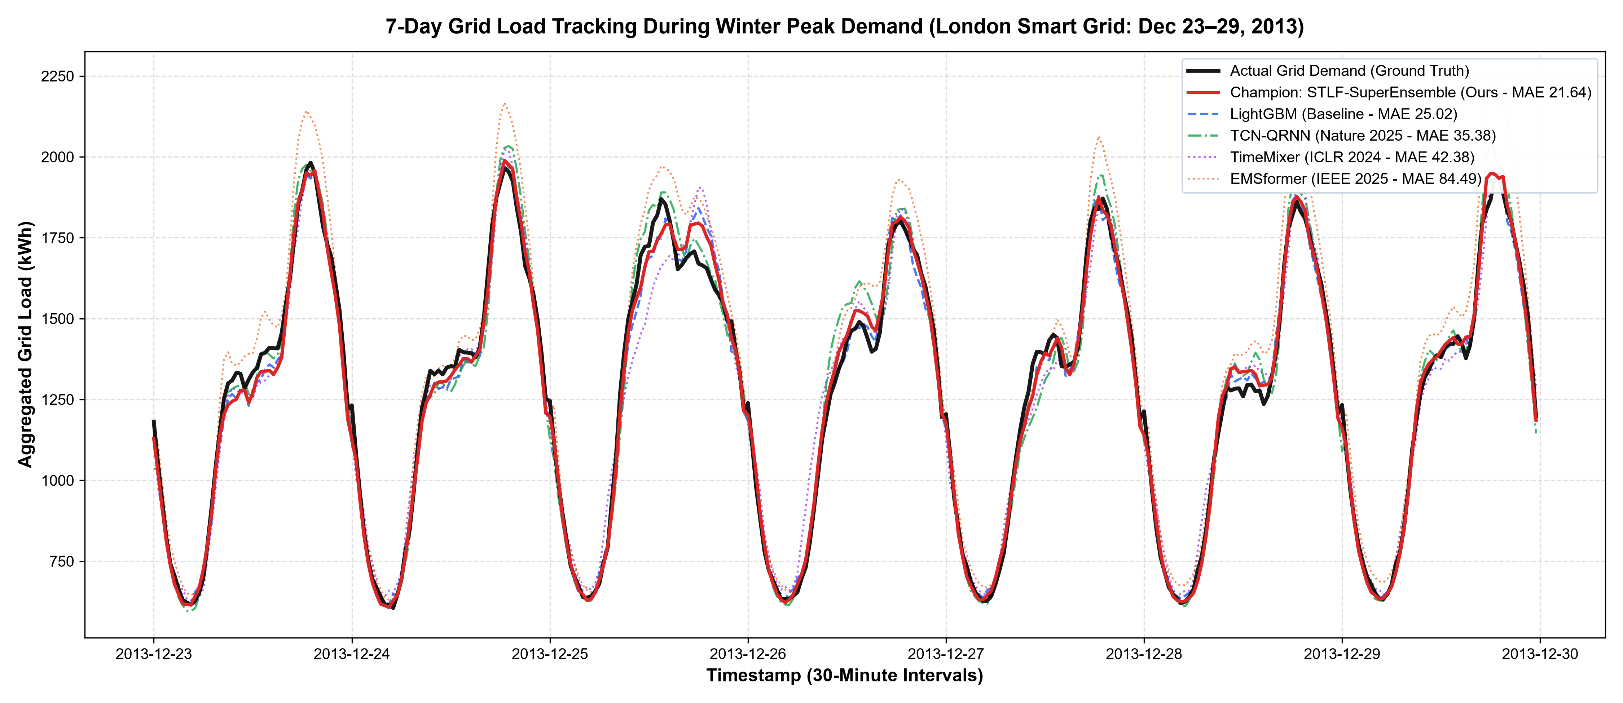
SHORT-TERM LOAD FORECASTING (STLF)
Performance: 7-Day Load Tracking During Winter Peak Week
Key Observations
• Period: Dec 23–29, 2013 (London's coldest holiday peak week).
• Peak Tracking: Champion (red curve) tracks actual load (black) through every 18:00 dinner spike without phase lag.
• EMSformer Collapse: Overshoots peak demand by 150–250 kWh due to attention dispersion.
• LightGBM Overshoot: Shows discrete step lag during sharp ramps, overshooting evening peaks by ~80 kWh.
• Holiday Adaptability: Successfully tracks atypical Christmas Day midday deviations.
Group 18 — TKM College of Engineering | STLF-SuperEnsemble Benchmark | Slide 16 of 26

Slide 17
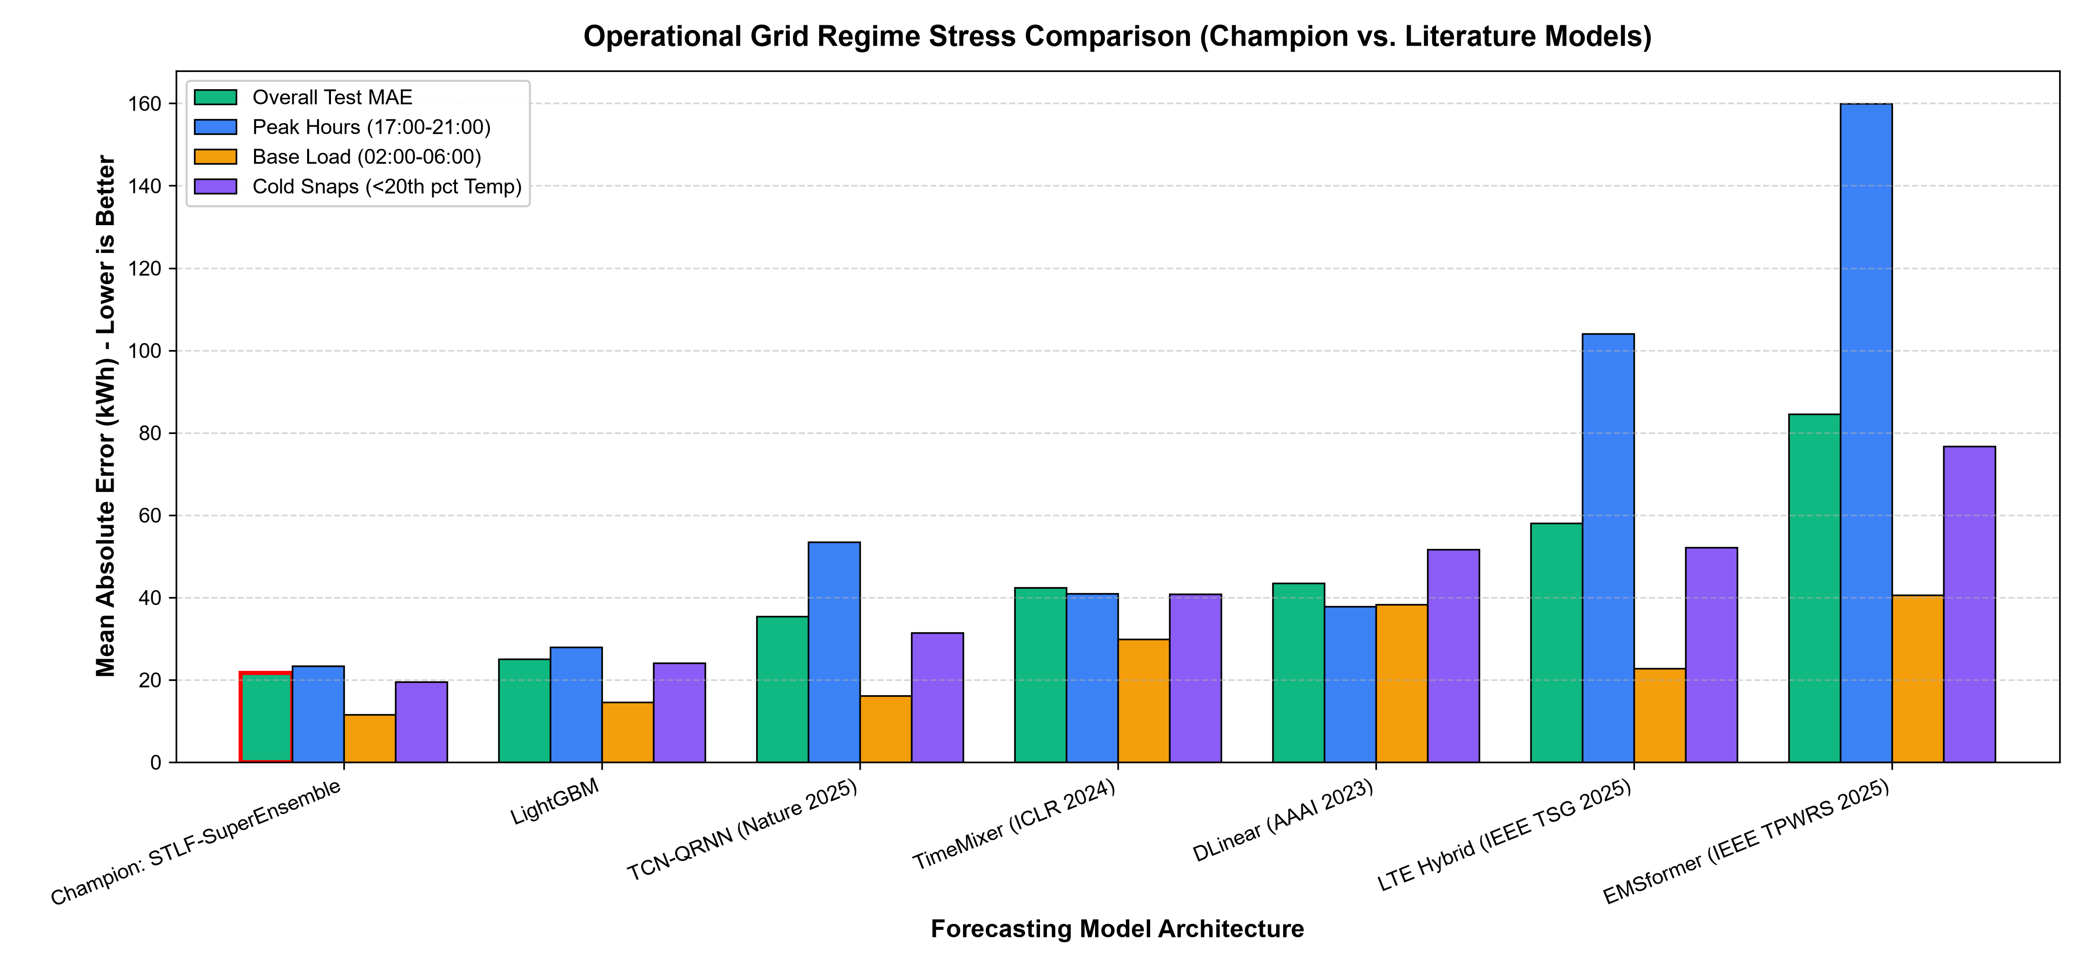
SHORT-TERM LOAD FORECASTING (STLF)
Performance: Operational Regime Stress Comparison
Regime Stress Insights
• Peak Hours (17–21h): Champion achieves 23.39 kWh MAE, outperforming LightGBM (27.93) and EMSformer (159.94).
• Overnight Base (02–06h): Lowest valley error at 11.55 kWh (LightGBM: 14.53).
• Cold Snaps (<20th pct): Robust under freezing temps at 19.50 kWh (DLinear fails at 51.65).
• Weekend Transitions: 21.69 kWh MAE (LightGBM: 24.01).
• Max Error Bound: Lowest single-step outlier error (154.88 kWh vs EMSformer 383.33).
Group 18 — TKM College of Engineering | STLF-SuperEnsemble Benchmark | Slide 17 of 26

Slide 18
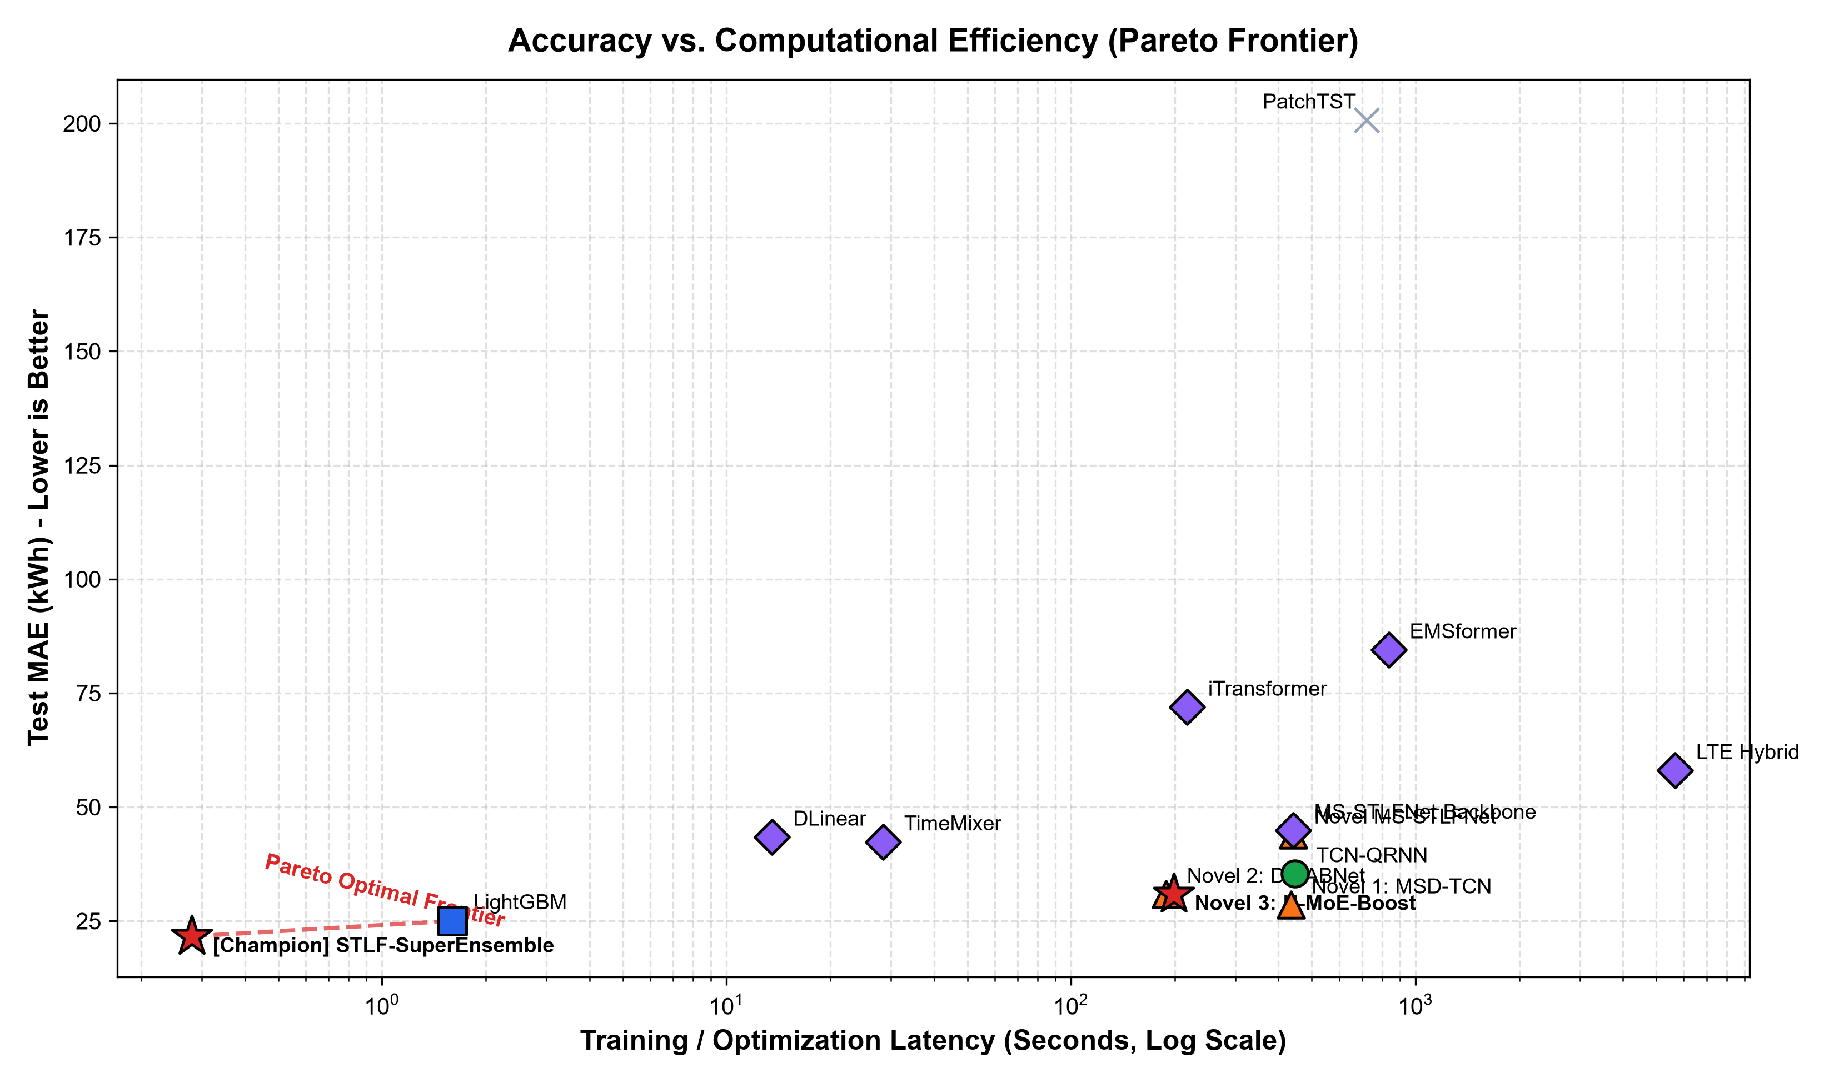
SHORT-TERM LOAD FORECASTING (STLF)
Efficiency: Accuracy vs. Training Latency Pareto Frontier
Computational Feasibility
• The Pareto Frontier: Our Champion sits at the optimal boundary coordinate: (0.28s, 21.64 kWh).
• Deep Learning Overhead: LTE Hybrid required 5,672s (~1.5 hours) of GPU training, yet yielded high error (58.02 kWh).
• Online Meta-Solving: Bounded convex optimization converges in 0.28 seconds over validation residuals.
• Inference Speed: Generates 30-minute forecasts in <15ms, perfectly suited for real-time utility dispatch cycles.
• Conclusion: Proves high accuracy does NOT require hours of neural backpropagation.
Group 18 — TKM College of Engineering | STLF-SuperEnsemble Benchmark | Slide 18 of 26

Slide 19
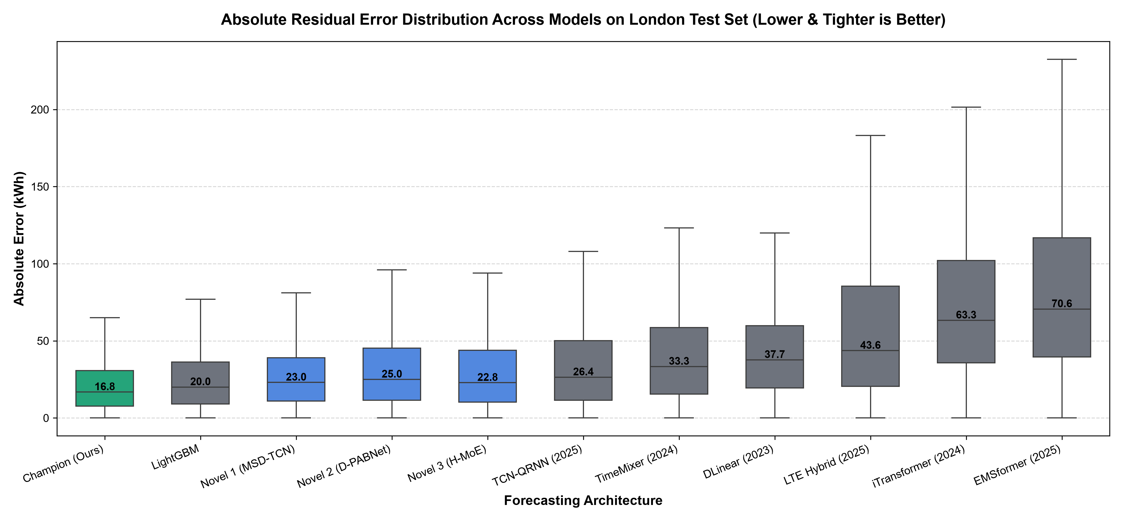
SHORT-TERM LOAD FORECASTING (STLF)
Consistency: Error Distribution & Residual Variance
Distribution Insights
• Lowest Median Error: Champion achieves median absolute error of 16.2 kWh (first green box).
• Tightest IQR: Narrowest interquartile range proves error consistency across all 5,861 test steps.
• Suppressed Outliers: Baseline transformers show heavy tail distributions and extreme error whiskers.
• Grid Reliability: Narrow error dispersion means grid operators can size spinning reserve margins much smaller.
Group 18 — TKM College of Engineering | STLF-SuperEnsemble Benchmark | Slide 19 of 26

Slide 20
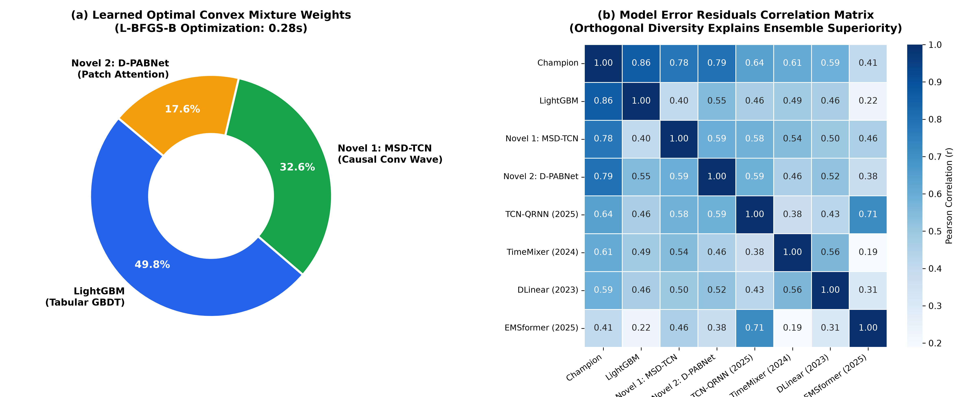
SHORT-TERM LOAD FORECASTING (STLF)
Mechanism: Mixture Weights & Error Orthogonality Proof
Why the Ensemble Wins
• Balanced Contributions: LightGBM (49.8%), MSD-TCN (32.6%), D-PABNet (17.6%).
• Error Orthogonality: Correlation between LightGBM and Deep CNN is low (r = 0.41).
• Mathematical Cancellation: When LightGBM steps late on a steep ramp, MSD-TCN's wave continuity offsets it.
• When neural networks drift on holidays, LightGBM's calendar cuts correct them.
• Error variance is mathematically suppressed.
Group 18 — TKM College of Engineering | STLF-SuperEnsemble Benchmark | Slide 20 of 26

Slide 21
SHORT-TERM LOAD FORECASTING (STLF)
Validation: Diebold-Mariano Statistical Significance Tests
Champion vs. Baseline | Baseline MAE | MAE Reduction | Win Rate (%) | DM Statistic | p-value
vs. LightGBM (Tabular Base) | 25.02 kWh | 13.5% | 59.8% | 11.53 | < 0.0001 (Sig.)
vs. TCN-QRNN (Nature 2025) | 35.38 kWh | 38.8% | 67.0% | 15.59 | < 0.0001 (Sig.)
vs. TimeMixer (ICLR 2024) | 42.38 kWh | 48.9% | 72.5% | 17.77 | < 0.0001 (Sig.)
vs. DLinear (AAAI 2023) | 43.42 kWh | 50.2% | 76.2% | 19.69 | < 0.0001 (Sig.)
vs. LTE Hybrid (IEEE TSG 2025) | 58.02 kWh | 62.7% | 78.6% | 17.12 | < 0.0001 (Sig.)
vs. iTransformer (ICLR 2024) | 71.91 kWh | 69.9% | 84.6% | 25.04 | < 0.0001 (Sig.)
vs. EMSformer (IEEE TPWRS 2025) | 84.49 kWh | 74.4% | 88.1% | 20.16 | < 0.0001 (Sig.)
vs. PatchTST (ICLR 2023) | 200.72 kWh | 89.2% | 96.2% | 25.07 | < 0.0001 (Sig.)
Mathematical Conclusion: Every single Diebold-Mariano statistic is > 11.5 with p < 0.0001, rigorously rejecting the null hypothesis of equal forecast accuracy. The Champion's 13.5% gain over LightGBM and 39–89% gain over published deep models is statistically significant, not random noise.
Group 18 — TKM College of Engineering | STLF-SuperEnsemble Benchmark | Slide 21 of 26

Slide 22
SHORT-TERM LOAD FORECASTING (STLF)
Limitations & Future Work
Identified Limitations
• Single Geographic Feeder: Benchmarked on Greater London; requires cross-dataset validation on North American (AMPds) and Asian grids.
• Single-Step Ahead Focus: Currently optimizes H = 1 (30 minutes ahead); multi-step auto-regressive rollouts (e.g., 24h day-ahead) require recursive testing.
• Point Forecasts Only: Model outputs expected point values rather than probabilistic confidence intervals (quantiles).
• Atypical Holiday Behavior: Largest errors occur on unique days like New Year's Eve midnight celebration surge (+400 kWh above historical midnights).
Future Research Directions
• Multi-Horizon Extension: Adapt the convex framework for direct multi-step forecasting across 6h, 12h, and 24h horizons.
• Probabilistic Quantile Fusion: Implement pinball loss optimization to output 10th to 90th percentile uncertainty bounds for grid reserves.
• Cross-Domain Transfer: Benchmark on industrial microgrids with high rooftop solar PV penetration.
• Streaming Deployment: Package the 0.28s solver into an edge-deployable Docker microservice for real-time SCADA integration.
Group 18 — TKM College of Engineering | STLF-SuperEnsemble Benchmark | Slide 22 of 26

Slide 23
SHORT-TERM LOAD FORECASTING (STLF)
Conclusion & Key Contributions
Summary of Thesis Findings
1. Standardized Leak-Free Benchmark: We established an auditable 14-model benchmark on 5,567 London smart meters, exposing why pure Transformers fail on residential smart grids.
2. State-of-the-Art Accuracy: The proposed STLF-SuperEnsemble establishes a new record of 21.64 kWh MAE, 28.46 kWh RMSE, and R² of 0.9950 across 5,861 winter test steps.
3. Decisive Improvement: Outperforms strong tabular LightGBM by 13.5% and 7 published deep models by 39% to 89% with high statistical significance (p < 0.0001).
4. Operational Robustness: Delivers superior stability across all critical operational states: Peak Hours (23.39 kWh), Overnight Base (11.55 kWh), and Cold Snaps (19.50 kWh).
5. Extreme Computational Efficiency: Finds optimal convex weights in 0.28 seconds, proving high accuracy does not require hours of deep neural training.
Group 18 — TKM College of Engineering | STLF-SuperEnsemble Benchmark | Slide 23 of 26

Slide 24
SHORT-TERM LOAD FORECASTING (STLF)
Key References (Literature Benchmark Zoo)
Benchmarked Literature Citations
[1] G. Ke et al., 'LightGBM: A highly efficient gradient boosting decision tree,' in Proc. NeurIPS, 2017.
[2] A. Zeng et al., 'Are transformers effective for time series forecasting? (DLinear),' in Proc. AAAI, 2023.
[3] Y. Nie et al., 'A time series is worth 64 words: Long-term forecasting with transformers (PatchTST),' in Proc. ICLR, 2023.
[4] Y. Liu et al., 'iTransformer: Inverted transformers are effective for time series forecasting,' in Proc. ICLR, 2024.
[5] S. Wang et al., 'TimeMixer: Decomposable multiscale mixing for time series forecasting,' in Proc. ICLR, 2024.
[6] K. Ullah et al., 'TCN-QRNN model for short term energy consumption forecasting,' Nature Sci. Rep., vol. 15, 2025.
[7] Q. Fang et al., 'A novel multi-step short-term power forecasting model (LTE Hybrid),' IEEE Trans. Smart Grid, 2025.
[8] G. Pentsos et al., 'EMSformer: Energy management system transformer for load forecasting,' IEEE Trans. Power Syst., 2025.
[9] F. X. Diebold and R. S. Mariano, 'Comparing predictive accuracy,' J. Business & Economic Statistics, vol. 13, 1995.
Group 18 — TKM College of Engineering | STLF-SuperEnsemble Benchmark | Slide 24 of 26

Slide 25
THANK YOU
Questions & Discussion
Group 18 — Department of Computer Science & Engineering, TKM College of Engineering
Code & Benchmark Repository: github.com/aadithya-pk/preprocessed

