Slide 1
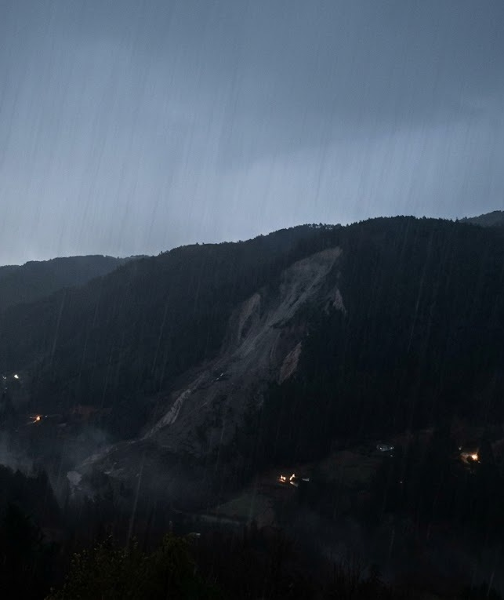
Survivors have hours.
01 PROBLEM & IMPACT
A hillside let go in the dark. The Army needed 31 hours to get in.
1.23 M
Chance a trapped person is still alive
REPORTED · 1990 PHILIPPINES EARTHQUAKE
lives lost to disasters, 2000–2019
355
lives lost in Kerala’s rain disasters, 2024
02:17 · 30 JULY 2024
WAYANAD, KERALA
Reported figures.
Buildings can be rebuilt. People can’t.
Notes:
SLIDE 1 [0:00–0:40 · 89 words] · RUBRIC: Problem Understanding & Impact (15)
SAY:
"At 2:17 on the night of 30 July 2024, a hillside in Wayanad, Kerala, let go in the dark. The only bridge was gone. The Army built a way in — in 31 hours. And survivors have hours: reported survival of trapped people falls from 88 percent on day one to 9 percent by day three. Disasters took 1.23 million lives in twenty years — one every eight minutes. In 2024, rain-driven disasters took 355 lives right here in Kerala. We can’t save the houses. Buildings can be rebuilt. People can’t."
FACTS / SOURCES
- 02:17 IST: UN OCHA situation report on the Wayanad landslides (some news reports say about 1 AM). The Army built a way in — in 31 hours (2024 Wayanad landslides; ReliefWeb).
- 88 / 35 / 9 percent: literature summaries of the 1990 Luzon earthquake. We have NOT traced the original paper, so the slide says "reported". The one figure verified to the original paper (Roces et al., 1992): 84% of survivors were rescued within the first hour.
- 1.23 million lives, 2000–2019: UNDRR / CRED EM-DAT. "One every 8 minutes" is derived (1.23 M / 20 years = about 61,500 a year).
- India 2024: 2,936 lives lost to rain-driven disasters, 355 of them in Kerala.
- Full links: Pitch_Draft.md, section 6.

Slide 2
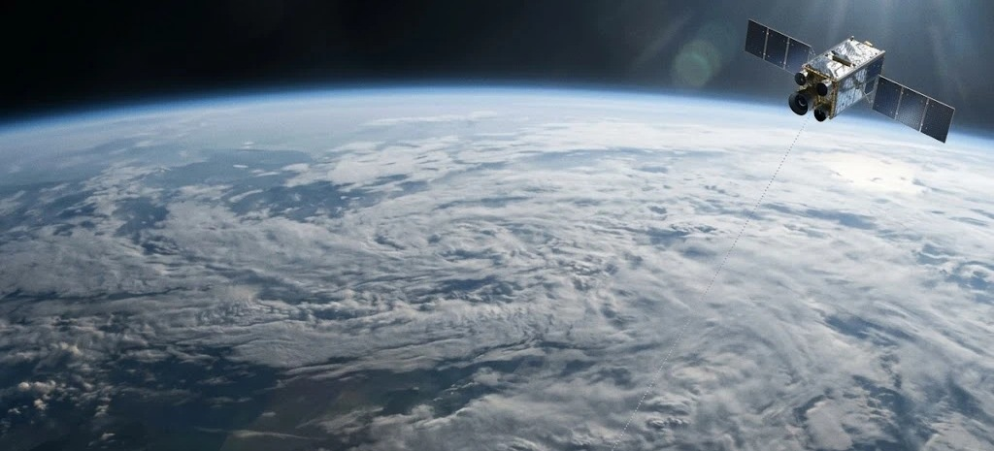
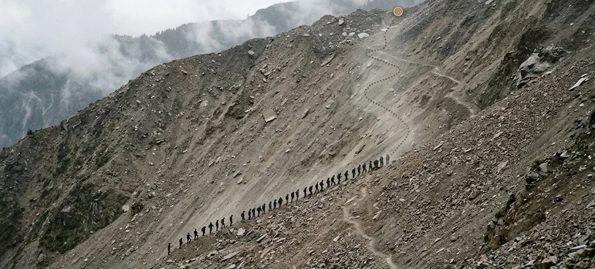
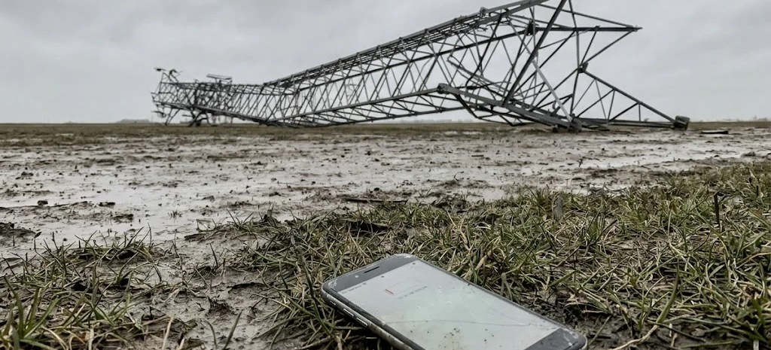
Too far. Too slow. Too silent.
02 WHY THE EXISTING RESPONSE FAILS
“…leaving trapped survivors isolated and search-and-rescue teams operating blind.” PS S.3
TOO FAR
TOO SLOW
TOO SILENT
Blind from orbit
~1,500 on foot
95.2% offline
India’s space chief: deep underground can’t be detected from space.
Wayanad was searched by hand. Nobody was found.
of Puerto Rico’s cell sites after Hurricane Maria.
ISRO chairman S. Somanath · Aug 2024
Wayanad · July–Aug 2024
FCC · Hurricane Maria, 2017
Between space and the ground, the sky is empty.
Notes:
SLIDE 2 [0:40–1:11 · 71 words] · RUBRIC: Problem Understanding & Impact (15) — what existing solutions miss
SAY:
"So why does today’s response fail? Too far: India’s own space chief says what lies deep underground can’t be detected from space. Too slow: about fifteen hundred people searched Wayanad by hand — radar flagged signs of life, crews dug, and nobody was found. Too silent: ninety-five percent of Puerto Rico’s cell sites went dark after Hurricane Maria. Survivors isolated, rescuers operating blind. Between space and the ground, the sky is empty."
SOURCES (full links in Pitch_Draft.md, section 6)
- ISRO chairman S. Somanath, 3 Aug 2024 (Onmanorama): detecting what is deep underground isn't possible from space. Paraphrased on the slide, no quote marks.
- Radar flagged signs of life; crews dug; nobody found (ThePrint). About 1,500 rescuers searched.
- 95.2% of Puerto Rico's cell sites were out after Hurricane Maria (FCC, 2017). Türkiye 2023: towers fell with the buildings; coordination broke down for about three days; some districts waited nearly a week.
- The quote is from the official PS S.3 brief. This slide is the problem as the brief itself states it.

Slide 3
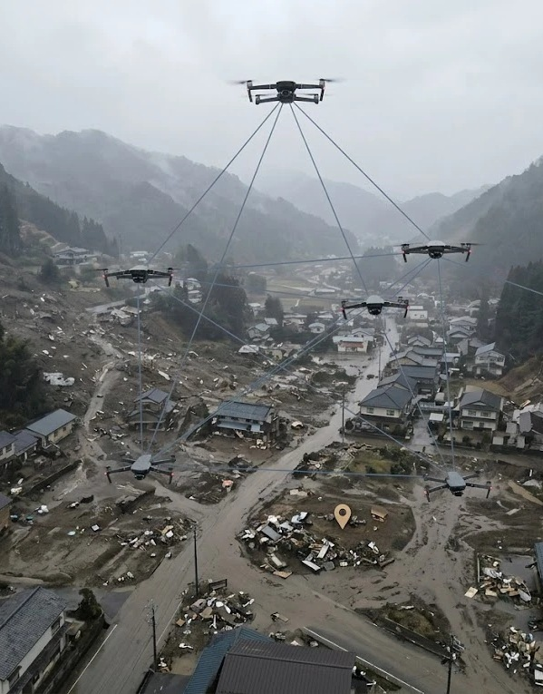
03 THE SOLUTION
RESQMESH
When the towers fall, the sky becomes the network.
PS S.3 · DECENTRALIZED DRONE SWARM FOR SEARCH & RESCUE
EYES
ANSWERS · TOO FAR
Spot every survivor.
2 Scouts · fly low
Find trapped people. Pin their GPS location.
BRAIN
ANSWERS · TOO SLOW
Plan the search together.
2 Mappers · mid-height
Split the zone so nothing is searched twice.
VOICE
ANSWERS · TOO SILENT
Carry every pin home.
1 Relay-Anchor · high
A flying mesh. No tower. No internet.
HOW ONE PIN TRAVELS
Person seen
GPS pin
Drone mesh
Relay-Anchor
Long-range link
Rescue base
Rescue teams
Notes:
SLIDE 3 [1:11–1:52 · 93 words] · RUBRIC: Proposed Solution Quality (25)
SAY:
"We fill that sky. ResQMesh: when the towers fall, the sky becomes the network. Five drones, three jobs. Two Scouts — the Eyes — fly low and find people automatically. Two Mappers — the Brain — split the zone between them, so nothing is searched twice. One Relay-Anchor — the Voice — hovers high and turns the swarm into a flying mesh. Follow one pin: a Scout sees a person and stamps a GPS location, a long-range link delivers it to the rescue base, and rescuers go to it with their own GPS. No tower. No internet. No pilot."
NAME: "Res" = rescue, "Q" = the quiet amber dot of a found survivor, "Mesh" = the network the drones form.
EACH ROLE ANSWERS ONE FAILURE FROM SLIDE 2: Eyes -> too far, Brain -> too slow, Voice -> too silent.
HOW THE COORDINATES REACH RESCUERS WITHOUT TOWERS: pin -> drone mesh -> Relay-Anchor -> long-range link -> rescue base (local dashboard, no internet) -> rescue teams, who use their own GPS. Walkie-talkie is the fallback for the last step.
BRIEF LINK: the subtitle is the official PS S.3 title. "Automated survivor localization", "distributed area-partitioning" and "ad-hoc mesh communication backbone" are the brief's own phrases.
We do not state drone specifications on purpose: the drones are custom-designed in Fusion and hardware comes after the hackathon.

Slide 4
The swarm is the network.
04 INNOVATION & ORIGINALITY
DRONE SEARCH TODAY
RESQMESH
FLIES
One drone, flown by hand.
→
An autonomous swarm.
CONNECTS
Needs towers or a pilot link.
→
The swarm is the network.
DELIVERS
Raw video to watch.
→
GPS survivor pins.
To our knowledge, no operational system combines all three.
Notes:
SLIDE 4 [1:52–2:21 · 64 words] · RUBRIC: Innovation & Originality (20)
SAY:
"What’s new? A typical search drone is flown by hand, needs towers or a direct link to its pilot, and sends back raw video that someone has to watch. ResQMesh is an autonomous swarm that re-plans when a drone is lost; the swarm itself is the network; and it delivers GPS survivor pins, not video. To our knowledge, no operational system combines all three."
"TYPICAL DRONE SEARCH TODAY" means the usual commercial / piloted search drones and satellite imagery. We say "to our knowledge" because we cannot prove a negative; we compared against piloted-drone SAR, satellite imagery and ground search.
THREE NEW IDEAS:
1. Autonomous and decentralized: no pilot in the loop, no single point of failure; the area plan re-forms when a drone is lost.
2. The swarm is the network: a dedicated flying Relay-Anchor builds an ad-hoc Wi-Fi / LoRa mesh, so findings reach the base when infrastructure is gone.
3. The output is a GPS pin, not video: automated survivor localization that rescuers can navigate to.
If challenged: the novelty is the combination and the closed loop (find -> pin -> relay -> rescuers), not any single component.

Slide 5
How it works.
05 TECHNICAL APPROACH & TECH STACK
01
→
02
→
03
→
04
Sense
Plan
Link
Show
SCOUTS
MAPPERS
RELAY-ANCHOR
RESCUE BASE
Camera detects people.
GPS stamps each find.
Split the zone.
Plan energy-aware paths.
Pins hop the mesh,
even if a link drops.
Offline dashboard.
Rescuers follow GPS.
TECH STACK
ROS 2
Unreal Engine
Dashboard
GPS
Fusion
swarm software
disaster simulation
live web map and pins
survivor coordinates
custom drone design
Lose a drone, and the swarm re-plans.
Notes:
SLIDE 5 [2:21–2:53 · 73 words] · RUBRIC: Technical Approach & Tech Stack (15)
SAY:
"How it works. Sense: Scouts run onboard image processing to detect people and stamp each find with GPS. Plan: Mappers run distributed area-partitioning, with energy-aware paths. Link: the drones form an ad-hoc mesh, with make-before-break handoff and store-and-forward, so pins keep flowing as batteries swap. Show: a local live dashboard, no internet. The stack is open and proven: ROS 2, Unreal Engine, a web dashboard, GPS — and drones we design ourselves in Fusion."
BATTERY: energy-aware planning, make-before-break handoff (a replacement takes over before the old drone leaves), store-and-forward for pins, and a base swap. The demo uses a time-compressed battery model.
PERCEPTION: image processing on the camera feed. In the demo it runs on rendered frames from Unreal Engine; hardware sensors come later. Honest limit: cameras see visible or partly exposed people, not deep under rubble.
PLANNING: two Mappers share one area plan (distributed area-partitioning) and steer the Scouts and the Relay. Altitude layers keep drones apart: Scouts low, Mappers mid, Relay high.
NETWORK: Wi-Fi / LoRa ad-hoc mesh. The demo's mesh is a simulated link model; we say so if asked.
We state no sensor or drone specifications on purpose: the drones are custom-designed in Fusion and hardware comes after the hackathon.

Slide 6
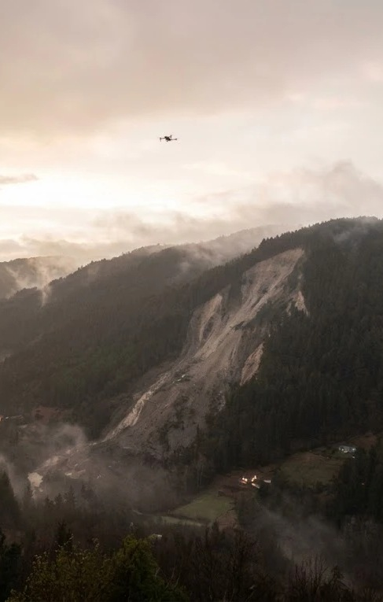
Proof, not a promise.
06 FEASIBILITY & PLAN
A live demo in a simulated disaster, built in two 16-hour sprints.
SPRINT I 16 HOURS
WHY IT IS FEASIBLE
Unreal world · 5 ROS 2 drones
planner · dashboard
✓ Simulation first, no hardware risk
✓ Proven open tools: ROS 2, Unreal
SPRINT II 16 HOURS
✓ Five drones, scoped to the brief
Detect → pin → relay
survive a drone loss
THE LIVE DEMO
Disaster → survivors found →
pins on the dashboard →
drone lost → swarm re-plans.
AFTER THE HACKATHON
Custom drones → field trial
At 02:17, nothing was in the air.
Next time, something will be.
Notes:
SLIDE 6 [2:53–3:22 · 65 words] · RUBRIC: Feasibility (15) · Presentation, Defence & Time Management (10)
SAY:
"Is it feasible? Yes, because we build simulation first. Sprint one, sixteen hours: an Unreal Engine disaster, five ROS 2 drones, the planner and the dashboard. Sprint two, sixteen hours: detect, pin, relay — and survive losing a drone, live. Then custom drones and a field trial. At 2:17, nothing was in the air. Next time, something will be. Thank you — we’re ready for your questions."
CLOSING LINE: "At 02:17, nothing was in the air" is rhetorical. It means no autonomous search swarm was flying at that hour. If challenged, say exactly that.
Q&A CHEAT SHEET (1:30 left; expect two or three questions)
- How do the Scouts actually find people?
Onboard camera plus image processing detects people in each frame; every detection is stamped with the drone’s GPS position and sent as a pin. In the demo this runs on frames from the Unreal Engine world. Honest limit: a camera sees people who are visible or partly exposed, not deep under rubble — deeper search needs extra sensors, which is the hardware phase.
- How do rescuers get the coordinates if every tower is down?
The pin hops across the drone mesh to the Relay-Anchor, which holds a long-range link to a rescue base placed outside the damage zone. The base runs the dashboard locally — no internet. Rescuers navigate with their own GPS; a walkie-talkie is the fallback for the last step.
- What if a drone fails or its battery dies?
Mappers re-partition the zone among the drones still flying. Planning is energy-aware, and a replacement takes over before a low-battery drone leaves (make-before-break). Pins are held with store-and-forward until a link is back. In the live demo we kill a drone on purpose.
- What if the Relay-Anchor itself is lost?
The demo has one Relay, so pins are kept on the swarm and delivered when a link returns. A second Relay is the natural next step; we kept the demo to the five-drone setup.
- How is this different from existing drone search and rescue?
Typical systems are piloted, depend on towers or a direct link, and return video for people to watch. ResQMesh is autonomous, the swarm is its own network, and the output is GPS survivor pins. To our knowledge no operational system combines all three.
- Why simulation, and is it realistic?
In 32 hours, simulation is how we prove the whole loop — detect, pin, relay, survive a loss — with no hardware risk. The software is ROS 2, so it moves to hardware-in-the-loop later. The demo’s radio mesh is a simulated link model, and we say so.
- Why five drones?
It is the smallest set that shows every role with redundancy: two Scouts and two Mappers can cover for each other, plus one Relay. More Scouts and Mappers scale the search area; relays can be chained.
- Where do the survival numbers come from?
The 88 / 35 / 9 percent curve is widely quoted from the 1990 Philippines earthquake; we have not traced the original paper, so the slide says “reported”. The figure we verified is that 84% of survivors were rescued within the first hour (Roces et al., 1992). 1.23 million deaths is UNDRR / CRED EM-DAT.
- What about safety and collisions?
The swarm flies in altitude layers — Scouts low, Mappers mid, Relay high — and Mappers assign non-overlapping zones. A real deployment would follow disaster-management and aviation rules; that is beyond Phase 1.
IF YOU ARE RUNNING LONG: skip the second sentence of slide 4 and the "how one pin travels" walk-through on slide 3; never skip the closing line.

