Slide 1
IBM University Engagement Project Submission
“Exploring the Power of Agentic AI with IBM Granite and IBM Bob”

Slide 2

Project Tile – SmartRecipe – AI Recipe Preparation Agent
Domain of Project – Domain of Project – Food & Lifestyle
Student Name | Recent Passport Photo | Email ID | Mobile number [WhatsApp]
Aaditi Udaya Shankar |  | aaditiudayashankar2004@gmail.com | 9108745038

Slide 3
Problem Statement -Recipe Preparation Agent
The Challenge
People often have limited ingredients available at home but struggle to decide what to cook, find suitable recipes, and adapt them to their dietary preferences. Recipe information is scattered across different sources, making it difficult to quickly find relevant recipes, substitutions, cooking instructions, and useful preparation tips. This can lead to food waste and unnecessary preparation time.
The Objective
Build a RAG-based AI Recipe Preparation Agent that retrieves relevant recipes and generates personalized, step-by-step cooking guidance. The solution should:
• Ingredient-Based Recipe Retrieval – Find relevant recipes based on ingredients provided by the user.
• RAG-Based Knowledge Retrieval – Retrieve useful recipe information from the recipe knowledge base.
• Personalized Recipe Generation – Adapt recipes according to available ingredients, servings, and user preferences.
• Step-by-Step Instructions – Generate clear and practical cooking instructions.
• Ingredient Substitution – Suggest suitable alternatives when ingredients are unavailable.
• Cooking Tips – Provide helpful preparation and cooking recommendations.
• Dietary Adjustments – Adapt recipes according to dietary preferences or restrictions.
• Food-Waste Reduction – Suggest ways to use available ingredients efficiently and minimize waste.
• Time-Saving Guidance – Provide cooking time and simplified preparation guidance.

Slide 4
Proposed Solution - SmartRecipe – AI Recipe Preparation Agent
The proposed solution is a RAG-based AI Recipe Preparation Agent built using IBM Bob, IBM watsonx.ai, and IBM Granite to generate personalized recipes from ingredients available with the user.
At its core, the system uses a Retrieval-Augmented Generation (RAG) pipeline to retrieve relevant recipes from a recipe knowledge base. The retrieved information is provided as context to the IBM Granite model through watsonx.ai, enabling the agent to generate an adapted recipe rather than simply returning a fixed recipe.
The system follows an agentic workflow consisting of five key stages:
ParseIngredients identifies and processes the ingredients entered by the user.
RetrieveRecipes searches the recipe knowledge base using ingredient-based retrieval and identifies relevant recipes.
BuildContext combines the retrieved recipe information into a context for the AI model.
GenerateRecipe uses IBM Granite through watsonx.ai to generate a personalized recipe based on the user's available ingredients and preferences.
FormatResponse presents the generated recipe in a clear and user-friendly format.
The generated response provides ingredient quantities, step-by-step preparation instructions, cooking time, servings, ingredient substitutions, cooking tips, and dietary adjustments.
The solution also focuses on reducing food waste by helping users make practical use of ingredients already available at home and provides time-saving cooking guidance.
IBM Bob is used as the development environment for building the agent workflow, while IBM watsonx.ai and IBM Granite provide the AI generation capability. The RAG component retrieves relevant knowledge before generation, improving the relevance of the personalized recipe.
Overall, SmartRecipe provides an intelligent, ingredient-aware recipe assistant that helps users decide what to cook, adapt recipes to their needs, and make better use of available ingredients.

Slide 5
Technology Used
• IBM Bob Platform – Used as the primary development environment for designing, coding, testing, and building the SmartRecipe AI agent.
• IBM Granite 4 H Small – ibm/granite-4-h-small used for natural language understanding and personalized recipe generation.
• IBM watsonx.ai – Used to access and run the IBM Granite model for AI-powered recipe generation.
• IBM Cloud – Provides the cloud infrastructure and API access required for the watsonx.ai and Granite integration.
• Retrieval-Augmented Generation (RAG) – Retrieves relevant recipes from the recipe knowledge base and provides them as context to IBM Granite before generating the response.
• TF-IDF Retrieval – Used to identify recipes relevant to the ingredients entered by the user.
• Python & Flask – Used to implement the backend, agent workflow, API integration, and web application.
• HTML, CSS & JavaScript – Used to create the interactive SmartRecipe web interface.

Slide 6
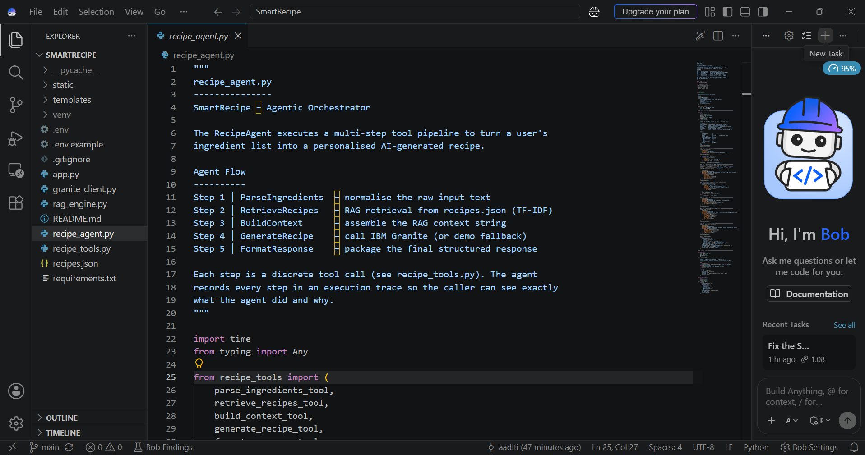
Required Files created using IBM bob -
BM Bob was used to develop and organize the SmartRecipe agent, RAG engine, recipe tools, IBM Granite integration, and web application components.

Slide 7
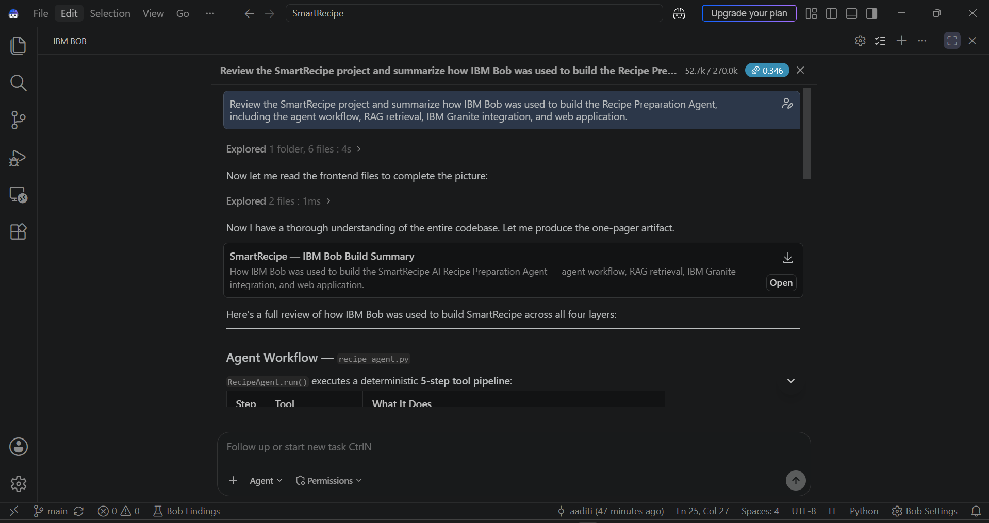
IBM Bob Screenshots:
IBM Bob was used to analyze, develop, and validate the SmartRecipe agent workflow, RAG retrieval, IBM Granite integration, and web application.

Slide 8
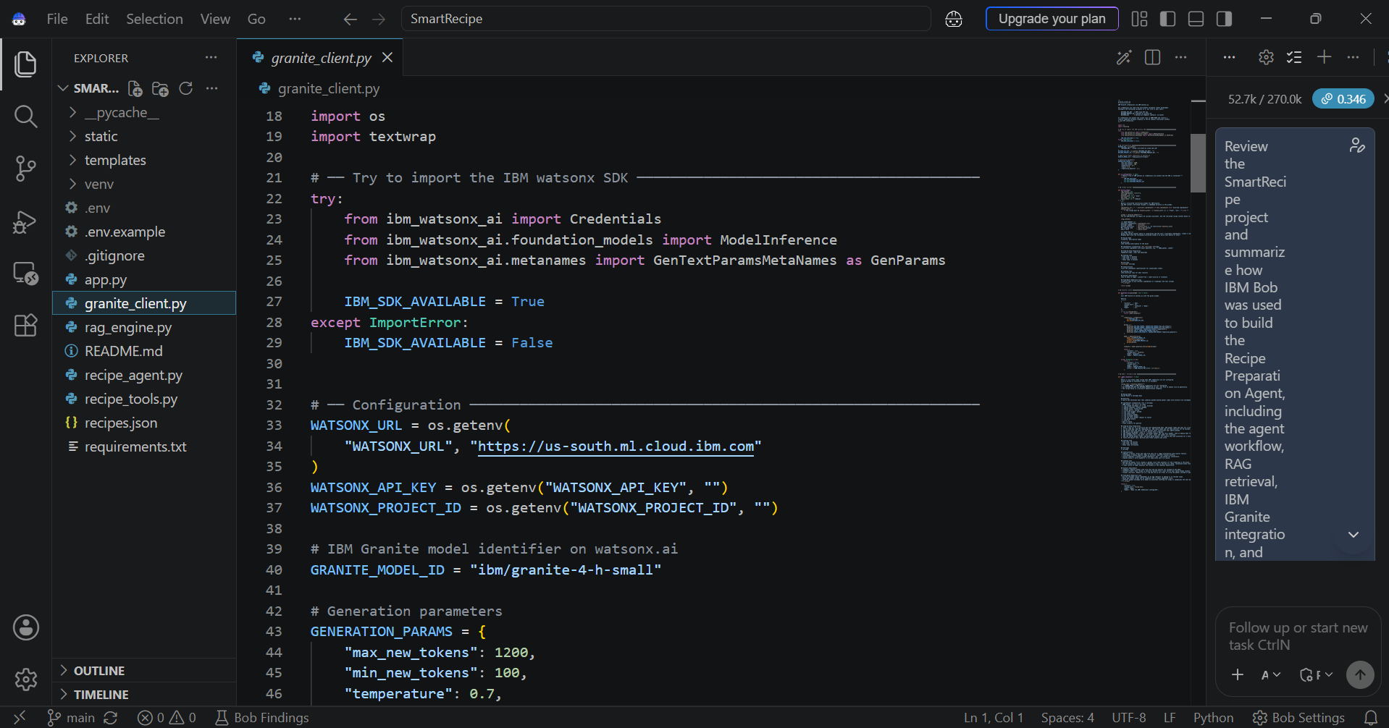
IBM Granite Integration – SmartRecipe uses IBM watsonx.ai to connect with the IBM Granite 4 H Small model. Credentials are securely loaded through environment variables, while the model generates personalized recipes using retrieved RAG context.

Slide 9
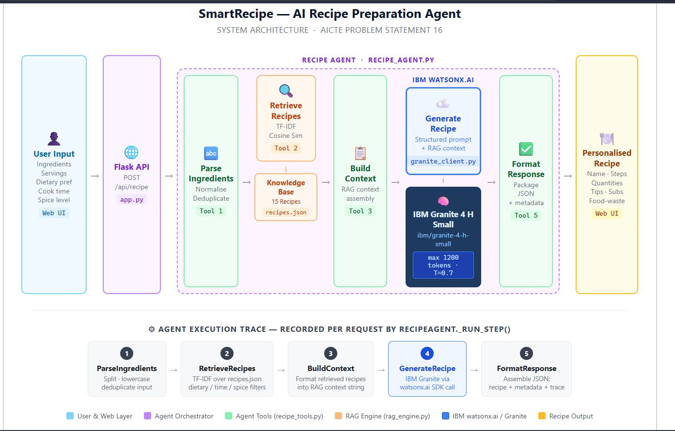
Architecture blueprint for IBM bob:

Slide 10
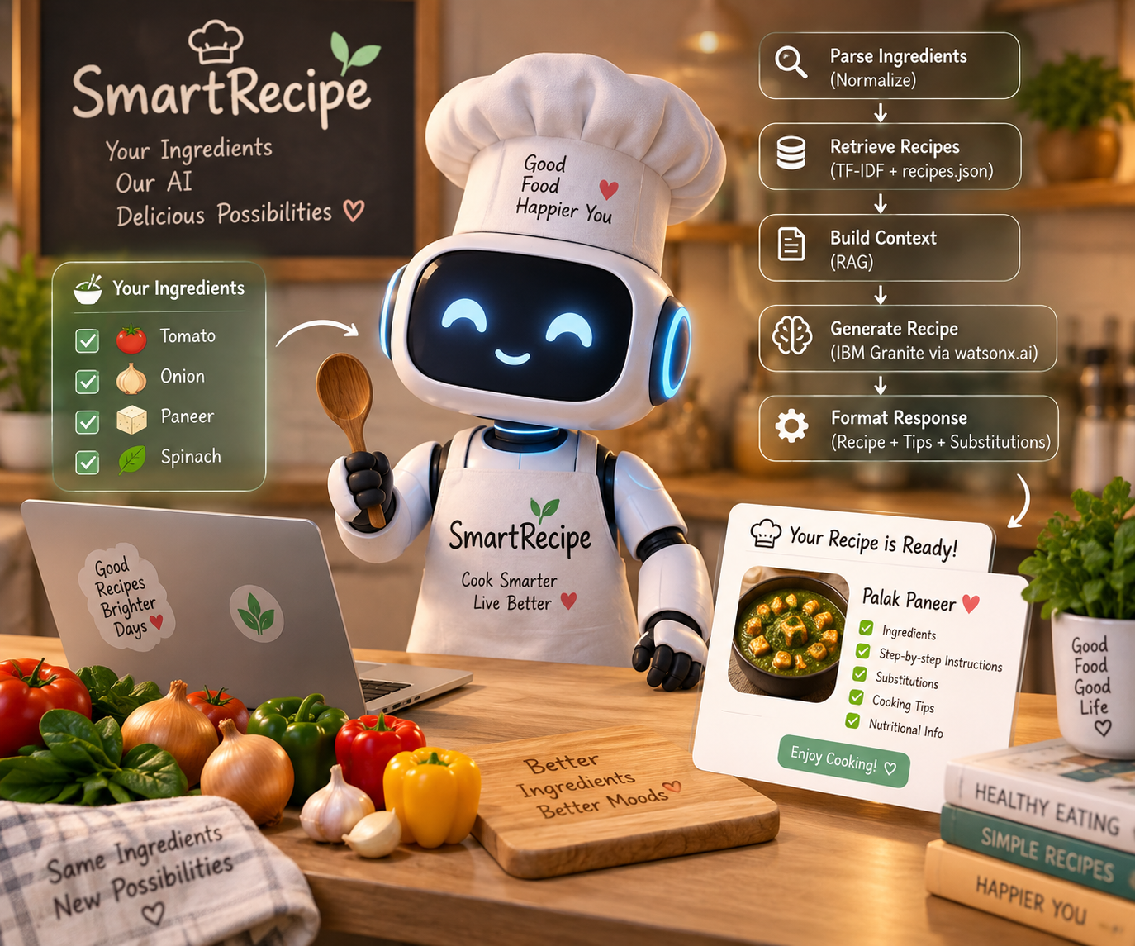
Role of Agentic AI in the solution
Role of Agentic AI in SmartRecipe
Agentic AI enables SmartRecipe to function as an intelligent recipe preparation system rather than a simple recipe search tool. The Recipe Agent coordinates multiple steps automatically, from understanding the user's ingredients to retrieving relevant recipes and generating a personalized response.
The agent follows a structured five-step workflow:
• ParseIngredients – Processes and normalizes the ingredients provided by the user.
• RetrieveRecipes – Uses RAG with TF-IDF retrieval to find relevant recipes from the recipe knowledge base.
• BuildContext – Builds a context from the retrieved recipes for the AI model.
• GenerateRecipe – Sends the retrieved context and user requirements to IBM Granite through watsonx.ai to generate the recipe.
• FormatResponse – Structures the generated recipe with ingredients, steps, substitutions, cooking tips, dietary adjustments, and metadata.
Agentic AI provides context-aware generation, allowing the system to consider the ingredients and preferences supplied by the user instead of returning a fixed recipe.
The workflow also records an execution trace, making each agent step visible and helping demonstrate how the final recipe was produced.
Overall, Agentic AI makes SmartRecipe goal-driven, adaptive, and capable of transforming available ingredients into a practical personalized recipe.

Slide 11
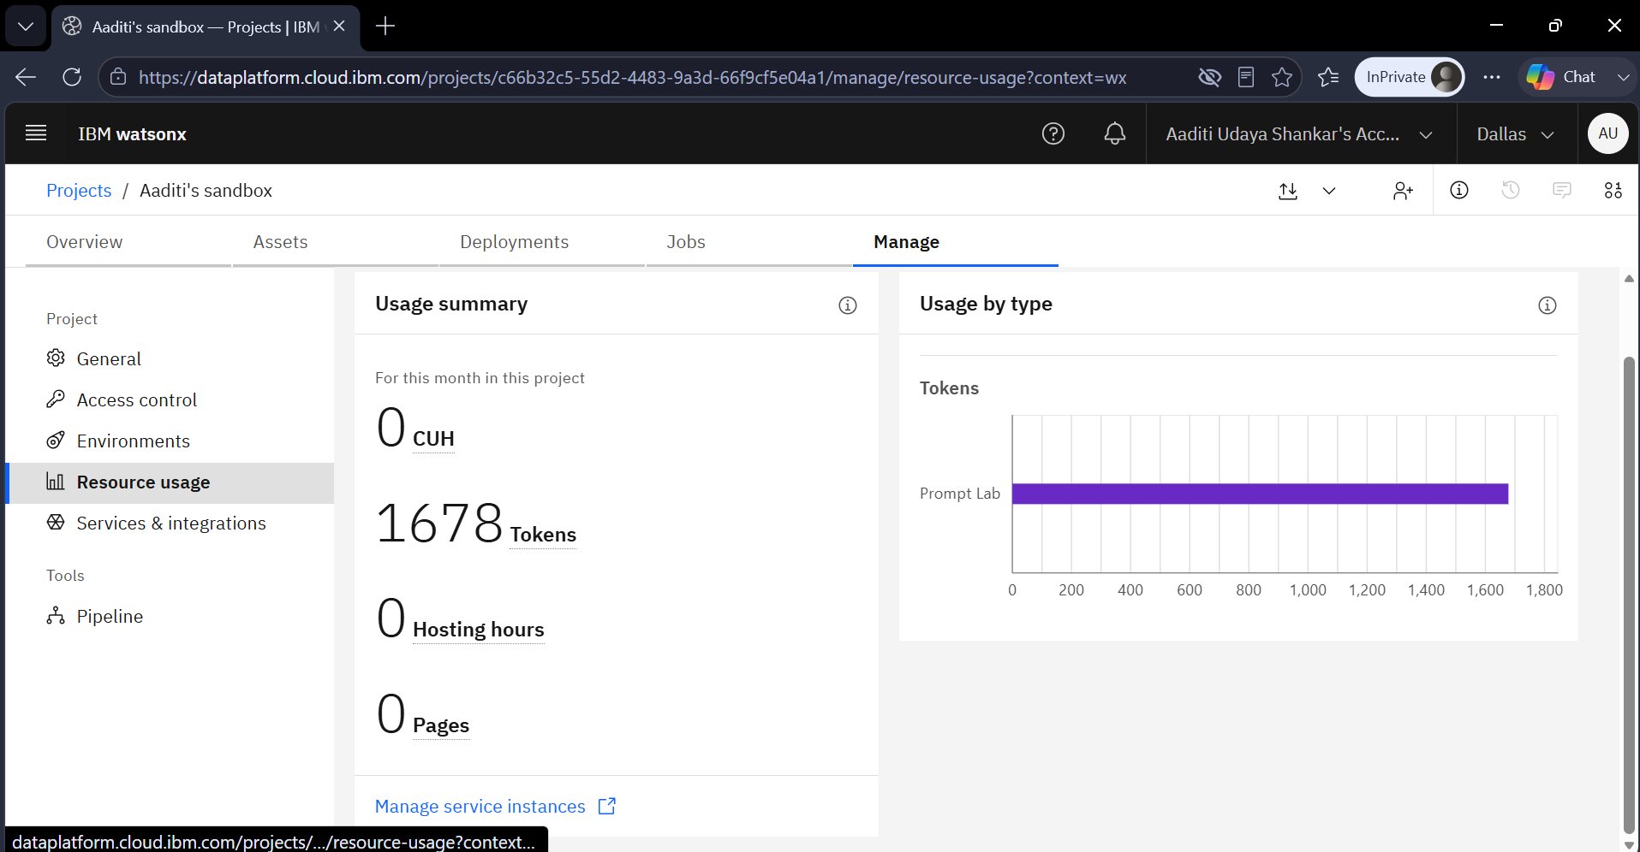
Token Usage
1678 tokens used
After the Prompt
·
·
·

Slide 12
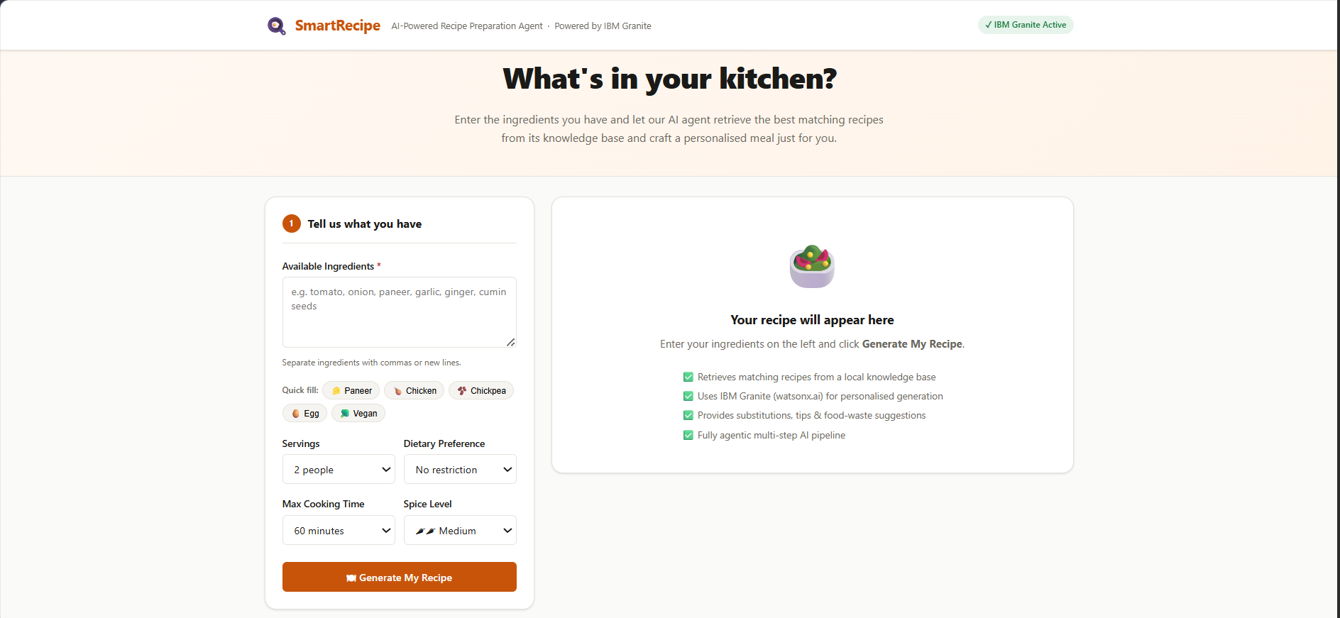
Project Output Screenshot
·
·
·
SmartRecipe user interface showing ingredient input, serving size, dietary preference, cooking time, and spice level before recipe generation.

Slide 13
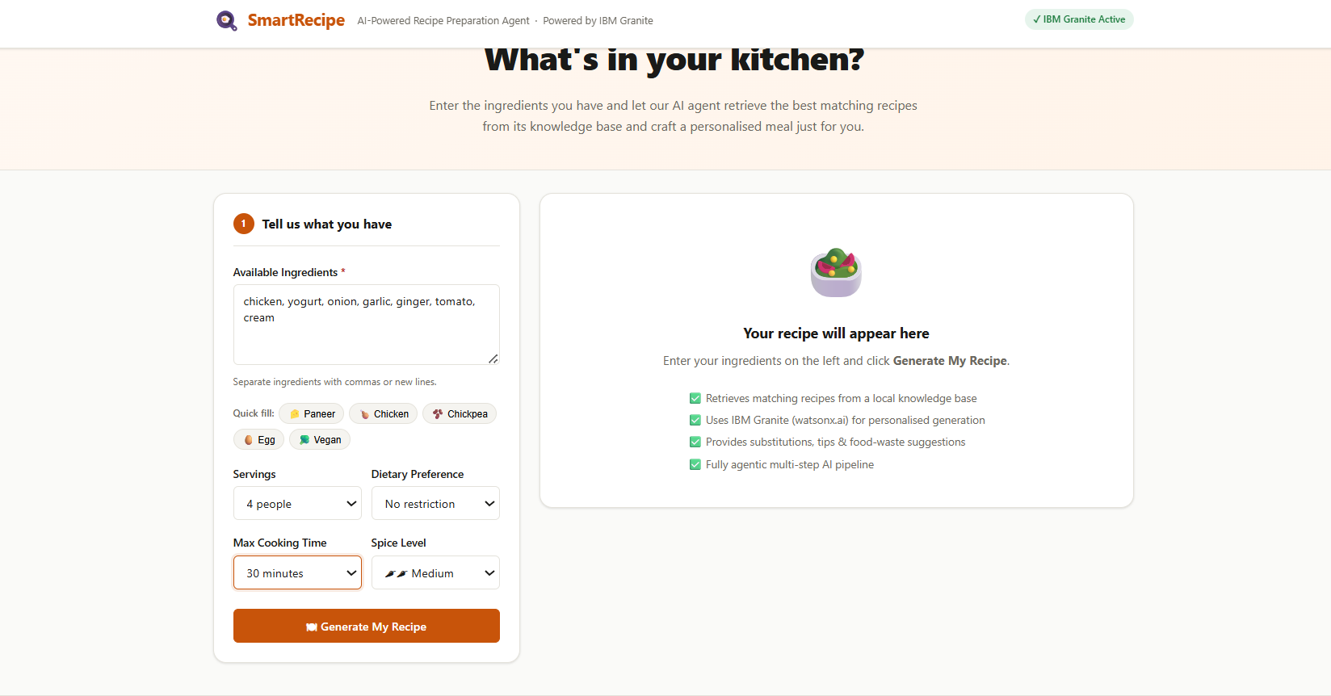
Project Output Screenshot
·
·
·
SmartRecipe interface showing user-provided ingredients and personalized cooking preferences before generating an AI-powered recipe.

Slide 14
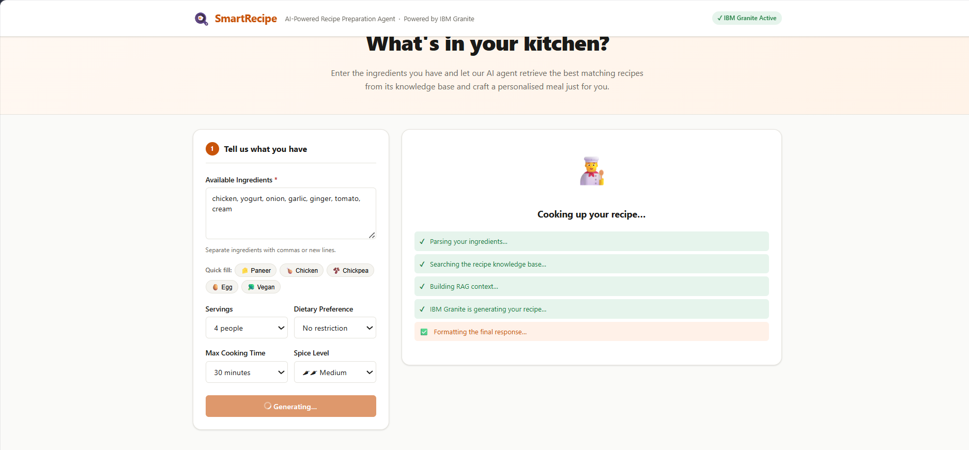
Project Output Screenshot
·
·
·
Agentic AI workflow executing the SmartRecipe recipe generation pipeline.

Slide 15
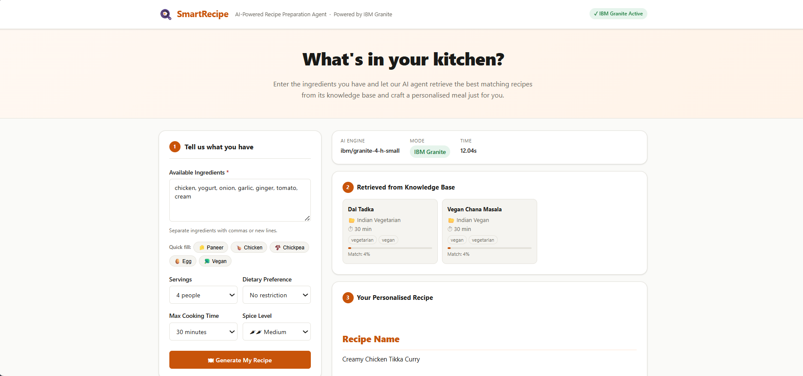
Project Output Screenshot
·
·
·

Slide 16
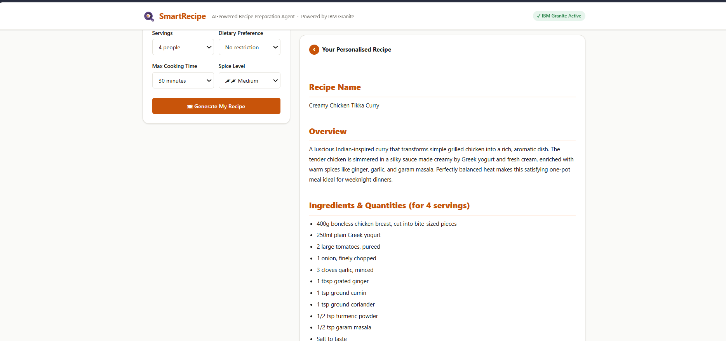
Project Output Screenshot
·
·
·

Slide 17
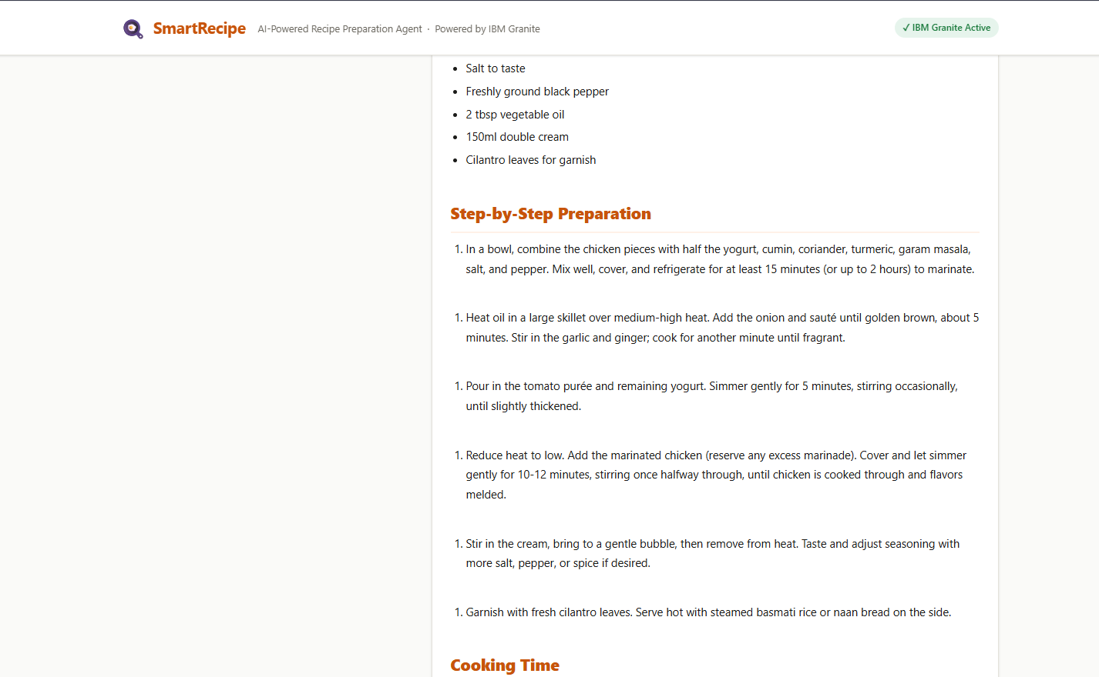
Project Output Screenshot
·
·
·

Slide 18
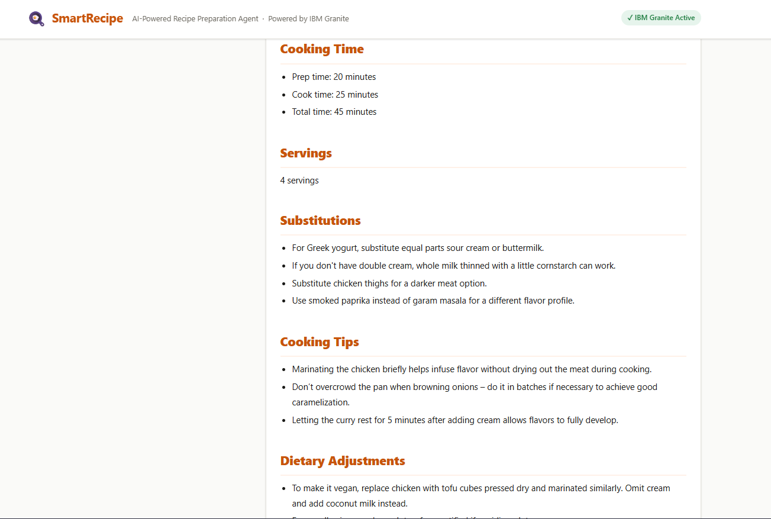
Project Output Screenshot
·
·
·

Slide 19
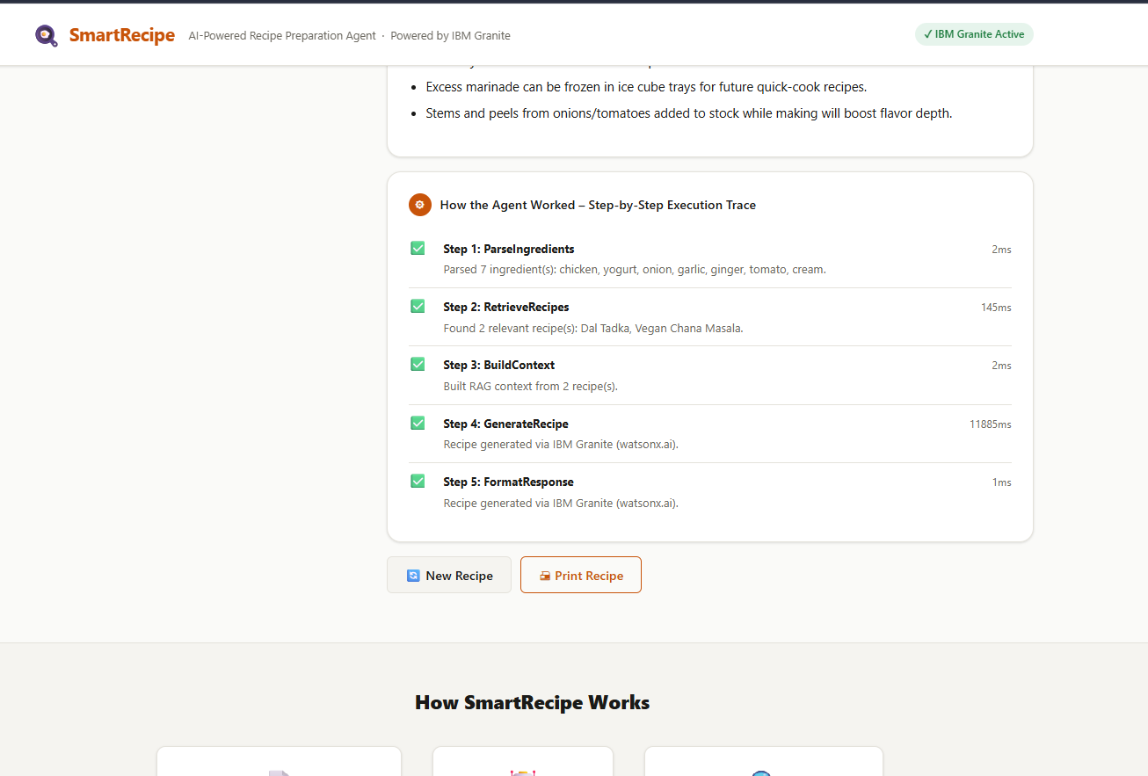
Project Output Screenshot
·
·
·

Slide 20
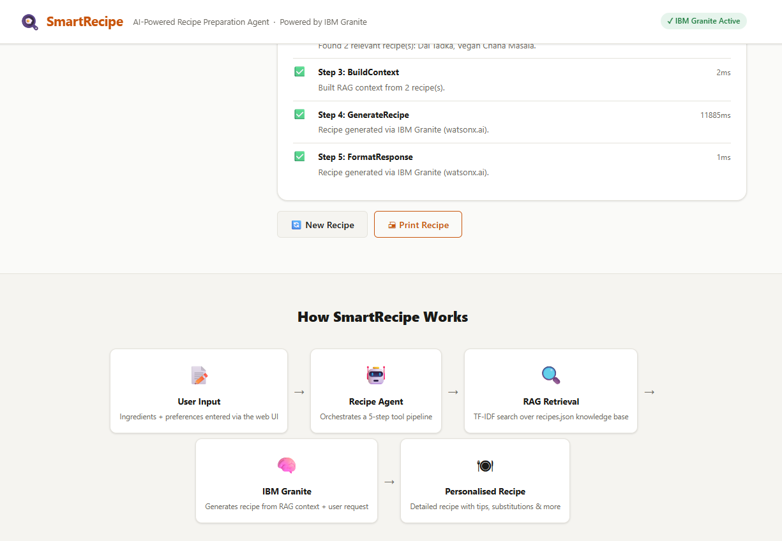
Project Output Screenshot
·
·
·
SmartRecipe project output demonstrating IBM Granite-powered personalized recipe generation, RAG-based retrieval, step-by-step preparation, substitutions, cooking tips, dietary adjustments, and food-waste reduction.

Slide 21
Project Output Screenshot
·
·
·

Slide 22
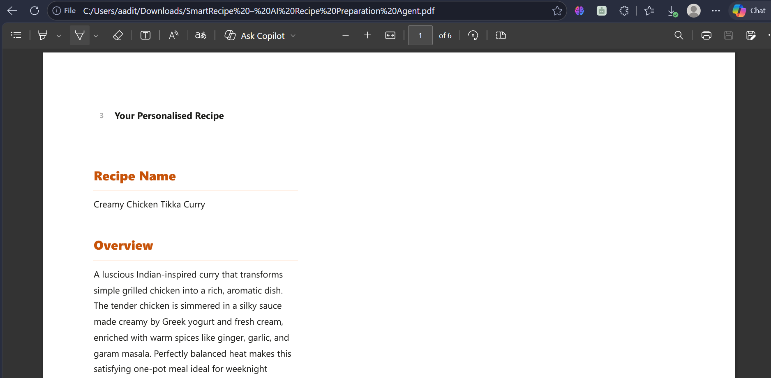
Project Output Screenshot
·
·
·

Slide 23
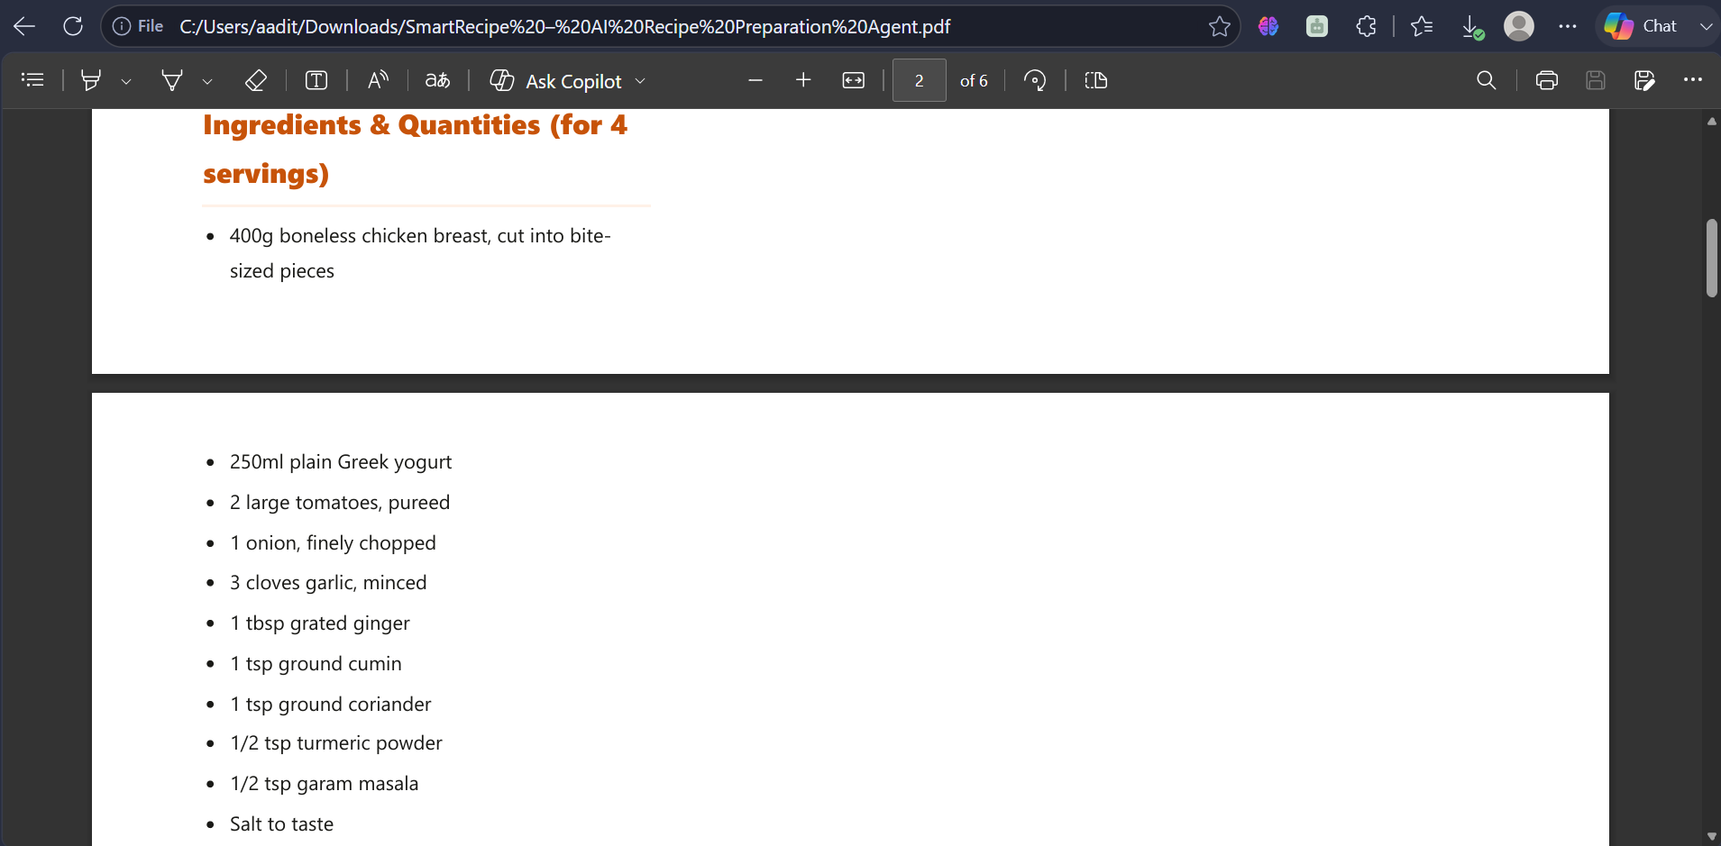
Project Output Screenshot
·
·
·

Slide 24
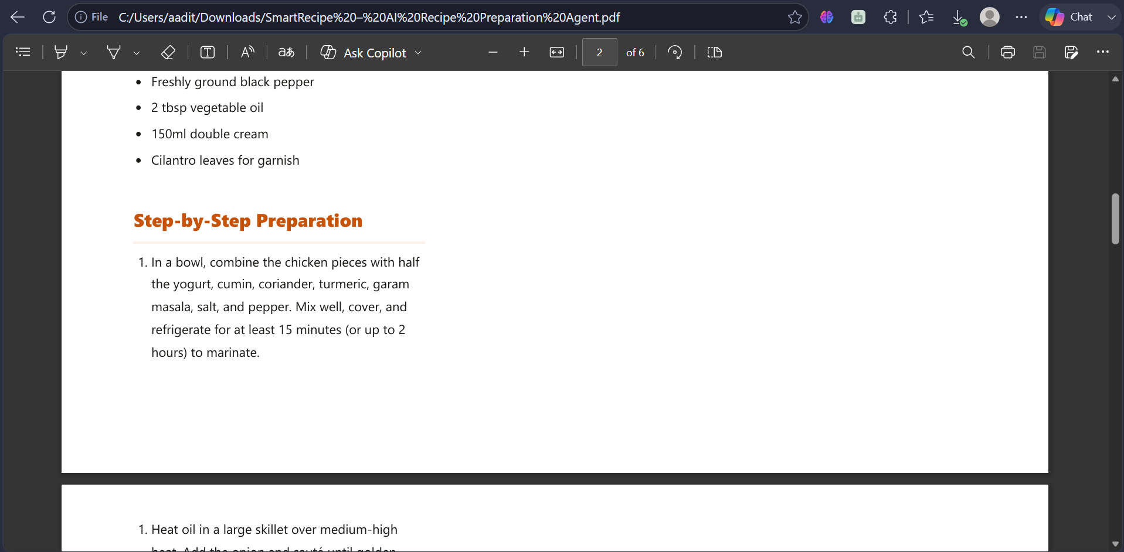
Project Output Screenshot
·
·
·

Slide 25
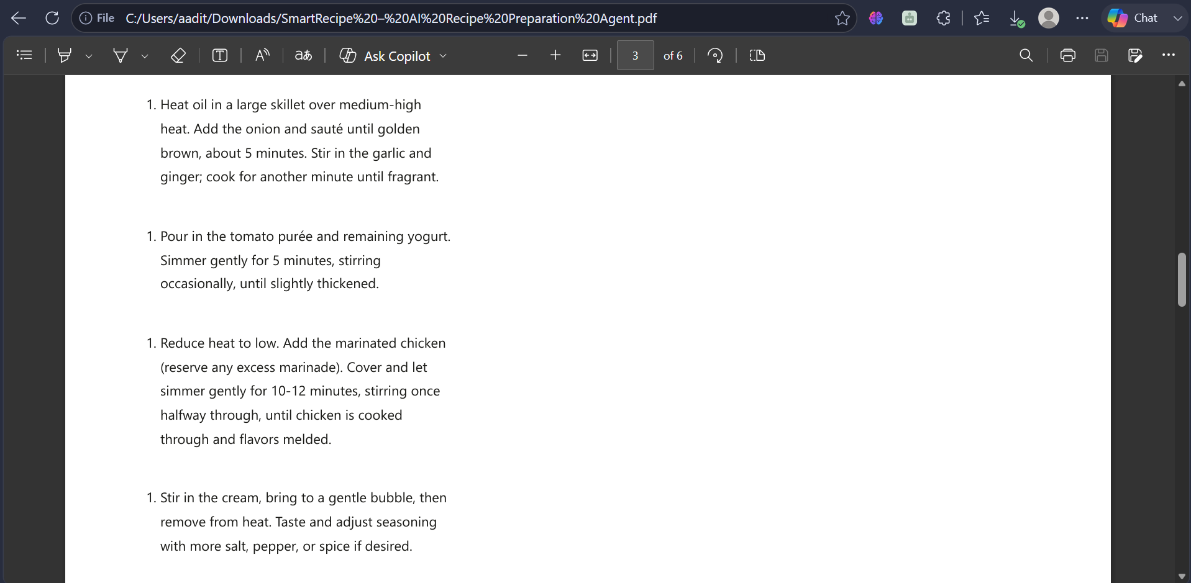
Project Output Screenshot
·
·
·

Slide 26
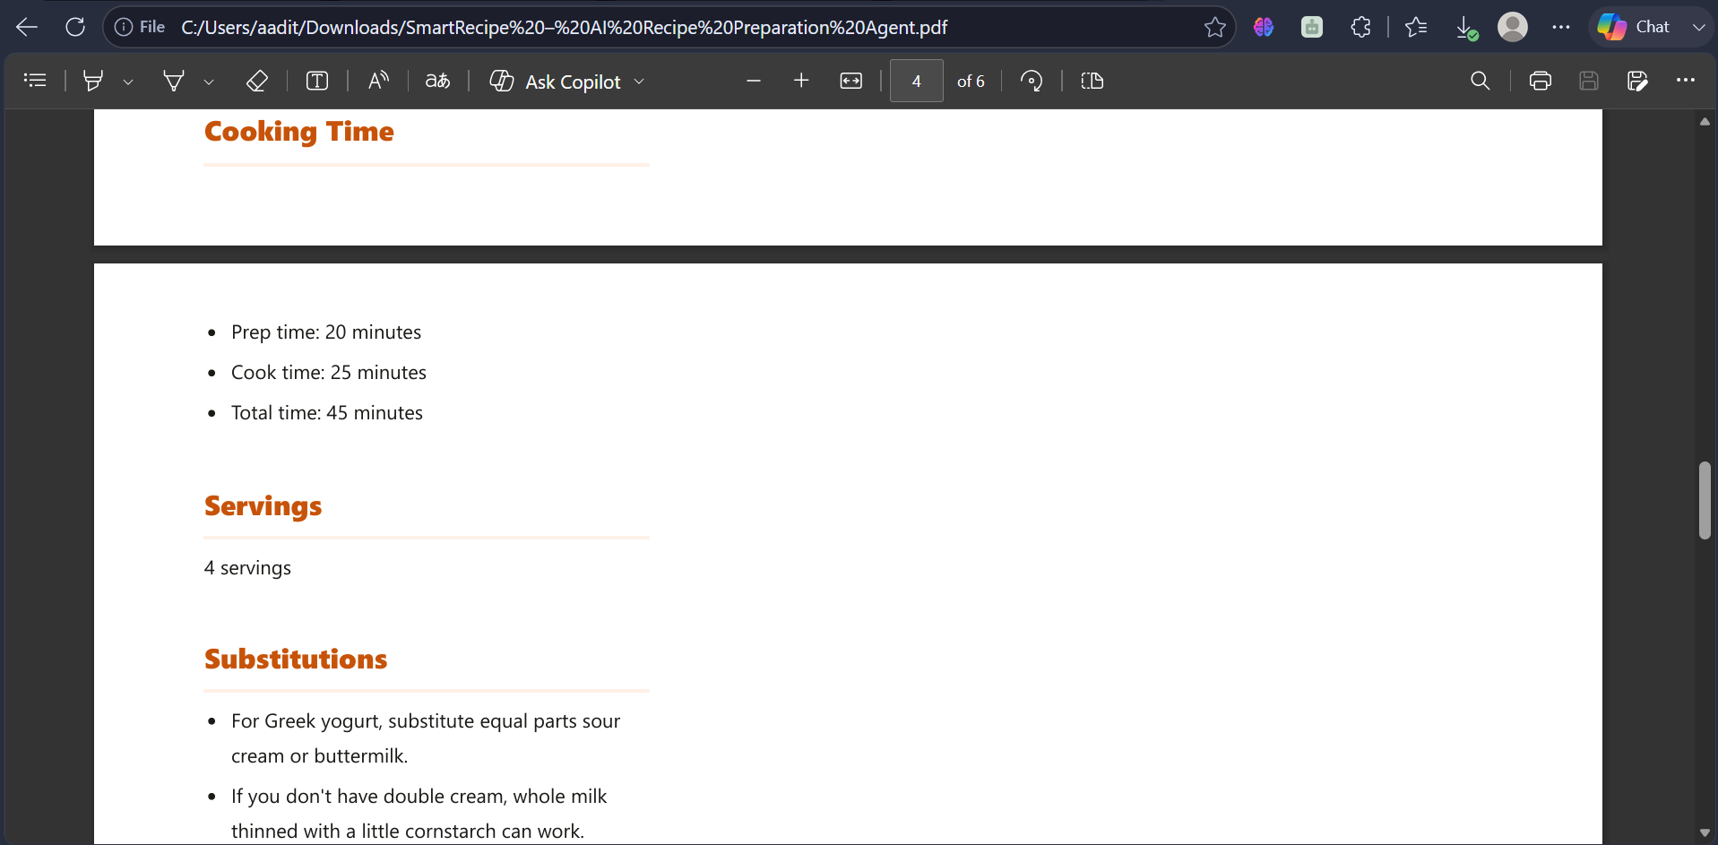
Project Output Screenshot
·
·
·

Slide 27
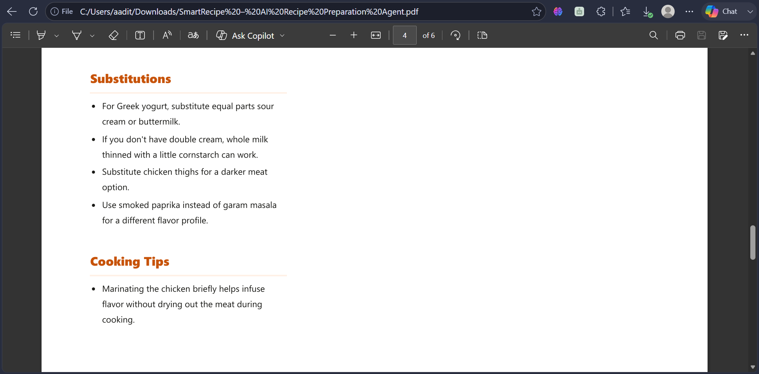
Project Output Screenshot
·
·
·

Slide 28
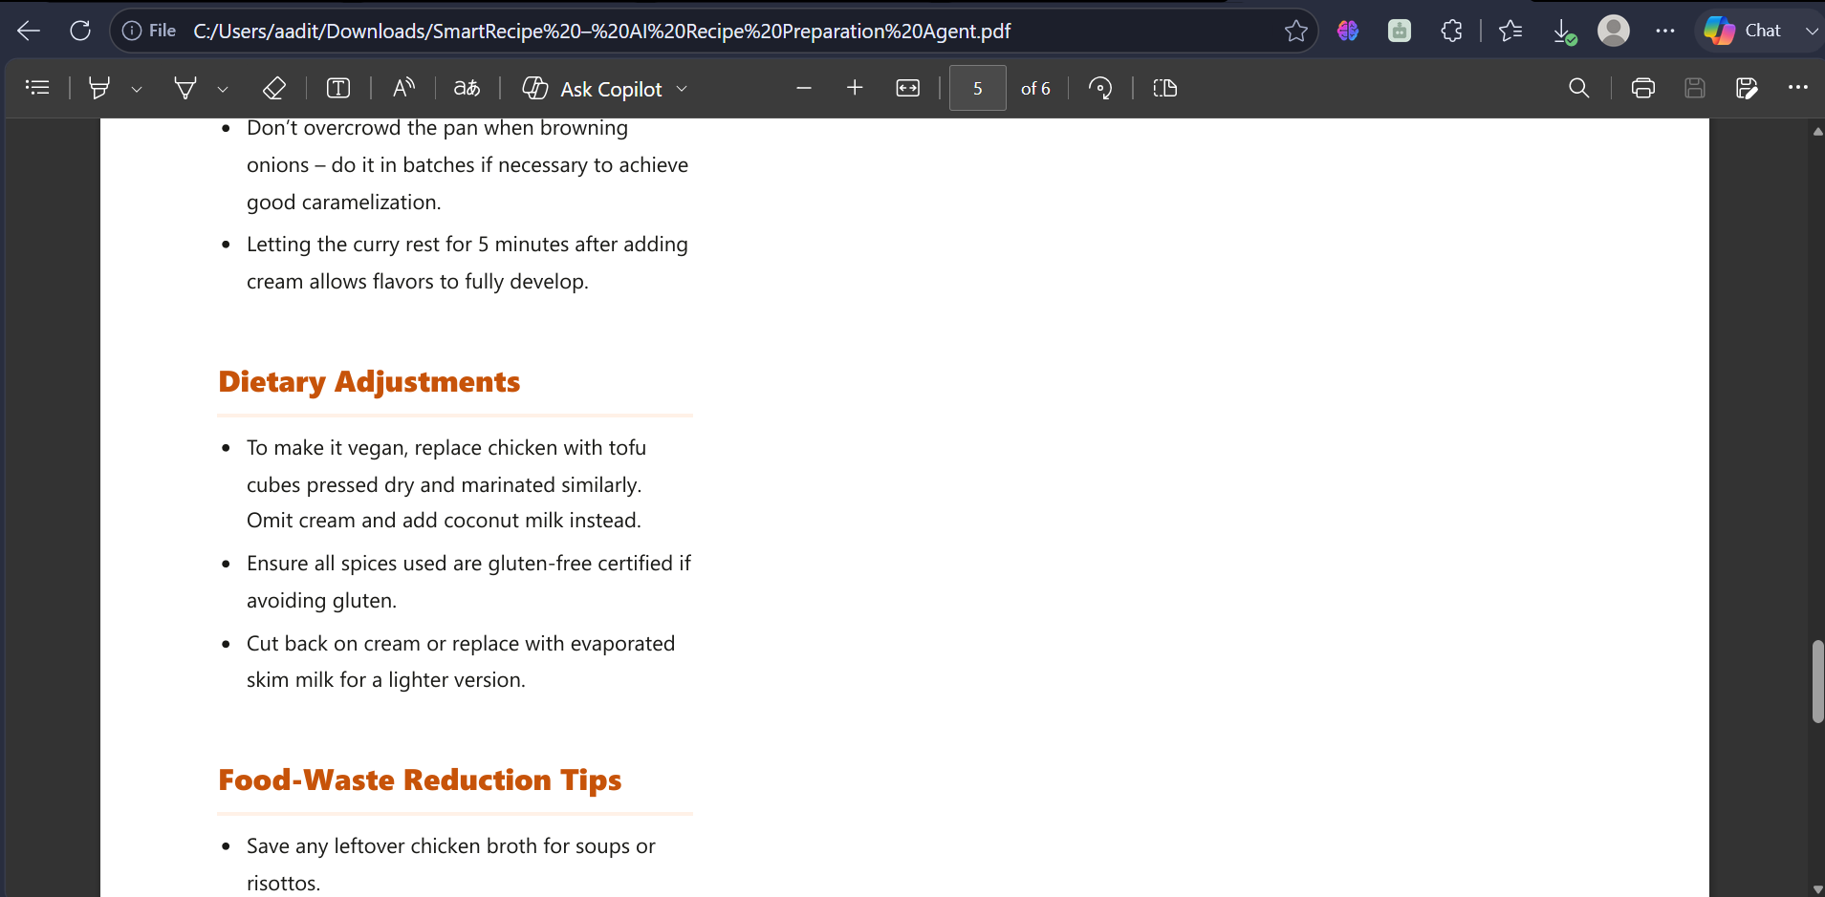
Project Output Screenshot
·
·
·

Slide 29
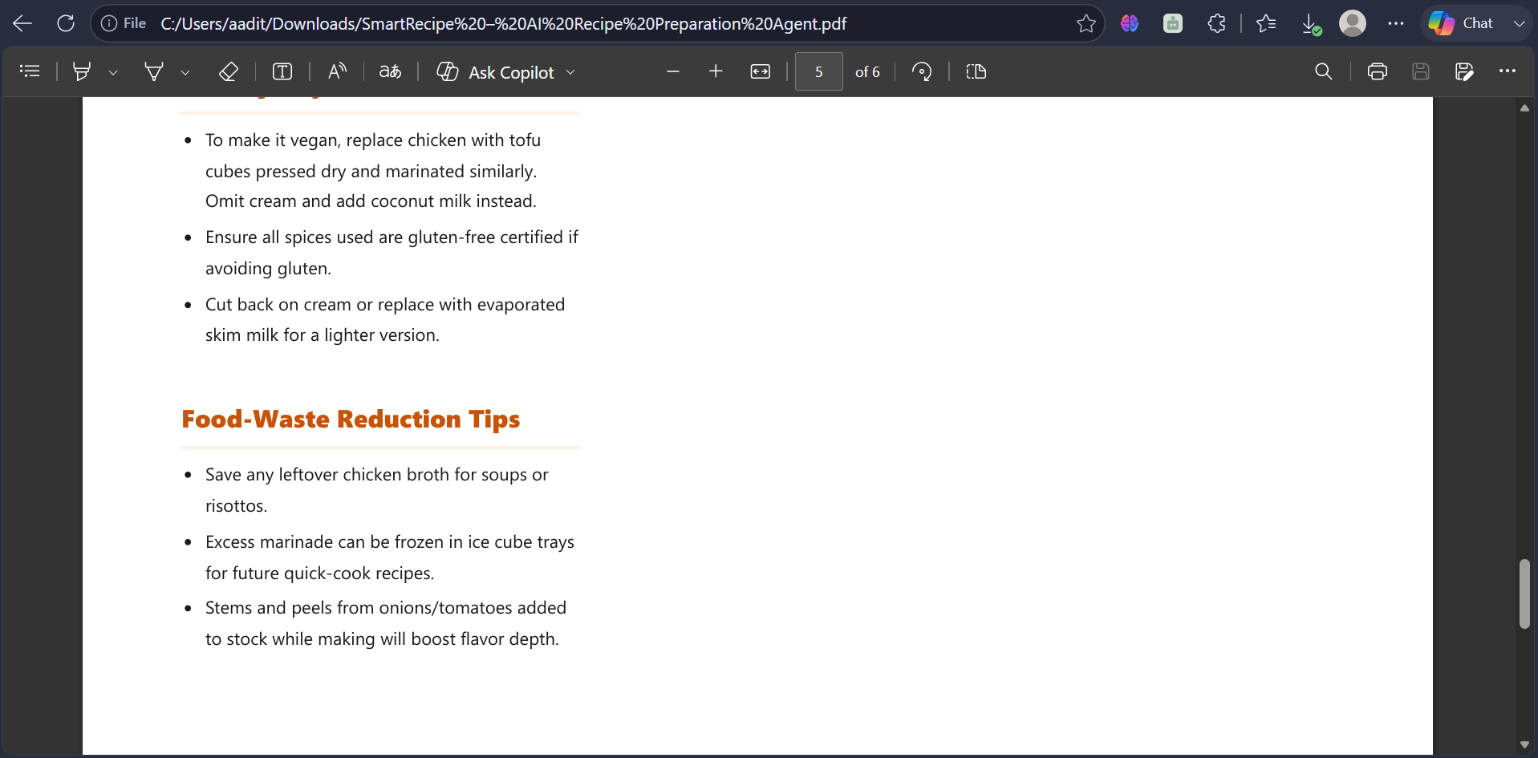
Project Output Screenshot
·
·
·
Generated SmartRecipe output demonstrating personalized recipe details, ingredients and quantities, step-by-step preparation, cooking time, substitutions, cooking tips, dietary adjustments, and food-waste reduction.

Slide 30
Novelty and Uniqueness
SmartRecipe stands out by combining Agentic AI, RAG, and personalized recipe generation into a single intelligent recipe preparation system.
Ingredient-Based Intelligence – Generates recipes based on the ingredients currently available to the user.
RAG-Based Recipe Retrieval – Retrieves relevant recipes from the recipe knowledge base using TF-IDF before generating the final response.
Personalized Recipe Generation – Adapts recipes according to servings, dietary preference, spice level, and maximum cooking time.
Agentic Workflow – Automatically coordinates five stages: ParseIngredients → RetrieveRecipes → BuildContext → GenerateRecipe → FormatResponse.
IBM Granite Integration – Uses IBM Granite 4 H Small through IBM watsonx.ai to generate context-aware recipe instructions.
Smart Substitutions – Suggests alternative ingredients when required, making recipes more practical with available resources.
Cooking Guidance – Provides step-by-step instructions, cooking tips, and time information to simplify preparation.
Food-Waste Reduction – Suggests practical ways to reuse leftover ingredients and minimize unnecessary food waste.
Practical & Time-Saving – Helps users decide what to cook quickly without searching through multiple recipe sources.
This makes SmartRecipe a smart, adaptive, and practical AI recipe preparation assistant rather than a simple static recipe search tool.

Slide 31
Git Hub Link
· Please create public github repository (Enable Add README button while creating repository) with format –
Please test and Paste the working Github URL –
Make sure you have Uploaded following three files into your github repository
1) All Agent relevant files of IBM Cloud , 2) yourproblemstatement.pdf file 3) your projectpresntation.pptx file 4)any other files
·
·
·

Slide 32
Future Scope
1. Voice-Based Recipe Assistance –
Enable users to provide ingredients and cooking preferences through voice commands, making recipe preparation more convenient and accessible.
2. Multilingual Recipe Support –
Extend SmartRecipe to support multiple Indian and international languages so users can receive recipes and cooking instructions in their preferred language.
3. Image-Based Ingredient Recognition –
Allow users to upload or capture an image of available ingredients. Computer vision can identify the ingredients and automatically provide them to the Recipe Agent.
4. Larger & Dynamic Recipe Knowledge Base –
Expand the recipe knowledge base with more cuisines, regional dishes, dietary options, and cooking styles to improve RAG retrieval.
5. Nutrition & Calorie Information –
Add optional nutritional information such as calories, protein, carbohydrates, and fats for generated recipes.
6. Mobile Application & Smart Kitchen Integration –
Develop a mobile application and explore integration with smart kitchen devices for timers, cooking assistance, and hands-free guidance.
·
·
·

Slide 33
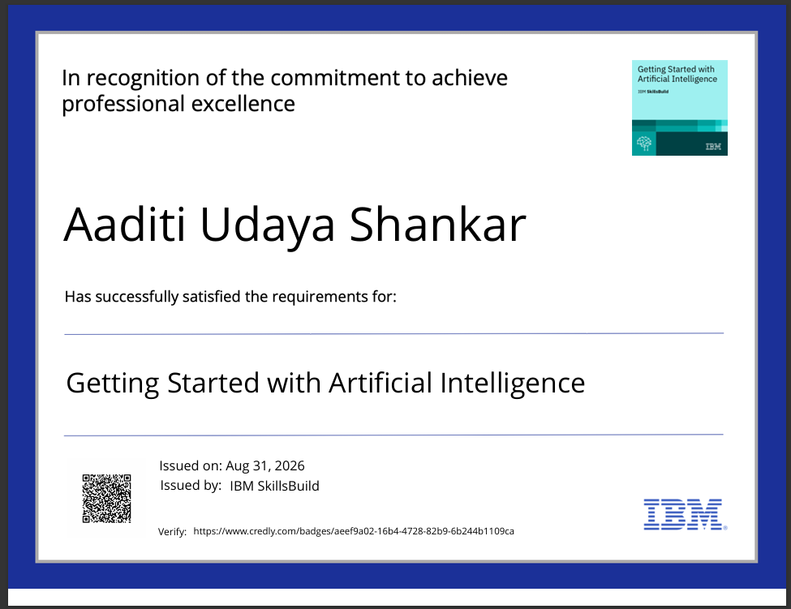
Certificates Earned:
Please add your credly certificate(Getting Started with Artificial Intelligence)

Slide 34
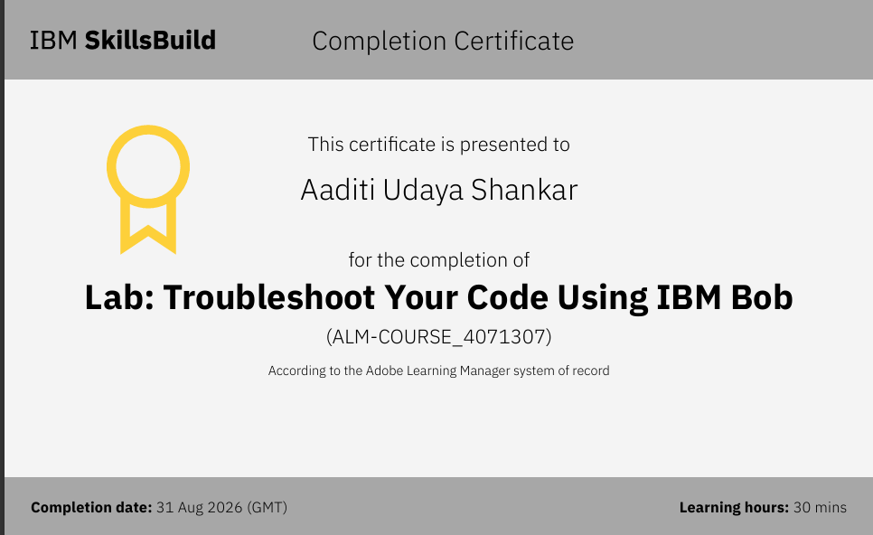
Certificates Earned:​
Add your IBM BOB Certificate

Slide 35


