Slide 1

Vivekanand Education Society’s Institute Of Technology
Department Of Information Technology
DSA mini Project
A.Y. 2025-26
Title: Data Structures & Algorithms
Domain: Data Structures & Algorithms
Member:Aadit Mascarenhas
Mentor Name: Kajal Jewani

Slide 2


Slide 3
Content
Introduction to the Project
Problem Statement
Objectives of the Project
Scope of the Project
Requirements of the System (Hardware, Software)
ER Diagram of the Proposed System
Data Structure & Concepts Used
Algorithm Explanation
Time and Space Complexity
Front End
Implementation
Gantt Chart
13. Test Cases
14.Challenges and Solutions
15. Future Scope
16. Code
17. Output Screenshots
18. Conclusion
19. References (in IEEE Format)

Slide 4

Introduction to Project
Built using C language and Trie Data Structure
Helps in fast contact search based on prefix
Inspired by real-world contact applications
Focuses on DSA implementation over GUI

Slide 5
Problem Statement
Manual searching through contacts is time-consuming
Linear search is inefficient for large datasets
Users need instant suggestions while typing
Existing solutions rely on heavy libraries
Goal: Build a lightweight autocomplete in C
r Rates

Slide 6
Objectives of the project
Implement an efficient contact search system
Use Trie Data Structure for prefix-based searching
Provide multiple suggestions for a given prefix
Demonstrate real-world application of DSA
Keep implementation simple & console-based

Slide 7
Scope of The Project
Works on small to medium-sized contact lists
Can be extended to phonebooks, search engines
Currently limited to English lowercase letters
Scalable to support numbers & special chars
Data Persistence via JSON file

Slide 8
Requirements of the system (Hardware, software)
Hardware: Any standard PC/Laptop
(2 GB RAM minimum)
Software: C Compiler (GCC/MinGW/Turbo C)
OS: Windows/Linux/Mac
cJSON library needed
Runs completely in console environment

Slide 9
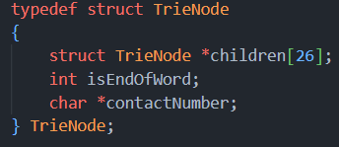
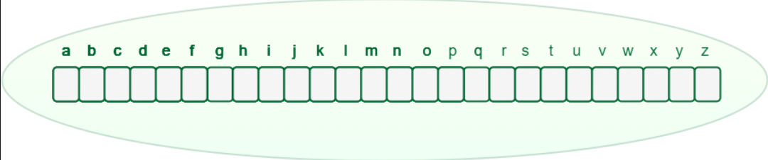
Data Structures & Concepts Used
Trie (Prefix Tree) for storing contacts
Decides if this is the end of a name or not.
Can be 0 or 1
Stores the contact number

Slide 10
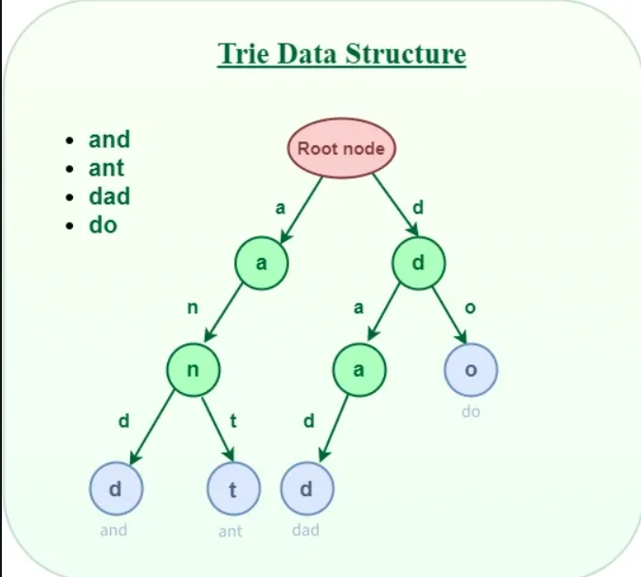
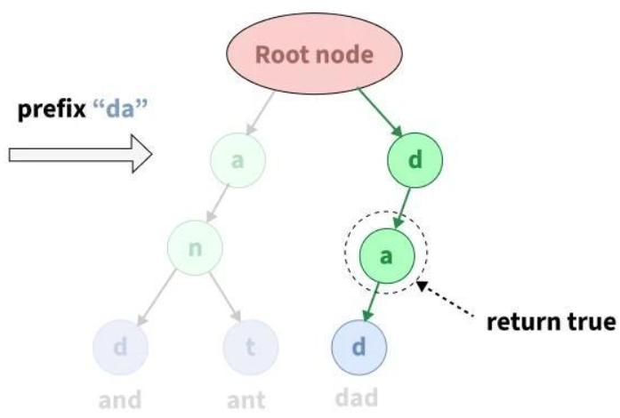
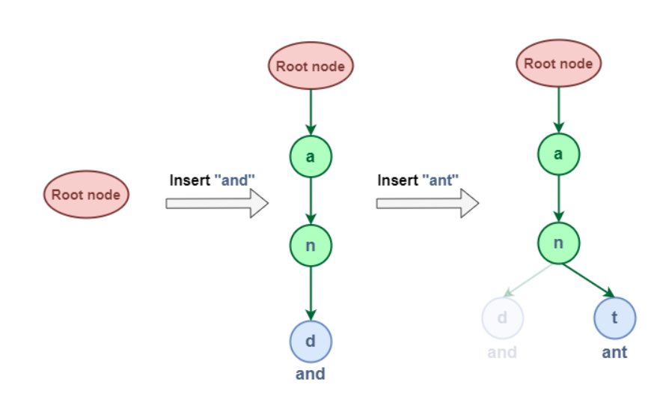
Data Structure Info
Searching using Prefix Time Complexity O(n):
Insert Time Complexity O(n):

Slide 11
Algorithm Explanation
Insert: Add each contact character by character into Trie
Search: Traverse Trie according to prefix characters
Suggest: Recursively list all words below prefix node
Output: Print matching contacts in console
Fallback: If no match, print “No Suggestions”

Slide 12
Time & Space Complexity
Insertion: O(L) per word (L = word length)
Search Prefix: O(P) (P = prefix length)
Suggestion Listing: O(N) for N words below prefix
Space: O(26 * total characters) for Trie nodes
Efficient compared to linear search O(N*L)

Slide 13
Implementation
Language: C
Functions: createNode, insert, searchPrefix, suggestionsRec
Input: Contact names entered by user
Output: Suggested contacts displayed on console
Contacts are stored in JSON format for data persistence.
Uses modular coding for clarity

Slide 14
CODE
All links below are clickable
Trie.c
Trie.h
Project.c
Libraries used were cJSON

Slide 15
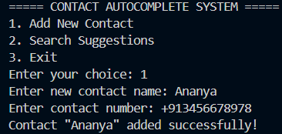
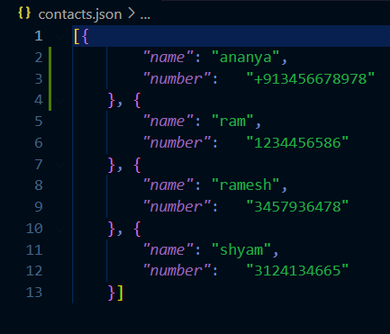
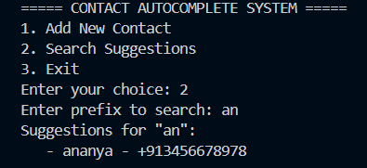
OUTPUT

Slide 16
Conclusion
Implemented efficient contact search system in C
Used Trie Data Structure for fast prefix search
Demonstrated DSA application in real-world problem
Simple console interface but effective logic
Provides a foundation for larger applications

Slide 17
References
Trie Data Structure (GeekforGeeks): https://www.geeksforgeeks.org/dsa/trie-insert-and-search/
Agnihotri, A. (2025, April 28). cJSON - JSON file write/read/modify in C. GeeksforGeeks. Retrieved October 7, 2025, from https://www.geeksforgeeks.org/c/cjson-json-file-write-read-modify-in-c/
GeeksforGeeks. (2025, September 1). Trie | (insert and search). GeeksforGeeks. Retrieved October 7, 2025, from https://www.geeksforgeeks.org/dsa/trie-insert-and-search/

