Slide 1
AI/NLP Risk Engine + Strategic Portfolio Stress Test
Aadit Siroya | IIT Guwahati | S&P Global & Crisil Campus Hackathon 2026

Slide 2
Problem & Approach
• Risk and ratings teams can't manually read every headline fast enough to know what it means for a portfolio.
• Build: ingest news + social text → structured sentiment/event/impact signals → trigger a real portfolio stress test.
• Discipline throughout: verify every external claim live, never report a number a script didn't actually produce.
• Confirmed false on inspection, adapted rather than worked around: X/Twitter has no free read API in 2026; FinBERT is fine-tuned on the exact dataset the brief's own eval plan implied using (leakage); "price target" collides with a naive "Target Corp" name match.

Slide 3
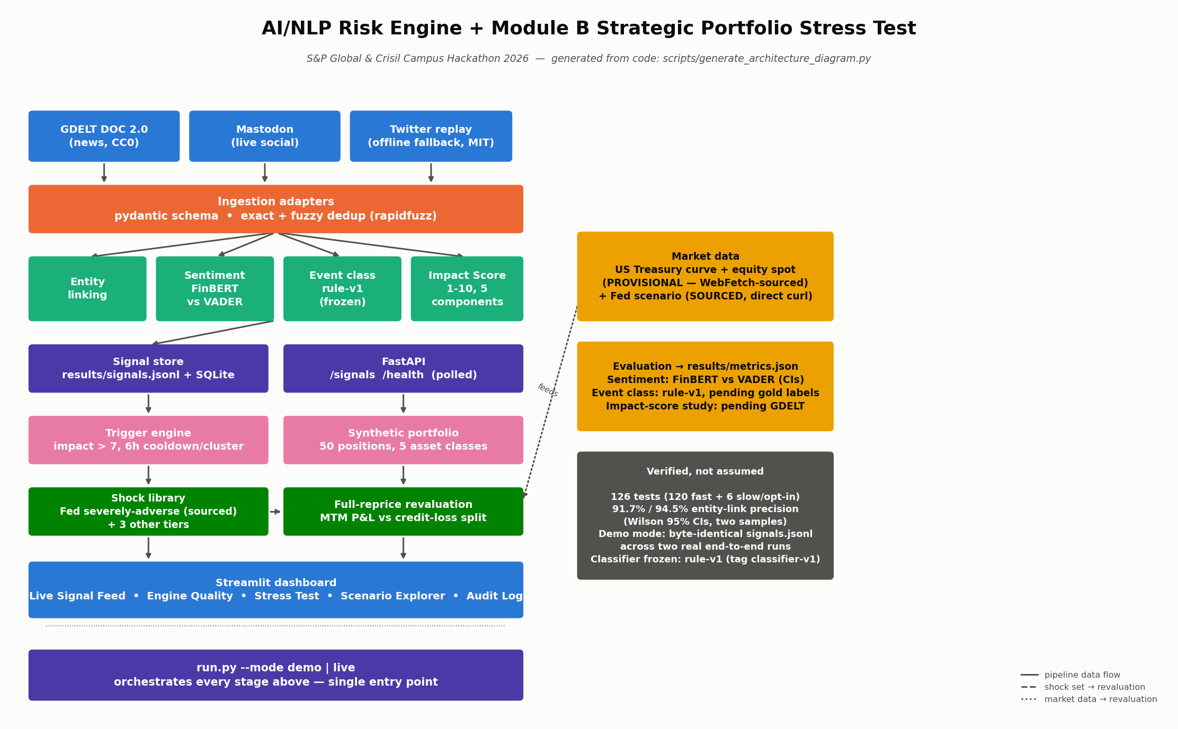
System Design

Slide 4
Implementation Highlights
• FinBERT (primary) vs VADER (naive baseline) vs majority-class, scored with bootstrap 95% CIs, not point estimates alone.
• Event classifier frozen at rule-v1 (git tag classifier-v1) before scoring against hand-labelled gold data — no eval-set tuning.
• Polling-based pub/sub (FastAPI + a flat JSONL file), documented honestly as polling, not a real message bus.
• Module B: full cashflow reprice for bonds, swap DV01 via bump-and-reprice, closed-form Black-Scholes for options — compared against the required naive (duration/delta-only) approximation, not just implemented once.
• Mark-to-market P&L and credit loss (ΔEL on loans) kept as two separate numbers by construction — a loan is never both fair-valued AND provisioned, which would double-count the same credit deterioration.
• Demo mode verified byte-identical across two real end-to-end runs (tests/test_demo_idempotency.py).

Slide 5
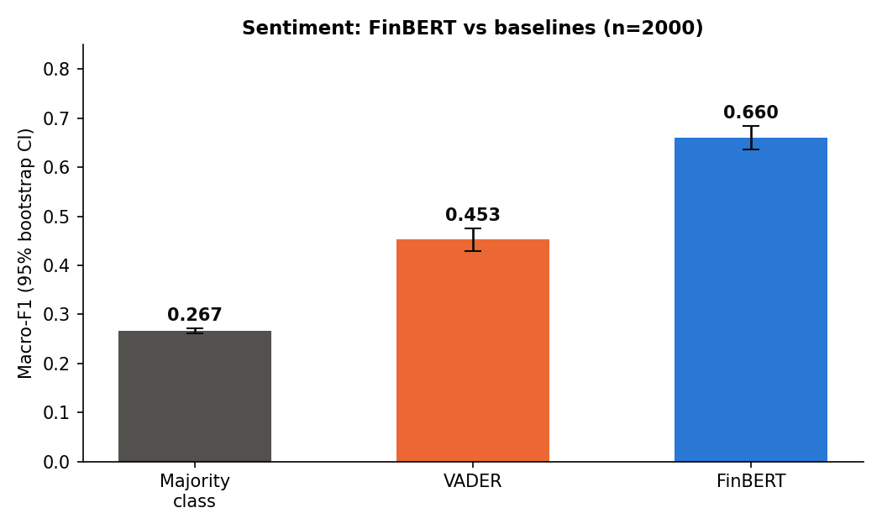
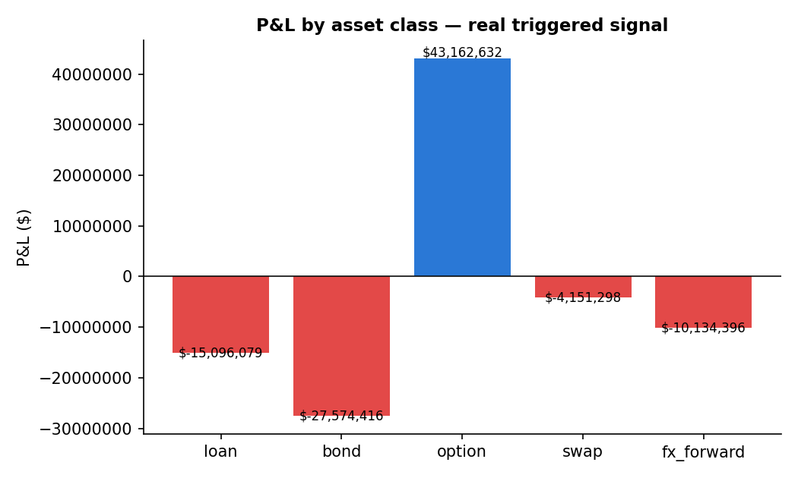
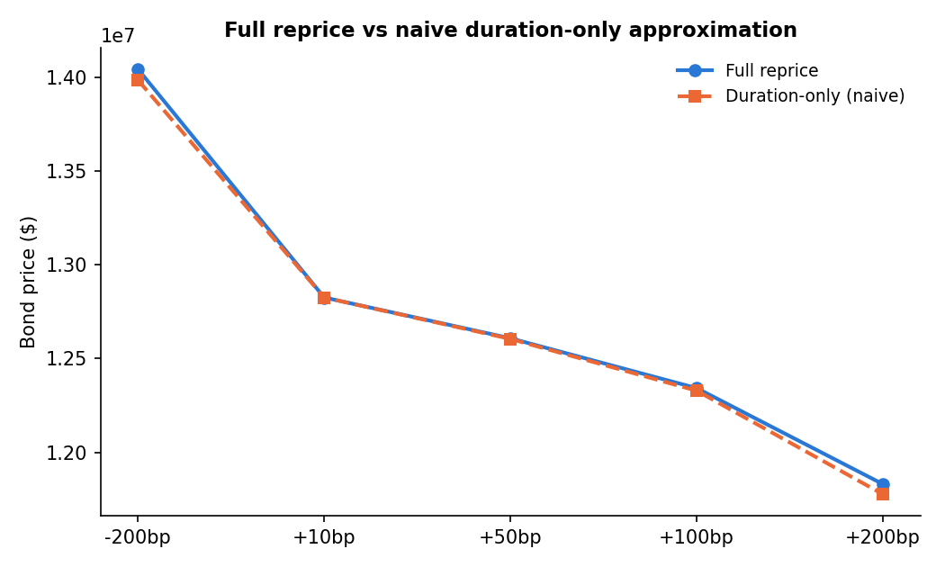
Key Results
FinBERT 0.660 macro-F1 [0.635, 0.684] vs VADER 0.453 vs majority-class 0.267 (n=2000, CIs don't overlap — real improvement). Bearish recall 76.5%. 138ms/doc on CPU. | 76 real signals evaluated, 3 fired a stress test. | Naive duration-only error grows to -58,394 at -200bp vs. full reprice — genuine, growing convexity error, confirmed by tests.

Slide 6
Domain Impact
• Translates a news/social firehose into a dollar P&L number a credit/risk desk can act on, with full traceability: signal → scenario → shock → P&L (visible in the dashboard's Audit Log tab).
• Separating MTM P&L from credit loss mirrors how a real risk desk actually reports exposure — a trading-book instrument and a banking-book loan are never collapsed into one undifferentiated number.
• Shock magnitudes anchored to the Federal Reserve's own published severely-adverse scenario (fetched and cited directly, not estimated) — domain-grounded, not arbitrary round numbers.
• Fits S&P Global / Crisil's own domain: credit events, rating-adjacent language, and portfolio-level stress are exactly the surface a ratings/risk-analytics business operates on.

Slide 7
Limitations & Next Steps
• Impact Score event-study correlation: not run -- GDELT rate-limited: HTTP 429 returned on every query for 2+ hours (0 articles returned). Abandoned as a data source for this submission. (attempted 2026-10-18). No number is reported here because none was computed -- see `docs/ASSUMPTIONS.md` "Impact-score event study: not run".
• Event classification (`rule-v1`, frozen before scoring, gold labels blind-human-only): accuracy=88.5%, 95% CI [83.3%, 92.2%], macro-F1=0.363 (macro-F1 over the 4 classes with support>0 in this sample: ['Geopolitical', 'Macroeconomic', 'Credit Event', 'Other']) (n=200 hand-labelled examples). Majority-class baseline (always predicts 'Other'): accuracy=84.0% [78.3%, 88.4%], macro-F1=0.228.
• Market data (Treasury curve, equity spot) is SOURCED, not provisional — fetched directly. (An earlier as_of-selection bug briefly mis-dated the curve; the provisional snapshot itself was always accurate for its stated date — see docs/ASSUMPTIONS.md.)
• English-only; GDELT gives headline-level text only (no article body); the social replay source is historical with synthetic timestamps, creating a real date mismatch against the live market snapshot.
• Credit loss is 1-year EL (Basel-style), not IFRS 9 lifetime ECL — a real stress scenario would typically trigger Stage 2/3 staging, so this is a lower bound, stated as such.
• Next: finish event-classification scoring once the gold set is hand-labelled. The impact-score event study has no further next step with GDELT abandoned (rate-limited, 0 articles over 2+ hours) — it would need a different news source entirely.

