Slide 1
Predicting The Word From Brain Activity
Aaditya Aanand – 14002 Aryaman – 14139 Pulkit Sharma – 14504 Shubham Swastik Behera - 14685

Slide 2
Problem Statement
There is a dictionary of 60 words. Each word has an associated 218 – D feature vector where each feature describe human responses to the particular question asked. The subject is shown a word from the dictionary along with its “Line Drawing” and then FMR image of the brain is captured which is represented as a 21764 – D feature vector of voxel intensities.
We have 300 training example sets and 60 test sets and the job is to predict the correct word derived from the ML algorithm out of the 2 shown word.

Slide 3
Dimensionality Reduction
Low Variance Filter: Data columns with variance lower than 1 were eliminated, attributes reduced to around 10,000 from given 21764.
Singular Value Decomposition:
X_{nxp} = U_{nxn} x D_{nxp} x V^{T}_{pxp}
Training Data: Assuming the training and test datasets come from the same distribution we choose top 250 eigenvectors from the training data and projected the test examples into the required dimensional space.
Combined Training and Test Data: Now, we choose the top 250 Eigen Vectors from the combined training and test set and then projected on to the test example. By this method, we could select the attributes up to (300+60) 360.
We have also plotted the graph of number of attributes chosen versus the accuracy obtained by our model.

Slide 4
Models Applied
Kernelized Linear Ridge Regression(KLRR): Applied Linear kernel, choose optimum hyper-parameter (=10) by trying out various values. Accuracy of the model = 81.67%.
We also applied quadratic and cubic kernels, both with accuracy 51.67%. Thus we conclude that the given data is linearly mapped.
KLRR with SVD on the combined training and test dataset. Accuracy of the model = 88.33% (Our maximum!).

Slide 5
Other Methods Tried and Future Aspects
Multiclass Perceptron : Using this model we predicted the exact WORD out of 60 words in the test dataset. The accuracy of the model is 18.33 %.
We tried to apply PCA but due to high dimensional feature constraint it was not successful. PPCA & Sparse PCA can be applied and can turn out to be a useful method.
Ensemble methods (bagging and boosting) can be applied to further increase the model accuracy.

Slide 6
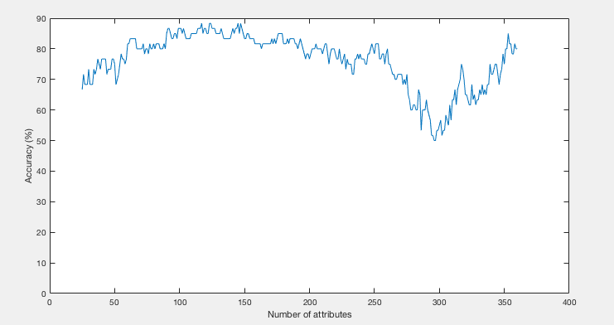
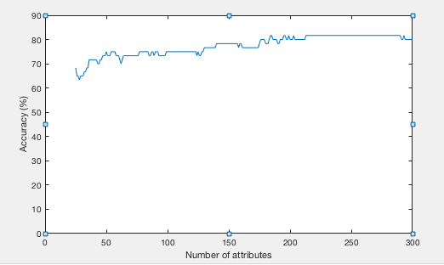
Attributes: SVD on train + test data
Attributes: SVD on only training data
1. Above are the graphs obtained from the kernelized ridge linear regression model applied on both datasets (combined and only training).
2. These plots helped us find out the optimum number of attributes.

Slide 7
What we learnt?
Importance of Regularizer : It comes to the rescue when the matrix becomes singular.
Importance of Kernels : Kernels can be helpful to identify non-linear mapping.
Machine Learning Techniques application in real life situations
Dimensionality reduction is very useful and efficient in many cases for extraction of information

Slide 8
Thank you!

